Slide 1

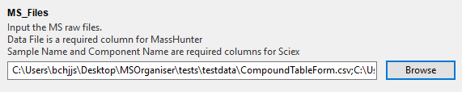
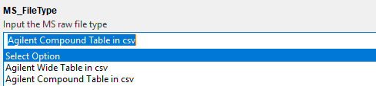
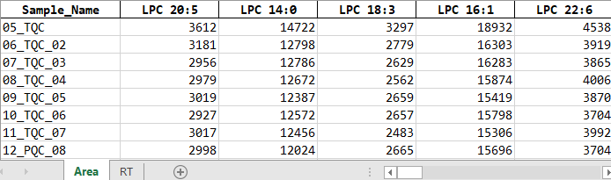

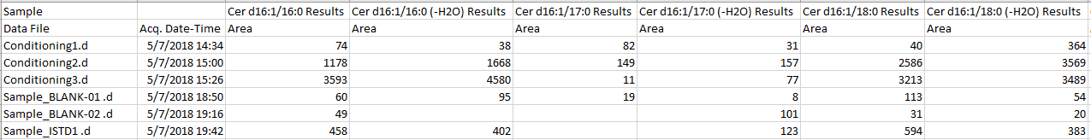
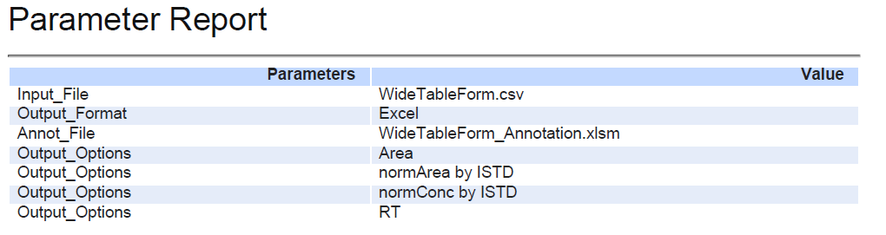
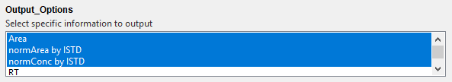
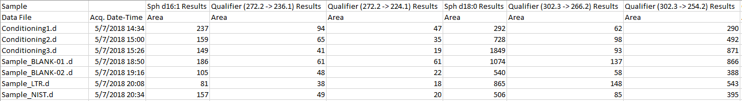
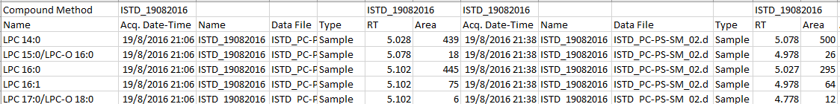

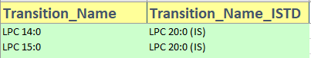
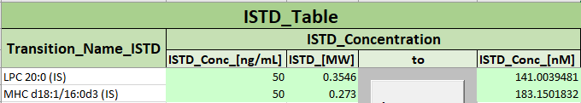
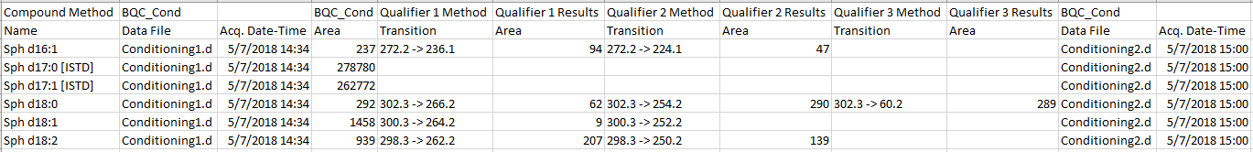
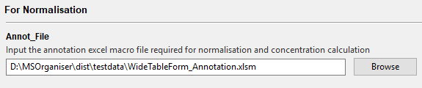
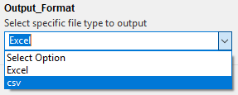
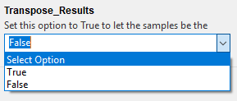
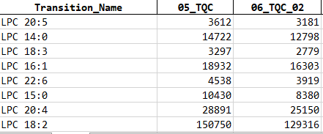
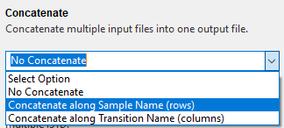

MSOrganiser Summary
Input Raw data
Organise MRM data to tidy form
Table of valid MRM data formats
Load MRM Files and specify MS_FileType and
Output Directory
3. Click start to organise data
MRM transition names data form | Compulsory column names |  | Restricted column names
 | Without Qualifiers | With Qualifiers
Agilent’s WideTable form | Sample Data File Compound Results Area | Qualifier Results Area | Sample Quantification Message Columns from ISTD Compound Methods ISTD Compound Results
Agilent’s CompoundTable form | Sample Data File Compound Method Name Compound Results Area | Qualifier Method Transition Qualifier Results Area
By default, organised data will be output into an Excel file in wide table form
Example
A report pdf file will also be provided to record the parameters used
Agilent’s Wide Table form
2. Choose Output options
Agilent’s Wide Table form with Qualifier
Input Annotation File
Agilent’s Compound Table form
When doing normalisation and concentration calculation,
Here are some input examples.
Transition Name Annotation
ISTD Annotation
Agilent’s Compound Table form with Qualifier
MS Template Creator Excel file must be provided.
Sample Annotation
Refer to the summary sheet or manual to see how it is used.
Additional Features
Different output format for the organised data.
Set Transpose_Results to True to let the sample name be the columns instead of the transition names.
Select the following concatenation options to combine multiple input files to one result file.
Updated: 2021-10

Slide 2

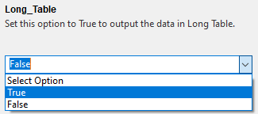
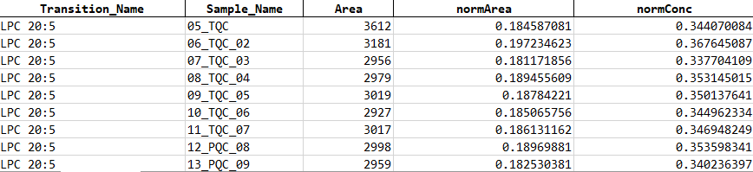
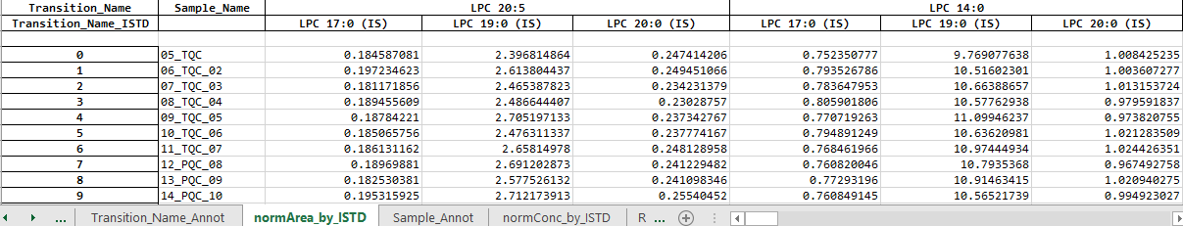
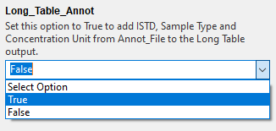
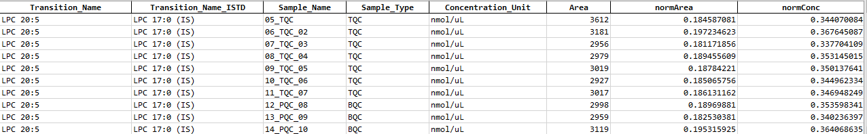
MSOrganiser Summary
Additional Features
If there is a need to calculate the normalised area and concentration, set Allow_Multiple_ISTD to True
Options to output results in a Long Table are available
Updated: 2021-10

Slide 3
Concentration calculation of non-liquid samples
Calculations explanation:
take the ISTD conc in nM (fmol/uL).
divide it by the ratio between volume of reconstituted extract before injection in uL and volume of added standard in uL (usually 200uL/10uL) to know the ISTD conc in sample.
multiply this value by the ratio of area endogenous/area ISTD to obtain conc of endogenous
multiply conc of endogenous by volume of reconstituted extract before injection in uL to give concentration of endogenous sample in fmol
divide by the unit of the sample (weight of the tissue) giving the concentration unit to be (fmol/unit of sample)

Slide 4
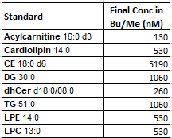

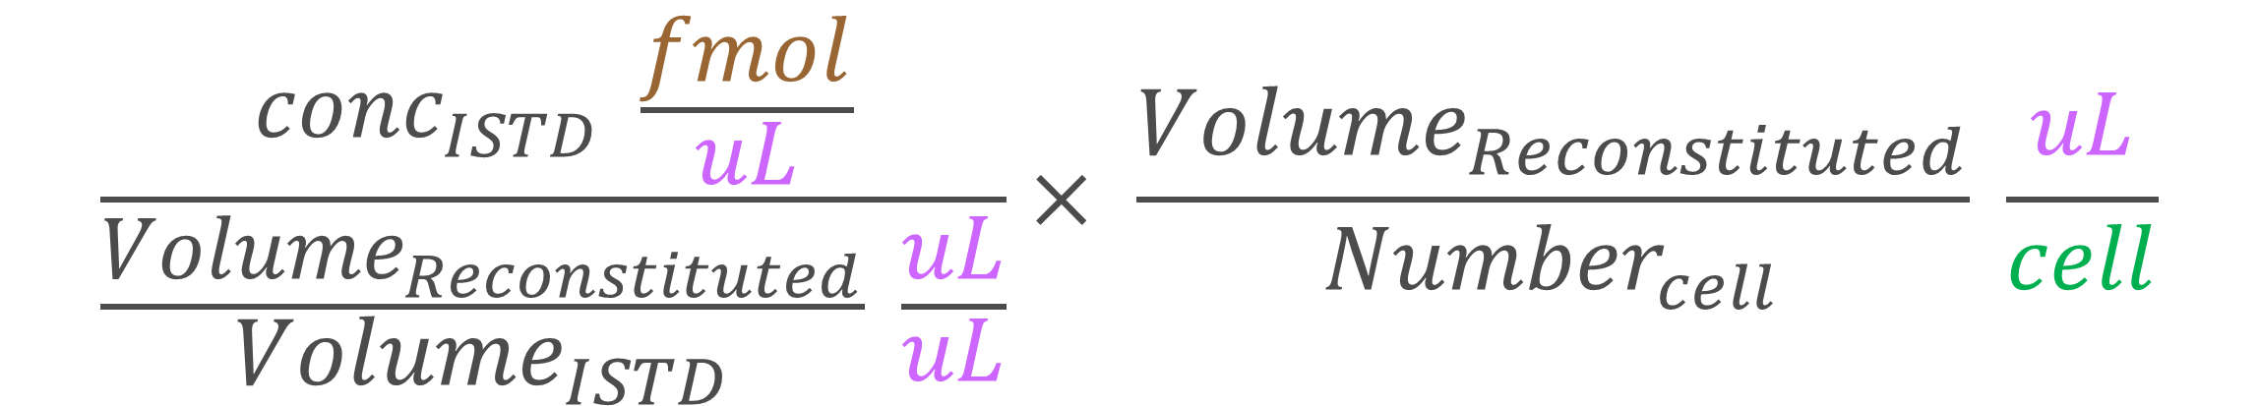

Cell number concentration calculation
$${Number}_{cell}= 2000000 cell$$
$${Volume}_{ISTD}=10 uL$$
$${Volume}_{Reconstituted}=200 uL$$
$${conc}_{ISTD}=\{some_value\} fmol/uL$$
$Convert to concentration in\left(\frac{fmol}{cell}\right) :$
$$\frac{{conc}_{ISTD} \frac{fmol}{uL}}{\frac{{Volume}_{Reconstituted}}{{Volume}_{ISTD}} \frac{uL}{uL}}× \frac{{Volume}_{Reconstituted}}{{Number}_{cell}} \frac{uL}{cell}$$

Slide 5
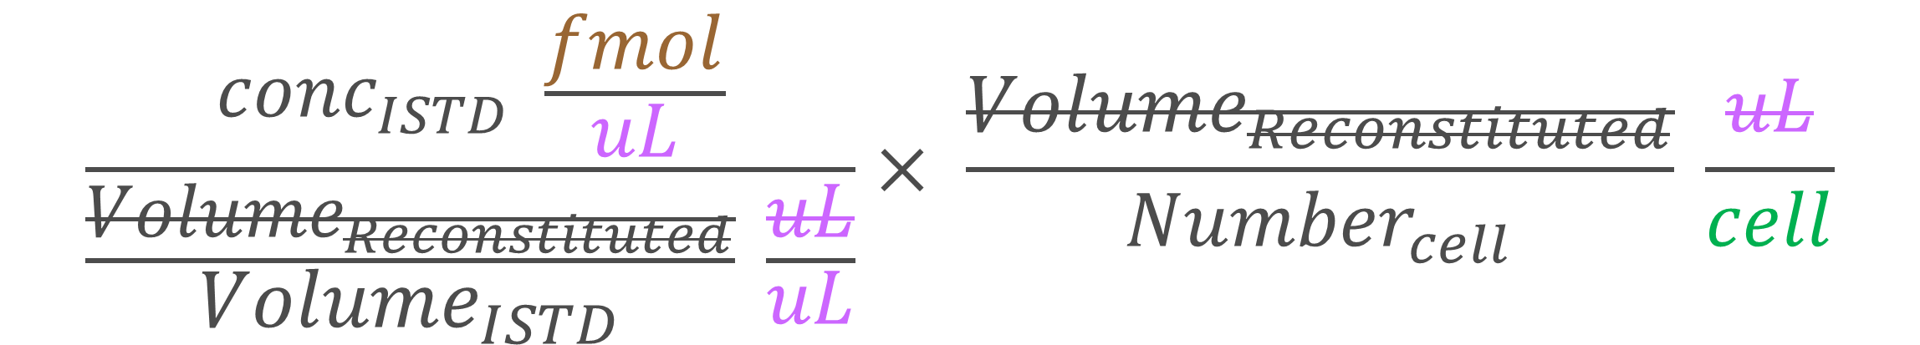


Cell number concentration calculation
$$\frac{{conc}_{ISTD} \frac{fmol}{uL}}{\frac{{Volume}_{Reconstituted}}{{Volume}_{ISTD}} \frac{uL}{uL}}× \frac{{Volume}_{Reconstituted}}{{Number}_{cell}} \frac{uL}{cell}$$
$${conc}_{ISTD}\frac{fmol}{uL} × \frac{{Volume}_{ISTD}}{{Number}_{cell}} \frac{uL}{cell}$$
$${conc}_{ISTD} × \frac{{Volume}_{ISTD}}{{Number}_{cell}} \frac{fmol}{cell}$$

Slide 6
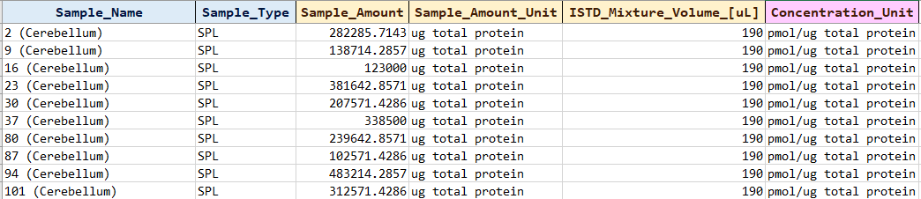


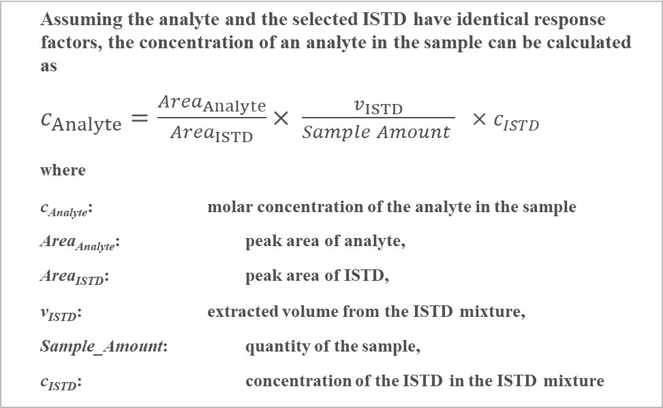

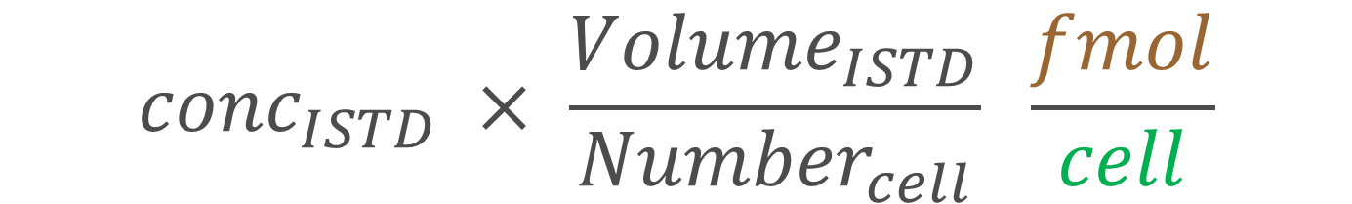
Cell number concentration calculation
Assuming the analyte and the selected ISTD have identical response factors, the concentration of an analyte in the sample can be calculated as
$c_{Analyte}=\frac{{Area}_{Analyte}}{{Area}_{ISTD}}× \frac{v_{ISTD}}{Sample Amount } ×c_{ISTD}$
where
c_{Analyte}: molar concentration of the analyte in the sample
Area_{Analyte}: peak area of analyte,
Area_{ISTD}: peak area of ISTD,
v_{ISTD}: extracted volume from the ISTD mixture,
Sample_Amount: quantity of the sample,
c_{ISTD}: concentration of the ISTD in the ISTD mixture
$${conc}_{ISTD} × \frac{{Volume}_{ISTD}}{{Number}_{cell}} \frac{fmol}{cell}$$
$c_{ISTD}$ is ${conc}_{ISTD} \frac{fmol}{uL}$
To put in MS Template Creator
$Sample Amount$ is $({Number}_{cell}=2000000)$
$v_{ISTD}$ is $\left({Volume}_{ISTD}=10\right)$
cell number

Slide 7
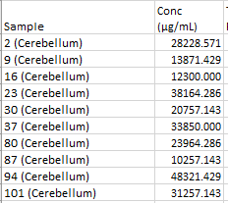
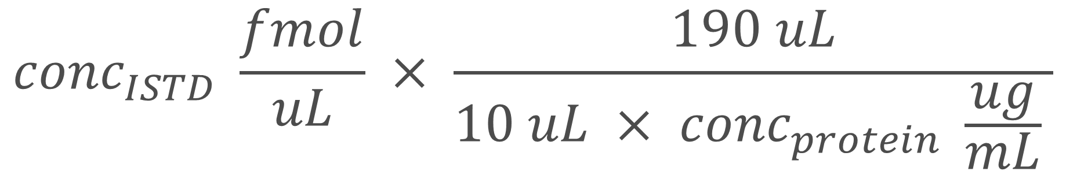
Protein concentration calculation
BuMe with ISTD volume
$${conc}_{ISTD} \frac{fmol}{uL} × \frac{190 uL}{10 uL × {conc}_{protein} \frac{ug}{mL} }$$
Protein homogenate volume

Slide 8
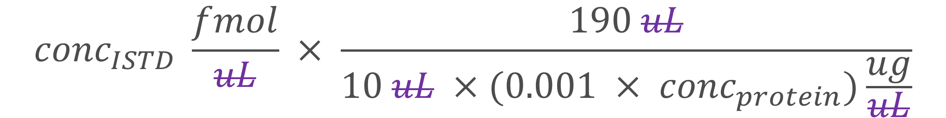

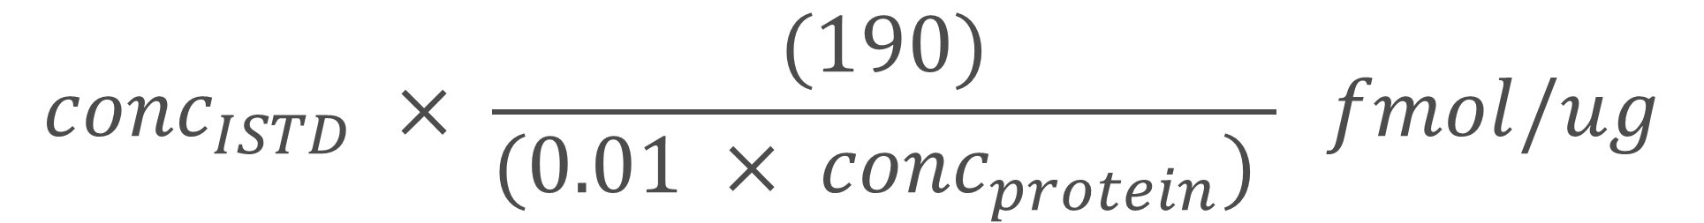
Protein concentration calculation
$${conc}_{ISTD} \frac{fmol}{uL} × \frac{190 uL}{10 uL × {conc}_{protein} \frac{ug}{mL} }$$
$${conc}_{ISTD} \frac{fmol}{uL} × \frac{190 uL}{10 uL ×(0.001 × {conc}_{protein})\frac{ug}{uL}}$$
$${conc}_{ISTD} × \frac{(190)}{(0.01 × {conc}_{protein}) } fmol/ug$$

Slide 9
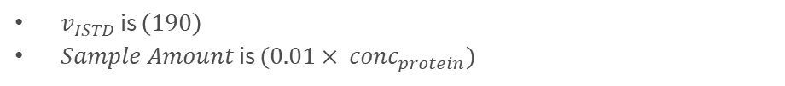
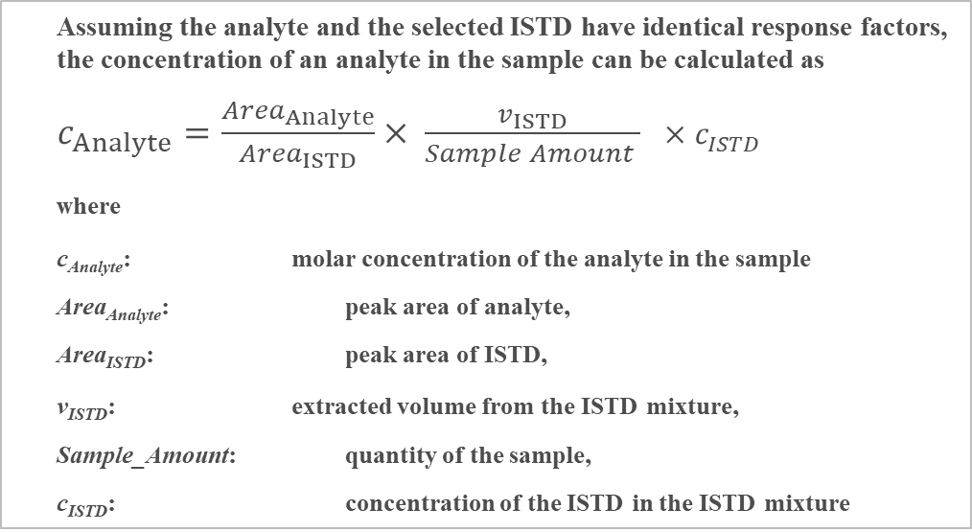

Protein concentration calculation
$${conc}_{ISTD} × \frac{(190)}{(0.01 × {conc}_{protein}) } fmol/ug$$
Assuming the analyte and the selected ISTD have identical response factors, the concentration of an analyte in the sample can be calculated as
$c_{Analyte}=\frac{{Area}_{Analyte}}{{Area}_{ISTD}}× \frac{v_{ISTD}}{Sample Amount } ×c_{ISTD}$
where
c_{Analyte}: molar concentration of the analyte in the sample
Area_{Analyte}: peak area of analyte,
Area_{ISTD}: peak area of ISTD,
v_{ISTD}: extracted volume from the ISTD mixture,
Sample_Amount: quantity of the sample,
c_{ISTD}: concentration of the ISTD in the ISTD mixture
$v_{ISTD}$ is $\left(190\right)$
$Sample Amount$ is $(0.01× {conc}_{protein})$

Slide 10
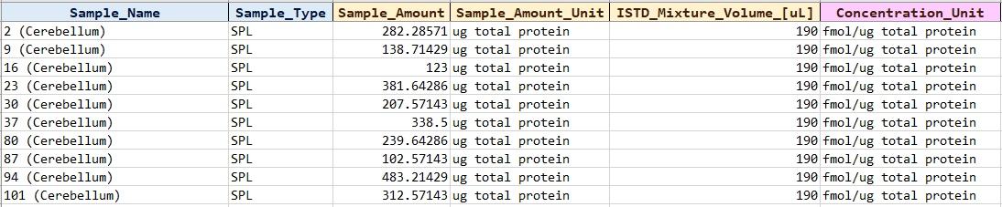

To put in MS Template Creator
Protein concentration calculation
$Sample Amount$ is $(0.01 × {conc}_{protein})$
$v_{ISTD}$ is $\left(190\right)$

