Slide 1
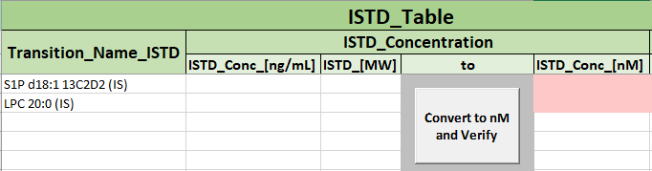


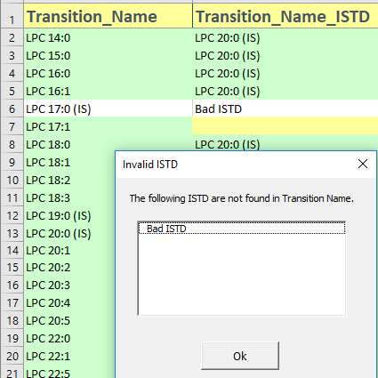
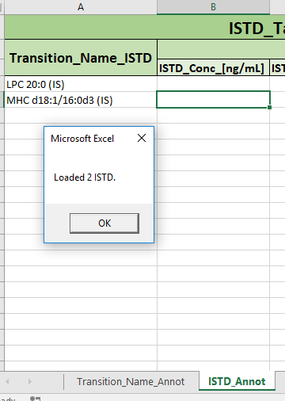
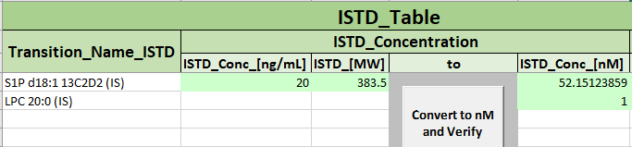
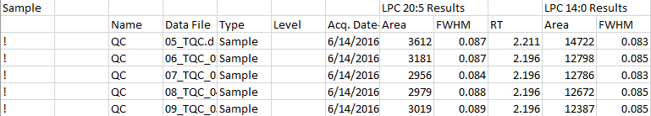


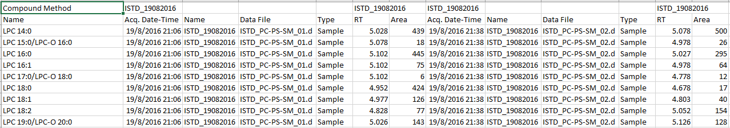



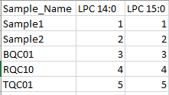


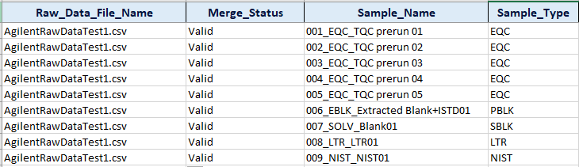




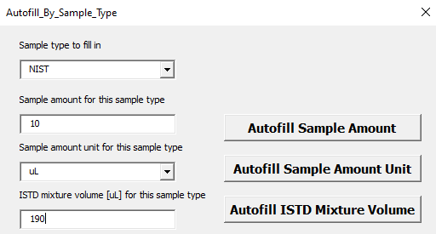
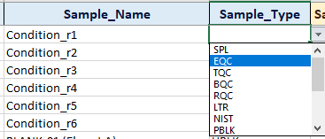
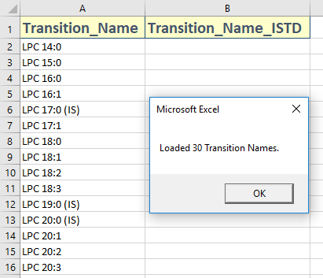

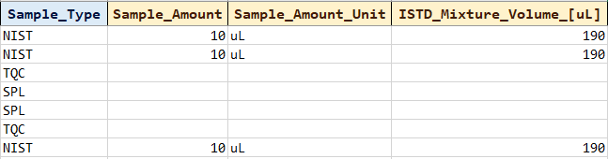


MS Template Creator Summary
Input Raw data
Transition Name Annotation (cont)
ISTD Annotation
Table of valid MRM data formats
Validation
Transfer ISTD for annotation
ISTD concentration calculation
MRM transition names data form | Compulsory column names | Restricted column names
Agilent’s WideTable form | Data File (from Sample) | Quantitation Message (from Sample) Columns from Qualifier Methods ISTD Compound Methods ISTD Compound Results
Agilent’s CompoundTable form | Name (from Compound Method) Data File (from Sample) | Quantitation Message (from Sample) Columns from Qualifier Methods Qualifier Results ISTD Compound Methods ISTD Compound Results
Click on the button below to check if ISTD is valid
Click on the button below to transfer the ISTD to the ISTD_Annot sheet
User must key in nM concentration value (red cell) for each ISTD
Click on the button “Convert to nM and Verify” to change the given ISTD calculations from ng/mL to nM
Example
Conversion of concentration values from nM to other units are available
Sample Annotation
Create a new Sample Annotation
Input Tabular data
Click on the button below to create a new sample annotation
Fill in the sample amount, unit and ISTD mixture volume
Fill in the concentration unit by clicking this button
Example
Samples as rows. Transitions as columns
Transitions as rows. Samples as columns
For Sample_Type with consistent values, click on this button
Concentration unit is determined by what is provided in the following columns
Fill in the values and click on the respective “Autofill” buttons
Transition Name Annotation
Choose the Sample type
Load Transition Names
Click on the button below to load the transition names
Fill any blank cells under the Sample_Type column with “SPL” by clicking this button.
Updated: 2021-04

Slide 2
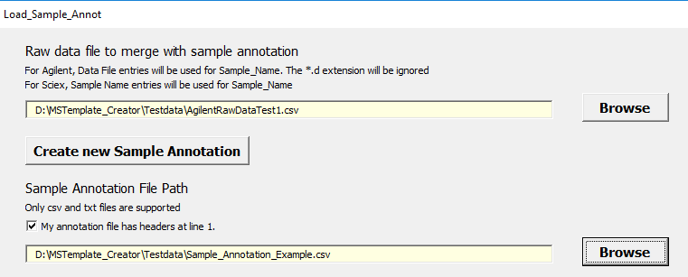
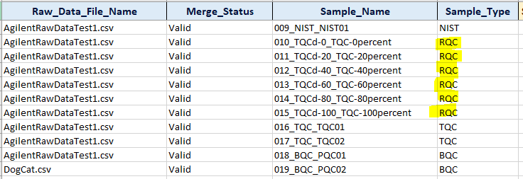
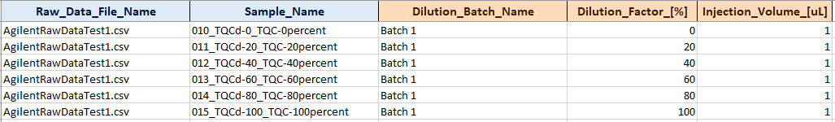
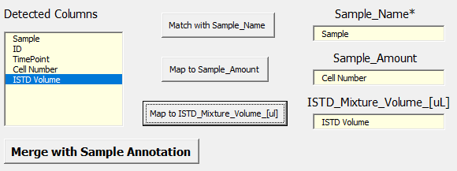

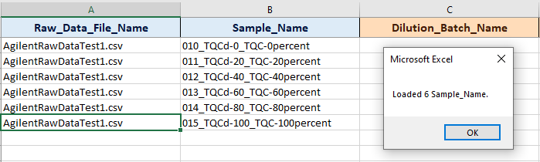
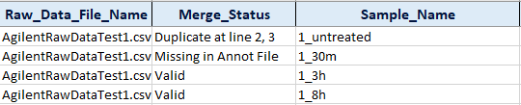
MS Template Creator Summary
Sample Annotation (cont)
Dilution Annotation
Merging with an existing sample annotation file
Copy RQC Samples to Dilution Annotation
Dilution Information
Insert MRM data and sample annotation file
Create a new sample annotation with RQC samples.
User will fill in the dilution batch name , the dilution factor in % and Injection volume in uL
Map the detected column and merge the data
Click on the button below to copy RQC samples to Dilution Annotation
Check if merge is successful for every row
Updated: 2021-04

