Slide 1
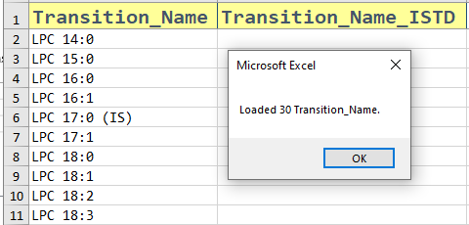

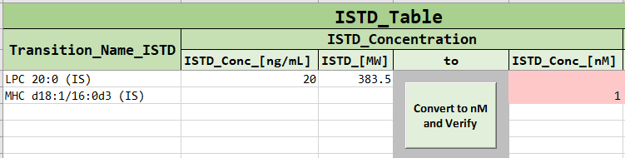

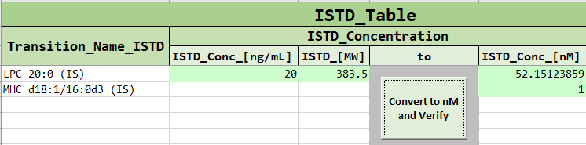


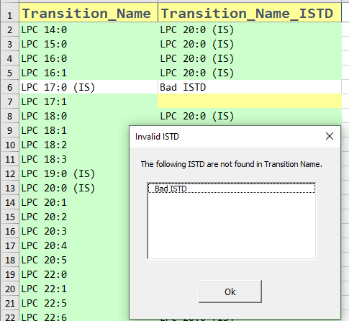
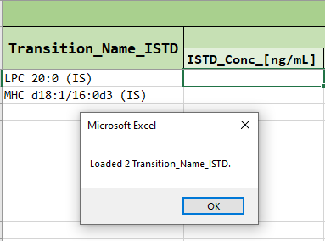
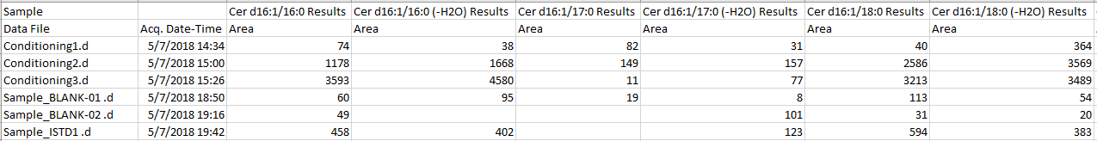


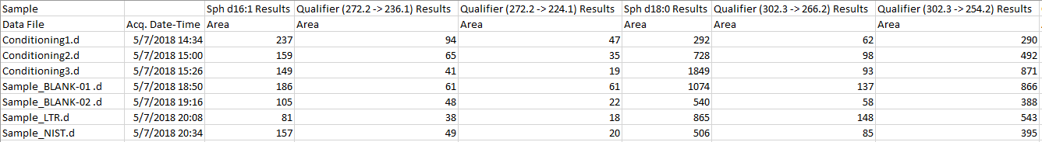
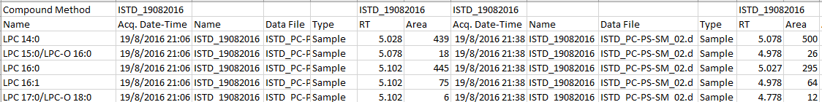



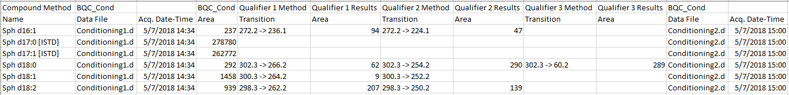

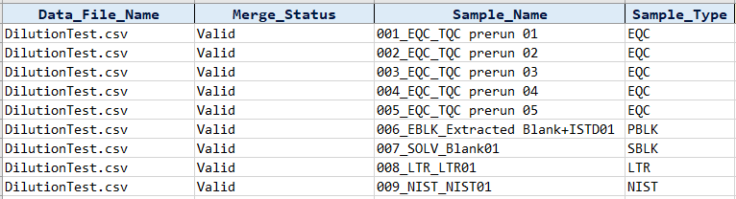




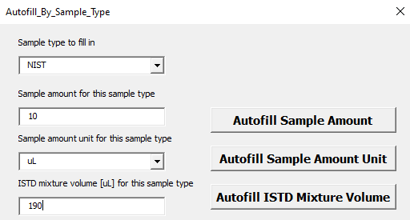
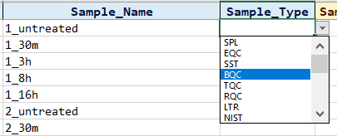
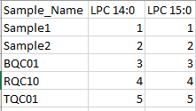

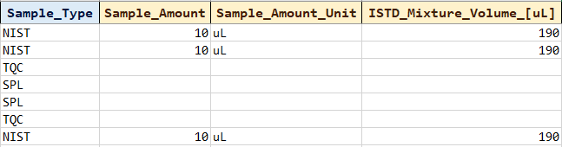

MS Template Creator Summary
Input Raw data
Transition Name Annotation
ISTD Annotation
Table of valid MRM data formats
Load Transition Names
ISTD concentration calculation
MRM transition names data form | Compulsory column names |  | Restricted column names
 | Without Qualifiers | With Qualifiers
Agilent’s WideTable form | Sample Data File Compound Results Area | Qualifier Results Area | Sample Quantification Message Columns from ISTD Compound Methods ISTD Compound Results
Agilent’s CompoundTable form | Sample Data File Compound Method Name Compound Results Area | Qualifier Method Transition Qualifier Results Area
Click on the button below to load the transition names
Click on the button “Convert to nM and Verify” to change the given ISTD calculations from ng/mL to nM. Users may key in the concentration in nM directly as well.
Validation
Transfer ISTD for annotation
Click on the button below to check if ISTD is valid
Click on the button below to transfer the ISTD to the ISTD_Annot sheet
Example
Conversion of concentration values from nM to other units are available
Agilent’s Wide Table form
Agilent’s Wide Table form with Qualifier
Sample Annotation
Agilent’s Compound Table form
Create a new Sample Annotation
Click on the button below to create a new sample annotation
Fill in the sample amount, unit and ISTD mixture volume
Fill in the concentration unit by clicking this button
Agilent’s Compound Table form with Qualifier
Concentration unit is determined by what is provided in the following columns
For Sample_Type with consistent values, click on this button
Input Tabular data
Fill in the values and click on the respective “Autofill” buttons
Example
Choose the Sample type
Samples as rows. Transitions as columns
Transitions as rows. Samples as columns
Fill any blank cells under the Sample_Type column with “SPL” by clicking this button.
Updated: 2021-10

Slide 2
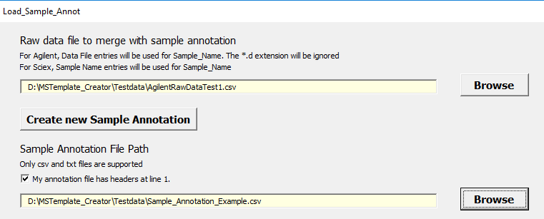
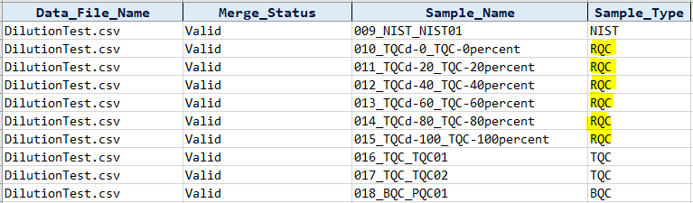
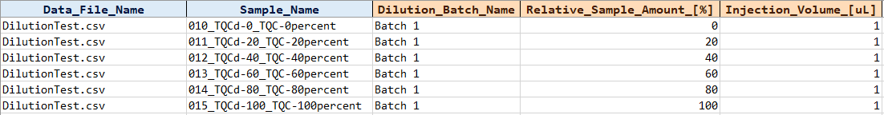
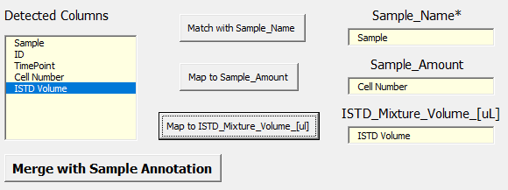

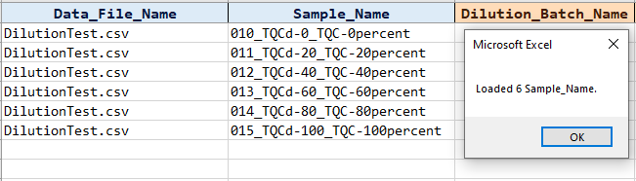
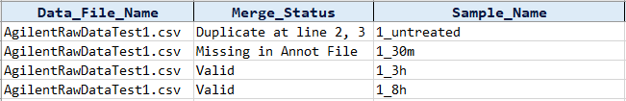
MS Template Creator Summary
Sample Annotation (cont)
Dilution Annotation
Merging with an existing sample annotation file
Copy RQC Samples to Dilution Annotation
Dilution Information
User will fill in the dilution batch name , the relative sample amount in % and Injection volume in uL
Insert MRM data and sample annotation file
Create a new sample annotation with RQC samples.
Map the detected column and merge the data
Click on the button below to copy RQC samples to Dilution Annotation
Check if merge is successful for every row
Updated: 2021-10

