Slide 1
Daniel
Lipidomics Analysis Report V1.2 SingMass / 03 March 2023

Slide 2
Table of Contents
EXPLORATORY DATA ANALYSIS
Sample Clustering
PCA analysis
Statistical Comparisons
Significanlty different lipid species
Dot/box plots of all species

Slide 3
EXPLORATORY DATA ANALYSIS

Slide 4
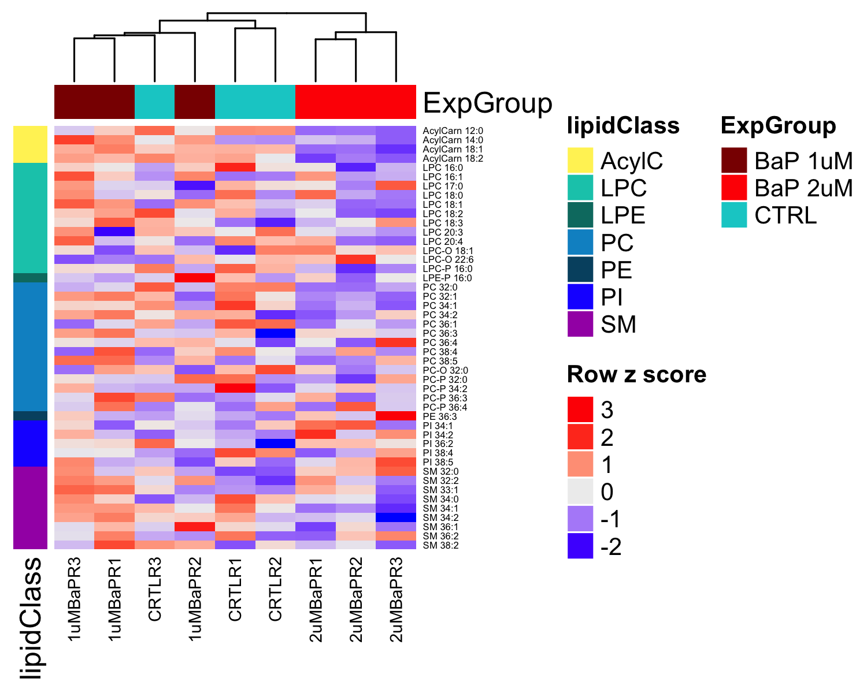
Sample Clustering
Figure 1. Heatmap with clusering of samples and lipid species

Slide 5
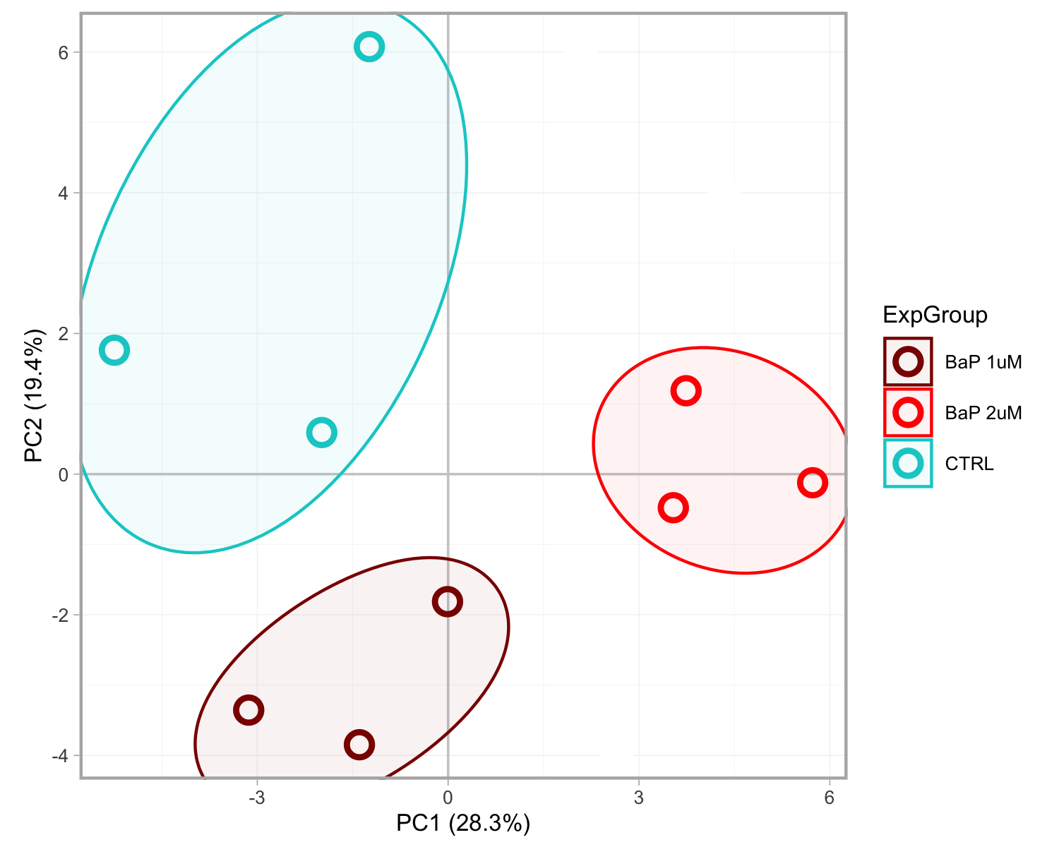
PCA analysis
Figure 2. Principal component analysis of all samples based on all lipid species. Ellipses are solely meant for annotation of the groups.

Slide 6
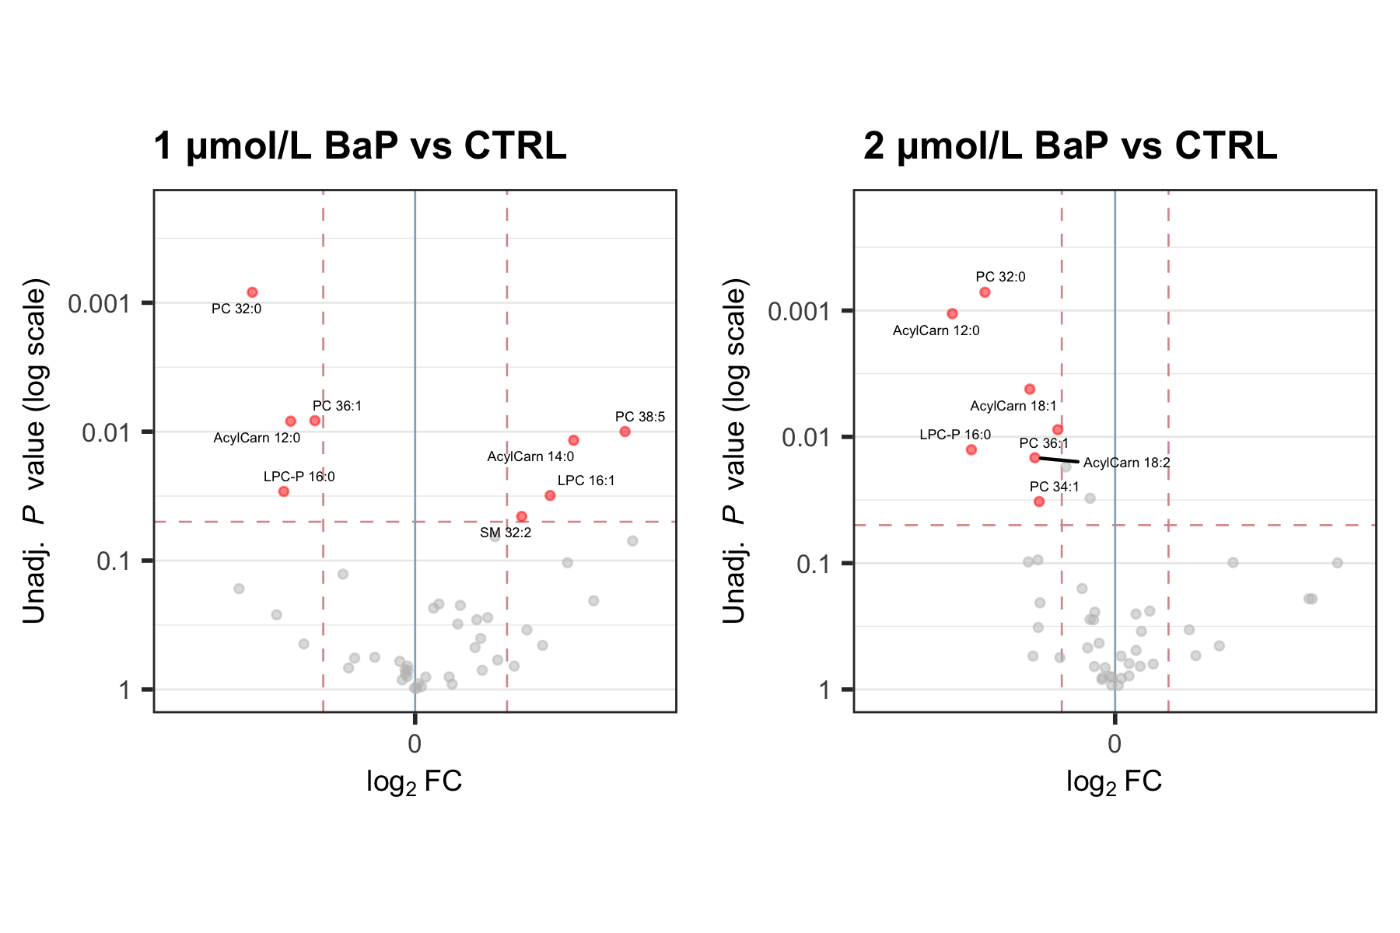
Statistical Comparisons
Figure 3. Volcano plots from the statistical comparison of the experimental groups using Welch’s t-tests. Lipid species with significant differences between the groups are highlighted in red (P < 0.05 and |FC| > 1.1).

Slide 7
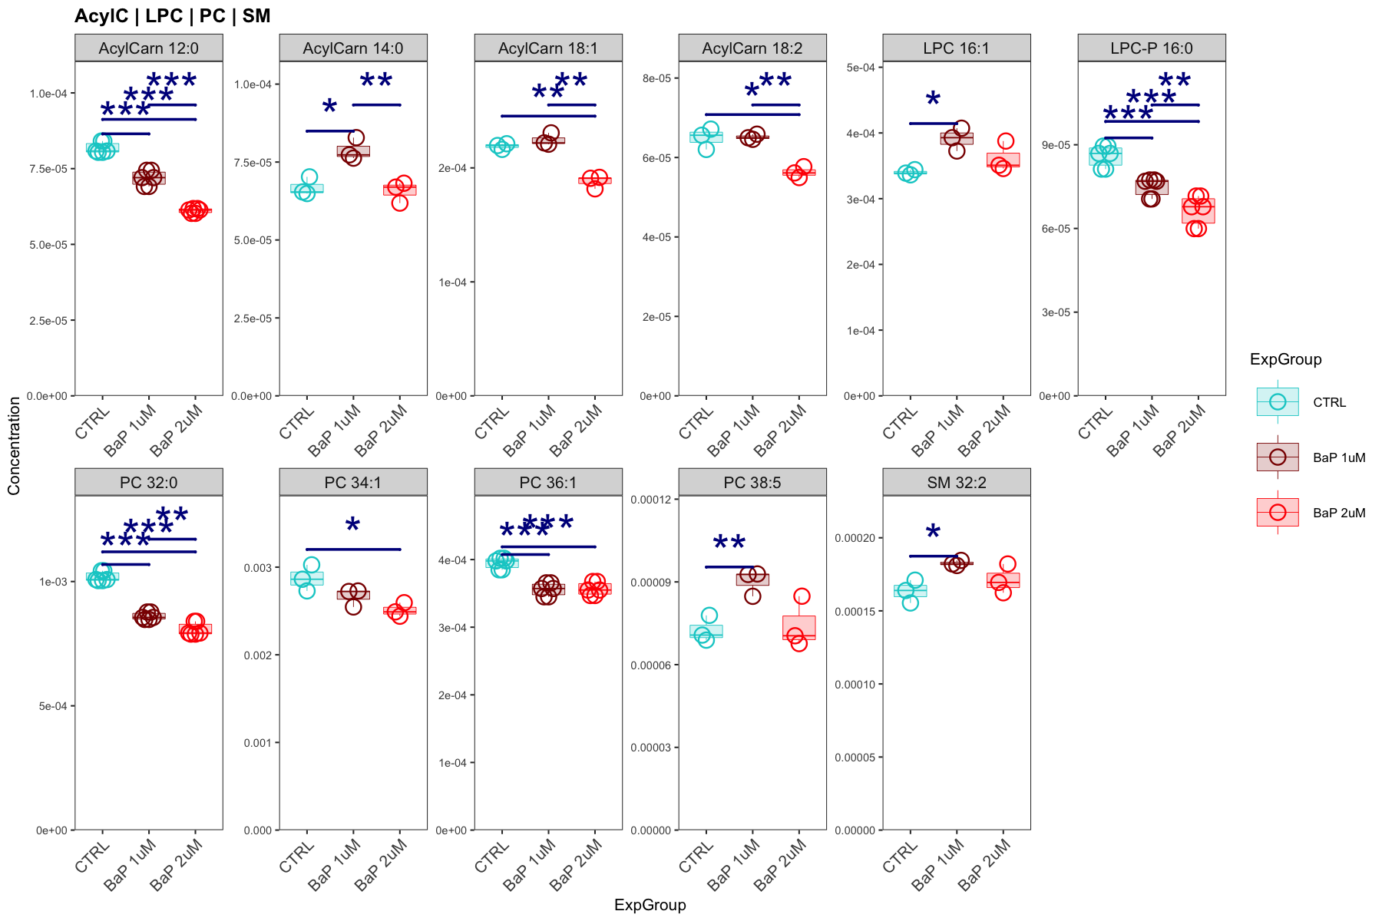
Significanlty different lipid species
Figure 4. Lipid species with statistically significant changes as indicated in the Figure 3 (P > 0.5, |FC| > 1.1)
## [[1]]

Slide 8
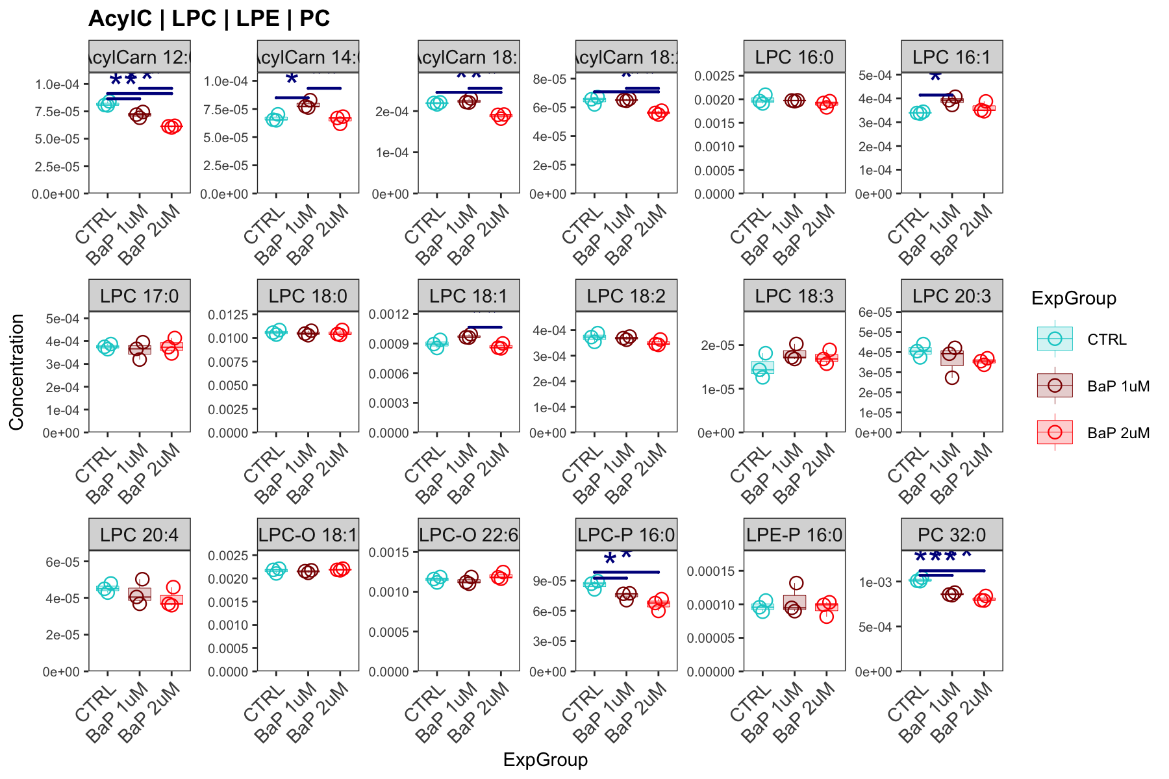
Dot/box plots of all species
Figure 5. All species quantified and passing QC
## [[1]]

Slide 9
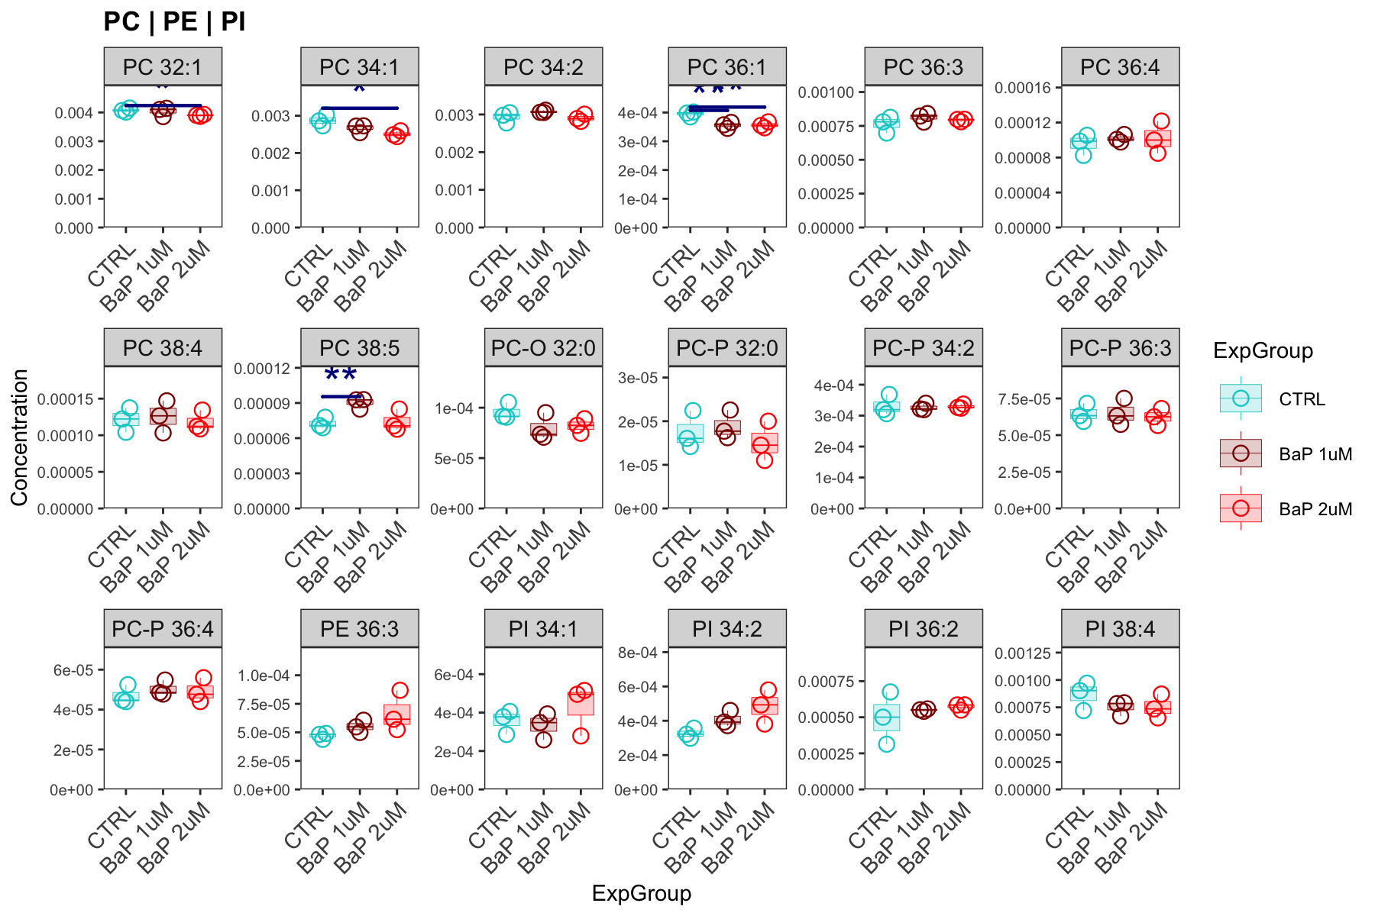
## ## [[2]]

Slide 10
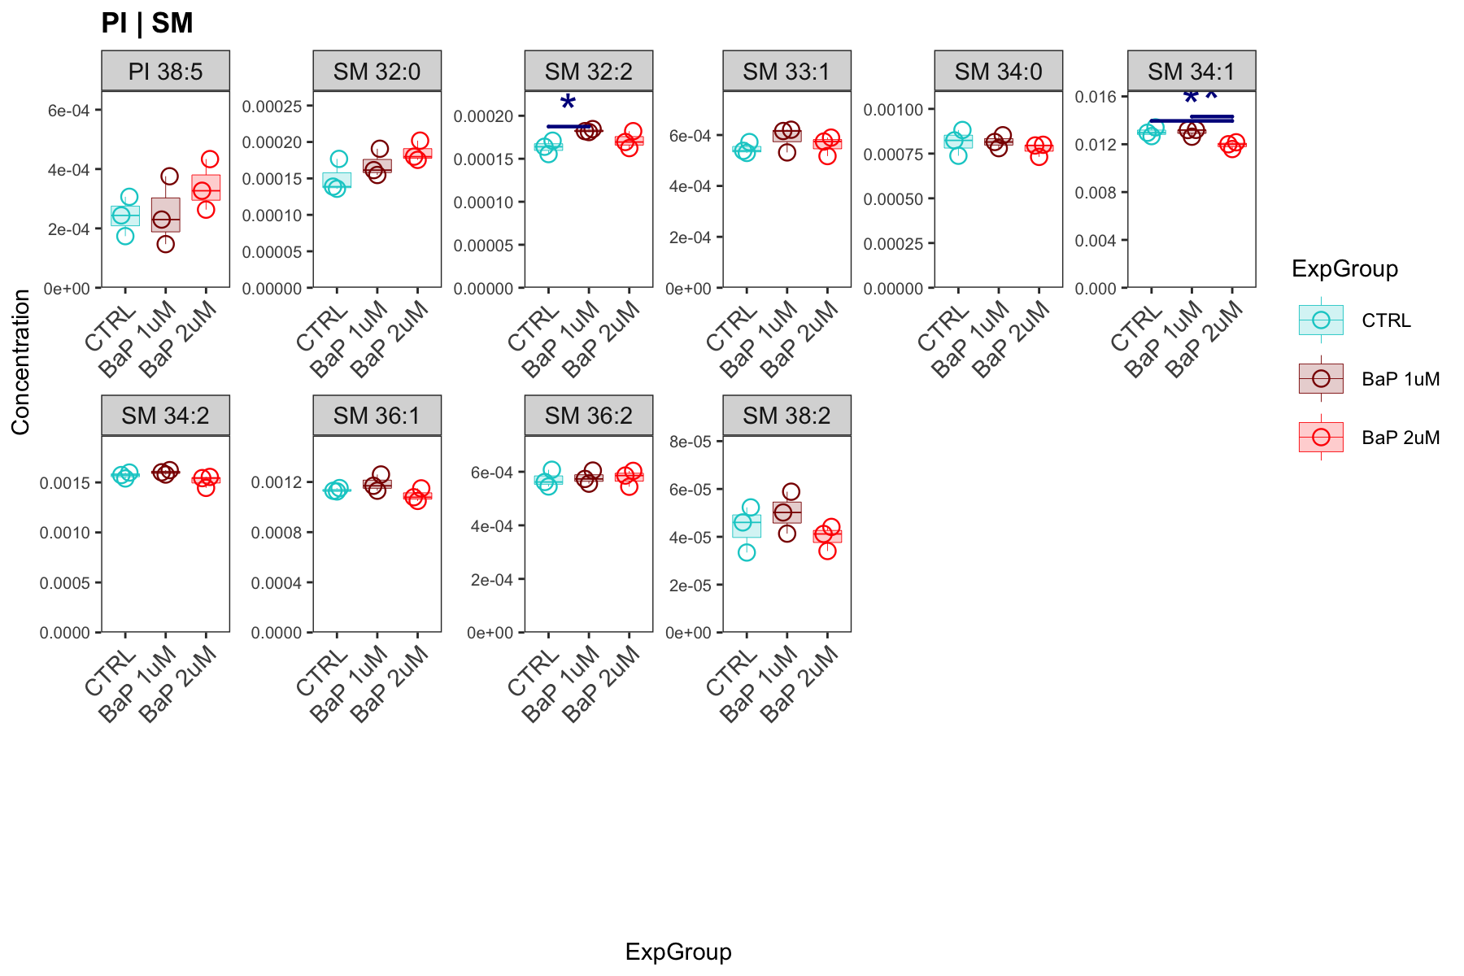
## ## [[3]]

