Slide 1
Daniel
Lipidomics Analysis Report V1.2 SingMass / 03 March 2023

Slide 2
Table of Contents
EXPLORATORY DATA ANALYSIS
Sample Clustering
PCA analysis
Statistical Comparisons
Significanlty different lipid species
Dot/box plots of all species

Slide 3
EXPLORATORY DATA ANALYSIS

Slide 4
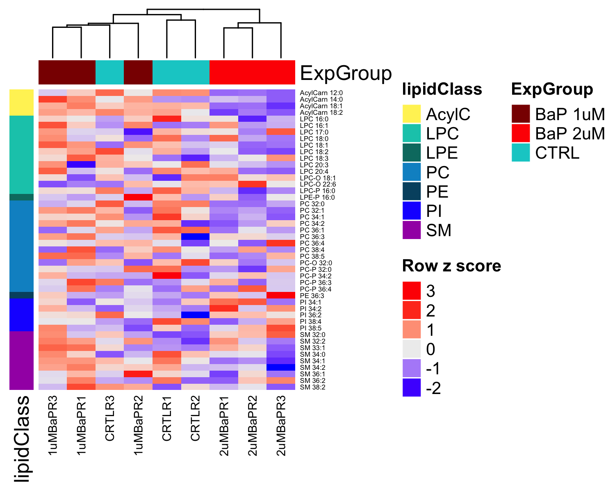
Sample Clustering
Figure 1. Heatmap with clustering of samples. Dendogram is based on hierarchical clustering of euclidean distances of z-scored lipid concentrations using complete linkage. Lipid species were ordered by alphabetical order. For the heatmap, colors corresponds z-scored (per row) concentration values.

Slide 5
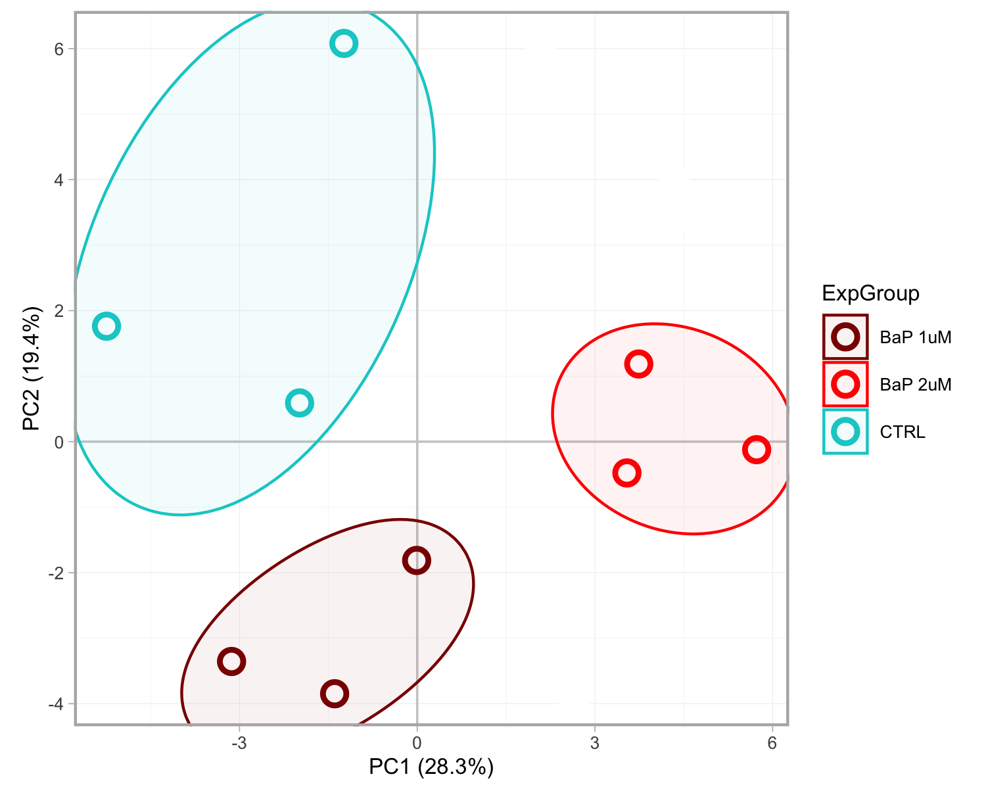
PCA analysis
Figure 2. Principal component analysis (PCA) of all samples based on all lipid species. PCA is based on standardized and centered (z-scored) concentration data of all measured lipid species and samples. Shaded ellipses are solely meant for annotation of the groups (they do not correspond to any confidence ranges).

Slide 6
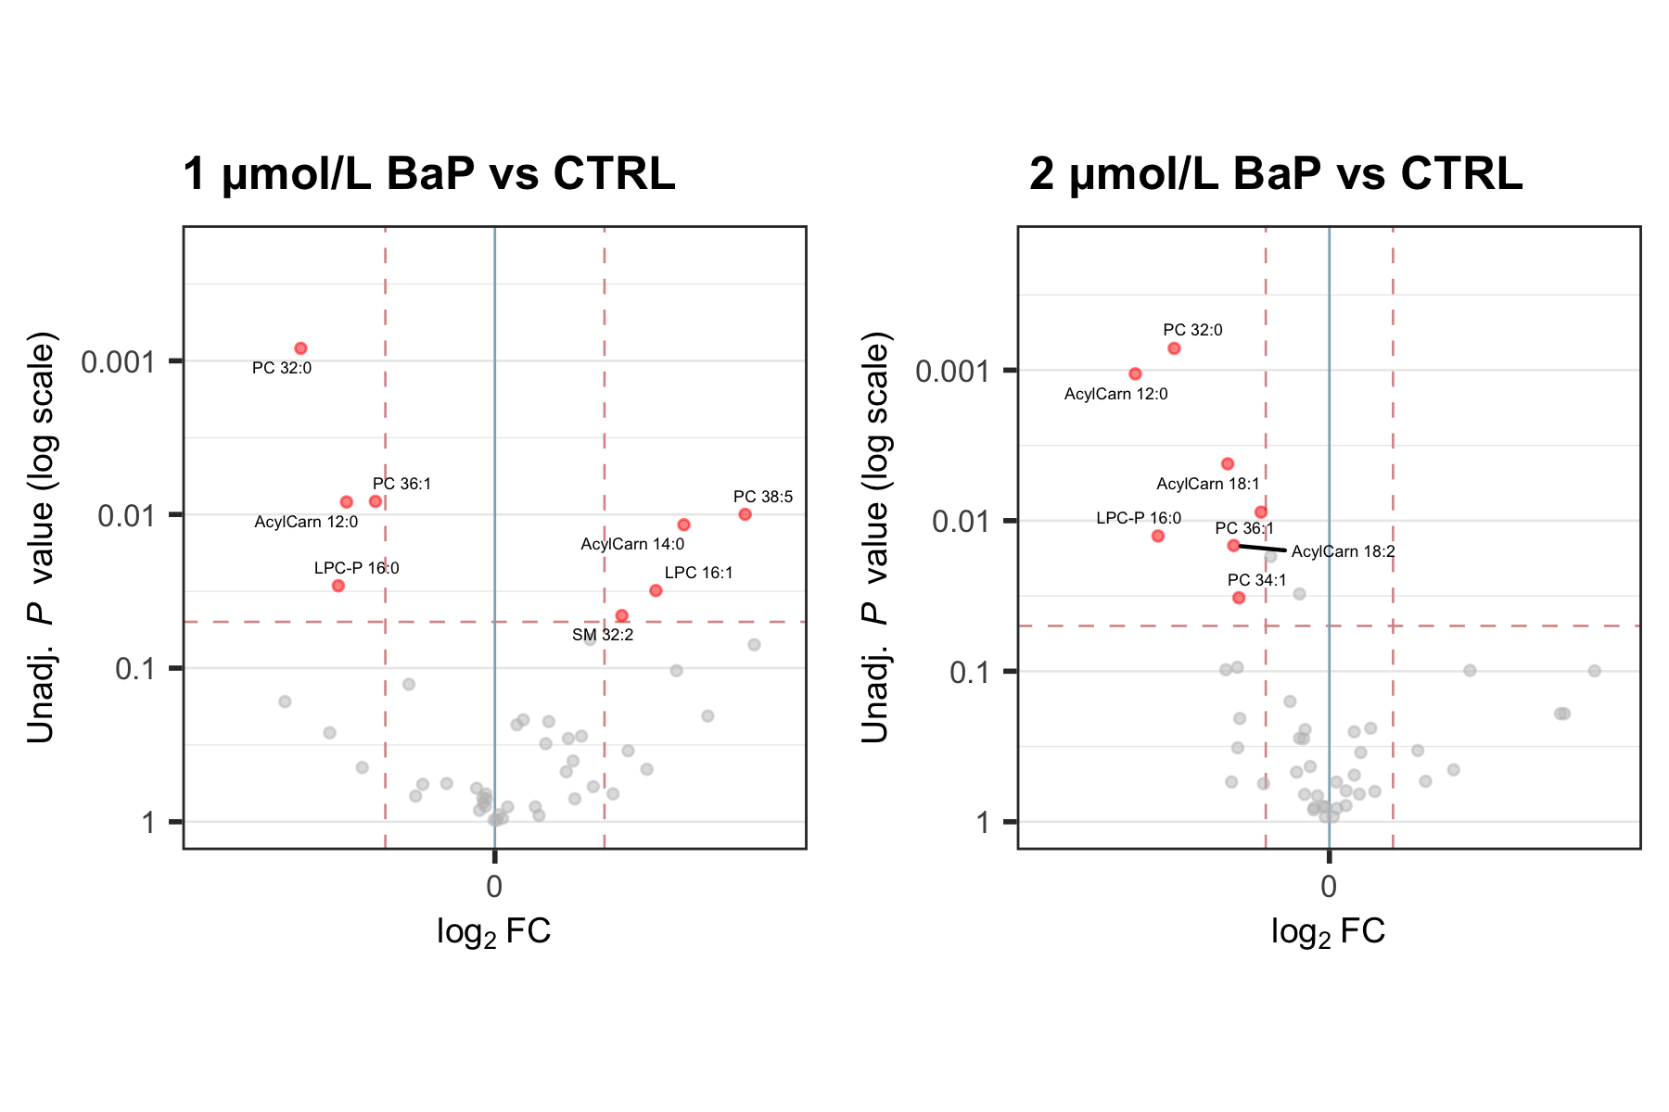
Statistical Comparisons
Figure 3. Volcano plots from the statistical comparison of the experimental groups. Unadjusted P values were obtained from Welch’s t-tests using lipid concentrations. Log2FC corresponds to the log2 of the fold-changes between the group means of the BaP and CTRL experimental groups. Positive log2FC indidcates concentrations are higher the in BaP group compared to the reference group (CTRL). Lipid species with P < 0.05 and |FC| > 1.1 ( = |log2FC| > 0.137) are highlighted in red.

Slide 7
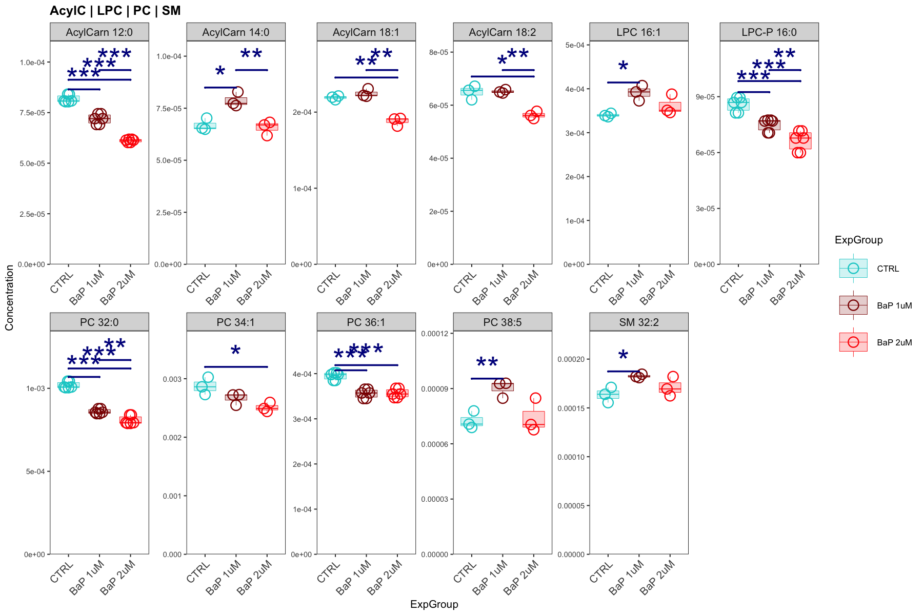
Significanlty different lipid species
Figure 4. Lipid species with statistically significant changes as highlighted in Figure 3. Only lipid species with P < 0.5 and |FC| > 1.1 in any of 2 comparisons (BaP 1 μM vs CTRL and BaP 2 μM vs CTRL, respectively) are shown. Statistical significances correspond to the results of Welch’s t-tests from concentration data. Only significant comparisons (P < 0.05) indicated: * < 0.05, ** < 0.01, *** < 0.001. Concentration corresponds to μmol/L medium.

Slide 8
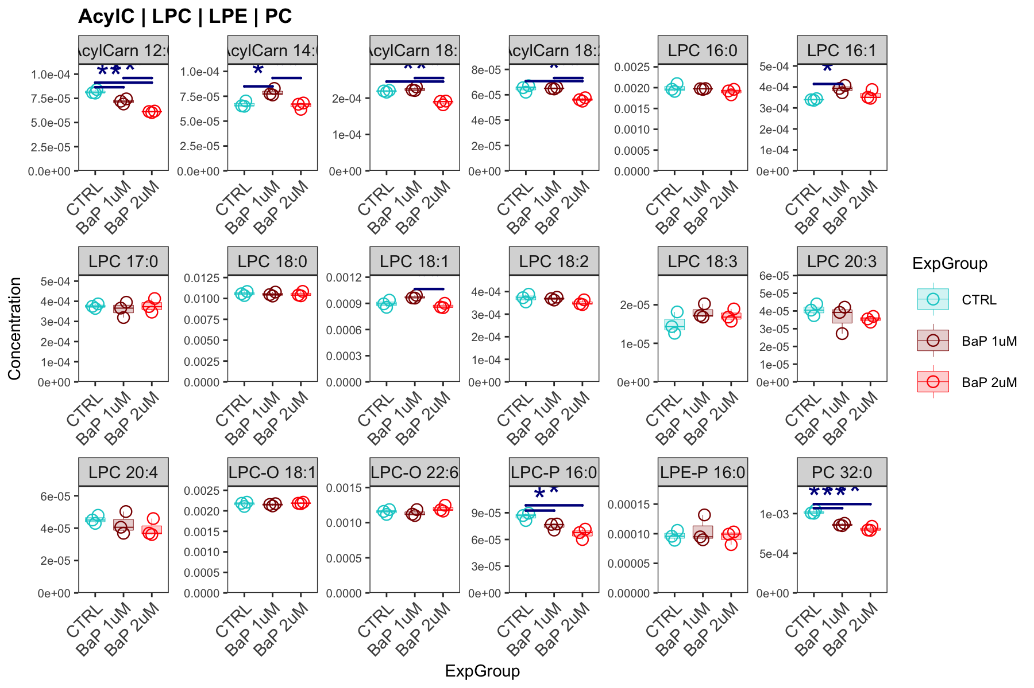
Dot/box plots of all species
Figure 5. Dot and box plots of all quantified lipid species. Statistical significances correspond to the result of a Welch’s t-test from concentration data. Only significant comparisons (P < 0.05) indicated: * < 0.05, ** < 0.01, *** < 0.001. Concentration corresponds to μmol/L medium.

Slide 9
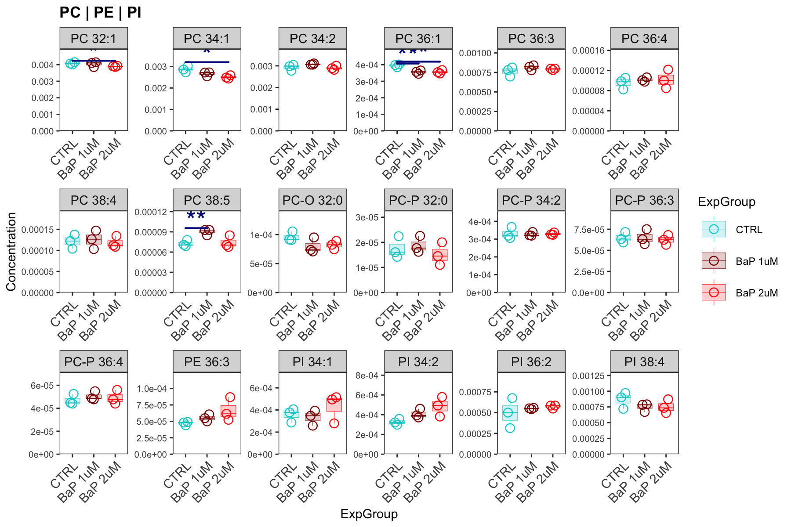
## ## [[2]]

Slide 10
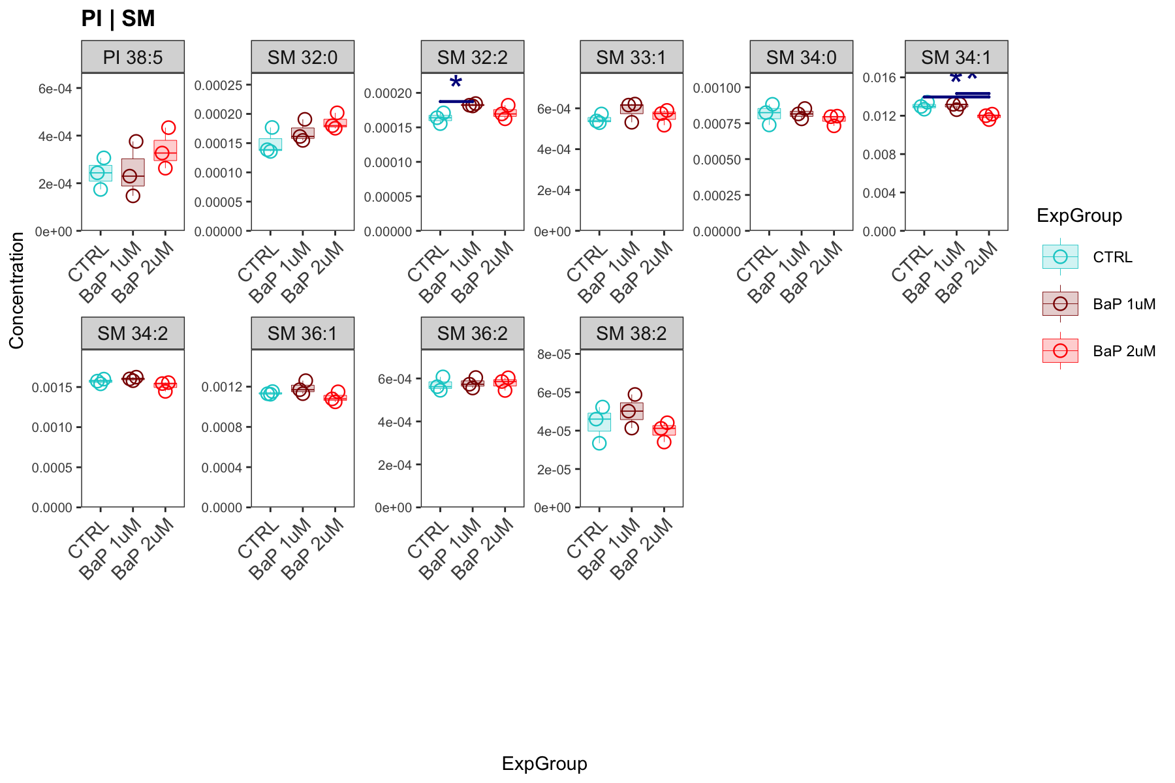
## ## [[3]]

