Slide 1
Healthy Athletes
Lipidomics Analysis Report V1.1 SLING / 03 March 2023

Slide 2
QUALITY CONTROL

Slide 3
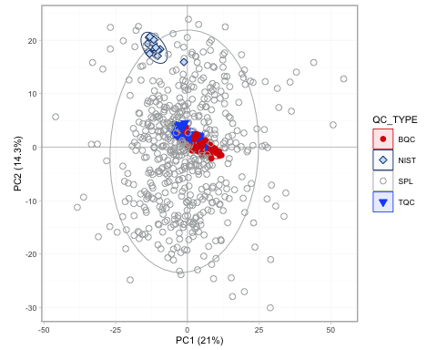
QC and Sample Variability and Outliers
Figure 1: PCA of all QCs and samples BQCs (Batch QCs) are pooled samples co-extracted with samples that represent the sample preparation and MS analysis variability. The TQC (technical QCs) is a common sample measured at regular intervals to monitor the instrument stability. Ideally, the BQC should be centered closely in the middle. No appearednt outliers. PASSED.

Slide 4
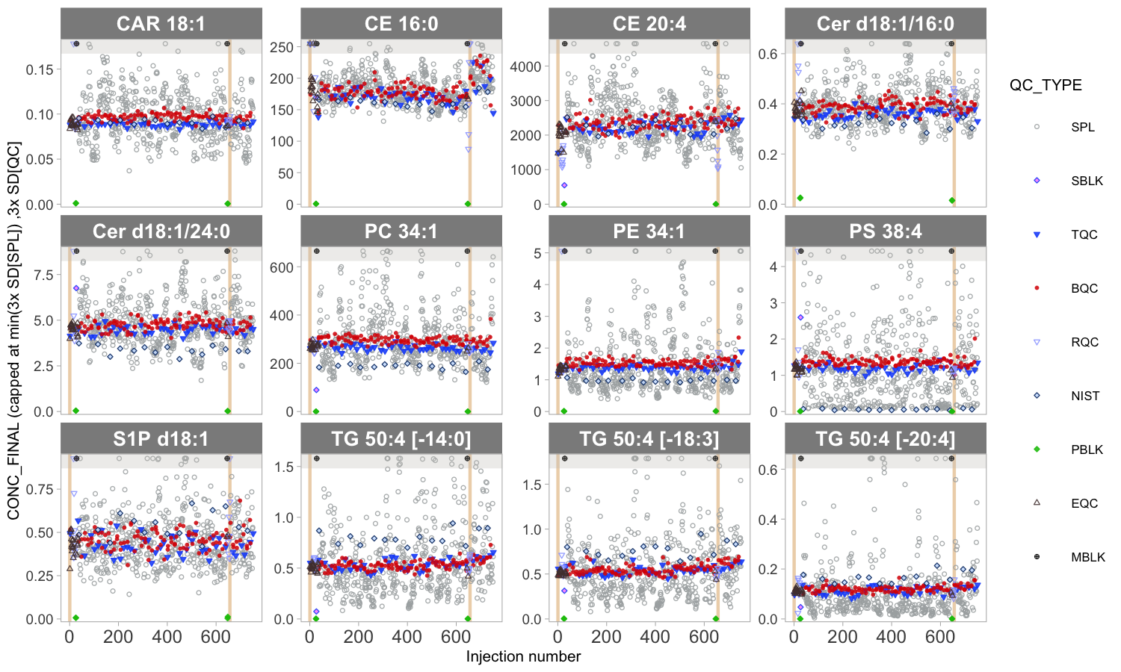
Analytical Robustness
Figure 2: Concentrations of selected species in QC and study sample arranged by analysis order. No appearent batch effects and drifts, QC samples with low variability and centered in the middle. Passed

Slide 5
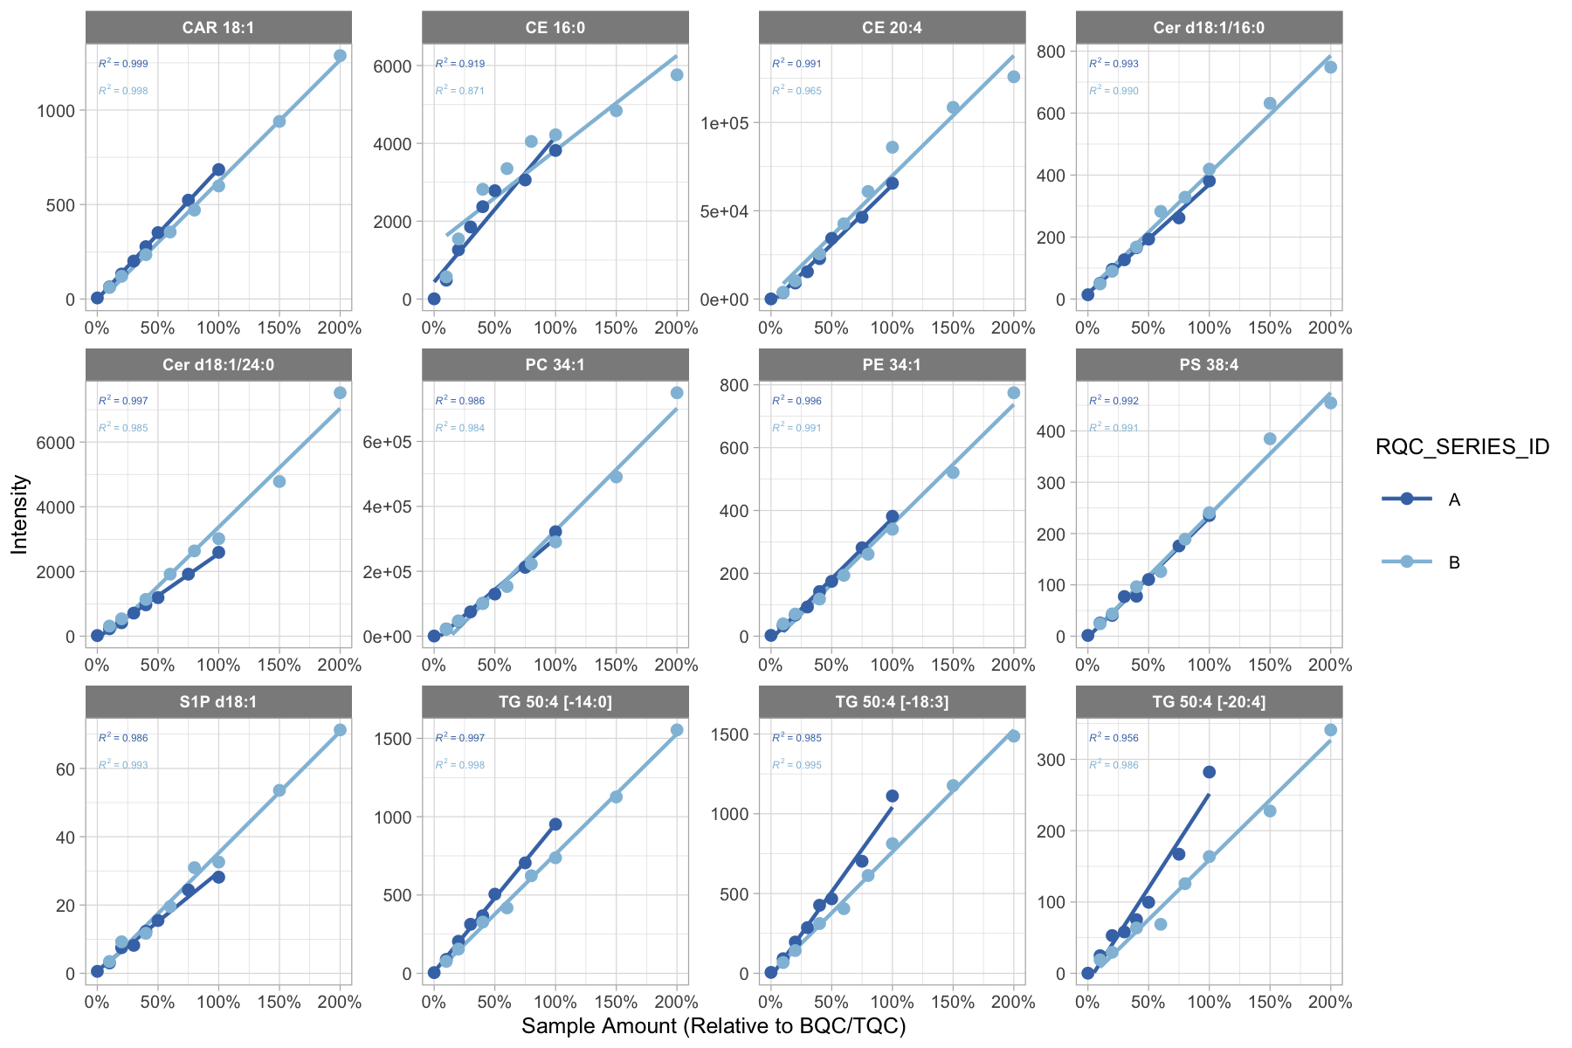
Analytical Linearity
Figure 3: Raw signal intensity as a function of sample amount analysed by the mass spectrometer. Responses should be linear. Passed, except some CE

Slide 6
EXPLORATORY DATA ANALYSIS

Slide 7
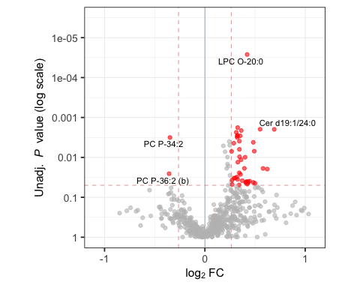
Statistical Comparison of Groups (M vs F)
Figure 4: Statistical comparison between the experimental groups M and F using Welch’s t-test. Lipid species with significant differences between F and M are highlighted in red (P < 0.05 and |FC| > 1.2).

Slide 8
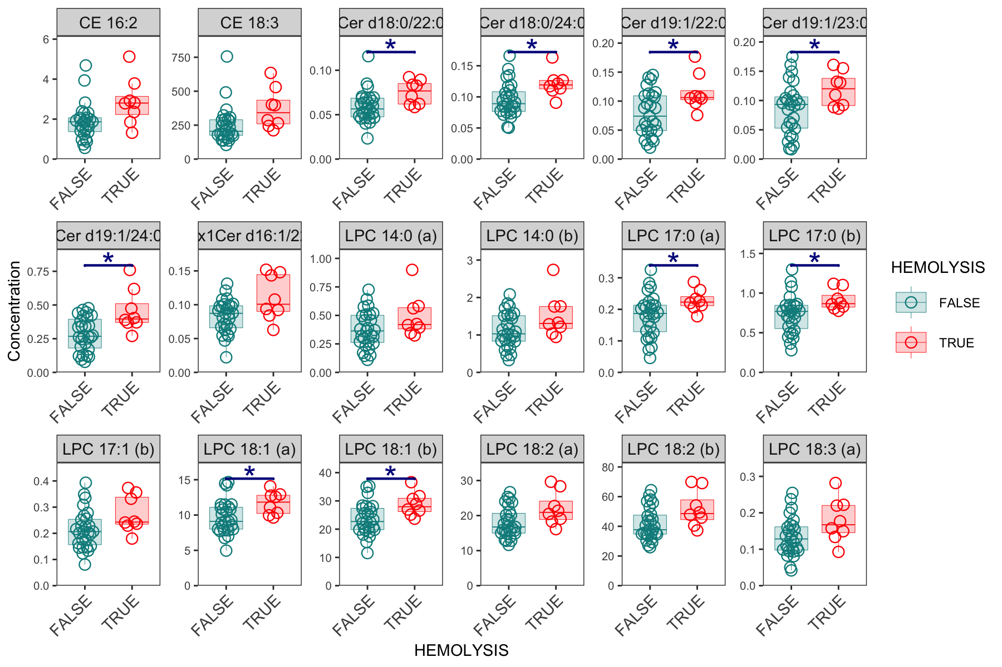
Significanlty different lipid species
Figure 5 Lipid species with statistically significant (P > 0.5, |FC| > 1.3) differences between M and F.

Slide 9
Thank You :-)

