Slide 1
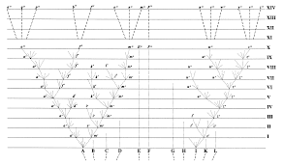
Forest for the Trees: phylogenetic inference

Slide 2
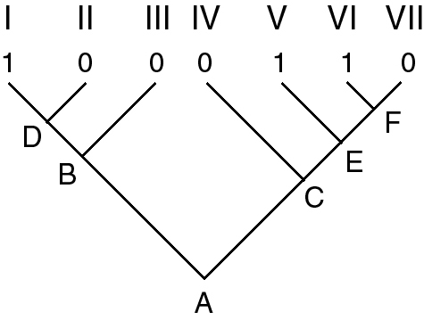
Tree building methods: Parsimony
Parsimony Algorithm: Downpass
Source: http://sites.biology.duke.edu/rausher/lec22_05.html

Slide 3
Tree building methods: Parsimony
Parsimony Algorithm: Downpass
1. Start with a phylogeny, with the character state known for each terminal taxon.
2. Start with two terminal taxa that share an immediate common ancestor (e.g. Taxa V and VI in the figure).
3. Assign character state(s) to the common ancestor of those two taxa using
two rules:
a. If the two taxa share any character state(s) in common, assign the set of shared
states to the common ancestor.
b. If the two taxa share no character states in common, assign the union of character state(s) exhibited by each of the taxa to the common ancestor.
Source: http://sites.biology.duke.edu/rausher/lec22_05.html

Slide 4
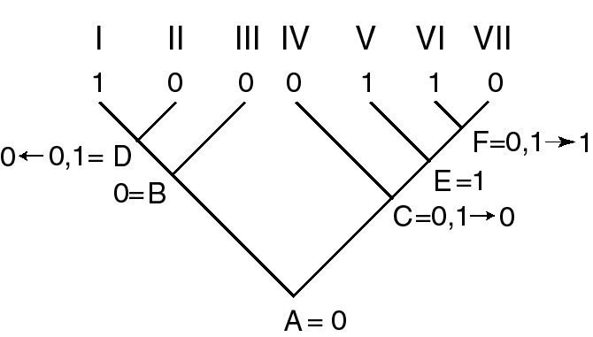
Tree building methods: Parsimony
Parsimony Algorithm: Up-pass
Start with the most ancestral node and compare it individually to each descendent internal node, applying rules (a) and (b) to determine the state of the descendent node.
Source: http://sites.biology.duke.edu/rausher/lec22_05.html

Slide 5
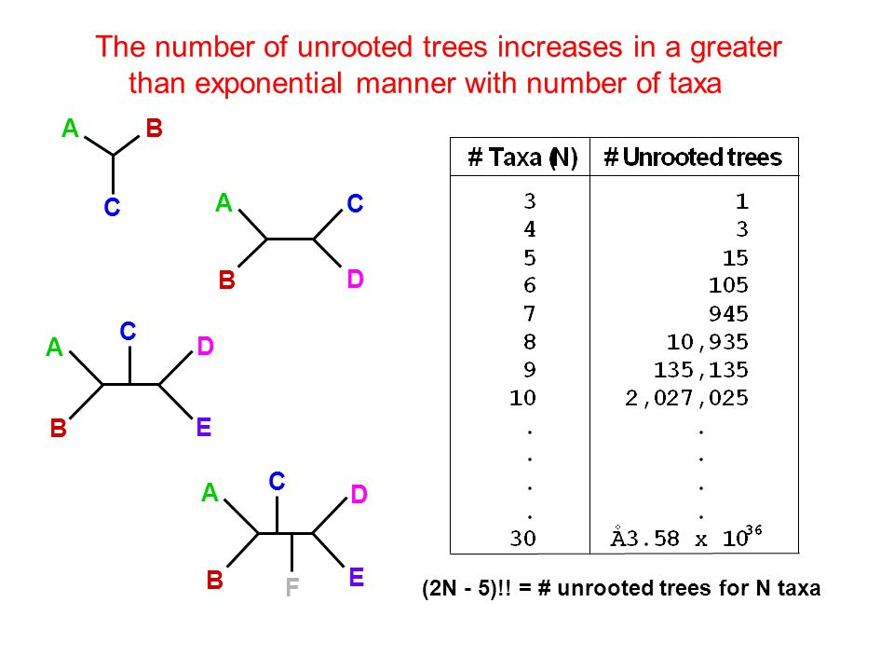
Tree inference: why is this hard?
Source: http://images.slideplayer.com/16/5019186/slides/slide_19.jpg

Slide 6
Tree inference: Overview
Maximizing an optimality criterion
Common to Parsimony, Likelihood, Bayesian methods*:
1. Start with a random tree T
2. Propose a perturbed tree T’
3. Evaluate whether T or T’ is better based on some optimality criterion.
e.g. How well does this tree explain the data?
4. If T’ is better, it becomes T. Either way, we repeat steps 2-4 with T
* Note: Other algorithmic methods like Neighbor-Joining, UPGMA, etc do not use this process,
instead inferring ‘the’ correct tree by analysis of characters or distances. However, these
are thought to be very error-prone and not currently preferred relative to maximum parsimony,
maximum likelihood, or Bayesian methods
Source: http://sites.biology.duke.edu/rausher/lec22_05.html

Slide 7
Tree building methods: Parsimony
Parsimony Algorithm: Up-pass
Notice: The number of ambiguous
nodes generated in the down-pass
is the same as the number of evolutionary
transitions needed to explain the tree.
This is used as an optimality criterion for
picking a best tree in parsimony analysis
Gain (0 → 1)
Loss (1 → 0)
Source: http://sites.biology.duke.edu/rausher/lec22_05.html

Slide 8
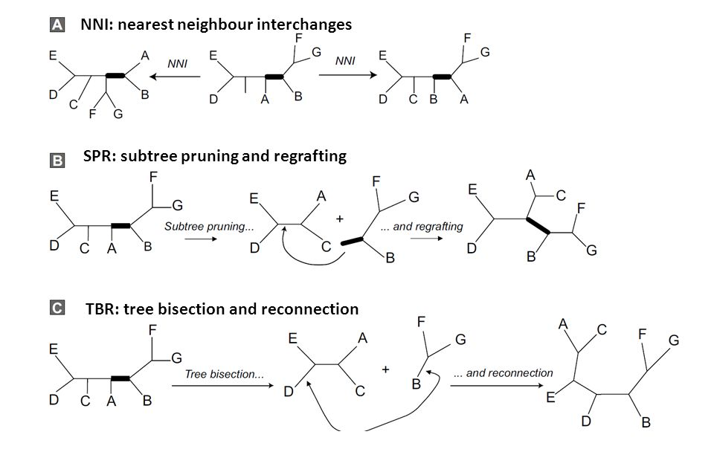
Tree inference: Perturbing a tree
Source: http://images.slideplayer.com/21/6239727/slides/slide_46.jpg

Slide 9
Parsimony: Long Branch Attraction
A
C
True
Tree
B
D

Slide 10
Parsimony: Long Branch Attraction
A
C
A
C
True
Tree
Branch
colors
reflect
trait
evolution
B
D
B
D

Slide 11
Parsimony: Long Branch Attraction
A
C
A
C
True
Tree
Branch
colors
reflect
trait
evolution
B
D
B
D
Long branch attraction makes Parsimony statistically inconsistent, in that if LBA is present,
more data does not imply a better tree

Slide 12
Tree Inference: Maximum Likelihood

Slide 13
Probability vs. Likelihood
O = observations
θ = Some stochastic (random) process
that produces observations
θ
O
Example:
fair coin, p(H) = 0.5
vs.
weighted coin, p(H) = 0.7
Example:
heads vs. tails
O = HHTTHHHHHH

Slide 14
Probability vs. Likelihood
O = observations
θ = Some stochastic (random) process
that produces observations
Probability
θ
O
Example:
fair coin, p(H) = 0.5
vs.
weighted coin, p(H) = 0.7
Example:
heads vs. tails
O = HHTTHHHHHH

Slide 15
Probability vs. Likelihood
O = observations
θ = Some stochastic (random) process
that produces observations
Probability
θ
O
Likelihood
Example:
fair coin, p(H) = 0.5
vs.
weighted coin, p(H) = 0.7
Example:
heads vs. tails
O = HHTTHHHHHH

Slide 16
Probability vs. Likelihood
O = observations
θ = Some stochastic (random) process
that produces observations
So more formally:
We want to pick a likelihood function θ that maximises the probability of generating
our observations O
L(θ|O) = P(O|θ)

Slide 17
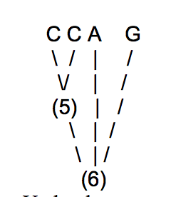
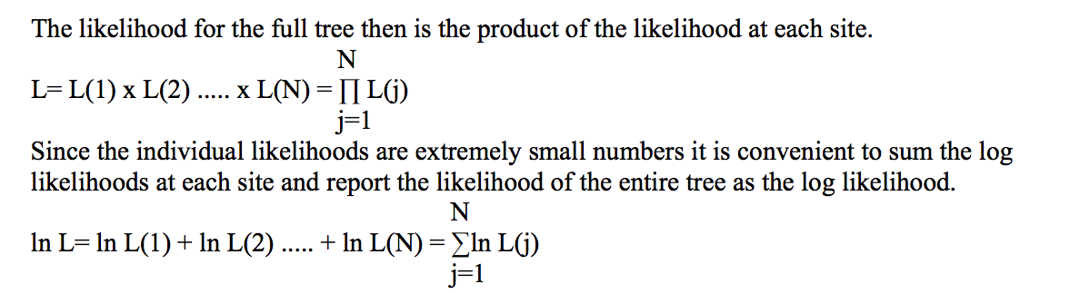
Likelihood models
Source: http://ib.berkeley.edu/courses/ib200a/lect/ib200a_lect11_Will_likelihood.pdf

Slide 18
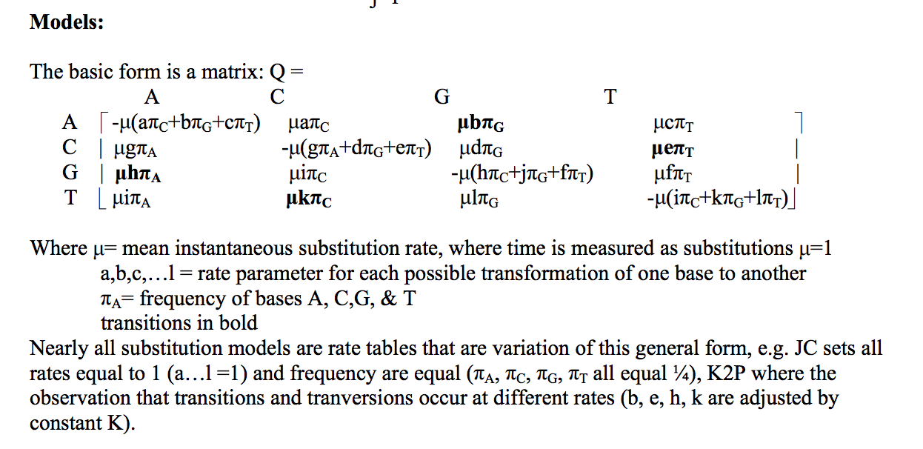
Likelihood models
Source: http://ib.berkeley.edu/courses/ib200a/lect/ib200a_lect11_Will_likelihood.pdf

Slide 19
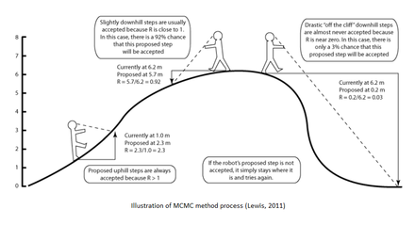
Tree building methods: Bayesian (Metropolis-Hastings algorithm)
Source:http://www.wikiwand.com/en/Bayesian_inference_in_phylogeny

Slide 20

Tree building methods: Bayesian The Metropolis-Hastings Algorithm
1. An initial tree, T_{i}, is randomly selected.
2. A neighbour tree, T_{j}, is selected from the collection of trees.
3. The ratio, R, of the probabilities (or probability density functions) of T_{j} and T_{i} is computed as follows: R = f(T_{j})/f(T_{i})
If R ≥ 1, T_{j} is accepted as the current tree
If R < 1, T_{j} is accepted as the current tree with probability R, otherwise Ti is kept
At this point the process is repeated from Step 2 N times.
Source:http://www.wikiwand.com/en/Bayesian_inference_in_phylogeny

Slide 21

Tree building methods: Metropolis-Coupled Markov Chain Monte Carlo
Run multiple chains of the Metropolis-Hastings algorithm, but at variable ‘heats’.
‘Heated’ chains are more likely to take unfavorable steps (down into valleys). This is
useful for exploring parameter spaces with steep local optima.
It’s like having multiple robots surveying our hill, but one is insane.
Source:http://www.wikiwand.com/en/Bayesian_inference_in_phylogeny

Slide 22
Tree building methods: Metropolis-Coupled Markov Chain Monte Carlo
Based on Metropolis algorithm
A stochastic process that only
depends on it’s last k states
Using random simulation or
permutation get an estimate for
a probability
Source:http://www.wikiwand.com/en/Bayesian_inference_in_phylogeny

Slide 23
Tree building methods: Bayesian (Metropolis-Coupled MCMC or MC³)
Source:http://www.wikiwand.com/en/Bayesian_inference_in_phylogeny

Slide 24
Tree building methods: Bayesian (Metropolis-Coupled MCMC or MC³)
Source:http://www.wikiwand.com/en/Bayesian_inference_in_phylogeny

Slide 25
Tree building methods: Bayesian (Metropolis-Coupled MCMC or MC³)
“This seems best”
(stuck in local optimum)
Source:http://www.wikiwand.com/en/Bayesian_inference_in_phylogeny

Slide 26
Tree building methods: Bayesian (Metropolis-Coupled MCMC or MC³)
The heated chain is less penalized for finding a worse solution, so it can traverse
“valleys”....but it doesn’t do a good job of carefully exploring local peaks.
Source:http://www.wikiwand.com/en/Bayesian_inference_in_phylogeny

Slide 27
Tree building methods: Bayesian (Metropolis-Coupled MCMC or MC³)
Solution: combine both a ‘hot’ and ‘cold’ chain, swap the cold chain with a heated chain
with a chance proportional to how good (high) their solutions are.
Source:http://www.wikiwand.com/en/Bayesian_inference_in_phylogeny

Slide 28
Tree building methods: Bayesian (Metropolis-Coupled MCMC or MC³)
Solution: combine both a ‘hot’ and ‘cold’ chain, swap the cold chain with a heated chain
with a chance proportional to how good (high) their solutions are.
“Nope”
Source:http://www.wikiwand.com/en/Bayesian_inference_in_phylogeny

Slide 29
Tree building methods: Bayesian (Metropolis-Coupled MCMC or MC³)
Solution: combine both a ‘hot’ and ‘cold’ chain, swap the cold chain with a heated chain
with a chance proportional to how good (high) their solutions are.
“Swap!”
Source:http://www.wikiwand.com/en/Bayesian_inference_in_phylogeny

Slide 30
Tree building methods: Bayesian (Metropolis-Coupled MCMC or MC³)
Solution: combine both a ‘hot’ and ‘cold’ chain, swap the cold chain with a heated chain
with a chance proportional to how good (high) their solutions are.
“Let me carefully survey this
new region”
Source:http://www.wikiwand.com/en/Bayesian_inference_in_phylogeny

Slide 31
Tree building methods: Bayesian (Metropolis-Coupled MCMC or MC³)
Solution: combine both a ‘hot’ and ‘cold’ chain, swap the cold chain with a heated chain
with a chance proportional to how good (high) their solutions are.
“Let me carefully survey this
new region”
“I’ll just keep, y’know,
bouncing around”
Source:http://www.wikiwand.com/en/Bayesian_inference_in_phylogeny

Slide 32
Tree building methods: Bayesian (Metropolis-Coupled MCMC or MC³)
Solution: combine both a ‘hot’ and ‘cold’ chain, swap the cold chain with a heated chain
with a chance proportional to how good (high) their solutions are.
Source:http://www.wikiwand.com/en/Bayesian_inference_in_phylogeny

Slide 33
Tree building methods: Bayesian (Metropolis-Coupled MCMC or MC³)
Solution: To finish, collect all the trees that the ‘cold’ chain explored (removing the first n as a
‘burn in’ vulnerable to bad solutions). The posterior probability of each node in the tree is how
often it shows up in those trees. You will see this written as e.g. 90/100 and called a Bayesian
Posterior Probability.
Source:http://www.wikiwand.com/en/Bayesian_inference_in_phylogeny

Slide 34
Python Discussion: Test Code
Source:http://www.wikiwand.com/en/Bayesian_inference_in_phylogeny

