Slide 1
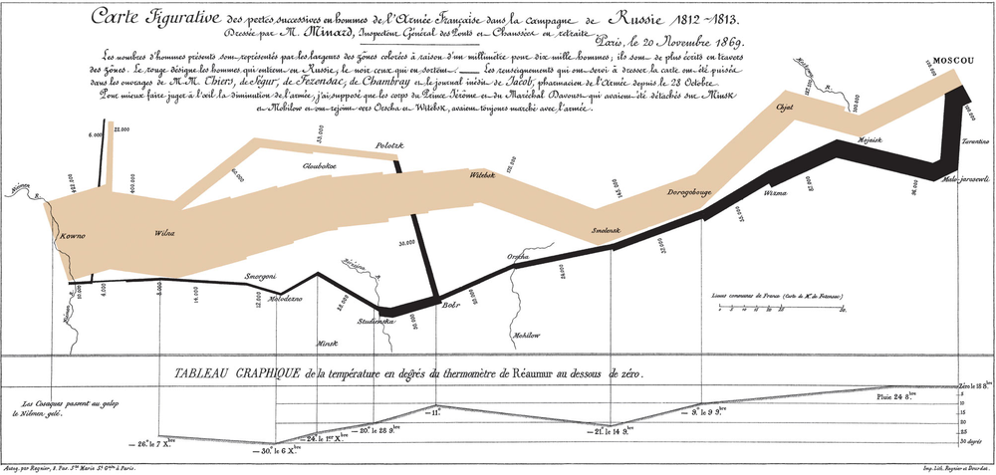
Data visualization: principles
Bioinformatics Week 5 Day 2 Jesse Zaneveld

Slide 2
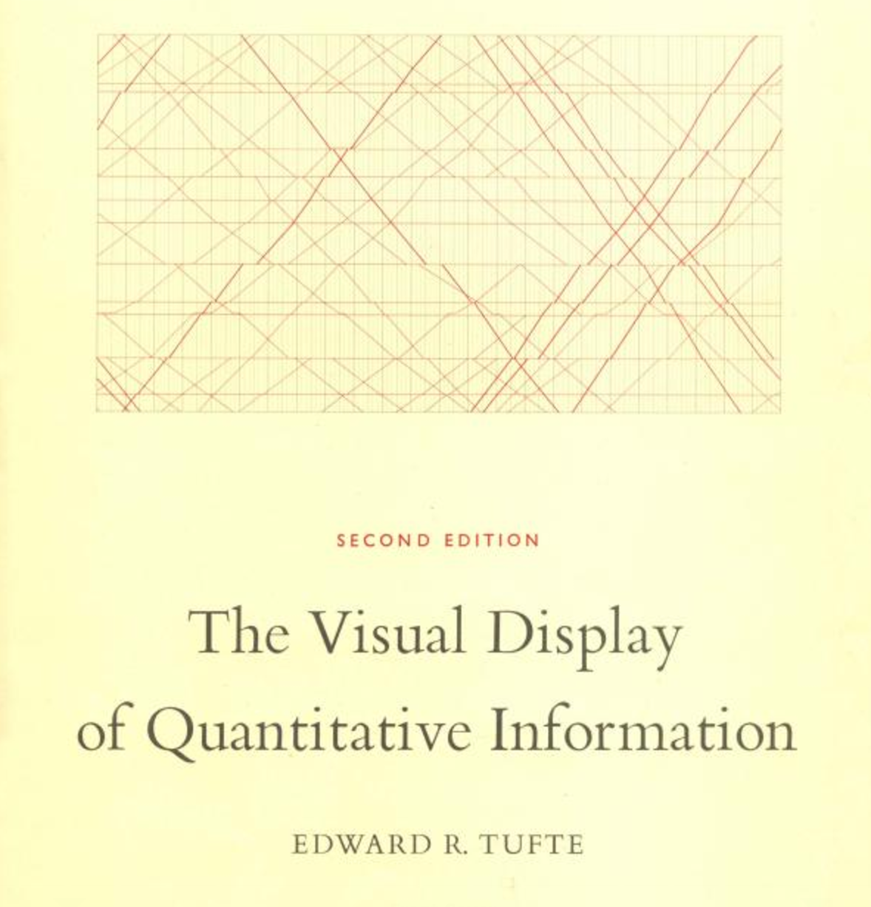
Data visualization: Tufte
Edward Tufte’s book is a classic
and the source for much current
conventional wisdom in data
visualization.
If you talk graphs long enough,
these principles will come up,
so let’s talk about them.

Slide 3
Data visualization: Tufte
I’ve uploaded a brief article
summarizing some of Tufte’s
principles to Canvas

Slide 4
Data integrity
The representation of numbers, as physically measured on the surface of the graphic itself, should be directly proportional to the numerical quantities represented.
Clear, detailed, and thorough labeling should be used to defeat graphical distortion and ambiguity.
Write out explanations of the data on the graphic itself. Label important events in the data
.
Show data variation, not design variation.
The number of information-carrying (variable) dimensions depicted should not exceed the number of dimensions in the data.
Graphics must not quote data out of context.

Slide 5
“Lie Factor”
The representation of numbers, as physically measured on the surface of
the graphic itself, should be directly proportional to the numerical
quantities represented.
Lie factor= size of effect shown in visualization/size of effect in data

Slide 6
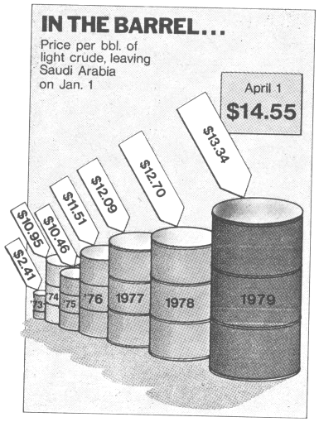
“Lie Factor”
The representation of numbers, as physically measured on the surface of
the graphic itself, should be directly proportional to the numerical
quantities represented.
Lie factor= size of effect shown in visualization/size of effect in data

Slide 7
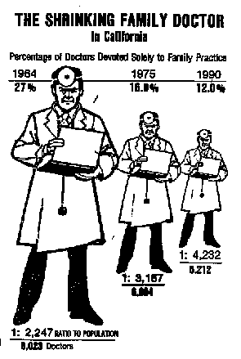
“Lie Factor”
Lie factor= size of effect shown in visualization/size of effect in data
Commonly accomplished by representing 1D data in 2 dimensions

Slide 8
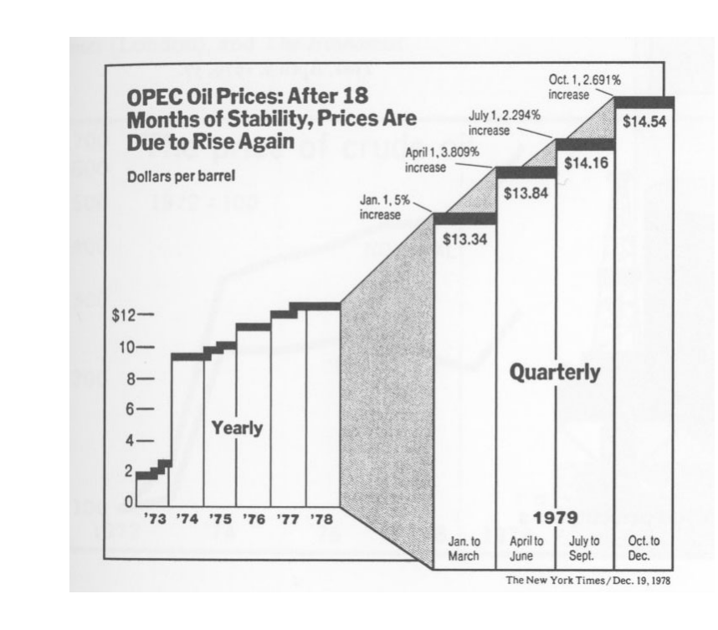
Data variation not design variation
Represent variation in the data,
not variation in design
Source: Tufte, pg. 61

Slide 9
Data ink ratio
Tufte suggests a few key principles for designing visualizations.
The first is to maximize the
Data-ink ratio = data-ink / total ink
This suggests:
Eliminate unnecessary ‘artistic’ decorations
Think carefully about the need for heavy grid-lines, frames,
etc.
If you need grids, consider converting them to light gray
(reducing non-data ink & the visual weight of non-data
elements)

Slide 10
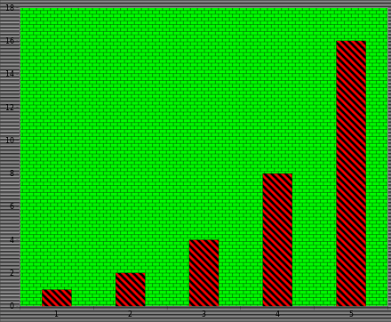
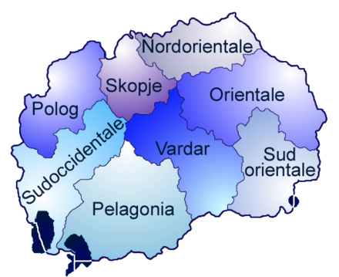
Data ink ratio: Chartjunk
We only get 1,2,4,8,16 from this
busy graph
Source: https://en.wikipedia.org/wiki/Chartjunk

Slide 11
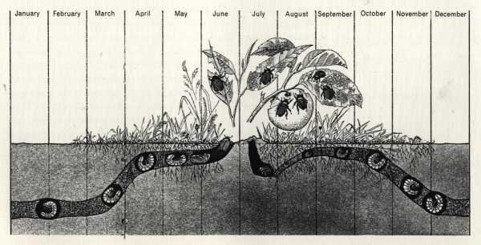
Data visualization: Time and Space
A complete yearlong life cycle of the Popillia japonica Newman (the Japanese Beetle) L. Hugh Newman, Man and Insects (London, 1965), pp. 104-105. Cited by Edward R. Tufte, (1991) p.110.

Slide 12
Data visualization: Time and Space
Charles Joseph Minard. Line width shows size of Napolean’s Grand Armée during the invasion of Russia and the retreat. Temperature scale links to temperatures encountered during the retreat.

Slide 13
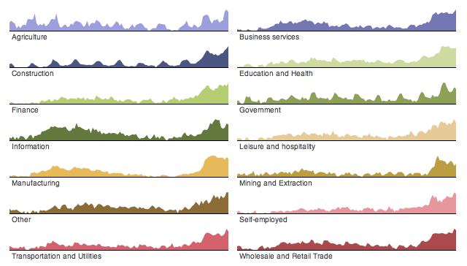
Data visualization: Small multiples
A. Ghizzo, B. Izrar, P. Betrand, E. Fijalkow, M. R. Feix, and M. Shoucri, "Stability of Bernstein-Greene-Kruskal Plasma Equilibria: Numerical Experiments Over a Long Time," Physics of Fluids, 31 (January 1988).
Source: http://homes.cs.washington.edu/~jheer//files/zoo/small_multiples.png

Slide 14
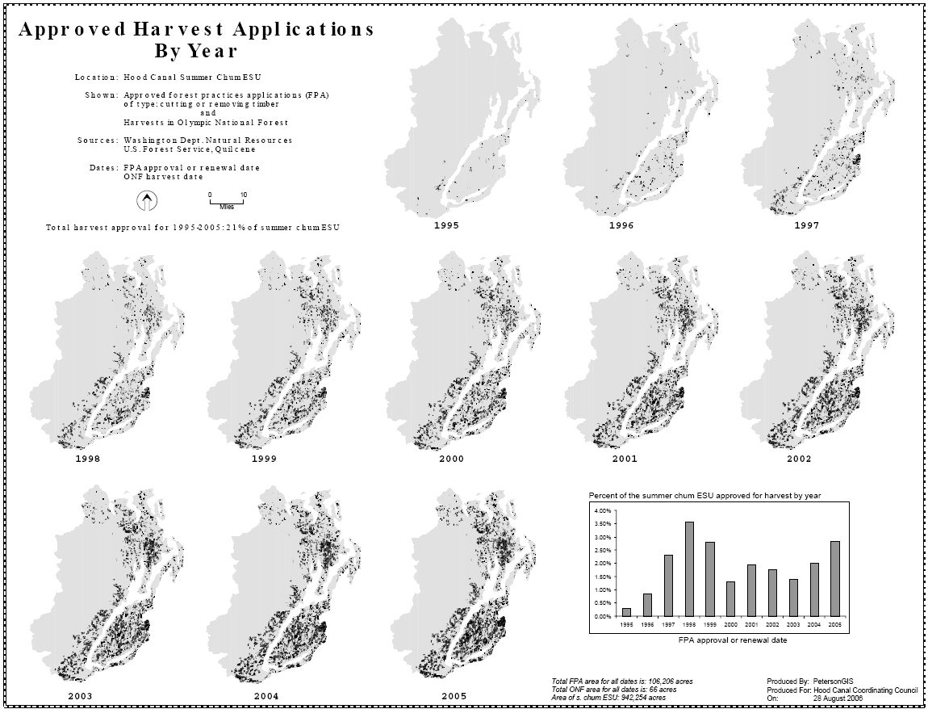
Data visualization: Small multiples
A. Ghizzo, B. Izrar, P. Betrand, E. Fijalkow, M. R. Feix, and M. Shoucri, "Stability of Bernstein-Greene-Kruskal Plasma Equilibria: Numerical Experiments Over a Long Time," Physics of Fluids, 31 (January 1988).
Source: http://www.gretchenpeterson.com/blog/archives/876

Slide 15
Data visualization: Micro/Macro
Micro/Macro views:
Allow viewers to see the main trend quickly but retain the ability zoom in
and study all the individual data, potentially noticing other trends.
Source: http://www.gretchenpeterson.com/blog/archives/876

Slide 16
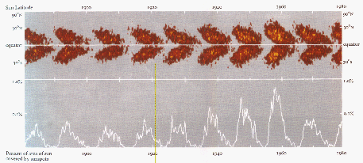
Data visualization: Micro/Macro
See the main trend quickly
but still zoom in and study all the individual data (nothing hidden)
Sunspots. Diagram by David H. Hathaway, Marshall Space Flight Center, NASA
Source: http://www2.cs.uregina.ca/~rbm/cs100/notes/spreadsheets/tufte_paper.html

Slide 17
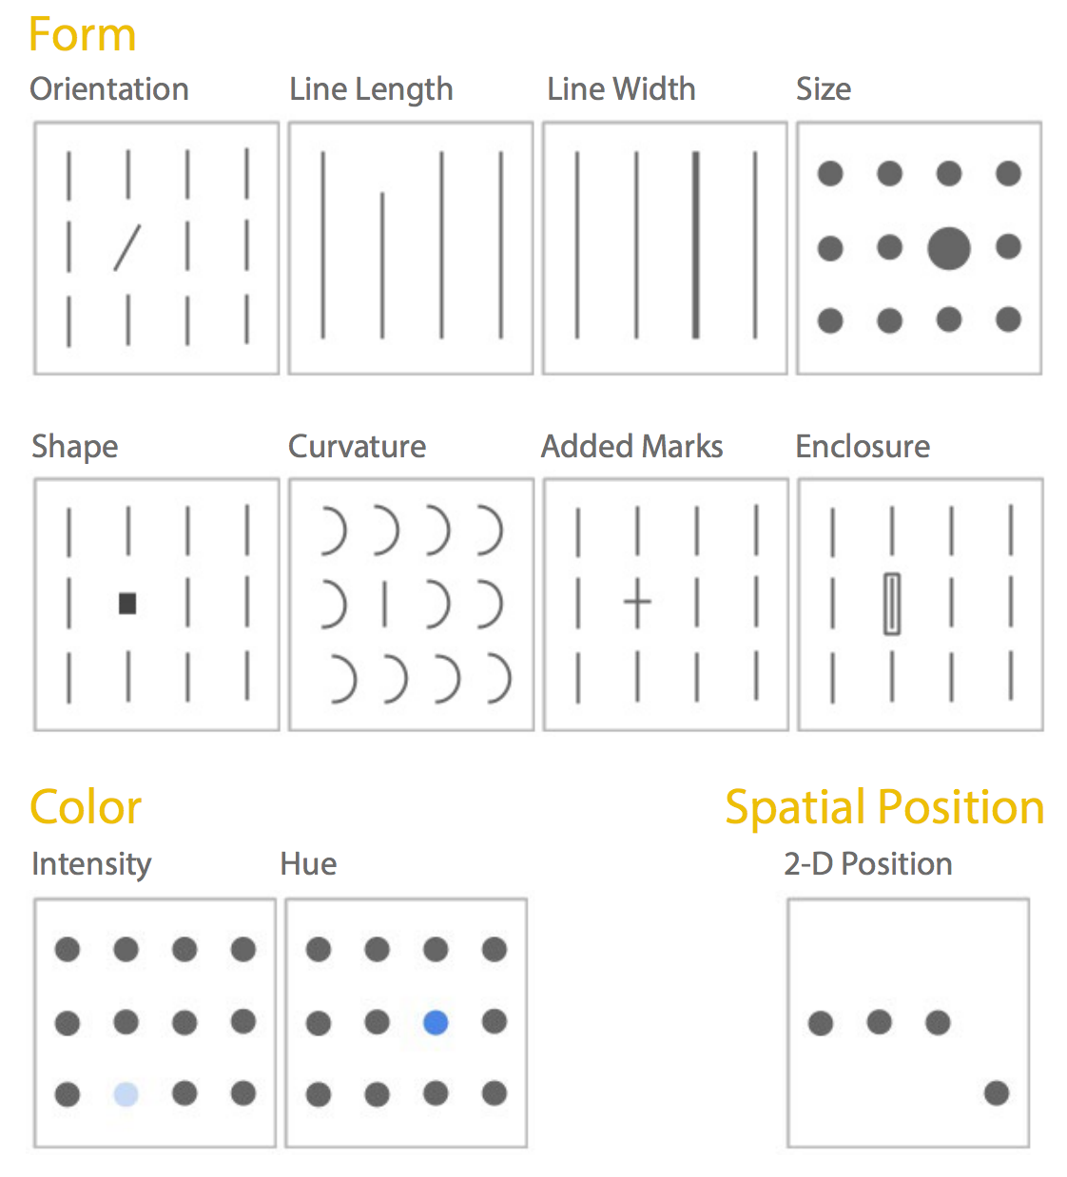
Pre-attentive attributes
Colin Ware at the Visualization Lab at University of New
Hampshire also has some interesting guidelines and books
on the psychology of data visualization.
Readers observing graphics varying in preattentive attributes
(pictured) can detect
categorical differences
in < 10 ms, even when
not trying.
Source: http://www.fusioncharts.com/whitepapers/downloads/Principles-of-Data-Visualization.pdf

Slide 18
Pre-attentive attributes
...but of these only line
length and spatial
position reliably convey
quantitative information.
Source: http://www.fusioncharts.com/whitepapers/downloads/Principles-of-Data-Visualization.pdf

Slide 19
Data Visualization: Python
Matplotlib
Altair
Seaborne
ggplot2 (port from R)
Pandas
Source: http://www.fusioncharts.com/whitepapers/downloads/Principles-of-Data-Visualization.pdf

Slide 20
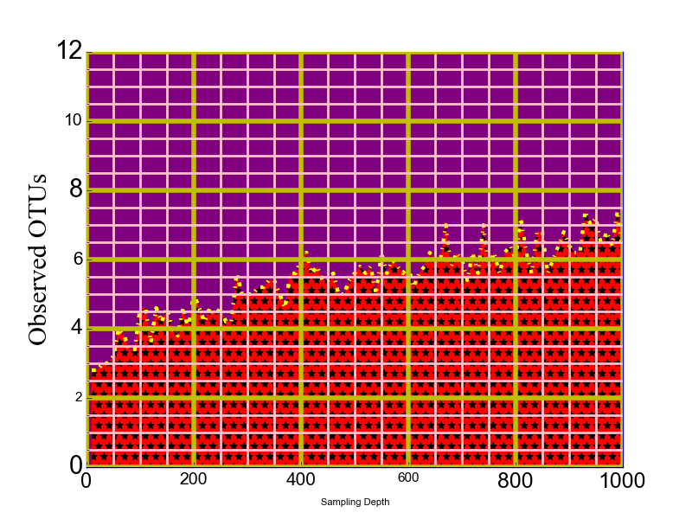
Exercise: Anger Tufte!
Source: http://www.fusioncharts.com/whitepapers/downloads/Principles-of-Data-Visualization.pdf

