Slide 1

San Antonio Vacation Dashboard
Contributors: Sierra, Gomez, Sierra Quevedo, Aaron DeVore, & Paul Serna

Slide 2
Welcome to our Dashboard!
The San Antonio Vacation Dashboard explores and visualizes 105 possible vacation destinations to visit by flight from San Antonio, Texas. 39 locations are available through direct flights and 46 are available through flights with layovers.
Know Before You Go!
What temperature like in the city you’re looking to visit?
What are the best restaurant recommendations?
What are the best Hotel options?
What are the average ticket prices to help plan for your trip budget?

Slide 3
Data Sources: APIs, CSVs, and Web-scraping
https://transtats.bts.gov/AIRFARES/
https://aviation-edge.com/developers/
https://openweathermap.org/api
https://flysanantonio.com/home/flights/nonstop-destinations/
https://maps.googleapis.com/maps/api/place/nearbysearch/json

Slide 4
Process
API Calls and data updates on Jupyter
CSV cleanup and data updates on Jupyter
SQL database creation
Flask app
Javascript file creation
HTML integration

Slide 5
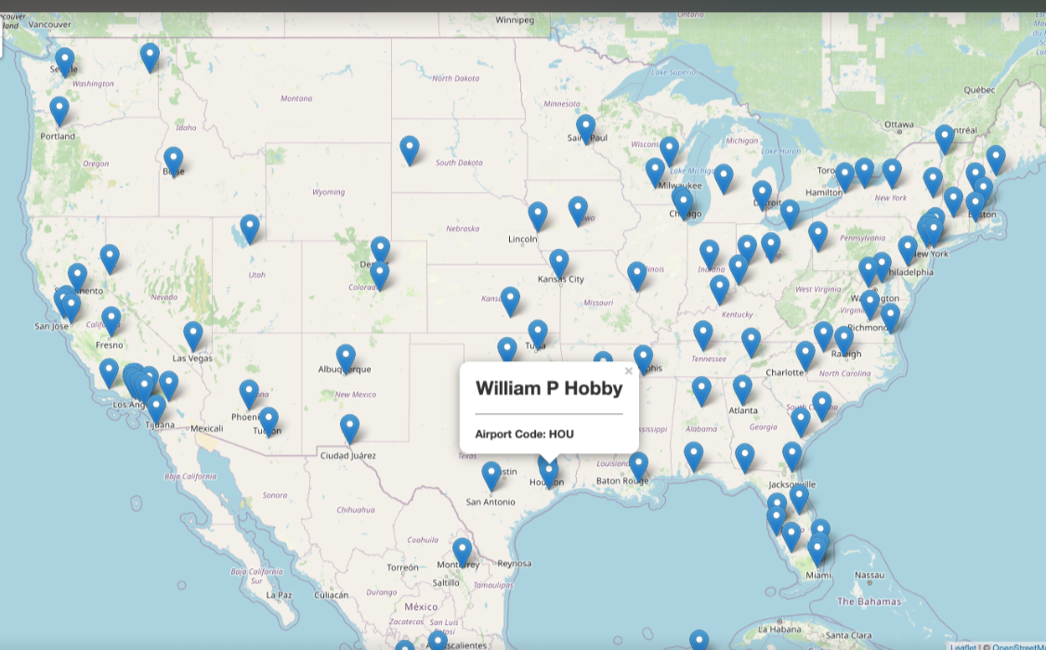
Map
Leaflet map of all the direct and indirect flights out of San Antonio.

Slide 6
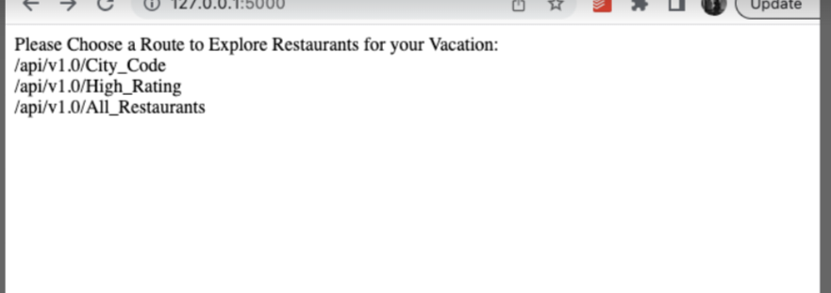
App
APP allows to pull by City code, Restaurant Rating, and then all other Restaurants.

Slide 7
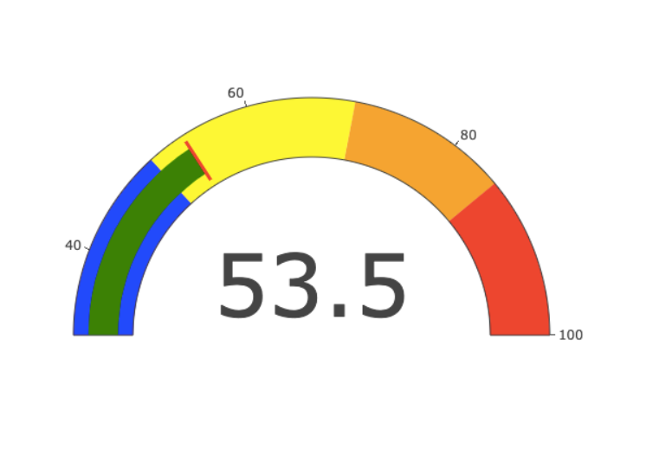
City Temperature gauge
Knowing what the temperature is like helps prepare with what is the appropriate attire for the vacation destination.

Slide 8
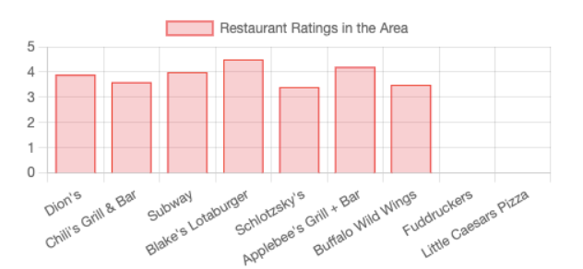
Restaurant Ratings in the Area
The ratings vary depending on location; however, the restaurant rating provides recommendations based on customer feedback ranging from 0-5 and 5 being the best overall. Currently, booking your vacation destination flight is part of the planning process, finding a great place to eat upon arrival is a must option to have prior to the final booking.

Slide 9
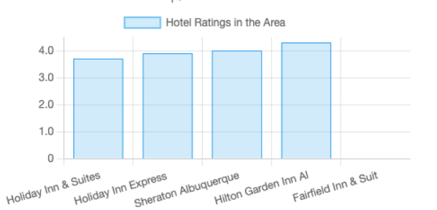
Hotel Ratings in the Area
Again, the ratings vary depending on location; however, the Hotel rating provides recommendations based on customer feedback ranging from 0-5 and 5 being the best overall. Ensuring, there are options for accommodations upon arrival to a destination prior to final booking makes planning a trip that much easier.

Slide 10
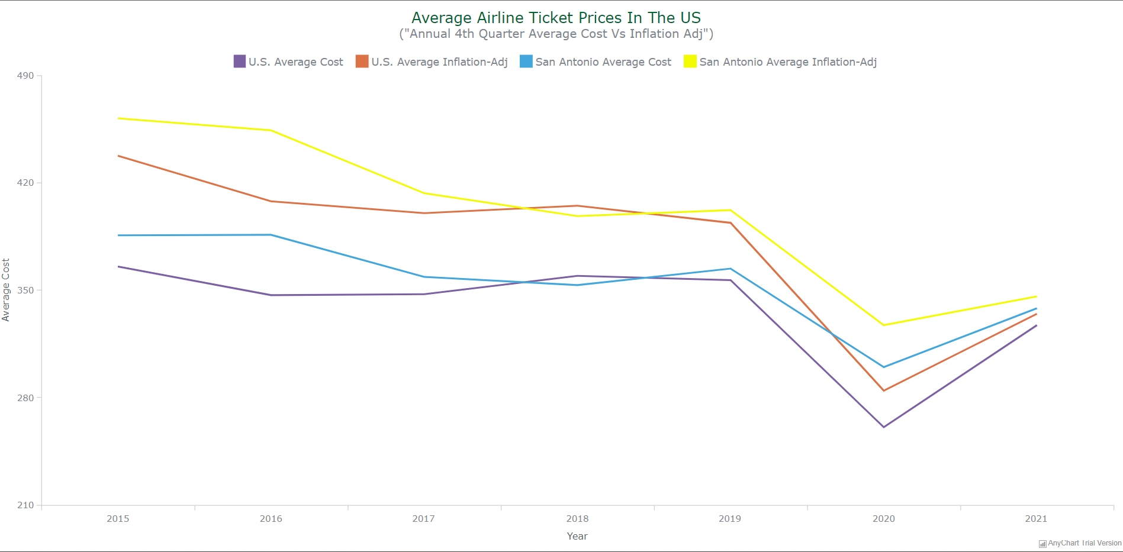
The average price for Airline Tickets.
Provides an overall average of the last 5 years of airline ticket prices to help with planning your trips budget.

Slide 11
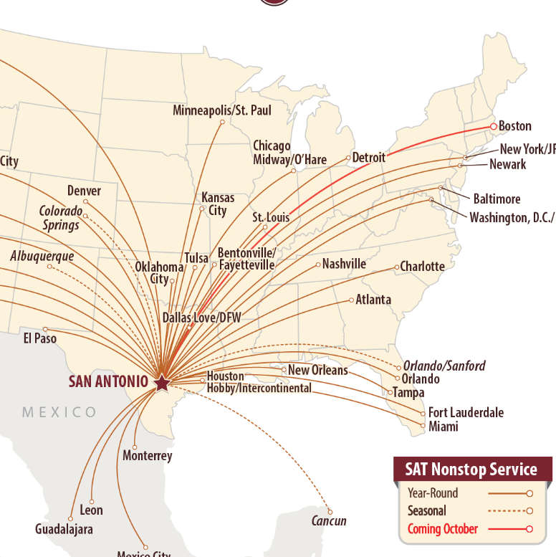
Flight destinations
105 possible vacation destinations to visit by flight from San Antonio, Texas. 39 locations are available through direct flights and 46 are available through indirect flights with layovers.

Slide 12
San Antonio Airport Interesting Facts
A large plot of land destined to become an airport was acquired by the city of San Antonio in 1941, covering some 1,200 acres / 485 hectares. In 1944 the airfield was officially named the San Antonio International Airport (SAT) and regular flights began. San Antonio International Airport now covers more than 2,600 acres / 1,050 hectares.
Southwest Airlines leads the way with 1,274,000 passengers from May 2020-April 2021.
San Antonio International tied with Dallas-Fort Worth International Airport, Dallas Love Field and Austin-Bergstrom International Airport for a lackluster three-star rating in air-industry consultant Skytrax's 2022 rankings.

