Slide 1
ENTERPRISE CPE PLAN
2025
ENTERPRISE DIGITAL PRODUCT

Slide 2
CPE Classification of Enterprise Product Portfolios
CPE Model | Access Medium | Uplink Interface | Ethernet Layer | Functionality | Key Features
One Access 1424 | Copper | G.SHDSL Bandwidth upto 2Mbps | L2/L3 | L2: Ethernet Demarcation L3: IP Routing (Dynamic) | VLAN management VPN termination SD WAN underlay QoS ACL
Huawei S5735 (Service Switch) | Fiber | 1G SFP x 4 Bandwidth upto 1Gbps | L2 | L2: Ethernet Demarcation | VLAN management L2 QoS
Juniper SRX 320 (L3 Switch) | Fiber | 1G SFP x 2 Bandwidth upto 1Gbps | L2/L3 | L2: Ethernet Demarcation L3: IP Routing (Dynamic) | VLAN management VPN termination SD WAN underlay QoS ACL IP Security

Slide 3
CPE Classification of Enterprise Product Portfolios
CPE Model | Access Medium | Uplink Interface | Ethernet Layer | Functionality | Key Features
Cisco 4321X | N/A | Combo (Copper / Fiber) Bandwidth upto 100Mbps | L3 | L3: IP Routing (Dynamic) SD WAN | VLAN management VPN termination QoS ACL IP Security SD WAN Edge
Cisco 1121X-8P | N/A | Combo (Copper / Fiber) Bandwidth upto 100Mbps | L3 | L3: IP Routing (Dynamic) SD WAN | VLAN management VPN termination QoS ACL IP Security SD WAN Edge
Juniper SRX 340 (L3 Switch) | Fiber | 1G SFP x 8 Bandwidth upto 1Gbps | L2/L3 | L2: Ethernet Demarcation L3: IP Routing (Dynamic) | VLAN management VPN termination SD WAN underlay QoS ACL IP Security

Slide 4
New CPEs under Enterprise Product Portfolios
CPE Model | Access Medium | Uplink Interface | Ethernet Layer | Functionality | Key Features
One 421 | N/A | Copper Ethernet Bandwidth upto 100Mbps | L3 | L3: IP Routing (Dynamic) SD WAN Ready | VLAN management VPN termination QoS ACL IP Security
One 521 | Fiber | Combo (Copper / Fiber) Bandwidth upto 1Gbps | L3 | L3: IP Routing (Dynamic) SD WAN Ready | VLAN management VPN termination QoS ACL IP Security
One 2501 | Fiber | Combo (Copper / Fiber) Bandwidth upto 1Gbps | L3 | L3: IP Routing (Dynamic) SD WAN Ready | VLAN management VPN termination QoS ACL IP Security

Slide 5
Retiring CPEs
CPE Type | CPE Model
Copper NTU (G.SHDSL) | One Access 1432 - V.35
Fiber NTU (Service Switch) | Huawei S5300 - Service Switch Basic Huawei S5230 - Service Switch Basic ZTE 5250-28TC - Service Switch Advance ZTE 5250-28TM - Service Switch Advance Plus
Cisco CPE | Cisco 891 Cisco 1921 Cisco 1941 Cisco ISR 4221 Cisco ISR 4231 Cisco ISR 4331 Cisco ISR 4431 Cisco ISR 4451
L3 Switch | Huawei 5331 Huawei 5332

Slide 6
Retiring CPEs
CPE Type | CPE Model
IP Phone | GXP 1611 GXP 1165 GXP 1450 GXP 1625 GXP 1780 GXP 1782 GXP 1760W GXV 3240 GXP 2130 GXP 2160 GXV 3350
IAD | RealTone products 96 Port IAD 2 Port IAD 16 Port IAD
Wi-Fi Access points | Ruckus R320 Ruckus R500 Aruba AP 303

Slide 7
What You Need to Know
Trigger: Replacement occurs when CPE is faulty.
Phased out CPEs
Cisco 891F / Cisco 1921 One Access ONE421
Cisco 1941 / ISR 4200 / ISR 4300 series One Access ONE521
Cisco 4400 series One Access ONE 2501
For faulty replacement, there will be no monthly rental increment as per existing Cisco CPE with the service
For new services, standard tariff of One Access ONE CPE will be applicable
In case of brand Specific needs where the customer insists on Cisco CPE,
Cisco 891F/ Cisco 1921 /Cisco 1941 Cisco 1121X
Cisco ISR 4200 / ISR 4300 series Cisco 4231X
Latest Tariff of Cisco CPE will be applicable for both new service and faulty replacement
For higher performance needs, Juniper SRX320 and SRX 340 L3 switches are available. In case of faulty replacement of Cisco CPE, latest monthly rental of L3 switch will be applicable.
- **Indicates the replacement option

Slide 8
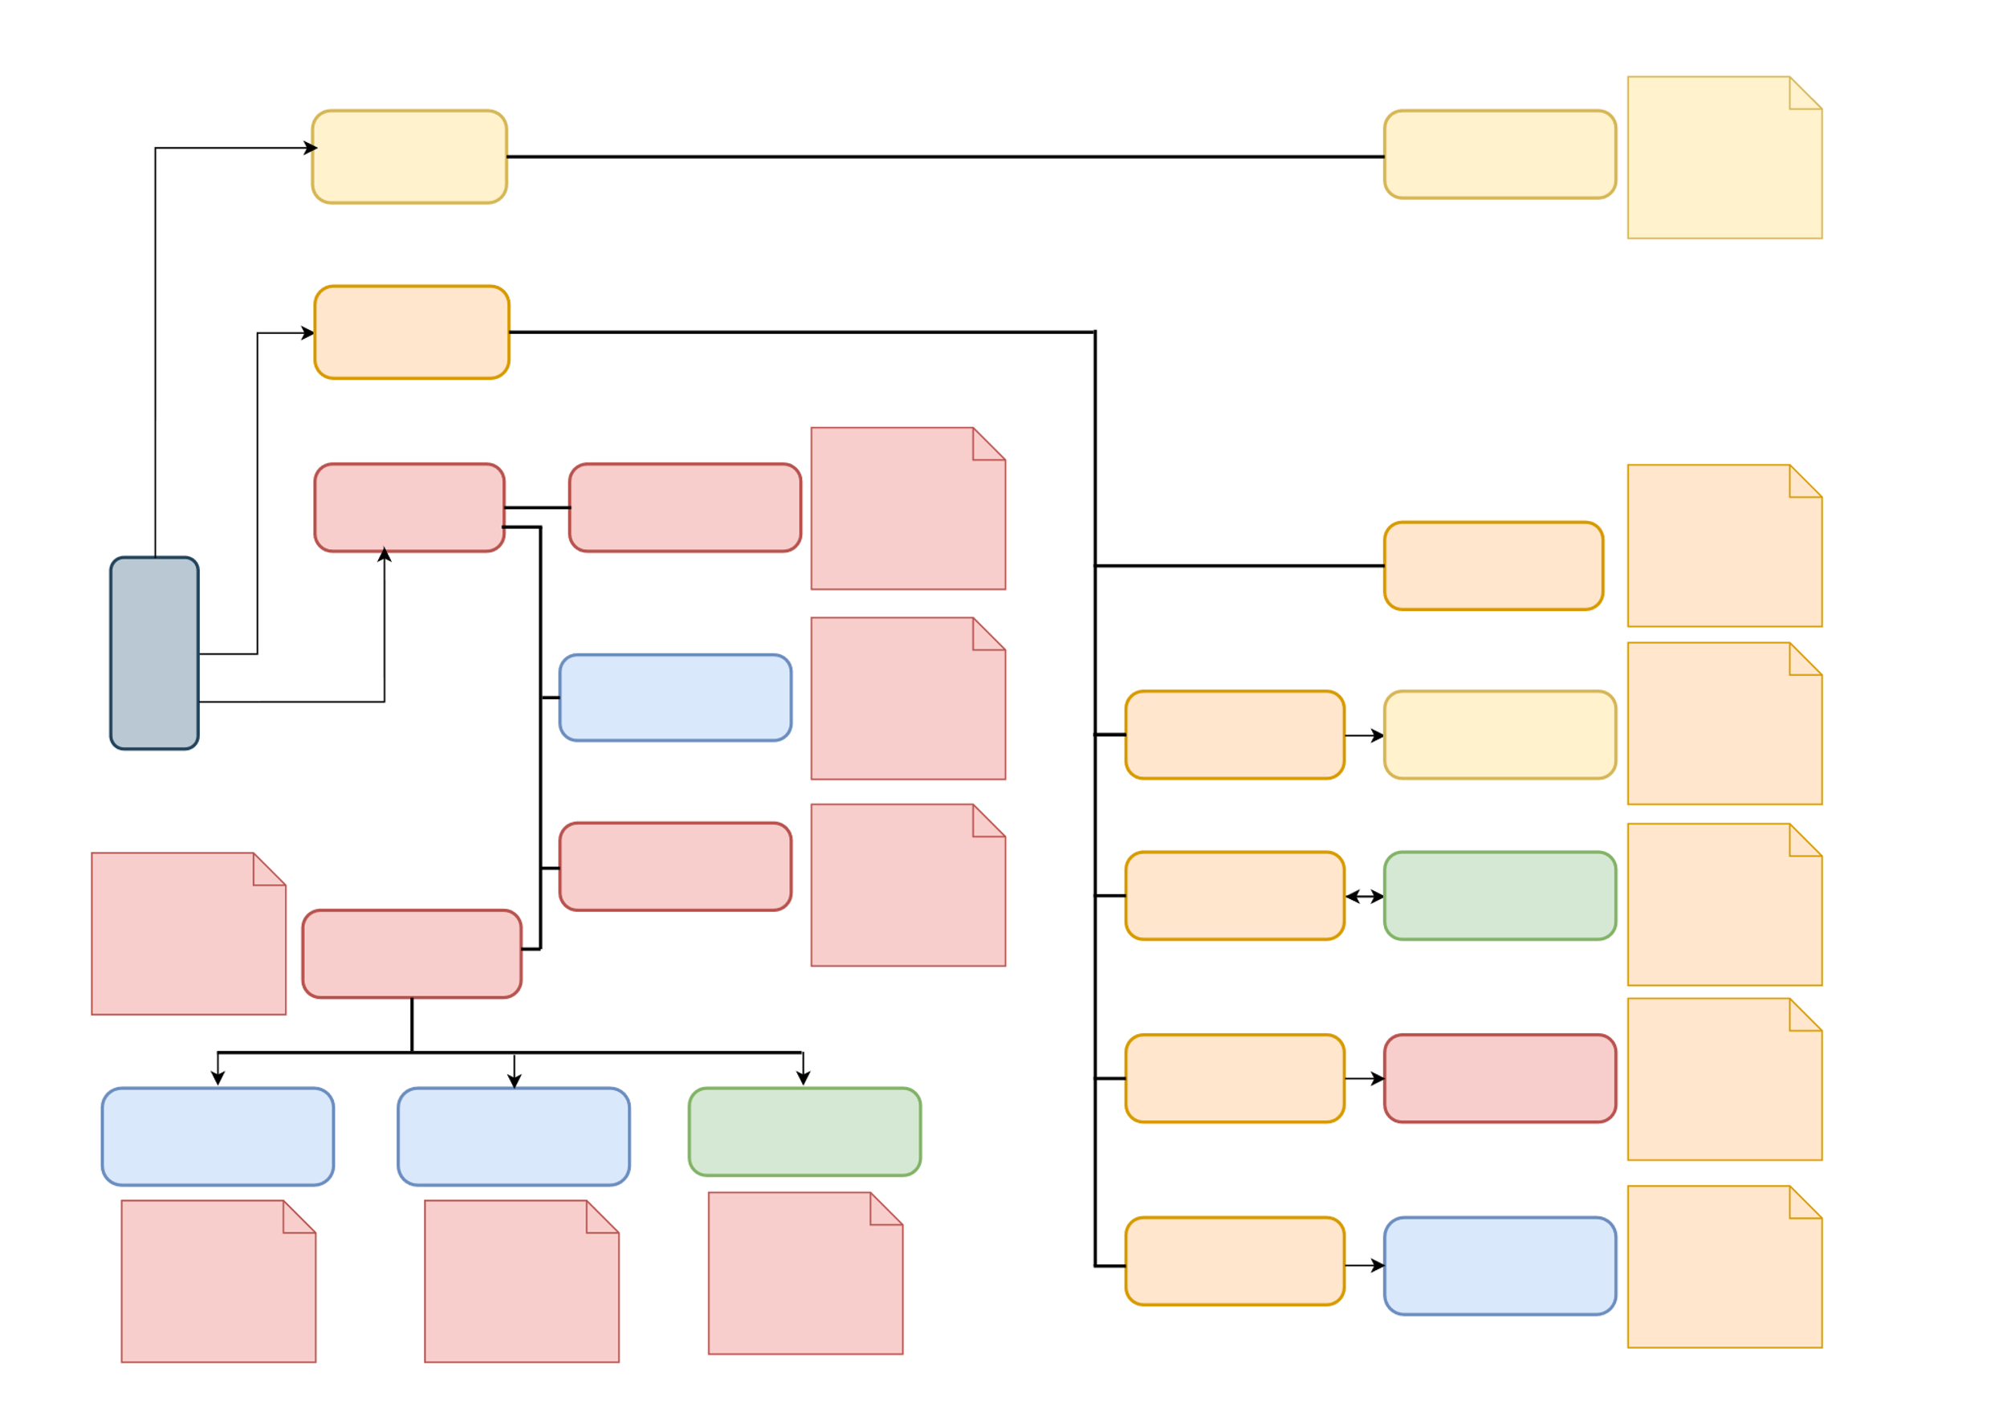
Enterprise CPE Selection
Copper
One Access 1424 NTU [As a Router]
BW under 2Mbps. Deliver IPVPN /BIL /IP Trunk
GPON
Juniper L3 Switch [SRX320]
Performance capped at 1Gbps Deliver IPVPN /BIL
/IP Trunk
Direct Fiber
BW under 100Mbps Deliver EVPN /EDL
ONT [As a L2 NTU]
Select CPE
ONE2501 [Act as a router] ** To be introduced
Performance capped at 1Gbps Deliver IPVPN /BIL
/IP Trunk
ONT [As a Bridge]
One Access 1424 NTU [As a Router CPE]
Performance capped at 30Mbps Deliver IPVPN /BIL
/IP Trunk
Juniper L3 Switch [SRX340]
Performance capped at 3Gbps Deliver IPVPN /BIL
/IP Trunk
Performance capped at 50Mbps Deliver IPVPN /BIL
/IP Trunk
ONT [As a Bridge]
Cisco ISR 4321X [Act as a Router CPE]
BW under 1Gbps Deliver EVPN /EDL
Service Switch [L2 NTU]
ONT [As a Bridge]
Juniper L3 Switch [As a Router CPE]
Performance capped at 300Mbps Deliver IPVPN /BIL
/IP Trunk
ONE421 [Act as a router] ** To be introduced
ONE521 [Act as a router] ** To be introduced
Cisco ISR 4321X [Act as a Router CPE]
Performance capped at 100Mbps Deliver IPVPN /BIL
/IP Trunk
Performance capped at 500Mbps Deliver IPVPN /BIL
/IP Trunk
Performance capped at 50Mbps Deliver IPVPN /BIL
/IP Trunk
ONT [As a Bridge]
ONE421 [Act as a router] ** To be introduced
Performance capped at 100Mbps Deliver IPVPN /BIL
/IP Trunk

Slide 9
Customer Options Explained
Option | CPE | Advantage
Default | ONE 421, ONE 521, ONE 2501 | Monthly rental-neutral for maintenance, standard performance
Brand Specific | Cisco C1121X, ISR 4321X | Higher monthly rental, for loyalists
Upgraded | Juniper SRX 320 / SRX 340 | Higher monthly rental, high performance

