Slide 1
This is your brain
This is your brain on politics

Slide 2
Political Preference Test
http://www.people-press.org/quiz/political-party-quiz/

Slide 3
Pinocchios
https://www.washingtonpost.com/politics/2018/12/14/biggest-pinocchios/?utm_term=.edecbf52849f_

Slide 4
Two ways to think about Decision Making
Reflective
Conscious
Slow
Serial
Controlled
Effortful
Rule governed
Driven by maximization of utility
Market
production
Reflexive
Unconscious
Fast
Parallel
Automatic
Effortless
Associative
Driven by empathy
Polis
Struggle of ideas

Slide 5
RAM
The rational actor model developed primarily to explain foreign policy decision making
The State is seen as a monolithic, unitary actor capable of making rational decisions
Goal Setting
Analysis of Options
Maximization of Utility

Slide 6
Problems with RAM
Unitary
A collection of bureaucracies competing for attention and resources
Thus multiple and competing goals
Viewed as a zero sum game – you win, I loose!
Politics and conflict, not rational decision making
So if not RAM, what else?

Slide 7
Findings from recent brain research
George Lakoff in The Political Mind states that 98% of our thought is unconscious (the cognitive unconscious)
Most thought therefore is reflexive not reflective
The book Blink, by Michael R. LeGault makes the same point
The adoptive unconscious

Slide 8
Daniel Kahneman in his book, Thinking Fast and Slow, distinguishes between Systems 1 and 2
“System 1 operates automatically and quickly, with little or no effort and no sense of voluntary control”
“System 2 allocates attention to the effortful mental activities that demand it, including complex computations…”

Slide 9
System 2 is our subjective sense of agency, choice, and concentration
System 2 is who we think we are – the conscious reasoning self
But, according to Kahneman, System 1 is where the action is
It is the originating source for the material System 2 works with when making deliberate choices

Slide 10
Consciousness is good, but not too much of it
David Eagleman in his book, Incognito: The Secret Lives of the Brain, notes the following
“Almost the entirety of what happens in your mental life is not under your conscious control…”
If you were conscious of most of your activity you could not in fact act!

Slide 11
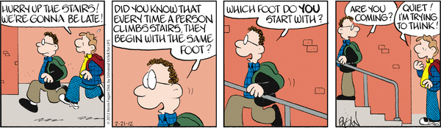
When Thinking is Bad

Slide 12
What we “see”
Eagleman also makes the point that we don’t directly perceive what’s out there, but whatever the brain tells us is out there.
Awareness only occurs when sensory inputs violate the predictive models in our heads
You only “think” about something when it is unexpected or new
You don’t think about riding your bike unless you have a flat tire
The predictive models get built up from experience – but our brains don’t tell always us what the model is

Slide 13
The Florida Effect
What happens when you are asked to construct a story using the terms Florida, forgetful, bald, gray, wrinkled?
The psychologist John Bargh asked students to move to another room for a task after they had constructed such a story with the following outcome –
THEY MOVED MORE SLOWLY THAN OTHER STUDENTS WORKING WITH A DIFFERENT SET OF WORDS!

Slide 14
The “stuff” of the cognitive unconscious (or system 1 or the adoptive unconscious)
The cognitive unconscious works through metaphor
Jim is a warm, caring, human being or Jim is a cold fish
How did temperature (something physical) get hooked up with emotion ?

Slide 15
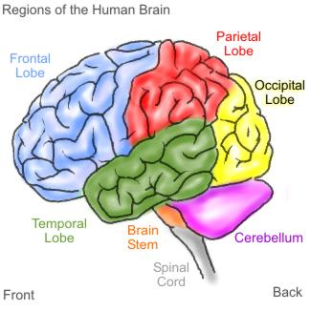
Neurons that fire together wire together
A part of the brain that characterizes temperature and a part that characterizes
affection are fired together over time and thus become wired together!

Slide 16
Metaphorical
Thought
is
Physical

Slide 17
This relates to policy process how?
Neural recruitment ( the creation of circuits from the activation of particular neurons) create complex metaphors which become bound into narratives.
Narratives are brain structures that we live out – our stories with heroes, villains, victims, etc.
Politics is about changing brains, not just changing minds

Slide 18
We Narrate the World to Ourselves
“The world makes much less sense than you think. The coherence comes mostly from the way your mind works.”
“His System 1 constructed a story, and his System 2 believed it. It happens to all of us”
The stories become hardwired

Slide 19
The Challenge
If it’s true that 98% of what we think is unconscious – this challenges the notion of the rational actor model (RAM)
It also means that how we view policy issues, how they are framed, may be related to the narratives we’ve constructed about the world rather than to an analytical process

