Slide 1
The Elements Of Framing

Slide 2
The elements of Framing www.FrameWorksInstitute.org
Context
Numbers
Messengers
Visuals
Metaphors and Simplifying Models
Tone

Slide 3
The relationship of frame to context
As we’ve seen the hippocampus is where new facts and context/source are stored
Each time we recall the fact the brain rewrites it
The reprocessing eventually moves the item to the cerebral cortex
Causing Source Amnesia
Context is lost

Slide 4
Media Manipulation of context
http://www.mediaite.com/tv/the-context-behind-nancy-pelosis-famous-we-have-to-pass-the-bill-quote/
http://www.politifact.com/truth-o-meter/statements/2010/oct/30/barack-obama/president-barack-obama-claims-mitch-mcconnell-says/

Slide 5
“The War on Terror”
Invasion of Iraq necessary – link to 9/11
Link current data and messages to long term trends
The front on the war on terror is Iraq
Interpret the data: tell the public what is at stake and what it means to neglect this problem
WMDs, Nuclear weapons development, Al Quida training camps
Define the problem so that the dots are connected
Community needs to address the problem not just individuals
Our way of life is at stake
Connect issues to root causes, conditions, and trends with which people are familiar
War on terror
Assign Responsibility
Sadam
Present a solution
Take him out

Slide 6
Numbers
If facts don’t fit the frame, it’s the frame that’s kept and the facts lose
Raw numbers seldom provide meaning
The need to use “social math” – making large numbers comprehensible and compelling by placing them in a social context that provides meaning
Iraq has cost $3 trillion
Twice as much as World War I and 10 times more than the Persian Gulf War

Slide 7
Messengers
Messengers are more effective if not seen as advocates
Unlikely allies can prompt public reconsideration of an issue or recommendation (Revs. Al Sharpton and Pat Robertson)
http://www.youtube.com/watch?v=NhmpsUMdTH8
Symbolism evoked by the messenger
9 out of 10 Doctors recommend Camels

Slide 8
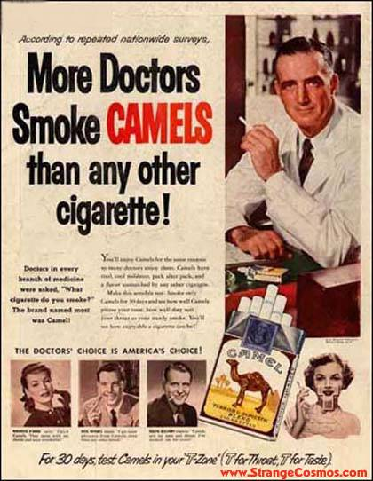
http://www.tvparty.com/vaultcomcig.html

Slide 9
Visuals
Close-up shots emphasize the personal and conceal environmental and systems-level influences
Suggest the public nature of the problem with pictures of public and community settings
Use sequence to demonstrate cause and effect and trends rather than just a series of isolated events

Slide 10
Metaphors and Simplifying Models
Connect random information to myths, ideologies and stereotypes
Hole in the ozone layer
Lakoff and Grady – Children as precious objects
Need to examine carefully the entailments of metaphors

Slide 11
Tone
Back and forth between rhetorical mode and reasonable mode
Rhetorical modes polarizes
Reasonable mode opens to problem solving
Use level one value to avoid partisan cue

Slide 12
The adoption of a decision frame is an ethically significant act!!!
Professors Daniel Kahneman and Amos Tversky wrote that in 1981, based on their experiments that showed even demonstrably false or irrelevant information can influence judgments which in turn influence decisions.
Back to those pesky neural pathways

Slide 13
Pathways to Subtraction and Emotion
For the chronically late, why does setting a time piece 10 or 15 minutes ahead work?
Can they still give you the correct time?
If so then the false time has no effect
Except, looking at the time on the time piece also produces anxiety
The anxiety is why the practice works and the false information has an effect even though we know its false
The pathways to subtraction and to emotion produce different results
(Robert H. Frank, NY Times, 5/30/10, p Bu 5)

Slide 14
The Ethics of False Framing
Shifting the terms of public debate away from relevant and important issues
Death panels
Government take over
Methods to keep framing honest
John Stewart and Ridicule
http://www.cc.com/video-clips/j0rtt7/the-daily-show-with-jon-stewart-crisis-in-dairyland---for-richer-and-poorer---teachers-and-wall-street
Unfortunately a segmented audience

