Slide 1
Rethinking the Set-Aside Requirement of the Small Business Innovation Act of 1982
Malcolm Townes
Saint Louis University

Slide 2
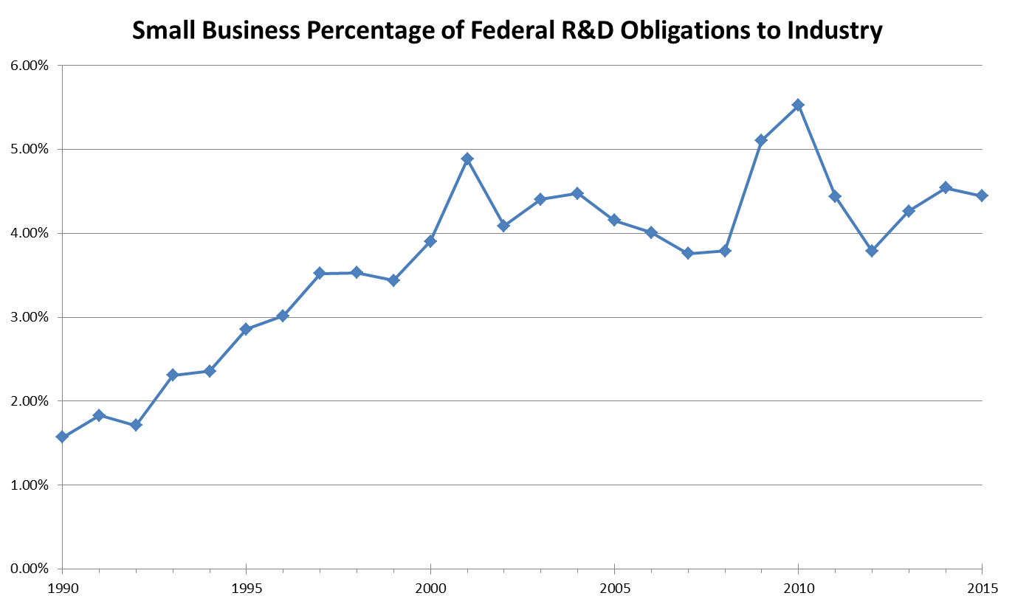
Source: www.sbir.gov

Slide 3
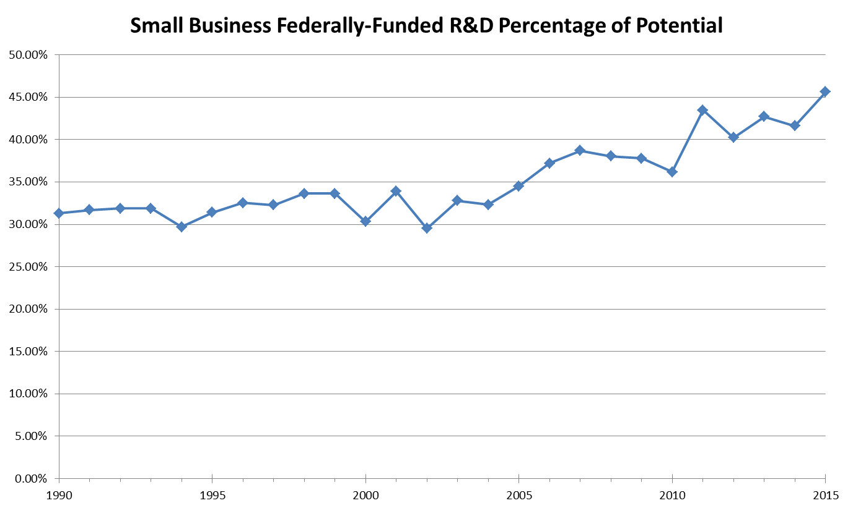

Slide 4

Notes:
We’re in a speedboat race but we’re running one of our engines at less than 50 percent and we’ve inadvertently attached an anchor to the boat.

Slide 5
Proposed Policy Change
Eliminate the minimum set-aside.
Establish bi-monthly submission cycles.
Fund up to the top 50 percent of the proposals that meet minimum criteria during each submission cycle.
Allow re-submission of proposals not funded.
Cap annual funding at 30% of extramural R&D funding.

Slide 6
References
SBIR/STTR Dashboard [data] (n.d.). Retrieved April 18, 2019, from https://www.sbir.gov/awards/annual-reports?view_by=Year
Small Business Innovation Act: 11th Annual Report. (1993). Retrieved from https://www.sbir.gov/sites/default/files/SBIR_1993.pdf

