Slide 1
Strengthening the
Small Business Innovation Act of 1982
Malcolm Townes
Saint Louis University
Notes:
Why one problem definition over another?
How the politics surrounding the issue can be managed?
What model of policy process are you assuming and why?

Slide 2
Pub.L. 97-219 Small Business Innovation Act of 1982
Original Design
Current Design
Requires federal agencies with R&D budgets in excess of $100 million to set-aside a percentage for awards to small businesses.
0.20% in fiscal year 1983
0.60% in fiscal year 1984
1.00% in fiscal year 1985
1.25% thereafter
Requires federal agencies with R&D budgets in excess of $10 billion to set-aside a percentage for awards to small businesses.
0.10% in fiscal year 1983
0.30% in fiscal year 1984
0.50% in fiscal year 1985
1.00% in fiscal year 1986
1.25% thereafter
Must be periodically reauthorized
Requires federal agencies with R&D budgets in excess of $100 million to set-aside 2.6% for awards to small businesses.
Set-aside increases 0.1 percentage point each fiscal year until it reaches 3.2%
Phase I Awards
Project duration up to 6 months
Project budget up to $150,000
Phase II Awards
Project duration up to 24 months
Project budget up to $1 million
Must be periodically reauthorized

Slide 3
Problem
The minimum set-aside acts like an anchor holding down small business participation in federally-funded research and development.
Small businesses are not receiving their fair share of federally-funded research and development awards.
The development of valuable innovations by small businesses is being systematically impeded.
The participation rate of small businesses in federally-funded research and development is essentially no different than it was prior to 1982.

Slide 4


Measurement pointer is obscured
This side can’t be less than 2.6% of your budget

Slide 5
Estimated small business participation prior to 1982

Slide 8
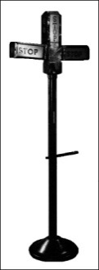
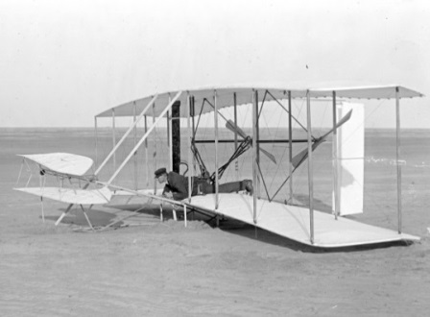
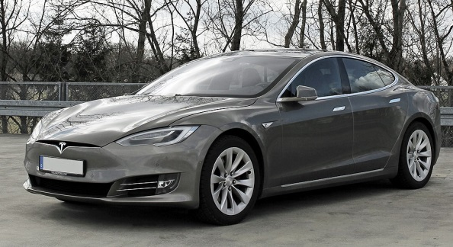

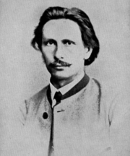
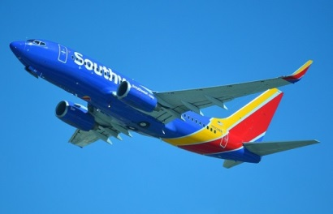
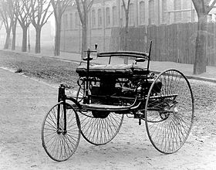
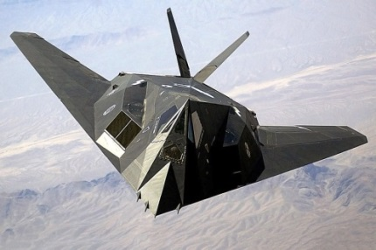
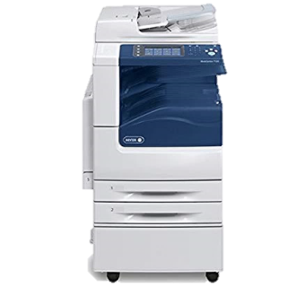
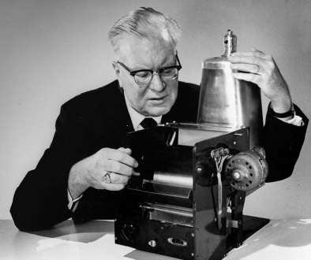
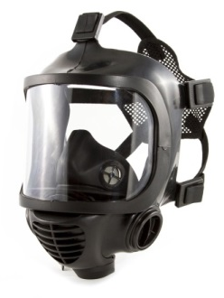

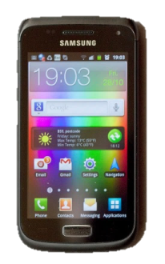
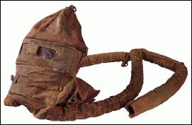
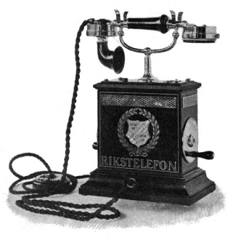
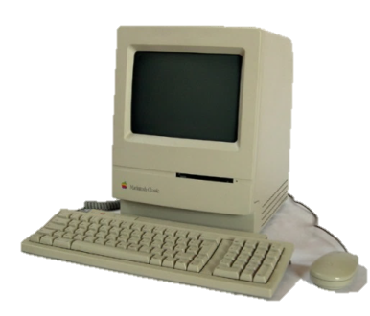


Slide 9
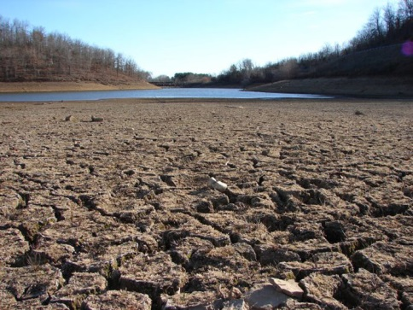
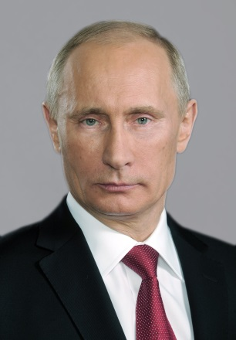


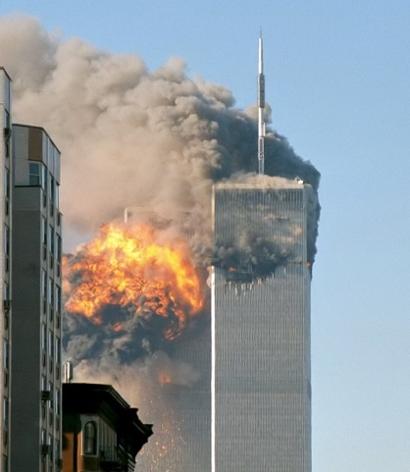
Temperature
Techno-criminals
Tyrants
Terrorism
Notes:
The four T’s (tyrants, terrorism, techno-criminals, and temperature)

Slide 10
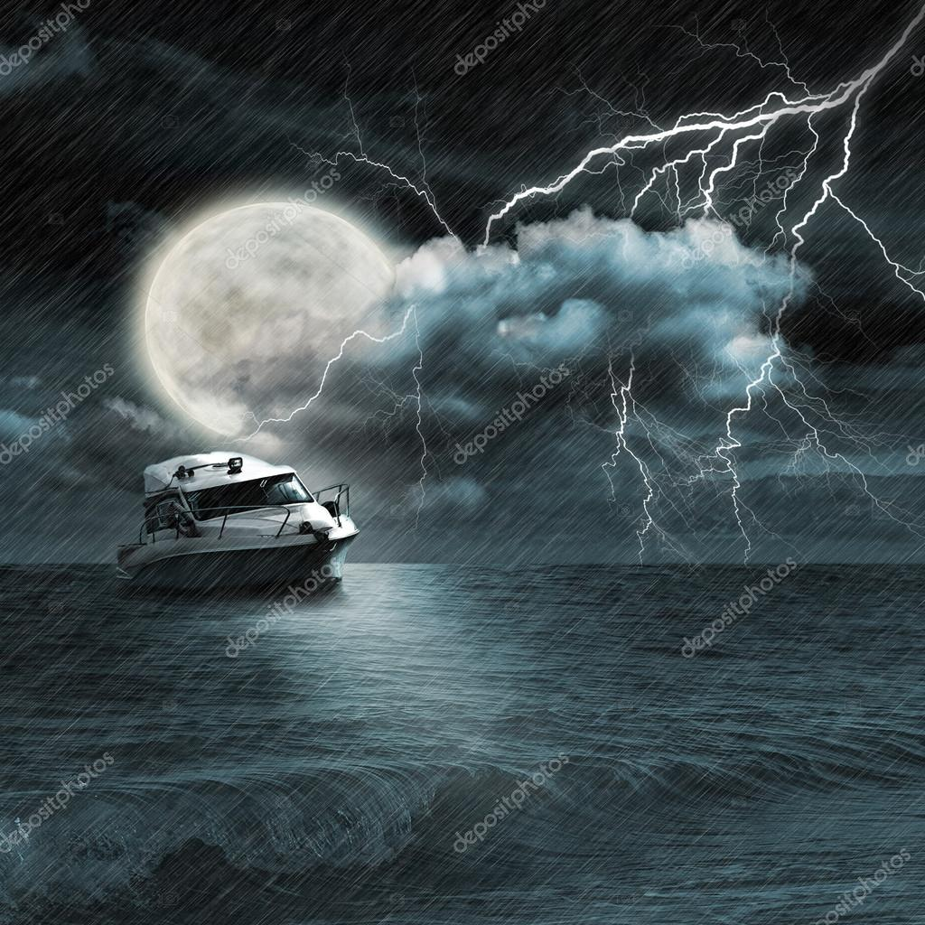

Notes:
We’re in a boat on rough waters with a storm barreling down on us. We’re running one of our engines at only 30 percent of capacity. Even worse, we’ve inadvertently dropped our anchor.

Slide 11
Proposed Policy Change
Maintain the minimum set-aside.
Nullify the de facto relative proposal ratings and enforce absolute ratings.
Fund all proposals that rate as excellent or very good, while funding is available.
Cap total annual SBIR funding at 10% of extramural R&D funding.

Slide 12










Slide 13

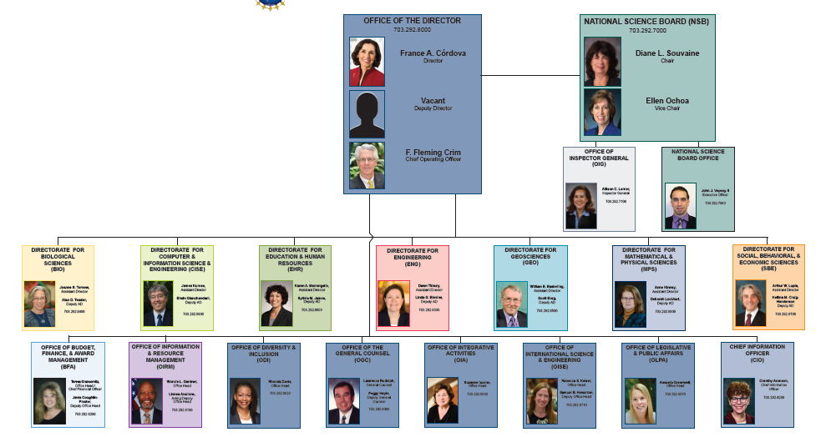
Notes:
Organization chart as of March 2019.
Use a branch approach and pilot the proposed policy change in one of the directorates.

Slide 14

U.S. House of Representatives
Members for the 116th Congress
Democratic Members:
Chairwoman, Nydia Velázquez (NY-07)
Rep. Abby Finkenauer (IA-01)
Rep. Andy Kim (NJ-03)
Rep. Sharice Davids (KS-03)
Rep. Jared Golden (ME-02)
Rep. Jason Crow (CO-06)
Rep. Judy Chu (CA-27)
Rep. Marc Veasey (TX-33)
Rep. Dwight Evans (PA-03)
Rep. Brad Schneider (IL-10)
Rep. Adriano Espaillat (NY-13)
Rep. Antonio Delgado (NY-19)
Rep. Chrissy Houlahan (PA-06)
Rep. Angie Craig (MN-02)
Republican Members:
Ranking Member, Steve Chabot (OH-1)
Rep. Aumua Amata Coleman Radewagen (AS-AL)
Rep. Trent Kelly (MS-1)
Rep. Troy Balderson (OH-12)
Rep. Kevin Hern (OK-1)
Rep. Jim Hagedorn (MN-1)
Rep. Pete Stauber (MN-8)
Rep. Tim Burchett (TN-2)
Rep. Ross Spano (FL-15)
Rep. John Joyce (PA-13)

Slide 15
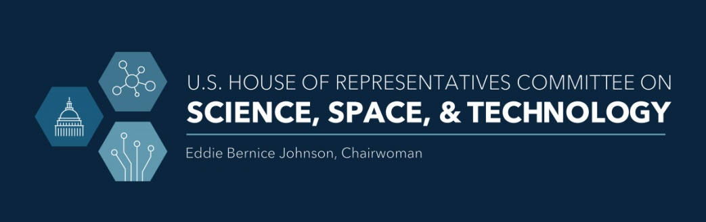
Subcommittee on Research and Technology
Members for the 116th Congress
Democratic Members:
Majority Members
Haley Stevens, D - Michigan
Dan Lipinski, Illinois
Mikie Sherrill, New Jersey
Brad Sherman, California
Paul Tonko, New York
Ben McAdams, Utah
Steve Cohen, Tennessee
Bill Foster, Illinois
Republican Members:
Minority Members
Jim Baird, R – Indiana
Roger Marshall, Kansas
Neal Dunn, Florida
Troy Balderson, Ohio
Anthony Gonzalez, Ohio
Jamie Herrera Beutler, Washington

Slide 16

Republican Members (10):
Chairman, Marco Rubio (FL)
James Risch (ID)
Rand Paul (KY)
Tim Scott (SC)
Joni Ernst (IA)
James Inhofe (OK)
Todd Young (IN)
John Kennedy (LA)
Mitt Romney (UT)
Josh Hawley(MO)
Democratic Members (9):
Ranking Member, Ben Cardin (MD)
Maria Cantwell (WA)
Jeanne Shaheen (NH)
Ed Markey (MA)
Cory Booker (NJ)
Chris Coons (DE)
Mazie Hirono (HI)
Tammy Duckworth (IL)
Jacky Rosen (NV)

Slide 17

Subcommittee on Communications, Technology, Innovation, and the Internet
Members for the 116th Congress
Republican Members:
Majority Members (14)
John Thune (SD), Chairman
Roy Blunt (MO)
Ted Cruz (TX)
Deb Fischer (NE)
Jerry Moran (KS)
Dan Sullivan (AK)
Cory Gardner (CO)
Marsha Blackburn (TN)
Shelley Moore Capito (WV)
Mike Lee (UT)
Ron Johnson (WI)
Todd Young (IN)
Rick Scott (FL)
Roger F. Wicker (MS), Ex Officio
Republican Members:
Minority Members (12)
Brian Schatz (HI), Ranking Member
Amy Klobuchar (MN)
Richard Blumenthal (CT)
Edward J. Markey (MA)
Tom Udall (NM)
Gary C. Peters (MI)
Tammy Baldwin (WI)
Tammy Duckworth (IL)
Jon Tester (MT)
Kyrsten Sinema (AZ)
Jacky Rosen (NV)
Maria Cantwell (WA), Ex Officio

Slide 18
Discussion and Suggestions
Open Discussion

Slide 19
References
“Federal Funds for Research and Development, Detailed Historical Tables: Fiscal Years 1951-2002” (2015). Retrieved from https://wayback.archive-it.org/5902/20150627201426/http://www.nsf.gov/statistics/nsf03325/
“Federal funds for industrial R&D performance, by industry and by size of company: 1953-98”. (n.d.). Industrial Research and Development Information System. Retrieved from https://wayback.archive-it.org/5902/20181004145057/https://www.nsf.gov/statistics/iris/search_hist.cfm?indx=16
“Federal obligations for research, development, and R&D plant, by category of obligation, performer, and field of scence and engineering: Fiscal years 2009 through 2017”. (2018). Available from https://nces.ed.gov/programs/digest/d17/tables/dt17_402.10.asp
The National Academies of Sciences, Engineering, and Medicine. (2000). Chapter F: National Science Foudnation Proposal Success Rates. Federal Funding of Astronomical Research. Retrieved from https://www.nap.edu/read/9954/chapter/16

Slide 20
References
SBIR/STTR Dashboard [data] (n.d.). Retrieved April 18, 2019, from https://www.sbir.gov/awards/annual-reports?view_by=Year
Small Business Innovation Act: 11th Annual Report. (1993). Retrieved from https://www.sbir.gov/sites/default/files/SBIR_1993.pdf
User: Robert. (2001). North face south tower after plane strike 9-11 [Image]. [CC BY-SA 2.0 https://creativecommons.org/licenses/by-sa/2.0] . No changes made. Retrieved April 19, 2019, from https://commons.wikimedia.org/wiki/Category:Terrorism#/media/File:North_face_south_tower_after_plane_strike_9-11.jpg
User: DavidBailey. (2009). A dry riverbed in California [Image]. No changes made. Retrieved April 19, 2019, from https://commons.wikimedia.org/wiki/File:California_Drought_Dry_Riverbed_2009.jpg

Slide 21
References
User: Lokal_Profil. (2007). Blank outline of the US [Image]. CC-BY-SA 2.5 [https://creativecommons.org/licenses/by-sa/2.5]. Photocopy effect added. Retrieved April 19, 2019, from https://commons.wikimedia.org/wiki/United_States#/media/File:Blank_US_Map,_Mainland_with_no_States.svg
User: Kremlin.ru. (2006). Official portrait of Vladmir Putin [Image]. CC-BY 4.0 [https://creativecommons.org/licenses/by/4.0]. No changes made. Retrieved April 19, 2019, from https://commons.wikimedia.org/w/index.php?title=Special:Search&limit=500&offset=0&profile=default&search=putin&advancedSearch-current=%7B%7D&ns0=1&ns6=1&ns12=1&ns14=1&ns100=1&ns106=1&searchToken=bcmpm63q76wb4lqzinwofwy4t#%2Fmedia%2FFile%3AVladimir_Putin_-_2006.jpg

Slide 22
Appendix
Supplemental Information

Slide 23
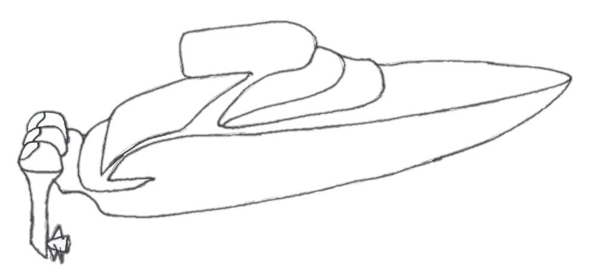
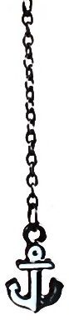
Academic R&D
Big business R&D
Small business R&D
United States
SBIR
minimum
set-aside
Notes:
We’re in a high stakes speedboat race but we’re running one of our engines at only 30 percent and we’ve inadvertently dropped our boat anchor.

Slide 24
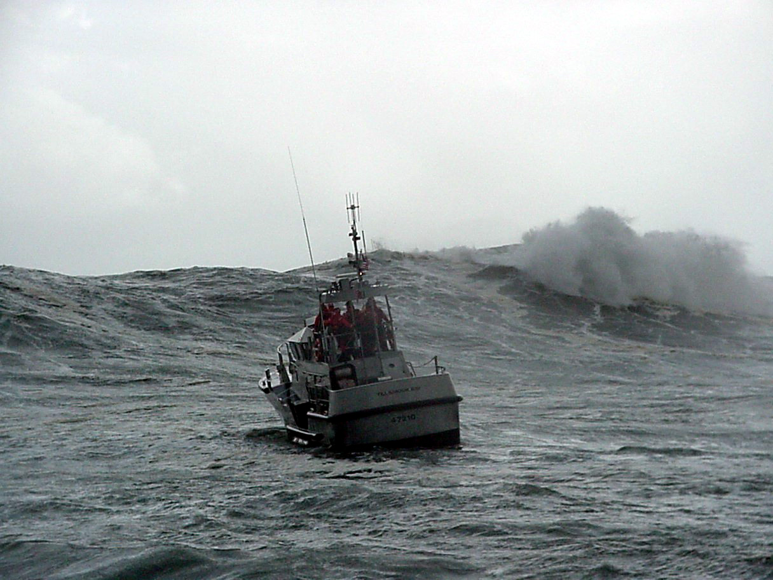
Notes:
We’re in a boat on rough waters with a storm barreling down on us. We’re running one of our engines at only 30 percent of capacity. Even worse, we’ve inadvertently dropped our anchor.

