Slide 1
Mysterious Money

Slide 2
Where we’re at
In our review of the financial melt down in 2008 and the policy responses to it, we noted that the Federal Government rather than criminally prosecuting major financial institutions, for the most part used DPA’s – deferred prosecution agreements
We also noted that major bail outs went to banks but relatively little was used to rescue mortgages that were “under water”
Thus no “perp walks” and the feeling that Wall Street won at the expense of Main Street

Slide 3
These outcomes created the feeling among many that the system was rigged in favor of the wealthy at the expense of the workers
Hence a suspicion of elites including so called “experts” and the belief that their “facts” could not be trusted
The appeal to these suspicions by certain politicians has fueled nationalist movements both in the U.S. and throughout Western Europe

Slide 4
Add the “Eyeball” Media Culture
The movement of “If it bleeds, it leads” into a social media ecosystem where the present moment can be instantly captured and disseminated, shifts media from coordinating facts to organizing and coordinating attention and emotion
Intelligence replaces knowledge

Slide 5
Characteristics of Intelligence
Emphasis on timeliness replaces emphasis on correctness
Intelligence is strategic and oriented toward directing action not toward understanding and reflection
Hence, system 2 thinking is discouraged
As William Davies notes, these characteristics are nicely illustrated by our smart devices and platforms
We give them commands, they give us results
Not understanding but a strategic outcome

Slide 6
This Affects Politics and Policy, How?
According to Davies, facts or truth telling by a political leader is less important than the belief that this person will lead me to where I want to go
This seems to capture the appeal of Trump presidency – facts are secondary to becoming great again (either as a nation or as an individual)

Slide 7
Back to the financial melt down
The belief that the system is rigged for the elite seems born out by current data
But, as we’ll see, the data raises some interesting questions
How is the rigging possible
Why do people seem to support in many instanaces those who are doing the rigging
But first, let’s look at the data

Slide 8
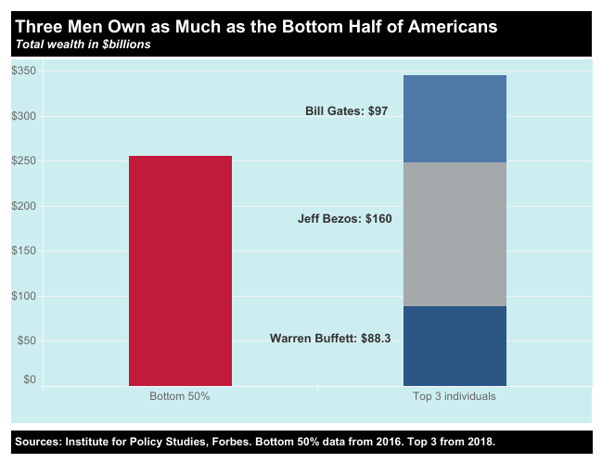

Slide 9
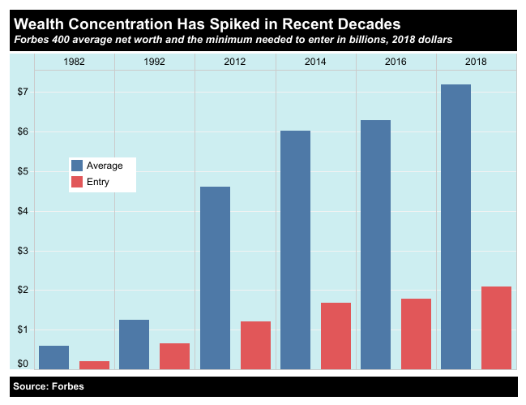

Slide 10
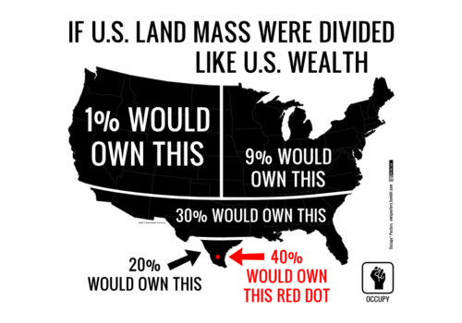
By Stephen Ewen - Own work, CC BY-SA 3.0, https://commons.wikimedia.org/w/index.php?curid=27391254

Slide 11
U.S. Bank Profits Under Dodd-Frank
Before, the most recent tax cuts and deregulations efforts, U.S. Banks scored record profits
According to the FDIC, in 2017 Bank Profits exceeded $164.8 billion
Banks paid out $121.4 billion in dividends, the highest pay out since the FDIC started keeping track in 1984
(http://money.cnn.com/2018/03/15/investing/bank-profits-senate-banking-bill/index.html, accessed 4/27/18)
Despite claims to the contrary, Banks have not been victimized by increased regulatory oversight

Slide 12
Minding Other People’s Money or Concern with the Bottom Line
The financial sector spent $2 billion on political activity in the 2016 election cycle, including campaign donations and direct lobbying (Americans for Financial Reform, http://ourfinancialsecurity.org/, accessed 4/27/18)
These totals do not include “dark money” contributions
Consequences of Political Spending and Regulatory Roll Back
Weaker consumer protections in housing and auto loans
Increased risk to the Economy
Continued growth of all ready significant profit margins in the financial industry sector

Slide 13
People who are minding our money are doing it “darkly”
Thus, we may face a situation where our own economic self-interest is being undermined as the management of wealth becomes increasingly opaque
Moreover the increasing concentration of wealth itself becomes difficult to explain – unexplained wealth is the new normal

Slide 14
Dark Money
The total amount of money spent by the financial industry for political activity is hard to gauge because of “Dark Money“ contributions
Nonprofit organizations can receive unlimited donations from corporations, individuals, and unions, spend the funds to influence elections, while not having to disclose their donors

Slide 15
Dark Money 101
Legal basis
Buckley v. Valeo (1976)
As long as the words-
vote for
elect
support
cast your ballot for
Smith for Congress
vote against
defeat
reject
were absent from a political ad or statement, they were exempt from campaign finance laws – providing first amendment protection for issue advocacy as opposed to endorsement of a particular candidate.

Slide 16
Definitions and Dynamics
Political Action Committees (PACs)
May give money directly to candidates but are restricted in amounts of money they may raise and spend
Super-PACs
May not give money directly to candidates and cannot coordinate with campaigns but have no restrictions on the amount of money they may raise or spend
Nonprofit organizations (501c - 4, 5, and 6)
Can raise and spend unlimited sums of money but do not have to disclose their donors to the public*
501c 4 – Social welfare groups who may engage in political activity as long as it does not constitute the majority of their expenditures (49.9% or less) e.g. NRA, Planned Parenthood
501 c 5 – Labor Unions and agricultural groups, same spending limits as above. e.g. AFL-CIO
501 c 6 – Business leagues, chambers of commerce, real estate boards, same spending limits as above. e.g. AMA, U.S. Chamber of Commerce
Donations to any of these groups are not tax deductible
However, contributions and fees are deductible as a business expense
The income of the groups themselves is exempt from federal income tax
*Currently donors names must be submitted to the IRS, but the Trump administration is trying to waive this requirement.
Notes:
501 (c) (4) – social welfare
501 (c) (5) - unions
501 (c) (6) – trade associations

Slide 17
So:
Like minded individuals form both a nonprofit and a PAC or Super-PAC. They give unlimited contributions to the nonprofit, which in turn gives the money to the either the PAC or Super- PAC. They in turn list the nonprofit as the donor, but the original contributors to the nonprofit remain hidden

Slide 18
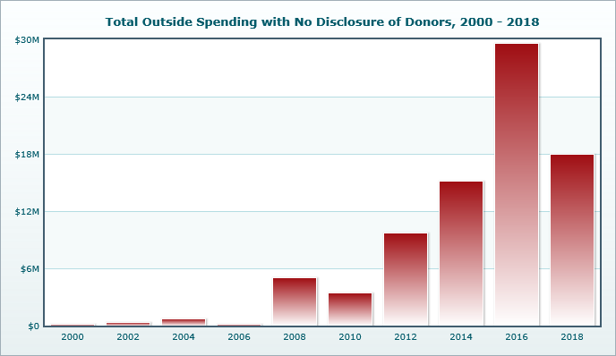
Dark Money Totals As of December, 2017 (https://www.opensecrets.org/dark-money/basics?cycle=2016&view=viewpt#spending-totals, accessed 4/30,2018)

Slide 19
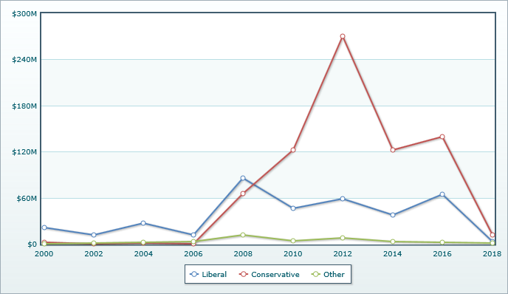
Expenditure by Type (https://www.opensecrets.org/dark-money/basics?cycle=2016&view=viewpt#spending-totals, accessed 4/30,2018)

Slide 20
Potential Points of Corruption
Neither Super PACS nor relevant non profits may have direct connection nor coordinate with particular candidates
But enforcing this has been haphazard at best
With the addition of Citizens’ United vs. The Federal Election Commission conclusion that corporations are individuals under the meaning of the First Amendment right to free speech, unlimited money to endorse candidates and positions, although independently of political parties, enhance these entities’ access to political actors
Thus, the political process becomes awash in a tsunami of corporate money
Potentially providing unfair advantage to the legislative priorities of a few at the expense of the many
And opening the door to the influence of foreign entities on American Elections and Policies

Slide 21
Be Very Worried About Who Has Access
Penalties Paid since 2000 by top banks
Top 10 Parent Companies | Total Penalty $ | Number of Records
Bank of America | $57,678,120,159 | 82
JPMorgan Chase | $29,459,836,382 | 79
Citigroup | $16,753,719,094 | 55
Deutsche Bank | $12,416,345,403 | 27
Wells Fargo | $12,385,854,147 | 66
Goldman Sachs | $9,540,317,860 | 23
BNP Paribas | $9,449,629,750 | 9
Credit Suisse | $9,154,269,714 | 15
Royal Bank of Scotland | $7,528,920,000 | 14
Morgan Stanley | $5,357,137,435 | 45
https://violationtracker.goodjobsfirst.org/prog.php?major_industry_sum=financial+services, accessed 4/30/2018

Slide 22
But now the problem of why people seem to vote against economic self interest
Libertarian think tanks are established to break the university/science community monopoly on knowledge production
The knowledge production model is spelled out by the Koch brothers
Establish beach heads at Universities funding alternative think tanks
Get ideas formerly fringe into public discussion through publishing and forums
Stress the idea of parity – if one side gets a hearing, it’s only fair that the other side gets a hearing
Then move to the policy agenda and the support of certain politicians

Slide 23
Finally, add to this intelligence gathering and social media
Cambridge Analytica
Founded by Steve Bannon and Robert Mercer
Sources of election disruption
Russia
Segmented Media
Conspiracy Theory Social Media Platforms

