Slide 1
Getting Their Attention
How Is Policy Change Possible?

Slide 2

How Did We Get From Here

Slide 3

To Here?

Slide 4
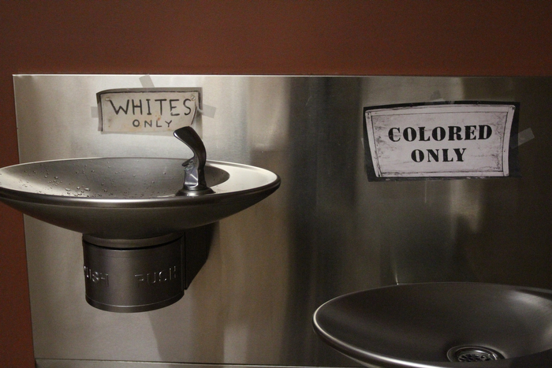
Or From Here

Slide 5
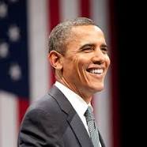
To Here?

Slide 6
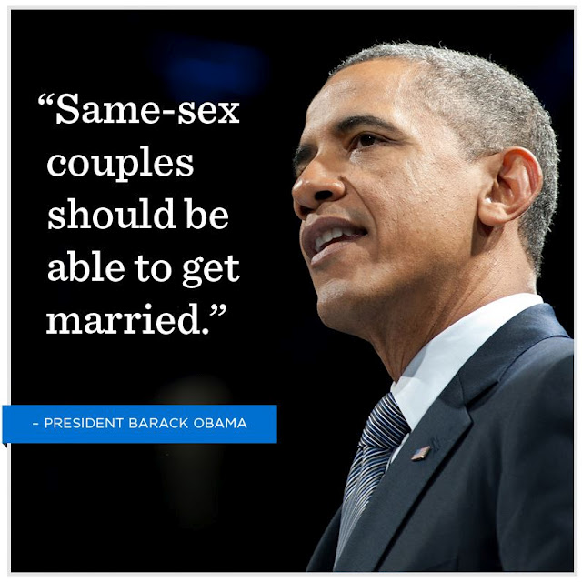
Or for that matter: To Here

Slide 7
Key question: How is policy change possible in a system that tends toward equilibrium and stasis?
Difficulty of changing core beliefs = stasis
American political institutions were designed to resist change (checks and balances)
Pluralism tends towards maintaining equilibrium
Powerful groups (Labor, business, non profits, political parties) engage in bargaining that tends toward equilibrium and/or at most incremental change
Or multiple centers of decision making with power widely dispersed making for policy silos with elites controlling what gets on the agenda with mutual non interference among themselves.
Either variation results in a tendency toward equilibrium
Despite the fact that stability and incrementalism characterize most the policy processes, occasionally there are large scale departures from past practice.

Slide 8
Five Dimensions of Policy Change
The first dimension is agenda setting
The second dimension is the nature of power
The third dimension is tools of persuasion and compliance
The fourth dimension maps the process of change through process models
The fifth dimension of change examines the role of public/private partnerships

