Slide 1
Creating Community
Toward a policy process that maximizes intrinsic utility

Slide 2

Cutting Edge Class This week in the news

Slide 3
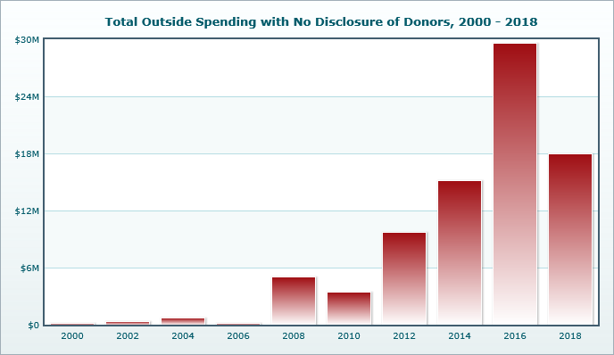
Dark Money Totals As of December, 2017 (https://www.opensecrets.org/dark-money/basics?cycle=2016&view=viewpt#spending-totals, accessed 4/30,2018)

Slide 4
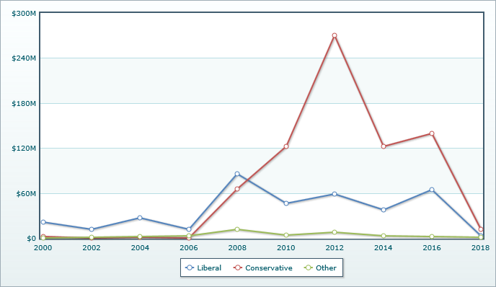
Expenditure by Type (https://www.opensecrets.org/dark-money/basics?cycle=2016&view=viewpt#spending-totals, accessed 4/30,2018)

Slide 5
But now the problem of why people seem to vote against economic self interest
Libertarian think tanks are established to break the university/science community monopoly on knowledge production
The knowledge production model is spelled out by the Koch brothers
Establish beach heads at Universities funding alternative think tanks
Get ideas formerly fringe into public discussion through publishing and forums
Stress the idea of parity – if one side gets a hearing, it’s only fair that the other side gets a hearing
Then move to the policy agenda and the support of certain politicians

Slide 6
Finally, add to this intelligence gathering and social media
Cambridge Analytica
Founded by Steve Bannon and Robert Mercer
Sources of election disruption
Russia
Segmented Media
Conspiracy Theory Social Media Platforms

Slide 7
Creating Space for Productive Policy Discussions
As work by Ostrom and her colleagues show, face to face communication can solve the common pool resource dilemma
We are wary cooperators
Once group members display trustworthiness, our desire belong creates bonds that allow problem solving
The need for third places

Slide 8
Third Places Ray Oldenburg - The Great Good Place.
Home – The First Place
Work – The Second Place
Community – The Third Place
Cheers - where everybody knows your name
Coffee Houses – emphasis on conversation
Any communal gathering spot
What’s your third place?
The suggestion that the perfect home has replaced the quest for the perfect city
Freedom to be exclusive rather than inclusive

Slide 9
Characteristics of Third Places
They are a neutral ground
They do not belong to anyone and people may come and go as they please.
The third place is a leveler
“Worldly status claims must be checked at the door in order that all within may be equals”
Conversation is the main activity

Slide 10
Accessibility and accommodation
provide a place where a person can go whenever they are free from other responsibilities and obligations of work and home and see people who they know.
The presence of regulars
regulars give a place its character and set the tone.
Third places should be plain and have a low profile
Everyone can come to the third place as they are

Slide 11
The mood of third places in playful
A home away from home
It roots those who frequent it to the community, provides a sense of belonging

Slide 12
Is social media a virtual “third place”?
Neutral Ground
Leveler
Conversation centric
Accessible
Regulars
Low profile
Playful
A home away from home

Slide 13
What it can do (or not)
Can mobilize people for action (The Arab Spring)
Can integrate people into ongoing political discourse (Twitter)
Can expand exposure to divergent points of view
Or it can do the exact opposite
Encourage inaction
Divide
Isolate

Slide 14
Implications of Virtual Power
Agenda setting is
Time pressured
Based on incomplete information
Potentially opened to all
But the emergence of a viral and mass media network that is elite
Ultimately ephemeral
Can it move things from the systemic to the institutional and decision agendas

Slide 15
Integrating third places and virtual reality
To activate System 2 thinking, the need to build and safeguard slower spheres of discussion
But using the power of social media such venues have been created
Black Lives Matter
Youth mobilized to prevent gun violence
Mobilization for the Climate

