Slide 1
What Does Ethics Have To Do With It
The problem of administrative evil

Slide 2
Administrative Evil
Administrative Evil has the following characteristics:
Ordinarily, a person is not asked directly to participate in an illegal, unethical or evil act
Rather, an evil result comes about through a person carrying out the normal functions of their organizational role.
Thus, the evil result is often masked.
If the untoward consequences of the routine function do become apparent, the trajectory of the action already established becomes harder to reverse and a moral inversion is likely to occur, redefining the action as appropriate, necessary or even good despite common sense understanding to the contrary.

Slide 3
Four Characteristics of modern society facilitate administrative evil
A complex division of labor makes it difficult to determine moral culpability for a particular outcome
Routinization of tasks dulls the feeling of curiosity and responsibility for a final outcome that is distant from a specific task performance.
Technical language is void of moral content so that words like “evil,” “bad,” “unethical,” “immoral,” “unjust,” do not appear in the work lexicon of technocratic utility maximizing organizational systems.
Systems dependent on highly complex technologies to achieve a particular end further remove the sense of moral responsibility for an evil result – system malfunction replaces moral malfunction.

Slide 4
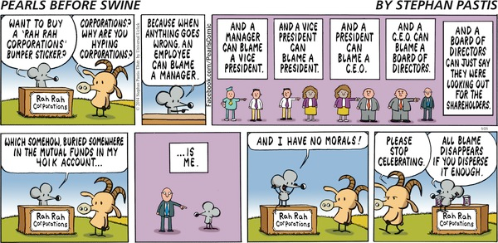

Slide 5
So how do we introduce an ethical dimension in policy debates?
How do we get ethics to matter in the formulation of policy?
Consequences for the most vulnerable among us
The use of a utilitarian ethic v. a deontology ethic
The need for a third approach in dealing with complex policy issues / a dialogic ethic

Slide 6
Explanation and fact gathering in the public arena
Not primarily for the purposes of discovering knowledge, new and better procedures, or more effective structures for achieving goals.
More for advancing a political or organizational agenda
What caused the financial melt down?
Lack of regulation
World wide economic dislocation so we can’t be sure

Slide 7
System 1 or the cognitive unconscious at the Organizational Level
Like individuals, organizations do not experience the world directly
What they experience is filtered through an organizational prism
That prism is the organizational culture or system 1 dynamics
And all organizational cultures contain paradoxes – elements that are inconsistent or contradictory

Slide 8
God, Wal-mart, and Christian Free Enterprise
Bethany Moreton, in her book, To serve God and Wal-Mart: The making of Christian Free Enterprise , nicely illustrates organizational cultural contradictions, how they’re managed, and the affects on public policy

Slide 9
Agrarian Values v. Urban Values
Urban Values
Rural Values
Consumption oriented
(the shopper – female)
Secular
Individual Fulfillment
Diverse
Corporate capitalism rather than small business
Production oriented
(the maker – male)
Religious
Family Values
Homogenous
Small business oriented (Town Square)

Slide 10
The Wal-Mart Paradoxes
A net work of Mega Stores that grew in the cultural soil of Small Town Rural America that contradicted those very values
the feminization of work (consumption over production)
Secular pursuit of wealth
Women taken outside the home
Corporate Capitalism
The only value that Wal-mart maintained was homogeneity

Slide 11
Managing the Paradoxes
Recognizing the importance of woman’s contribution to the economic stability of the farm family
Allowing the private contribution to become public
But building on the rural value of the family (not the individual) being the economic unit
Resulting in a business model built on the low wage, part-time worker

Slide 12
Adopting A Servant – Leader Model
Originally a business concept to frame work in the new service economy
Fit in nicely with the evangelical notion (Focus on the Family, etc.) of the man being the traditional head of the family but sensitive to the needs of his wife and children
He assumed the risk of ultimate financial stability
New definition of masculinity not based on production
But the boss was still the boss at home and at work

Slide 13
Based on the organizational structure of the Farmers cooperative
Although small town America waged war against chain stores, farmers had no problem with cooperatives that would increase their individual bargaining power
Wal-mart took advantage of this heritage by allowing individuals to invest in the stores and then by financing locally rather than use banks in the East

Slide 14
By keeping a homogeneous base
Customer and clerk were same social class
Consumption was for family items strengthening the family unit
Store decor was utilitarian not fancy – shopping was not a frivolous past-time
Part time work fit in with family obligations
Wal-Mart became an extension of family

Slide 15
Political Policy Implications of the Culture
The paradox of simultaneously using government resources and eschewing government oversight
Rural America depends upon government resources in the form of subsidies for crops, equipment, roads, and so on.
At the same time favors small government
Risk is socialized and profit is privatized

Slide 16
Paradox and ethics
Becoming aware of the paradox in a policy can lead to the development of a dialogic ethic
The paradox leads to conversation and an analysis of assumptions, frameworks, and sops
Can be a force for engaging in System II thinking

