Slide 1
Rethinking the Policy Design of the Small Business Innovation Act of 1982
Malcolm Townes
Saint Louis University
Notes:
Why one problem definition over another?
How the politics surrounding the issue can be managed?
What model of policy process are you assuming and why?

Slide 2
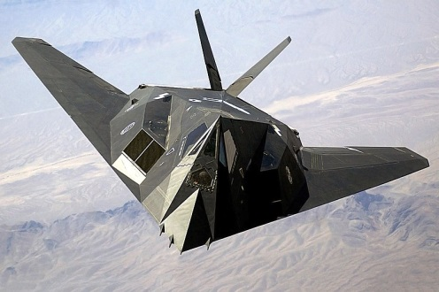
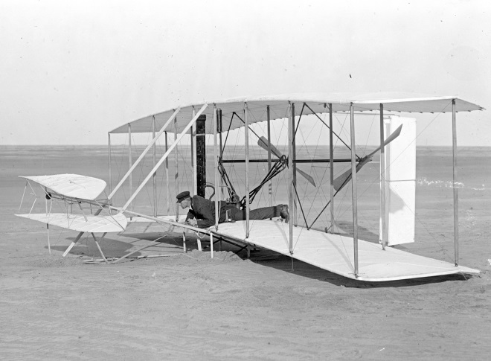
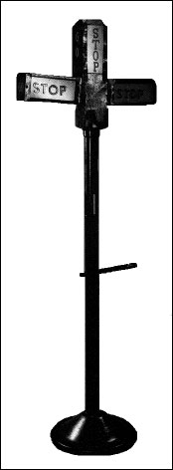
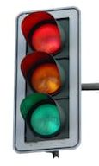
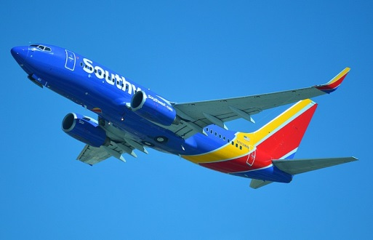
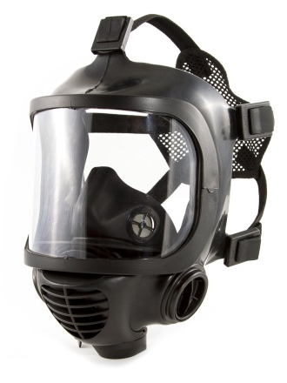
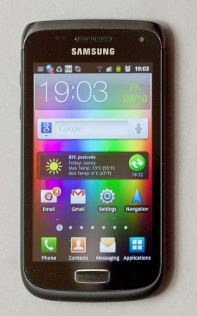
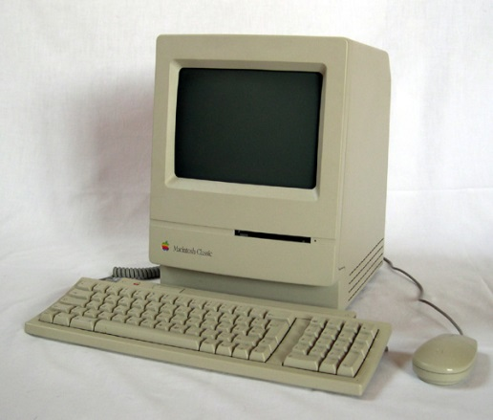
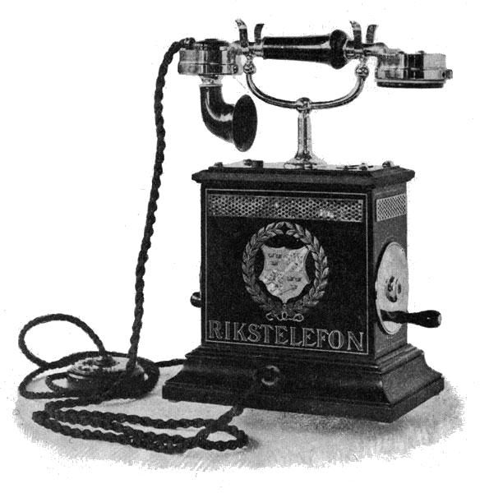
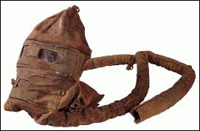

Slide 3
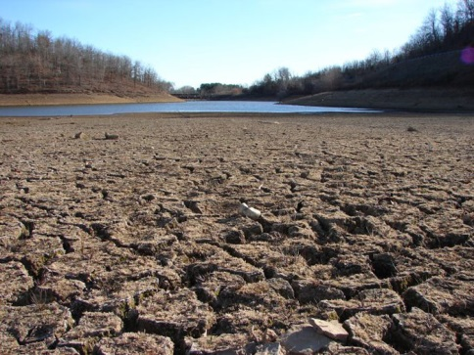
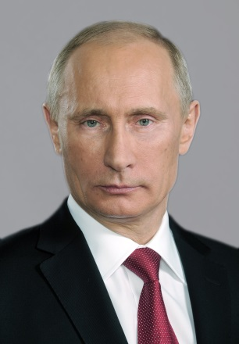
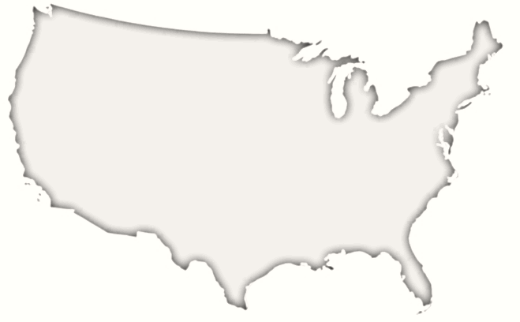
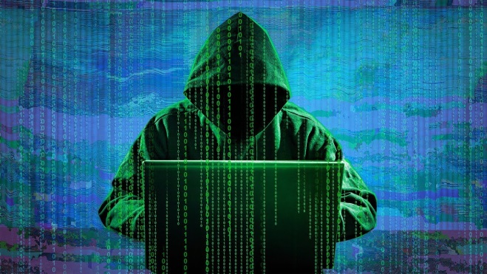
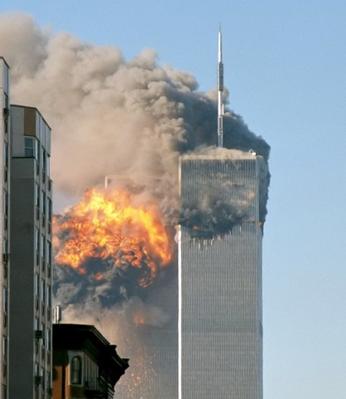
Temperature
Techno-criminals
Tyrants
Terrorism

Slide 7
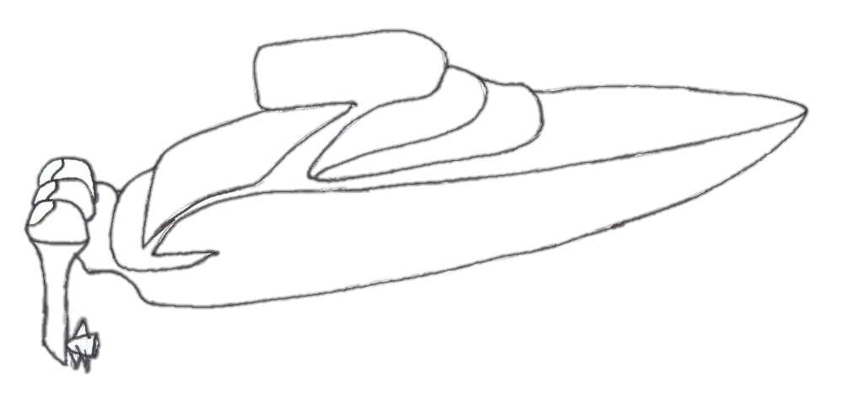
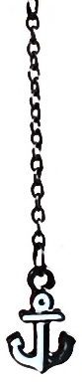
Academic R&D
Big business R&D
Small business R&D
United States
SBIR
minimum
set-aside
Notes:
We’re in a speedboat race but we’re running one of our engines at less than 50 percent and we’ve inadvertently attached an anchor to the boat.

Slide 8
Proposed Policy Change
Maintain the minimum set-aside.
Convert from relative proposal ratings to absolute ratings.
Fund all proposals that rate as excellent or very good, while funding is available.
Cap total annual SBIR funding at 15% of extramural R&D funding.

Slide 9
How to enact policy change.

Slide 10
References
SBIR/STTR Dashboard [data] (n.d.). Retrieved April 18, 2019, from https://www.sbir.gov/awards/annual-reports?view_by=Year
Small Business Innovation Act: 11th Annual Report. (1993). Retrieved from https://www.sbir.gov/sites/default/files/SBIR_1993.pdf
User: Robert. (2001). North face south tower after plane strike 9-11 [Image]. [CC BY-SA 2.0 https://creativecommons.org/licenses/by-sa/2.0] . No changes made. Retrieved April 19, 2019, from https://commons.wikimedia.org/wiki/Category:Terrorism#/media/File:North_face_south_tower_after_plane_strike_9-11.jpg
User: DavidBailey. (2009). A dry riverbed in California [Image]. No changes made. Retrieved April 19, 2019, from https://commons.wikimedia.org/wiki/File:California_Drought_Dry_Riverbed_2009.jpg

Slide 11
References
User: Lokal_Profil. (2007). Blank outline of the US [Image]. CC-BY-SA 2.5 [https://creativecommons.org/licenses/by-sa/2.5]. Photocopy effect added. Retrieved April 19, 2019, from https://commons.wikimedia.org/wiki/United_States#/media/File:Blank_US_Map,_Mainland_with_no_States.svg
User: Kremlin.ru. (2006). Official portrait of Vladmir Putin [Image]. CC-BY 4.0 [https://creativecommons.org/licenses/by/4.0]. No changes made. Retrieved April 19, 2019, from https://commons.wikimedia.org/w/index.php?title=Special:Search&limit=500&offset=0&profile=default&search=putin&advancedSearch-current=%7B%7D&ns0=1&ns6=1&ns12=1&ns14=1&ns100=1&ns106=1&searchToken=bcmpm63q76wb4lqzinwofwy4t#%2Fmedia%2FFile%3AVladimir_Putin_-_2006.jpg

