Slide 1
The Revolution Begins

Slide 2
The Revolution Begins
flexibility
1924 –Hawthorne Studies Begin
1918
Follett on organizations
1924
1933-Elton Mayo
Reports on Hawthorne
external
Internal
Classic bureaucracy
(the machine)
control

Slide 3
The Hawthorne Studies
Start in 1924 with a team supported by the National Academy of Science
Takes the perspective of scientific management
Sought to identify environmental changes that would increase productivity
Three years later they could make no sense of their findings

Slide 4
Fritz Roethlisberger takes over the story
Something was “screwy”
  The assumptions of the researchers!
  Change → Response
The researchers finally realized that the response of workers to what was happening about them depended upon the meaning they attached to the event.
  Change → Attitudes →Response

Slide 5
First Reflective Pause
The researchers begin with a model that sees the worker as just a passive recipient of environmental stimuli: a change in the environment causes a change in the worker
The second model, inserting the worker’s attitude toward the change as governing his/her reaction gives the worker agency
A move away from a key assumption of scientific management toward recognition of the worker as an active participant in the definition of workplace
What examples can you think of where the first model predominated/what examples portraying the second model?

Slide 6
A new research approach
The workers become subjects, not just objects
  “…experimenters decided to go into the shops and – completely disarmed and denuded of their elaborate logical equipment and in all humility - … learn how to get workers to talk about things that were important to them…”

Slide 7
Not an easy transition from expert to learner
“At first, they found it difficult to learn to give full and complete attention to what a person had to say without interrupting him…”
Wanted to give advice, make moral judgments, argue, be cleaver
“There followed from {this new approach} a gradually changing conception of the worker and his behavior”

Slide 8
Second Reflective Pause
This new research approach substitutes the Normative Research Paradigm (the scientist discovering laws of causality using deductive logic) with the Interpretive Paradigm (the scientist discovering how people construct reality through inductive logic)
In the first approach, reality is an objective, external phenomenon; in the second, reality is a socially constructed phenomenon, meaning there are multiple realities
From a management perspective, which approach is more appropriate? Or does it depend on the type of problem being addressed?
Final thought, who has the most expertise on being homeless? The social scientist who studies the problem or the person who lives the problem?

Slide 9
Change →Attitude ← [Personal history, social situation at work] → Response
Output as a form of social behavior
  Rate busters, chiselers, etc
The importance of the work group
  The satisfaction that comes from being accepted and recognized as people of worth by our friends and work associates

Slide 10
flexibility
Human Relations
(the family)
Internal
External
Classical bureaucracy
(the machine)
control

Slide 11
Human Relations School
Leadership
Motivation
Individuals in teams and in groups
Effects of the work Environment
Power and influence
Organizational Change

Slide 12
Third Reflective Pause
Give examples of the following alternatives as suggested by the Human Relations School
  Leadership instead of management
  Motivation as opposed to detailed rules and supervision
  Emphasis on teamwork rather than individual progress
  Less demarcation between work environment and social outlets (ping pong tables, communal snack rooms)
  Power and influence not the sole possession of the positional leader
  Significant Change requires change in work culture

Slide 13
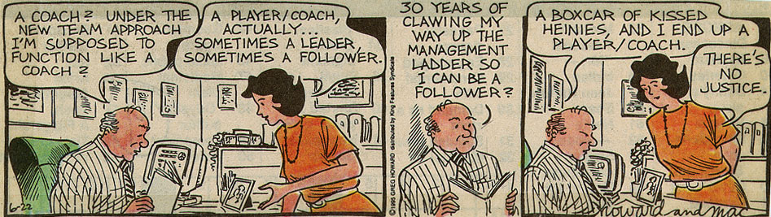
But giving up old ways is hard!

Slide 14
What is the dominant form of organization you are familiar with?
MACHINE---------------------------------------------------------------------TEAM
Notes:
P

Slide 15
Four major organizational snafus in the News this semester
Boeing
Iowa caucuses
Turmoil in the Intelligence Community
St. Louis County Police Department Discrimination Suit payout
Machine------------------------------Team

Slide 16
Fourth Reflective Pause
Along the Machine – Team continuum, where would you place the cause for each of the previous snafus – too much machine or not enough: too much team or not enough?

Slide 17
The Human Relations School in a Nutshell
A happy worker produces more
Needs of workers are similar
Self actualization is possible through work that is:
  Interesting
  Well structured
  Sufficient information
  Sufficient authority
  Opportunity to develop
  See results
  Adequate pay
  Security

Slide 18
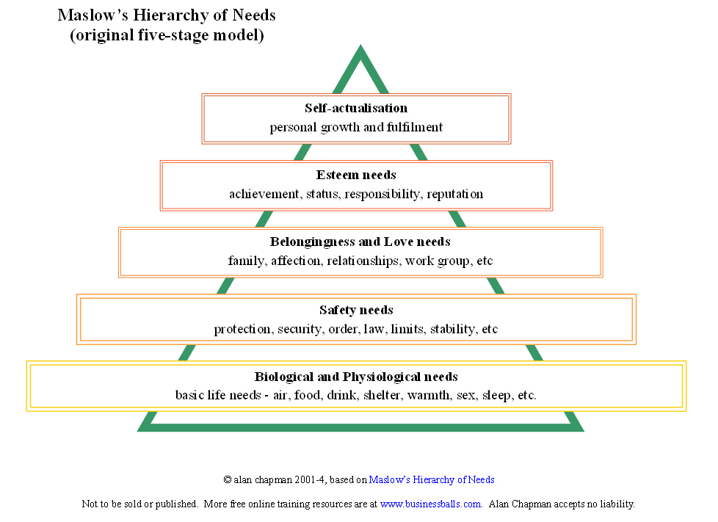

Slide 19
Douglas McGregor
Theory X
  Management organizes
  Controls and motivates
  Or people will be passive and resistant
  Average person is lazy
  Lacks ambition
  Is resistant to change
  Not very bright
Theory Y
  Management organizes
  People are not naturally lazy, resistant, unmotivated
  Management should arrange so that individual goals and organizational goals can be met together

Slide 20
Theory Z
A number of variations
  Maslow wrote a paper called theory Z
  But the most popular is Dr. William Ouchi’s Japanese management style – which itself was based on the work of W. Edwards Deming
Theory Z is a hybrid management approach combining Japanese management philosophies with U.S. culture.
Whereas Theory Y is individual, Psychologically oriented, Theory Z is group oriented

Slide 21
Elements of Theory Z (Roborto Colon, http://www.stfrancis.edu)
“A” organizations and “J” organizations
Org. Type A (American) | Org. Type J (Japanese) | Org. Type Z (Modified American)
Short term employment | Lifetime employment | Long-term employment
Individual decision making | Collective decision making | Collective decision making
Individual responsibility | Collective responsibility | Individual responsibility
Rapid evaluation and promotion | Slow evaluation and promotion | Slow evaluation & promotion
Explicit control mechanisms | Implicit control mechanism | Implicit, informal control with explicit, formalize measures
Specialized career path | Nonspecilaized career path | Moderately specialized career paths
Segmented concern for employee | Holistic concern for employee as a person | Holistic concern, including family

Slide 22
Fifth Reflective Pause
The “nutshell” version of the Human Relations School emphasizes job enrichment
  Can all jobs be enriched?
  Does everybody want an enriched job?
Unpackage each of the Models X Y and Z
  Where have you seen or experienced one or more
  Which model seems most congruent with your experience
  Consider the next slide; what are the tensions faced by organizations where there are mixed models?

Slide 23
Discussion of X,Y,Z
University tenured faculty operate in a theory Z
  Can the rest of the university?
  Are there other organizations where only a class of people can enjoy the benefits of theory Z?
Given the economic melt down in Japan in the 90’s did theory Z even work there
The universal consultant – job permanence is not assumed and all employers become “clients” (theory Y)

Slide 24
Herzberg
Two Factor Theory
Satisfiers (Motivators)
  Achievement
  Recognition
  Work itself
  Responsibility
  Advancement
  Growth
Dissatisfiers (Hygiene factors)
  Company policy
  Supervision
  Relationship with boss
  Working conditions
  Salary
  Relationship with peers
  Security
Can only motivate
through these

Slide 25
Key Points
Used Critical Incident Technique
  …we asked our respondents to describe periods in their lives when they were exceedingly happy and unhappy with their jobs
Because the factors causing satisfaction are different from those causing dissatisfaction, the two feelings cannot simply be treated as opposites of one another.
  The opposite of satisfaction is no satisfaction
  The opposite of dissatisfaction is no dissatisfaction

Slide 26
KITA* factors (dissatisfaction) are extrinsic to the work
Satisfaction factors are intrinsic to the work
Huge Assumption:
  A Happy Worker will be more productive
*Kick in the ___ (3 letters!)

Slide 27
Content Theories of the Human Relations School
(Because they relate to the contents of the job)
All based on Maslow
Intrinsic rewards
Change structure and job design to meet Maslow’s higher level needs
Salvation replaced by self actualization

Slide 28
Changing Views of Leadership
From vertical to horizontal
Both Follett and Mayo point out the importance of group process and the cumulative nature of authority
Power over is transformed to power with
  Basic needs of workers have to be met if they are to become productive members of the organization
  Responsibility/Authority rests with everybody

Slide 29
Hegel and George Herbert Mead
They are key to understanding these “new” leadership ideas as they emerge in Follett and Mayo
Hegel’s dialectic
  Thesis ← → Anti Thesis = Synthesis
    Follett’s Laws of Interpenetration, the Doctrine of the whole, integration and circular response.

Slide 30
Sixth Reflective Pause
Which of these statements is true?
  This class is like other classes
  This class is different than other classes
How does the answer to these questions illustrate Hegel’s dialectic and Follet’s notions of Laws of Interpenetration, the Doctrine of the whole, integration and circular response.

Slide 31
The emerging mind
George H. Mead 1863 – 1931 is considered to be one of the founders of social psychology and the American sociological tradition.
Spent most of his career at the University of Chicago

Slide 32
Mead is a symbolic interactionist, a major theoretical approach in sociology
  People interact with the world based on the meaning they assign to phenomenon
  They represent to themselves the meaning of an action of another
  Do not interact directly with facts/objects/reality but with interpretations (symbols)

Slide 33
Thought is symbolic behavior
  There can be no mind or thought without language
  And language is the development and product of social interaction
I and the ME
The Me is the social self – takes on the roles of others and represents those roles to the I
The I is the response to the Me

Slide 34
The self arises when the individual becomes an object to themselves
  We are objects first to other people
  Then we become objects to ourselves by taking the perspective of other people toward us
  Language enables us to talk about ourselves in the same way as we talk about other people

Slide 35
The Play Stage and the Game Stage
Children learn how to take on different roles through play (doctor, police officer, etc,)
As they advance, they move to the game stage where they have to take on the roles of everyone in the game in order to play their role appropriately.
This is the emergence of personality; the individual understands him/herself in relation to the generalize other

Slide 36
Mary Parker Follett’s circular Response and Evocation
Mayo and Follett and the importance of group process
Chester Barnard’s notion that organizational purpose is an aggregate of acts
Moves away from structure to activity

Slide 37
Tying the Past and the Present
From Weber’s notion of the influence of religion on the work ethic to more psycho/social influences
  Salvation replaced by self-actualization
But the ghost of Durkheim lurks in the writings of Elton Mayo
  Both concerned with social disorganization
  Both concerned with the effects of modernity on societal relationship
  Both use the notion of anomie

Slide 38
Mayo in a “nut-” shell
Social ills may exacerbate psychological maladjustment, but must deal with the latter to have any meaningful effect on the former
Modern industry → Social disorganization → Personal Disorganization →uncontrolled reveries/irrational obsessions /manic–depressive
  Strained interpersonal relationships
  Labor unrest
  Diminished work effectiveness

Slide 39
State must get out of the way in order to promote appropriate social growth
Education must produce an informed administrative elite – the industrial psychologist!
Knowledge of Acquaintance
  Overcoming worker isolation

Slide 40
Seventh Reflective Pause
Many of Mayo’s concerns resonate in today’s environment
  The opioid crisis
  The rise of populism
    The Donald
    Bernie
How would you apply Mayo’s insights to some of these issues?

Slide 41
The organization as a system of Exchange
Chester Barnard’s five characteristics of complex formal organizations
  Systems
  Depersonalized
  Specialized (purpose, process, clientele, place, time, person)
  Contain informal organizations
  Use an environment-oriented decision process
Authority is relational – the acceptance of an order defines authority not its issuance
  Zone of indifference

Slide 42
Creating the Commons
Power Over Power With
Suppression of Conflict Synthesis through conflict
Rational Individualism Non rational Group Belonging
From Isolation To Neighborhood, City, State, Nation
Internal concerns Recognition of the Environment

Slide 43
Spatial Challenges to the Commons
What are these:
  # Me Too
  Tahrir Square
  Tiananmen Square
  Berlin Wall
  Washington Mall
What do they have in common?

Slide 44
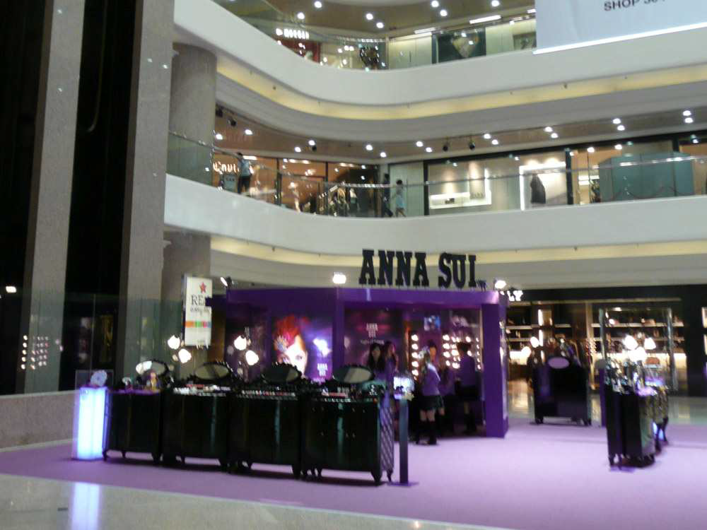
The Development of Mass Private Property

Slide 45
The Commons has a spatial dimension
It’s place based (either an actual physical space or cyber space)
Need to network to develop common understandings
The more controlled space is, the less gatherings can occur that can form a commons
Third places are social – but are too small to be a commons exercising agency

Slide 46
The New Office Geography Based on the idea of a commons
https://www.behance.net/gallery/5316591/JWT-NY

Slide 47
Eighth Reflective Pause
The notion of a commons – a place where people can gather to develop solutions to complex problems, and exercise political efficacy, flows from the writings of Follet, Mayo and others in the human relations school
Third places (Ray Oldenburg) are local gathering spots like coffee houses or taverns, but our not large enough to foster agency
Do you have experience with a commons, spaces where people gather to form collectives that tackle a significant issue?

Slide 48
Other Challenges to the Commons
The curious case of the disappearing fish
  the stock of large fish (tuna, cod, marlin and swordfish) has fallen 90% over the last fifty years.
  Catches are increasing
    Better technology for both locating and harvesting the remaining supply
    ( Ransom A. Myers and Boris Worm, “Rapid Worldwide Depletion of Predatory Fish Communities,” Nature 423 (May 15, 2003): 280-283
But Fish are a renewable resource

Slide 49
Individuals Acting Rationally Can Produce a Collectively Irrational Outcome
Catching the 27-pound female red-snapper pregnant with over 9 million eggs
  If you owned or controlled the whole fishery:
    For the long-term viability of the resource, throw it back
  If the resource is shared in common
    It is rational to keep the fish
Why these outcomes?
  (Charles Wheelan, Introduction to Public Policy, Chapter 4)

Slide 50
Negative Externalities: A cost on society that does not have to be paid by the party generating the externality
  The private costs and benefits of some activity are different than the social costs
  Making it rational to engage in activity that benefits the few at the expense of the many

Slide 51
The Problem of Property Rights and the Commons
A property right is a legal right to exercise control over some resource
But with a shared resource, property rights are ambiguous, undefined and difficult to enforce
Transaction costs will affect the ability to manage the commons
As the commons gets more complex, transaction costs increase – the free rider!

Slide 52
Final Reflective Pause
Many of our current organizational/political problems can be framed as managing a commons
  Climate change
  Cyber space
  Spatial inequalities in education, health care, community safety
  Urban Sprawl
What does the human relations school suggest as ways to deal with the challenges of a commons?

