Slide 1
From Machine to Team
Organizational Culture

Slide 2
So what does the Commons have to do with organizations?
Flexibility
The Team
Open systems
The organism
Internal
External
The Machine
The Planner/The Firm
Control
Robert E. Quinn, Beyond Rational Management, Jossey – Bass, 1988

Slide 3
First Reflective Pause
Organizations are complex and consist of multiple cultures related to our organizational map
There may be one dominant culture and some sub cultures that are either in sync or not in sync with the dominant culture – i.e. they can be oppositional sub cultures
A commons allows people to come together to relate across organizational boundaries
Examples from your own organizational experience?

Slide 4
Key questions regarding culture
What is the concept of culture?
What elements construct it?
How do you study it?
What are the practical consequences?
What are the relationships with our readings?
How do organizations change their culture?
What is the link between culture and ethics in an organization?

Slide 5
Uncovering Culture
The different definitions of culture
1. Van Maanen and Barley: Culture is a living, historical, product of
group problem solving.
(form follows function but then function at times gives way to form)
2. Linda Smircich

Slide 6
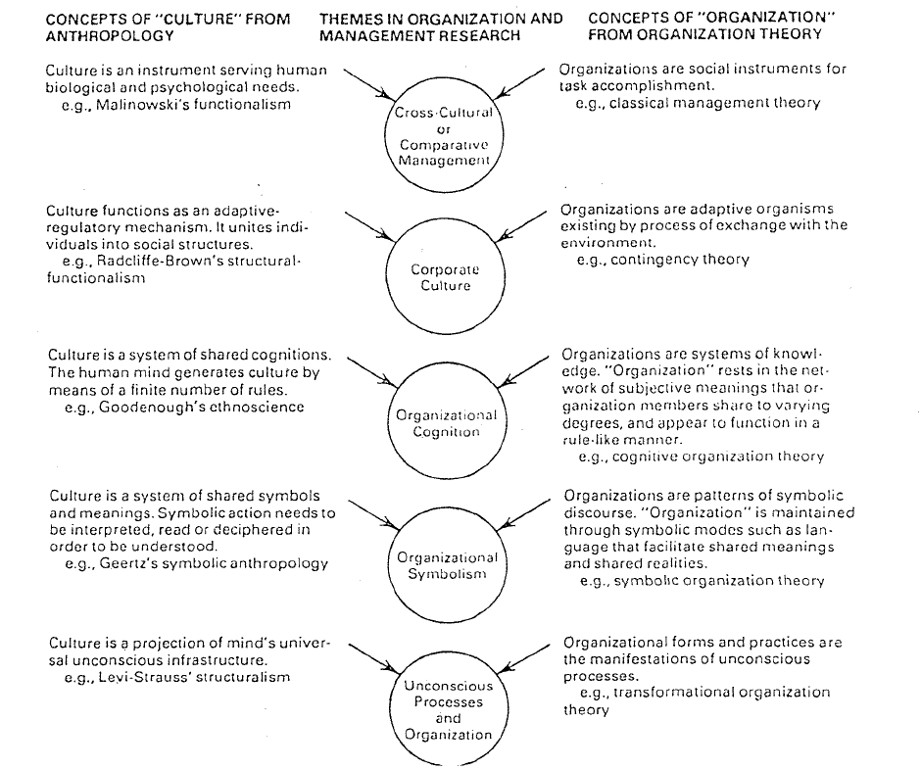
Concepts of Culture and Organizational Analysis
Author(s): Linda Smircich
Source:
Administrative Science Quarterly,
Vol. 28, No. 3, Organizational Culture (Sep., 1983)
339-358

Slide 7
Second Reflective Pause
A fun exercise (ok, maybe fun is too strong a term!)
  Given the five different cultural concepts, where would you place
    Theory X Y Z
    Follet
    Mayo
    The fact that we didn’t have to learn to “do class”
    The proliferation of University Library Technology Commons

Slide 8
Culture as a mind set
Recent concern about government monitoring of citizens is not really recent!
  (NSA) had been monitoring both the phone calls and the telegrams of American citizens…for decades
From a 1975 congressional hearing
  “…the intelligence agencies have regularly collected information about personal and political activities irrelevant to any legitimate government interest “ (Church Report, April 27, 1976)
Cultures do not change easily!
(The Invisible Bridge: The Fall of Nixon and the Rise of Reagan, Rick Perlstein 2014)

Slide 9
Elements of Culture
Deal and Kennedy:
1. Environment
2. Values
3. Heroes
4.Ceremonies/play/
ritual
5. Networks
Schein:
Artifacts
Values
Basic assumptions

Slide 10
Ritual/ceremonies
artifacts
Environment
Basic Assumptions
values
The iceberg theory of culture – only some cultural elements are visible above the
surface

Slide 11
Deal and Kennedy/ Environment
Degree of risk
High Low
Macho
Sales
High
Low
x
x
Degree of Feedback
x
x
Bet your company
Process

Slide 12
Third Reflective Pause
Deal and Kennedy are trying to classify organizational cultures by degree of feedback (high – low) and degree of risk (high – low), resulting in a four-cell description of culture types.
Can you give an example of an organization that would fit in each cell?

Slide 13
Other Deal/Kennedy Elements
Values are found in slogans and status assignments
Heroes provide an insight into culture
Ceremonies/play/ritual
Cultural roles:
The Storyteller – passes on the anecdotes and history of the organization
Priests – guardians of tradition (“that’s not how it’s done around here”)
Whisperers – knows where the bodies are buried
Gossips – key nodes in the SLUmer mill
Spies – reports organizational doings to people outside your group
Cabals – groups of two or more who promote each other or
a unified set of ideas to the higher ups to gain favor

Slide 14
Fourth reflective pause

Slide 15
Ways and examples of how to study organizational culture
Inventories - Quinn and Cameron – questionnaires that inquiry about culture
Participant observation – actually becoming a member of the culture to observe
e.g. for my doctoral dissertation, I became a member of a police academy class
Collecting Cultural Stories

Slide 16
Organizational Stories
It turns out that there are a finite number of cultural organizational stories: These
Seven story themes appear universal
Rule Breaking
Is the Big Boss Human
Can the little person rise to the top
Will I get fired
Will the organization help me when I move
How will the boss react to my mistake
How will the organization deal with obstacles
Each story has two versions – the particular version (outcome) helps define the culture
From Martin, Feldman,Hatch, and Sitkin
ASQ 28 1983

Slide 17
Fifth Reflective Pause
How would the stories turn out in your organization?
(E.G. Does the boss break the rules or follow them like everybody else? Does the boss help out when all hands are needed regardless of the task or remain the boss? Etc. )

Slide 18
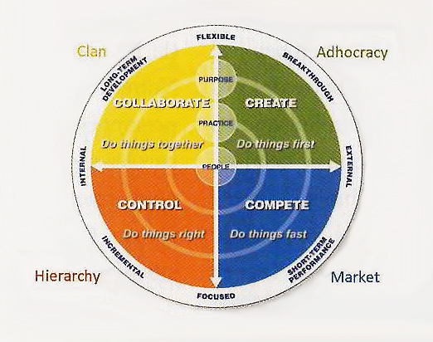
Quinn and Cameron
A Cultural Elaboration

Slide 19
Reflective Pause Six to Eighteen
The next twelve slides asks you to rate your organizational culture and your leadership style, allowing you to map them according to the Quinn and Cameron cultural types

Slide 20
Diagnosing your organizational culture
1.
Dominant Characteristics (Divide 100 points)
  A._____ A is a very personal place. People seem to share a lot of themselves
  B._____ B is a very dynamic place where people experiment and take risks
  C._____ C is a very formalized and structured place. Bureaucratic procedures govern what people do.
  D.______ D is a very competitive place. A major concern is getting the job done. People are very production and achievement oriented.

Slide 21
2.Organizational Leader
A._____ The head of A is generally considered to be a mentor, a kind of parent figure.
B._____. The head of B is generally considered to be an innovator, or risk taker, always willing to try new things.
C._____ The head of C is generally considered to be a coordinator, an organizer, or an efficiency expert.
D._____ The head of D is generally considered to be a hard driver, focused on competition and getting things done.

Slide 22
3.Organizational Glue
A. _____The glue that holds A together is loyalty. Cohesion and teamwork are characteristic.
B._____ The glue that holds B together is a focus on being cutting edge, being the first to try something new.
C.______ The glue that holds C together is formal procedures, rules, and policies. Emphasis is on keeping things smoothly running.
D.______ The glue that Dept D together is an emphasis on achievement and aggressively pursuing goals

Slide 23
4. Organizational Climate
A._____ The climate inside A is comfortable and a place where high trust and openness exist
B._____ The climate inside B emphasizes dynamism and readiness to meet new challenges. Trying new things and trial and error learning are common.
C._____ The climate inside C emphasizes stability with clear expectations regarding procedures and what’s expected.
D. _____ The climate inside D is competitive and confrontational. Emphasis is on winning.

Slide 24
5. Criteria of Success
A._____ A defines success in terms of team work and developing each person to achieve their own potential. Concern for people is highly valued.
B._____ B defines success on the basis of being unique and innovative.
C._____ C defines success as having an orderly, predictable, smoothly running unit where disruptions are kept at a minimum
D._____ D defines success as being number 1 in comparison to other units

Slide 25
6.Leadership Style
A._____ In A the leadership style is characterized by teamwork, consensus building, and participation
B.______ In B leadership fosters uniqueness, freedom, and innovation.
C.______ In C leadership is characterized by adhering to rules, procedures and emphasizing stability
D._____ In D leadership stresses competitiveness and achievement.

Slide 26
Organizational Profile
Total Organizational Points Assigned
Average Points for
A__________ /6
B__________ /6
C__________ /6
D__________ /6
A_________
B__________
C__________
D__________

Slide 27
Flexibility
Internal
External
Control
Map your organization on this grid according to the scores given each criteria

Slide 28
Leadership related to culture
Very Infrequently 1 2 3 4 5 6 7 Very Frequently
  1.Listen to the personal problems of subordinates
  2.Meticulously review detailed reports
  3.Influence decisions at higher levels
  4.Do problem solving in creative, cleaver ways
  5.Clearly define areas of responsibility for subs
  6.Display a whole hearted commitment to the job
  7.Facilitate consensus building in work group sessions

Slide 29
  8.Protect continuity in day-to-day operations
  9.Compare records, reports, and so on to detect any discrepancies in them
  10.Show empathy and concern in dealing with subs
  11.Set clear objectives for the work unit
  12.Search for innovations and potential improvement
  13.Work on networking with influentials
  14.Insist on minimum disruption of work flow
  15.Reflect high motivation for my role
  16.Encourage participative decision making

Slide 30
The Facilitator
  # 7___ and 16___ T___
The Innovator
  # 4___ and 12___ T___
The Producer
  #6___ and 15___ T___
The Coordinator
  #8___ and 14___ T___
The Mentor
  # 1___ and 10___ T___
The Broker
  #3___ and 13___ T___
The Director
  #5___ and 11___ T___
The Monitor
  #2___ and 9___ T___

Slide 31
Mapping your leadership style
Map your leadership style according to the scores in each category

Slide 32
Where we are at
Culture is important for understanding a variety of organizational elements
  Leadership style
  The case of transformational leadership
  Ethics of the organization
  Time
  Space
  Ability to read the environment
  Organizational form

Slide 33
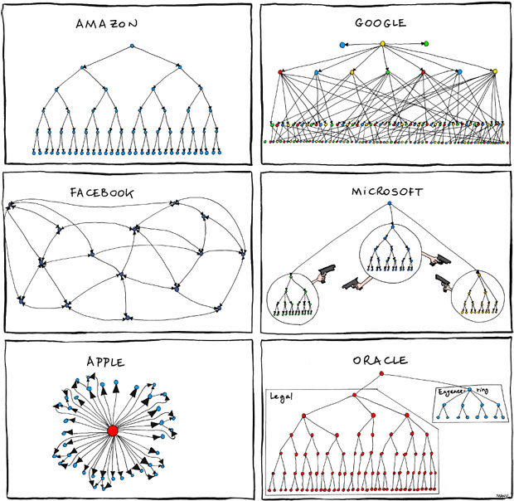

Slide 34
Culture Plus
Culture is a necessary but not sufficient condition for explaining success or failure of an organization
The case of Tandem
  Tandem was famous for its unique Silicon Valley company culture
  The goals of that culture were formalized in a 'Tandem Philosophy' class for new employees in 1980 and refreshed in 1983:^{[27]}
    An employee-oriented workplace.
    Sustained profitability.
    High customer satisfaction.

Slide 35
Beer Busts
Tandem's weekly beer busts were the most visible sign that this company was a bit different. These had keg beer, wine, soft drinks, popcorn, unshelled peanuts, and good conversation. Besides being fun, they encouraged employees of different groups and levels to mix and learn what others in the company needed. The CEO was always present and accessible.

Slide 36
The End
Tandem's spectacular growth stagnated due to saturated markets, economic slowdowns, and the costs and limitations of the main product line.
As a nearly anonymous division within Compaq and now HP, Tandem's culture is now just history.
You can’t escape the influence of the environment

Slide 37
Connecting the Dots: Leadership, Culture, and Ethics
Barnard makes the point that the executive is responsible for the creation and inculcation of an organizational moral code.
Most large organization have developed codes of codes of conduct
Such codes are the product of the rationalization of processes and the dominance of bureaucracy as described by Weber.

Slide 38
The Meta Narrative: A One Size Fits All Ethics
Rationalism in Western Society assumes a single meta narrative
  Efficiency/Free Market Economy is the way to maximize the greatest good for the greatest number
Leads to a utilitarian/ consequentialist ethic
Unfortunately, application of such an ethic can have an unintended, unethical consequence
  People treated as means to an end rather than as an end in themselves
  The bus not the bus driver is important
  Trolleyology

Slide 39
The Corrective: Deontology
Duty to universal principles
  E.g. The golden rule/treat others as you wish to be treated
  Code of conduct: Be impartial in dealing with suppliers; decisions based on fact not personal, relationships

Slide 40
Reflective Pause 19
Please read the article “When Deontology and Utilitarianism Aren't Enough: How Heidegger's Notion of "Dwelling" Might Help Organisational Leaders Resolve Ethical Issues Author(s): D. Ladkin Source: Journal of Business Ethics, Vol. 65, No. 1 (Apr., 2006), pp. 87-98”
Then proceed to work the following slides

Slide 41
The Case Study
Jake and Max
What should Jake do?
Which of the two major ethical frameworks are you basing your decision on?
Do you feel good about your decision?
Is there a third Way?
WWMPFD? (What Would Mary Parker Follett Do?)

Slide 42
Mary Parker Follett
Circular Response, Evocation, Integration
Intellectual roots in Hegel – Synthesis
Philosophically aligned with Heidegger as well
Heidegger’s notion of “dwelling with”
  STAYING WITH
Not rushing to a solution
  Waiting to see how reality catches up with appearance
Consequentialism assumes knowledge

Slide 43
Back to Jake
How much did he really know about Max’s situation?
  The need to find out more
  Be open in conversation
In actually talking to Max he found out that the account executive responsible for the Vimex account had left the company
New solution emerges/Vimex loans a staff member to Saide for six months
(When Deontology and Utilitarianism Aren’t Enough: How Heidegger’s Notion of ‘‘Dwelling’’ Might Help Organisational Leaders Resolve Ethical Issues, D. Ladkin (Journal of Business Ethics (2006) 65: 87–98 _ Spring 2006)

Slide 44
Lessons for Leadership and Ethics
Leadership is highly situational – Follett’s idea of “law of the situation”
  Hence her emphasis on functional leadership, rather than positional or personality
Ethics of leadership also has to be open to the situation
  In some situations neither of the major ethical frameworks work
Feminist ethics or the “ethics of care”
Carol Gilligan – men focus on objective truth, women on nurturing relationships

Slide 45
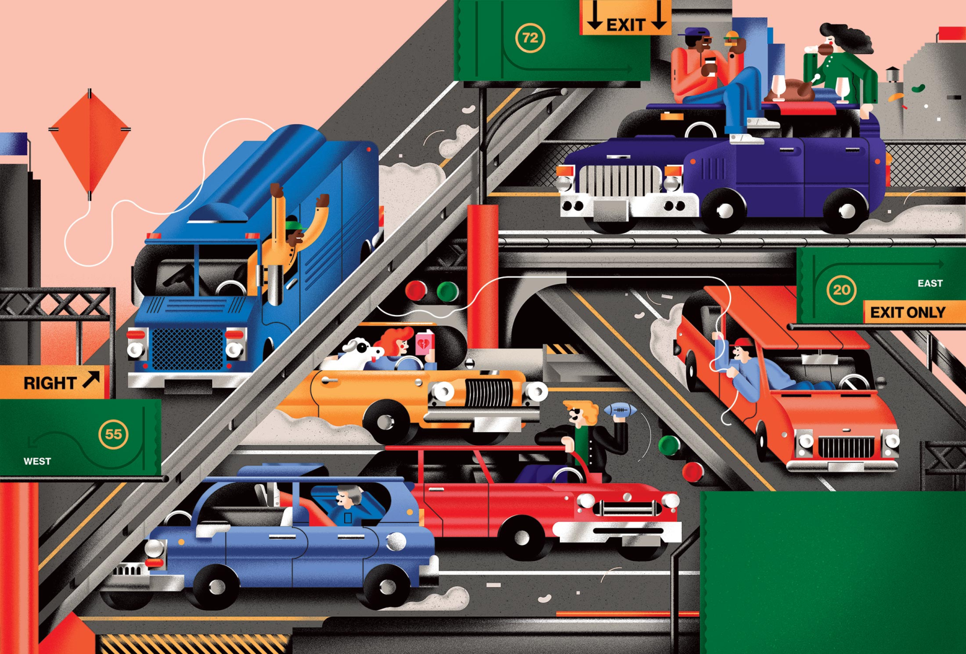
Can Detroit Beat Google to the Self-Driving Car?

Slide 46
What Do Self Driving Cars Have To Do With Ethics?
They will have a built in Ethics Algorithm
  Utilitarianism
  Deontology
Researchers at MIT,U of Oregon, and Toulouse School of Economics asked potential consumers what they would prefer
The trolley problem applied to a new technology
  Ten people suddenly appear in the road
    Swerve into a wall avoiding the people but killing the owner
    Or save the one but kill the many

Slide 47
What do Folks decide
(http://www.washingtonpost.com/news/morning-mix 10/28/2015)
Support the Utilitarian/Consequentialist Algorithm
But they thought manufactures would opt for saving the passenger, regardless of the number of lives that would be lost
Most respondents supported buying self driving cars that estimates suggest would save over 21,000 lives (a utilitarian calculation)
  But were less willing to buy such cars themselves
  Who would want to buy a car that could kill them?

Slide 48
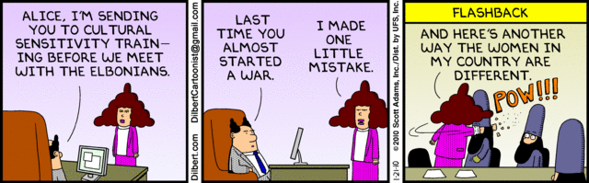
Ethics of Researching A Culture

Slide 49
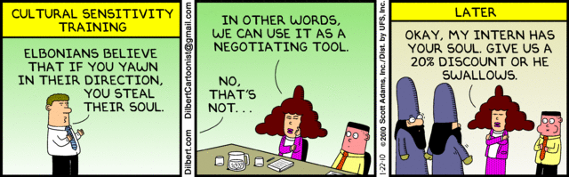
Ethics of Researching a Culture (cont.)

Slide 50
The Importance of the Hyphen In Cultural Research
Cultural research involves a relationship
You – and - ?
The key question in organizational research is
“Who is the client?”
  How will the information be used
  Will someone win and someone lose as a result of uncovering culture
  What is the ethical obligation of the researcher

Slide 51
Ways to work the -
Vertically – the expert in the ivory tower
Horizontally – evaluation research
Hermeneutically – a circular relationship
Each of these relationships has its own ethical challenge

Slide 52
The vertical axis
The Hawthorne studies start out framed by Taylorism
  The worker as object
  The goal to increase productivity (i.e. management is the customer)

Slide 53
The horizontal axis
This is one way to think about Follett and Barnard – authority is cumulative and organizations are systems of exchange
Ethical dilemma for a researcher however -
Do you serve the interest of the client no matter the ethical/moral consequences ?
Who is John Yoo?

Slide 54
Ethical Challenges in Circular Relationships
Particularly problematic in studying marginal organizations
  Gangs
  Blue collar ways of organizing work
“Othering”
Narrative Affirmative Action

Slide 55
Final Reflective Pause
Each of the relationship described have their own ethical challenges
Have you seen or participated in situations of the type described below?
  In the interest of efficiency an employee was treated as an object rather than as a partner in decision making/just get a decision made and move on
  As a consultant, a report was framed to meet the needs, desires of management (who after all are paying the consulting fee) rather than an objective report that may have contained some negative information
  As a researcher, perhaps inadvertently contributing to a negative stereotype and further “othering” a group

Slide 56
Summary of Cultural Models
Cross Culture – Corporate Culture - Organizational Cognition - Symbolism – Unconscious Processes
X-Y-Z
Deal/Kennedy
Macho, Bet your
Company, Sales,
Process
Doing Class
Organizational
Stories
CYA. Be Suspicious
(Shared knowledge
Rules, Scripts)
(Shared reality)
Rituals, ceremonies, artifacts
Values Basic Assumptions
F
Clan
“do it together”
Entrepreneurial
“do it first”
I
E
Bureaucratic
“do it right”
Market
“do it fast”
C

