Slide 1
Organizations, Mental Health, and Ethics
Spring, 2020

Slide 2
What comes to mind when you hear the name:
Equifax
  145.5 million personal financial information hacked
  Homeland Security notifies company of a data breach on March 9, 2017
    Scan by company on March 15 fails to detect vulnerability
    Hackers begin to access information on May 13
    July 30, Equifax disabled compromised Web application ending the hacking
  Since disclosure – stock down 31%, fines likely between $500 million to $1 billion
Harvey Weinstein Studio
  Sexual predator
  Known for sexual harassment activity for over thirty years
  During that time, he paid in excess of $800,000 to settle claims and company is being sued for $5 million for knowingly facilitating his behaviour

Slide 3
Volkswagen
  Emissionsgate – cars programmed to activate emissions controls only during laboratory emissions testing
  In place from 2009 through 2015
  Cost to company as of October, 2017, $23billion
Wells Fargo
  Employees created 2 million sham accounts generating $1.5 million in fees
  Practice began in 2011
  5,300 lower levels employees fired in September of 2016; company fined $185 million by consumer protection bureau and $85 million in assorted other fines

Slide 4
What do these organizational failures have in common?
“…large scale failures can only be produced if time and resources are
devoted to them (Turner, ASQ, vol. 21, No. 3, 1976)
Major organizational failures have an incubation period – there is
failure of foresight

Slide 5
First Reflective Pause:
The argument being made is rather astounding – organizations expend considerable effort to produce major failures! Do you believe it/why or why not? What examples can you find that demonstrate the argument being made?

Slide 6
Major Organizational Screw Ups Are Predictable
General Motors failed for years to recognize a safety defect in millions of small cars
  Recalled 2.6 million cars in 2014 to fix the defect
  But An August 2001 memo noted the defect in the ignition power switch
  13 deaths and 54 accidents
NASA managers had known that the design of the Solid Rocket Booster (SRB)contained a potentially catastrophic flaw in the O-rings since 1977
  The failure of the O-ring caused the 1986 Challenger disaster
During the launch of Columbia's 28th mission in 2003, a piece of foam insulation broke off from the shuttle’s external tank and struck the left wing. Most previous shuttle launches had seen minor damage from foam shedding, but some engineers suspected that the damage to Columbia was more serious.
  NASA managers limited the investigation, reasoning that the crew could not have fixed the problem if it were confirmed.
  Seven Astronauts perished on reentry

Slide 7
In March 1979, a sticky valve at the nuclear plant on Three Mile Island mislead operators into shutting off the system that would have prevented a nuclear meltdown.
  The sticky valve issue was known about at least a year and a half earlier, but the builder had not realized it’s significance (Four cases from a summary by Matthew L. Wald, International N.Y. Times, 6/10/2014, p.12)
BP Documents Show Early Worries on Rig
  “…in March…BP was struggling with a loss of well control…and as far back as 11 months ago, it was concerned about well casings and the blow out preventer” (NY Times, 5/30/10)

Slide 8
Three elements need to be examined to understand organizational snafus/fubars/and tarfus
The individual human element
  Purposeful deception, fraud, evil intent – the bad apple theory
The element of organizational cultural
  Norms and values of the organization
    “That’s just the way it is; that’s how we do things around here.”
The structural element – how is the place organized
  Division of labor, task specialization, compartmentalization by function = diffusion of responsibility – the Holocaust problem and administrative evil

Slide 9
Second Reflective Pause:
Ethics is often considered an individual challenge. As you review the next slide, construct an ethical concern that each position incumbent should consider given their role.

Slide 10
The rational organization and the division of labor
Job description:
  I am responsible for scheduling all rail transport, passenger, freight, and special trains.
  I am responsible for records, creating, updating and keeping track of files of people under government jurisdiction.
  We are responsible for heavy equipment maintenance (pipe fitters, boiler makers, welders)

Slide 11
The Holocaust Is An Example of Administrative Evil
The holocaust could not have happened without the people in the previous slide doing their ordinary jobs!
Modern organization stress technical, rational competence
Leads to a division of labor and specialization
Organizational tasks are compartmentalized
Thus a diffusion of moral responsibility
The Banality of Evil

Slide 12
Third Reflective Pause
When you consider ethics from the level of organizational structure, an individual’s ethical responsibility changes.
Make a second list of ethical concerns for each of the positions using an organizational rather than individual perspective. How does this list compare with the first?

Slide 13
Individual purpose, culture, and structure are also involved in change or lack thereof
Individual Human Element
  People who challenge rules and customs vs
  The need to belong and be liked
The cultural element
  The need for new ways of seeing the world vs
  Security
Structural element
  Error adverse structures vs
  Error tolerant structures

Slide 14
While we separate the three elements for analytical purposes, in fact they all occur and interact together
Sources of Change
Elements
  Diversity
    Gender
    Generational
    Racial
    Ideas/Ideological
  Technology
    AI
    Social Media
  External Environment
Human Actor
Organizational Culture
Organizational Structure

Slide 15
Organizational Folk Heroes Are Those Who Challenge the Status Quo
People who demonstrate exceptional skill
  Captain Chesley Sullenberger
People who demonstrate exceptional political courage to change systems
  Rosa Parks, Nelson Mandela
The Bandit Hero – “I won’t take it anymore!!”
  Steven Slater
The whistler blower
  Edward Snowden – Hero or traitor?

Slide 16
Whistle Blowers have been in the news previously and now big time
Anonymous – the Impeachment
Chelsea Manning
Edward Snowden
Bob Cocker
Jeff Flake

Slide 17
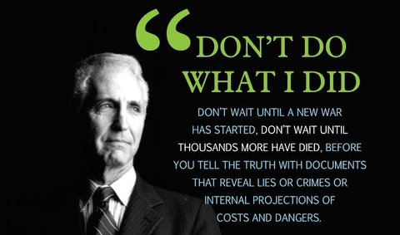
An add campaign in Washington, D.C.

Slide 18
The whistle-blowing campaign is the work of ExposeFacts.org,
an off-shoot of the liberal activist Institute for Public Accuracy,
which is promising more posters — for Wall Street and Silicon Valley workers,
too —in an attempt “to shed light on concealed activities that are relevant
to human rights, corporate malfeasance, the environment, civil liberties
and war.”

Slide 19
Fourth Reflective Pause:
We will be discussing whistle blowing quite a bit, but it might be worthwhile at this point to consider your personal
Organizational Preferences – What does your organizational self prefer?
Rocking the boat and agitating for improvement or wanting to be liked and feel accepted?
  Look for new ways to consider processes and tasks or liking routine and the sense of security and competence it
  provides?
  Answers to these questions will determine your own capacity for whistle blowing.

Slide 20
What are the conditions that make organizations ripe for whistle blowing?
Success breads failure
Complacency
  Failure to examine routines’ relevancy to changing circumstances
Arrogance
  Nobody can do what we do
Tribalism
  “Companies aren’t families. They’re battlefields in a civil war” Charles Duhigg, The Power of Habit

Slide 21
To understand why organizations fail to recognize changing circumstances, risking turmoil and failure, we turn to Research Methods!!
What is Type I Error:
  rejecting the null hypothesis when it should be accepted
  in plan English, detecting a pattern where none exists
What is Type II Error:
  accepting the null hypothesis when it should be rejected
  in plan English, failing to see a pattern
What does this have to do with organizations?

Slide 22
So why do organizations seem to miss patterns?
Pressure to Avoid Type I error
If you plan for patterns that are not there you
  Decrease efficiency
  It’s costly
  Too many false positives affect productivity
Think TSA at Airports
Trade off between productivity and reliability
“Airport Security, High Reliability, and the Problem of Rationality,” H. George Frederickson and Todd R. LaPorte, Public Administration Review, v. 62 (September, 2002), pp. 33-43

Slide 23
What happened on 9/11 at Logan International Airport?
10 Type II errors
At Newark International Airport – 4 Type II errors
At Dulles, 5 Type II errors
Patterns were missed – “it can’t happen here”
  Accepting the null hypothesis when it should have been rejected

Slide 24
What kind of Error was common in the cases we’ve looked at (Equifax, NASA, General Motors, etc.) ?
Type II error
Accepting the null hypothesis when it should have been rejected i.e. failure to see a pattern or to see the significance of a problem beyond its immediate manifestation

Slide 25
Ways to think about eliminating errors
Classical Model
  Hierarchy
  Control
  Rules
  Efficiency criteria (Avoid Type I Errors)
Redundancy Models
  Backup duplicative systems
  Loose Coupling (Avoid Type II Errors)
Error tolerant organizations vs. error adverse organizations

Slide 26
Which one is Disneyland?
https://www.youtube.com/watch?v=sWK9RwGTWNA
Characteristics of High Performing Organizations (Error Adverse)
  Adequate Funding
  Strong Collective Sense of Mission
  Complex Technologies and patterned interactions between these technologies and their human operators
    Training that is continuous
    High level Entrance Standards
    Established protocols
    Emphasis on the development of teams that are collegial, flexible, and a decentralized authority pattern
    “Airport Security, High Reliability, and the Problem of Rationality,” Ibid.
The decision making network and the information distribution network must match
  Complex technologies require integration not siloing
  The significance of complex technical/ structural information requires integrated communication networks
Three elements affect the integration of the networks
  Organizational Structure i.e. Silos discourage integration
  Culture i.e. Executives Known to Shoot the Messenger
  Individual Personalities and Relationships i.e. knowing the politics of getting along / going along to get along or rock the boat

Slide 27
Fifth Reflective Pause:
What kind of organization do you belong to? Risk Adverse or Risk Tolerant? What is your basis for this
Assessment?
Are Risk Adverse Organizations necessarily the best? “Uncle” Walt, as we’ll see, was actually pretty mean
to his employees. Steve Jobs was notorious for his lack of compassion for employees at Apple, and Jeff Bezos
of Amazon has created organizational systems that foster high stress among workers.
Thus there are counter pressures to move towards risk tolerance – it can be cheaper and less stressful and, at least
Initially seem more efficient. Think of Airport Security again/ right after 911, everybody was screened – now we
have TSA preapproved boarding/ shorter lines but more error tolerance.

Slide 28
The efficiency/reliability vicious circle
Productivity model found wanting (Type II Error)
Organizational crisis
System becomes less error tolerant
Move from productivity to reliability model
Avoiding Type II errors becomes costly
As time from crisis lengthens, pressures to increase efficiencies
Concern with Type I error becomes dominant, organization more error tolerant
Move back to productivity model

Slide 29
Stages in Failure of Foresight
Normal = culturally accepted beliefs about the world
and its hazards, and these are codified in laws, norms etc
Incubation period = unnoticed sets of events accumulate at odds with accepted beliefs about hazards and avoidance
3. Precipitating event
Onset = consequences of collapse of cultural precautions become apparent
5. Rescue and salvage
6. Full cultural readjustment

Slide 30
The efficiency/reliability vicious circle has both social and psychological consequences
From the perspective of society major organizational failures erode trust
From the perspective of the individual, organizational life has significant periods of dissatisfaction

Slide 31
Trust in American Institutions
http://news.gallup.com/poll/1597/Confidence-Institutions.aspx

Slide 32
HAVE YOU EVER HEARD THE PHRASE -
“ Going postal”
“Good enough for government work”
“Too much bureaucracy”
“SNAFU”
“FUBAR”
“TARFU”
Organizational SNAFUS lead to individual alienation

Slide 33
Sixth Reflective Pause:
What do each of these terms mean – what does it say about organizational life as we experience it?

Slide 34
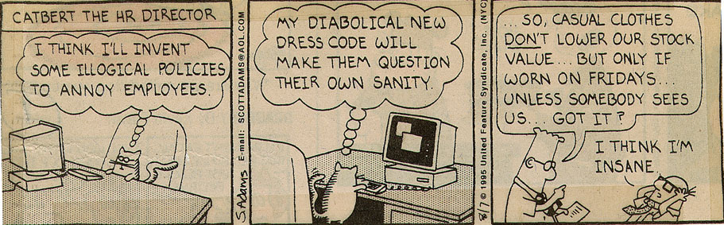
Alienation from the Bosses

Slide 35
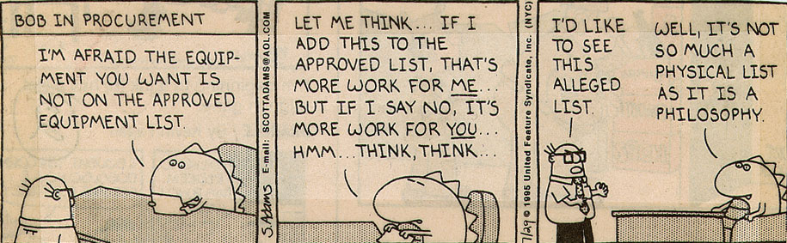
Alienation from Processes

Slide 36
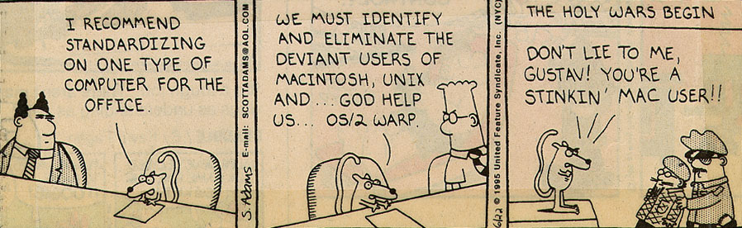
Alienation from Colleagues

Slide 37
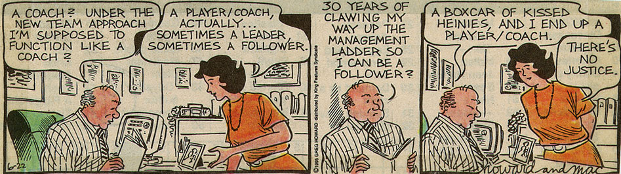
Alienation from Change Efforts

Slide 38
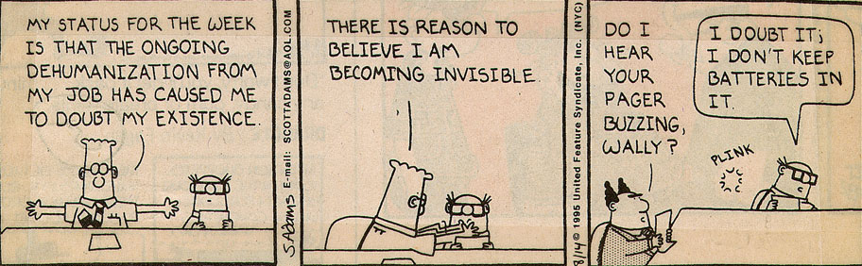
Alienation from Self

Slide 39
Seventh Reflective Pause
The model suggests that employees get frustrated and alienated by organizational incompetence – in a sense a failure to act rationally.
Artificial Intelligence introduces a new element into the equation – the ability to produce rationally 24/7 and to assess employees continually on their ability to meet rational goals
The result is Amazon – a place where employees are frustrated and alienated by too much rationality!
As a leader or manager, how to you confront this paradox
  Too much rationality leads to alienation
  Too little rationality leads to alienation

Slide 40
Where we’re at and where we’re going
The ability of organizations to see and act upon patterns (i.e. avoiding a TYPE II Error) depends upon:
  Structure
  Culture
  People
We’re going to start with people – The Ethics 0f Dissent i.e. whistle blowing (The Rosemary O’Leary book)
Then we’re going to move onto Structure and Culture (Fry and Raadschelders)
We finish with the Fox and Miller book, which looks at a different way of conceptualizing organizations

Slide 41
Routines, Standard Operating Procedures, The Habit Loop
routine
Cue
reward

Slide 42
Standard operating procedures
Can’t live with ‘em, can’t live without
‘em
They save time and resources and increase efficiency
They provide security and a sense of direction
They inhibit the desire to change
They can become dysfunctional and destructive

Slide 43
An organizational map
flexibility
Human relations
Open systems
(The family)
(The Organism)
internal
External
Planning
Classic bureaucracy
(The Firm)
(The machine)
control

Slide 44
A brief intellectual history
Intellectual history is often presented in a linear fashion
Western
European
Greek
Ancient
1700’s
300 B.C.
Theological
Philosophical
Scientific

Slide 45
The Intellectual Currents Affecting Org. Theory
Science
Religion
Org. Theory
Philosophy

Slide 46
Deconstructing the Circles
Philosophy
  Positivism
    Only those statements that are empirically verified can be counted as true
    The world is rational and can be understood by this empirical method
    By such understanding people can maximize utility, obtaining ends (mastery) in the most efficient way possible

Slide 47
Science
  Utility maximization, i.e. efficiency, can be obtained through the systematic gathering and interpretation of data
    Taylorism
    Performance budgeting
    Results-oriented management
    Outcomes measurement

Slide 48
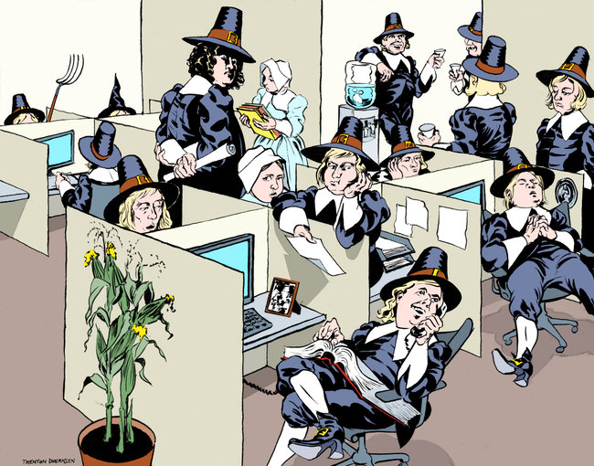
The Protestant Ethic and the Spirit of Capitalism

Slide 49
Religion
  Direct influence/ Max Weber, The Protestant Ethic and the Spirit of Capitalism
  Indirect influence/ the creation of a meta-narrative, the narrative that explains everything and is universal
  Body/mind distinction like body/soul distinction sets in motion a dichotomy that results in hierarchy

