Slide 1
A Perspective on Organization Dynamics and Dysfunction
Malcolm S. Townes
POLS 6320 Organization Theory and Behavior
Saint Louis University
May 4, 2020

Slide 2
 | Pre-Course Belief | Post-Course Belief
Conceptualizing the organization | Conceived of organizations as human-like entities capable of independent motivations and action. | An organization is a human construct defined by norms and expectations that its members must continually negotiate and affirm.
Exercising human agency | Membership in an organization requires one to abdicate their human agency. | When conceived as a set of malleable recursive practices, an organization cannot exist without human agency.
Effectuating organizational change | Only high level fiduciary leaders have the responsibility and authority to effectuate organizational change. | Every member of the organization has a right to try to effectuate organizational change regardless of their status.
Appropriateness of guerilla activity | Guerilla activity within an organization is seldom if ever appropriate, a sign of disloyalty to the organization, and damaging to the organization. | Guerilla activity is a legitimate, appropriate, and useful method to effectuate beneficial change in an organizational context.

Slide 3

Setting organizational objectives and effectuating organizational change to achieve those objectives are not the exclusive responsibility, right, and privilege of the organization’s fiduciary leaders.

Slide 4
The Principle of Distributed Authority
Guerilla activity is a legitimate, appropriate, and useful method to effectuate change in an organization.
An organization is a human construct defined by norms and expectations that its members must continually negotiate and affirm.
Every member of
an organization has a warrant, rooted in human agency and their membership in the organization, to influence organizational objectives and pursue organizational change to achieve them.
Every member of the organization has the right to try to effectuate organizational change regardless of status.
What we conceive of as an organization cannot exist without human agency.

Slide 5
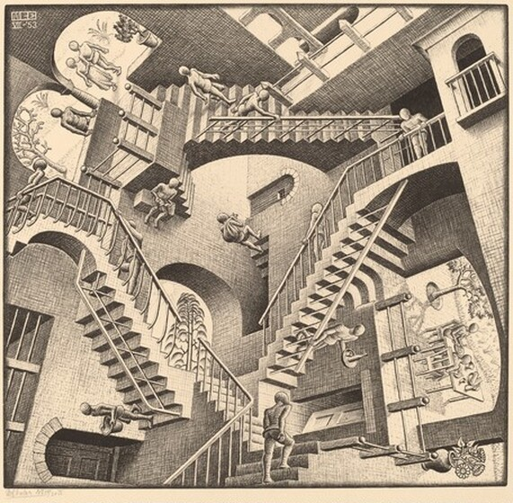

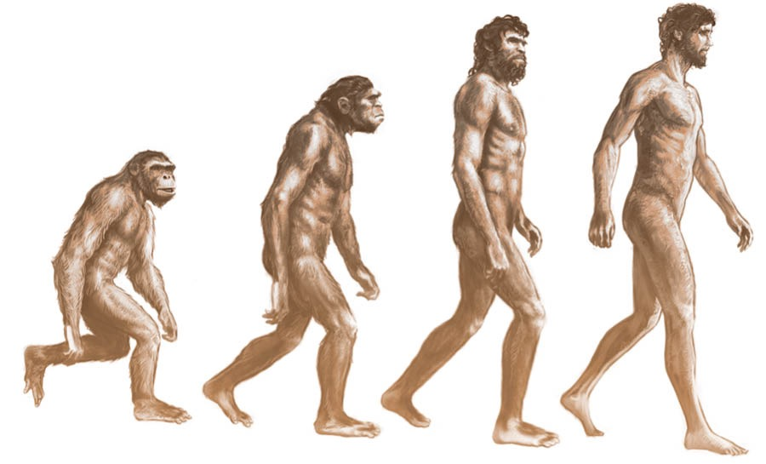
Dehumanization
Paradox of Rationality
Bounded Rationality
Minimizes the dehumanizing nature of various organizational paradigms.
Minimizes the risk of blind abidance to rationally constructed rules leading to irrational decisions and actions.
Mitigates the limitations of bounded rationality.

Slide 6
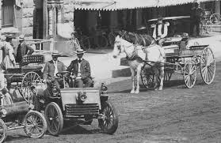

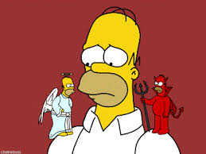
Environmental Change
Whistleblowing
Ethical Dilemmas
Minimizes the risk of an organization being crippled or destroyed from inadequate or inappropriate responses to changes in the operating environment.
Affirms whistleblowing as a legitimate strategy for effectuating organizational change while minimizing the need for it.
Provides a new perspective for resolving ethical dilemmas.

Slide 7
Application to status of subordinate within an organization
Think of effectuating change not as matter of “what gives me the right” but a matter of under what circumstances do I choose to exercise my right.
Consider organizational allegiance and commitment a matter of fulfilling ethical obligations and satisfying personal needs rather than blind loyalty to the organizational entity.

Slide 8
Application to status as colleague to other organization members
View conflict as an opportunity for creative problem solving that helps the organization better adapt to the environment rather than a dysfunction to be avoided at all costs.
Pursue interactions with colleagues as negotiations rather than zero sum games characterized by domination and submission.

Slide 9
Application to status as a supervisor within an organization
Reject the notion that supervisors must do all of the thinking for the group.
Avoid treating subordinates as unthinking automatons whose only function is to carry out the directives of superiors.
Create an environment where subordinates have options to express opinions and influence organization activities other than through guerilla activity.

