Slide 1




Intro to Public Finance
Week 3 Spring 2020

Slide 2
Some Examples from the Blogs
"I think that growing income inequality has made our economy more efficient, but it has come at a great cost. As the article said, 40% of Americans 55 and older are still in the workforce as of 2018 compared to 30% 30 years ago. Yes, this is efficiency in that we are working people for more years of their life but, it comes at a human cost."
Unfortunately, from a cold-blooded economic perspective, rising income inequality has resulted in the economy being more efficient. Poorer people who require monetary assistance from the government for subsistence are dying off at significantly lower ages than individuals in higher income brackets who are far less reliant on government benefits. Individuals interpreting the economy based on data without empathy for human suffering would conclude that the elderly poor are a drain on society. “When older Americans finally do retire, most are depending on Social Security and other safety net programs”

Slide 3
Some Examples from the Blogs
Measuring the efficiency of the whole economy requires measuring the economic value of resources used for production (i.e., input) as well as the economic value of both what is produced and the benefit society derives from that production. Some benefits derived from economic activity are hard to quantity and assigning an economic value to them is difficult. This is further complicated because an output for one economic actor may be an input for another economic actor.

Slide 4
If we overhaul the system to be more cost effective, that still necessarily comes from somewhere else. If we end an insurance-based healthcare delivery model, that would impact insurance companies. If we had a one-payer system, that may increase unemployment if less labor is required manage the claim cycle for multiple payers and various rules. Health outcomes, productivity, and health sector employment could all be good measures, and correlation with demographics is essential.

Slide 5
Overview
Review of where we left off.
Private goods vs public goods—what's the difference? (Quick review of Pareto and equity video).
Providing public goods.
Pure & impure public goods.
Gives rise to mixed economy.
Necessity of competition.
How economists define efficiency.

Slide 6
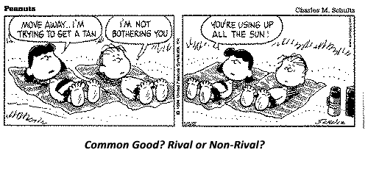
Public Goods
What one considers a public good may be subject to some debate.
However, most economists tend to agree.
Notes:
Many consider Education to be a pure public good (not many economists). This position is based on the notion that the benefits of education accrue to everyone in society not just those who receive it. Particularly true of K-12.

Slide 7

Pure Public Goods & Market Failure
Causes of Public Goods
The Lighthouse Example
Combined Causes of Market Failure:
  Non-rival and non-excludable consumption.
    Examples include water purification, national defense, lighthouse, streetlights
Exclusion is both undesirable and impossible.
Notes:
A very important attribute of economic goods is their divisibility among individuals. Some of them are divisible by both quantity and quality. However, not all goods are divisible. Goods that have indivisibility of consumption share the following characteristics: they are consumed by all consumers together, if they are only consumed by one entity, the consumption of other consumers is not reduced.
Think of a lighthouse. When a lighthouse is constructed and operating, its light shines for everyone to see in the water. You cannot prevent someone from seeing the beam from the water. The fact that I see the light doesn’t in any way diminish your ability to use the light. How does one prevent anyone from using the lighthouse?

Slide 8
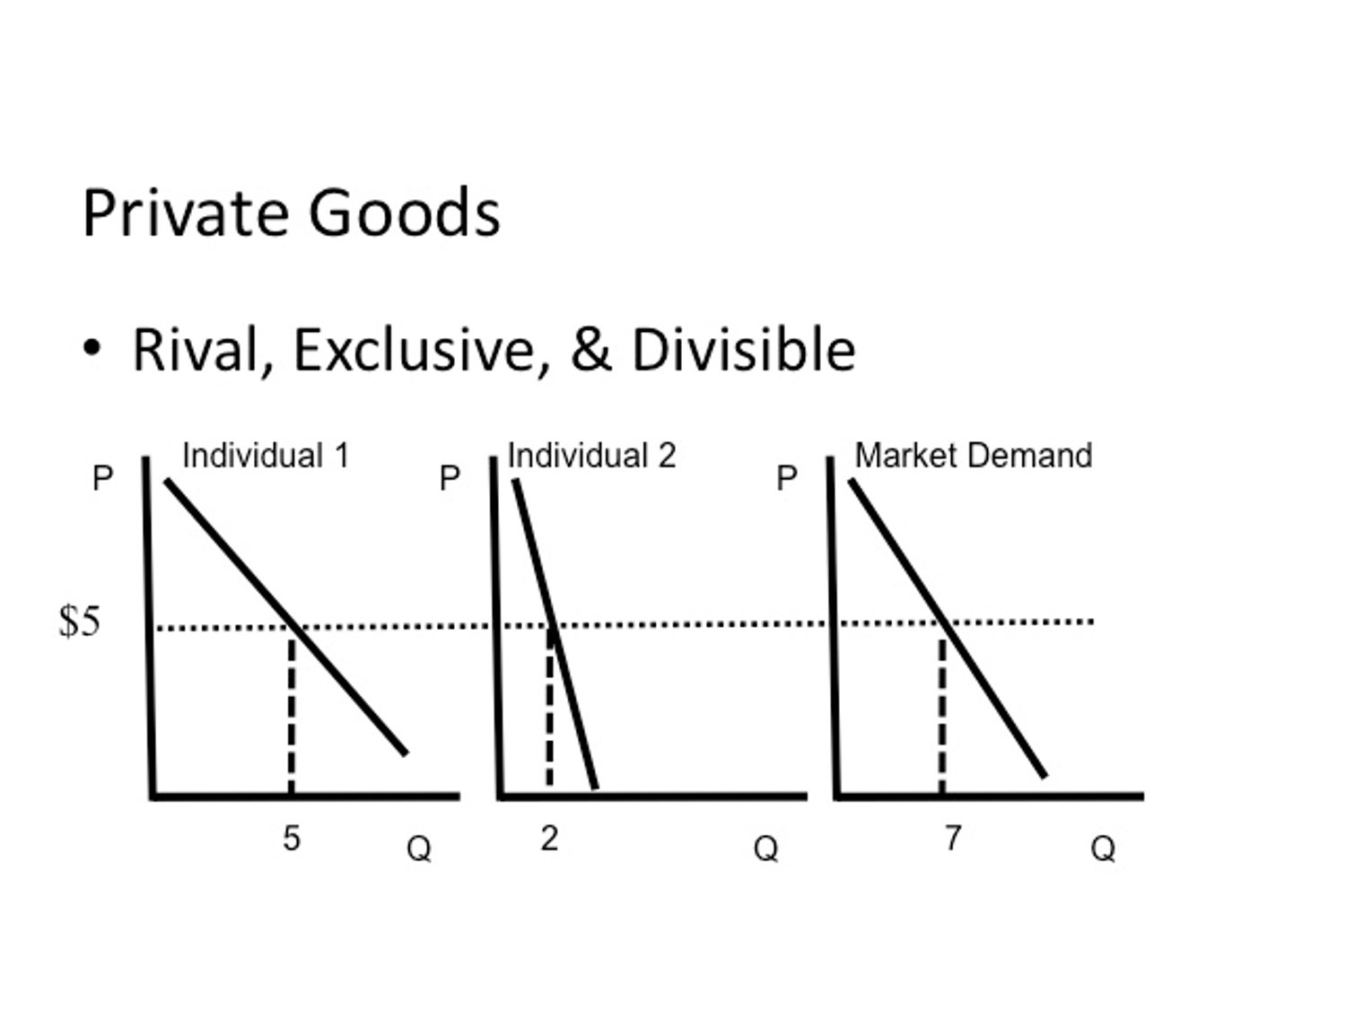
Notes:
Everyone pays the same amount for the good (sandwich) but each one demands a different quantity. #1 eats 5 sandwiches a week and #2 eats 2. Both pay $5 for each one. The aggregate demand for sandwiches in this case is 7 (the sum of #1 & #2). This represents horizontal summation of the demand, which is a characteristic of private goods.

Slide 9



Review of Pure Public Goods
Revealing individual preferences is a problem in public goods.
  No price mechanism.
Because pure public goods are non-rival and non-excludable, consumers will not voluntarily reveal preferences.
How, then, do we determine demand? Trick question because, of course, you already know the answer, right?

Slide 10
Comparison of Private with Public Goods
“Pseudo-demand” curve is the vertical addition of individual demand curves.
Shows the sum of the prices which consumers are willing to pay for any given amount.
Everyone consumes the same amount.
Each pays a price = to their evaluation of the good.
Notes:
To determine the optimal quantity of a public good, it is necessary to first determine the demand for it.
Demand for public goods is represented through price-quantity schedules, which show the price someone is willing to pay for the extra unit of each possible quantity.
Unlike the market demand curve for private goods, where individual demand curves are summed horizontally, individual demand curves for public goods are summed vertically to get the market demand curve. As a result, the market demand curve for public goods gives the price society is willing to pay for a given quantity. It is equal to the marginal benefit curve. Due to the law of diminishing marginal utility, the demand curve is downward sloping.

Slide 11
Provision of Public Goods
Where the number of participants is large, an individual’s contribution will make little difference in total provision.
Gives rise to free rider problem.
  National defense
  National parks
  Climate (debate over who has responsibility to reverse climate change)
Notes:
Think of national defense, the contribution of one person is relatively small in comparison to the overall total and every taxpayer contributes. If you took away my contribution and even the contribution of everybody at SLU it would amount to a drop in the bucket. It would not enable you to buy even one jet fighter.

Slide 12

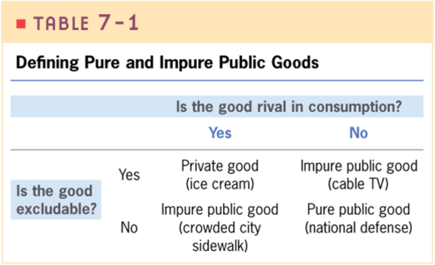

Pure & Impure Public Goods
Notes:
Other examples:
Highway at rush hour
Highway at 2 AM
Internet
Electricity
Airlines
Elections

Slide 13
Private & Public Sectors Intertwined
Public & Private Sectors are closely interconnected.
This is known as the mixed economy.
Policy decisions affect the operations of private markets.
  Taxing & spending decisions impact on consumer choice & producer decisions.
  Also regulations.
  Monetary policy.

Slide 14
Government Failures
Government failures arise from:
  Limited information. Cannot know everything.
  Limited control over private market responses.
  Limited control over the bureaucracy.
  Limitations imposed by the political process.
Notes:
Tax cuts are designed to jump-start a weak economy. It will only do this if consumers go out and spend the money immediately, preferably on things like new homes and cars. But what happens if they don't? What happens if they choose to save the money instead?
Regulations work if they are properly enforced. Enforcement depends on the bureaucracy. Bureaucrats may choose to enforce some laws more strongly than others. Or Congress might not provide enough funding for proper enforcement.
Health care is a good example of what happens when something becomes a political football. This introduces greater uncertainty into the system. Uncertainty creates more inefficient conditions.

Slide 15
Private & Public Sectors Intertwined
Public sector also buys factors of production & makes transfer payments to individuals & firms.
  Defense (Boeing sells aircraft to government, Social Security, Medicare)
Government is a monopoly consumer (monopsony) in some sectors including national defense and social services.
  Most social services are provided by government or by non-profits funded by government.

Slide 16
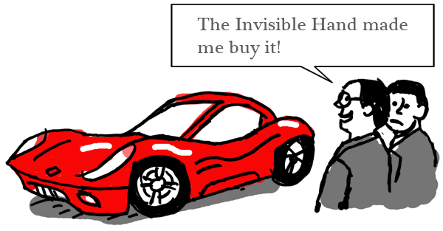
Competition is Good!
According to economists, that is.
Invisible hand results in everyone pursuing the public interest.
Adam Smith: Theory of Moral Sentiments (1759)
Notes:
The invisible hand describes the unintended social benefits of an individual's self-interested actions,

Slide 17

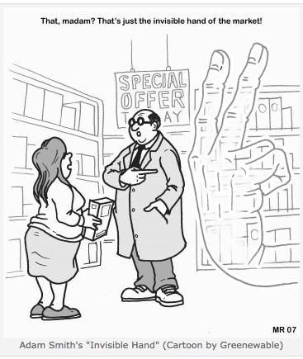
The Invisible Hand
Left to its own devices, the market will find its way to equilibrium.
This is the most efficient solution (Pareto optimality).
Notes:
The idea of trade and market exchange automatically channeling self-interest toward socially desirable ends is a central justification for the laissez-faire economic philosophy, which lies behind neoclassical economics. In this sense, the central disagreement between economic ideologies can be viewed as a disagreement about how powerful the "invisible hand" is.

Slide 18
Welfare Economics
Welfare economics is branch that focuses on normative issues.
What should be the economy’s organization—what should be produced, how it should be produced, for whom, and who should make these decisions.
Takes into account both the private sector and public sector.

Slide 19

Welfare Economics
If economy is competitive, it is Pareto efficient.
Pareto efficiency is concerned with individual’s welfare and what counts is his/her welfare.
After redistribution, if we allow market forces to play themselves out, we will have a Pareto efficient allocation of resources.
Notes:
Person's welfare is determined by their utility, material well-being, which is typically measured by income.
2nd theorem says that with a decentralized market mechanism every Pareto efficient allocation can be attained.
Important to repeat that Pareto says nothing about how fair an economy is.

Slide 20
Why Competition Results in Efficiency
Demand curve = amount individual willing to buy at each price.
Supply curve = amount firm is willing to supply at each price.
Efficiency requires that marginal cost = marginal benefit (point e).
Notes:
Demand curve is normally downward sloping.
Supply curve is normally upward sloping.
At E, marginal benefit=marginal cost and each equal price of the good.
We can derive a simple demand and supply curve for the class. Pretend that I ban all electronic devices in class and you can only use a notebook and pen or pencil (like in the old days).
Also pretend that there are two providers of pens. The department and me. Economists would say (all things being equal) that you will opt for the pen that is the least expensive. I purchase my pens for 50 cents per pen and charge 60 cents. The department sells the same pens for 65 cents. Economists say you will purchase my pens. My mc is equal to your mb (taking profit into account).

Slide 21
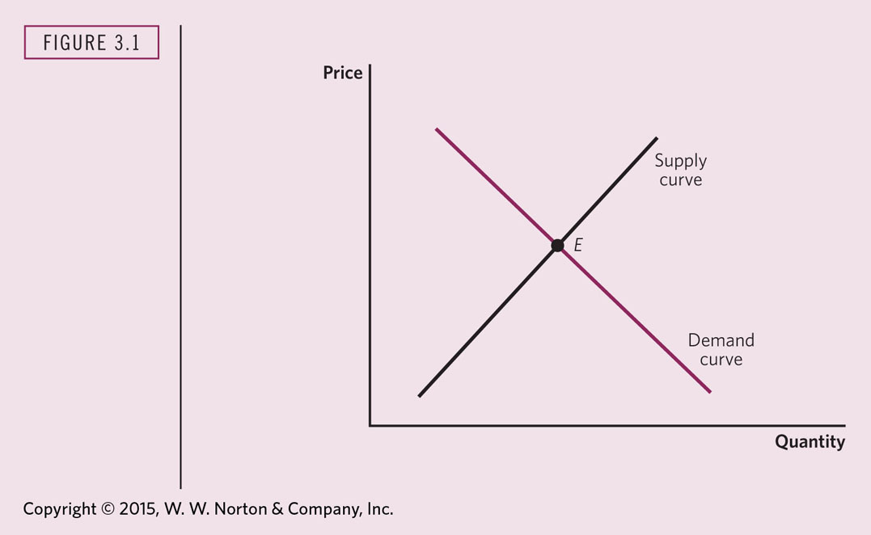
Notes:
EFFICIENCY FROM THE PERSPECTIVE OF A SINGLE MARKET
In deciding how much to demand, individuals equate the marginal beneﬁt they receive from consuming an extra unit with the marginal cost, the price they have to pay. In deciding how much to supply, ﬁrms equate the marginal beneﬁt they receive, which is just the price, with the marginal cost. At the market equilibrium, where supply equals demand, the marginal beneﬁt (to consumers) is equal to the marginal cost (to ﬁrms)—and each equals the price.

Slide 22
Utility Possibilities Curve
Benefit an individual receives from consumption is called utility.
If a person gets more goods, their utility increases.
  More of any commodity is considered a good thing leaving aside other concerns like effects on the environment, etc. This also includes goods that we might consider social bads like alcohol, gambling, etc, when consumed in excess.
UPC traces out the maximum level of utility that may be achieved by 2 consumers.
Notes:
If an economy is efficient it must be operationg along the utility possibilities frontier. If the economy were below the frontier, it is possible to increase the utility of R and C without decreasing the utility of the other, or to increase the utility of both.

Slide 23
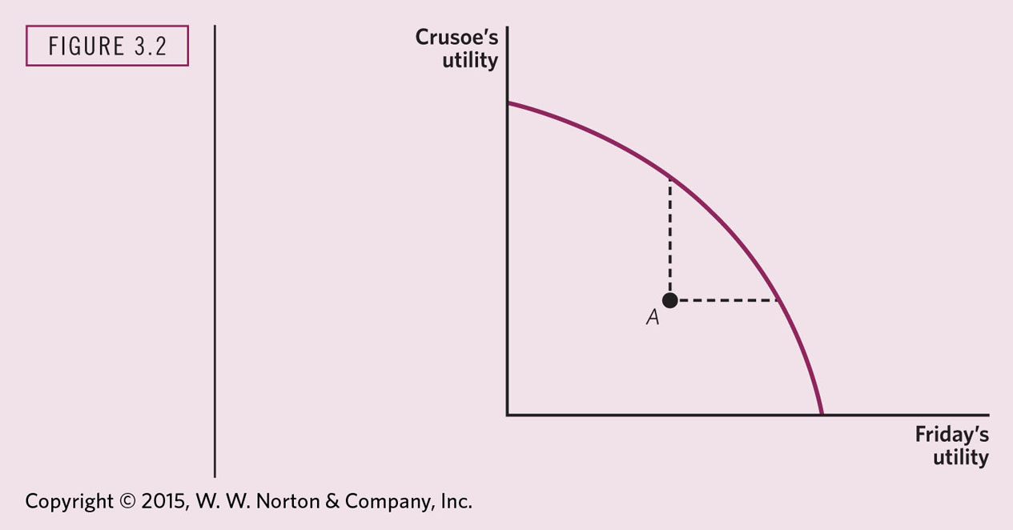
Notes:
THE UTILITY POSSIBILITIES CURVE
The utility possibilities curve gives the maximum level of utility that one individual (Friday) can achieve, given the level of utility of the other individual (Crusoe). Along the frontier, it is not possible for Crusoe to consume more unless Friday consumes less. Therefore, the utility possibilities curve is downward sloping: the higher Crusoe’s utility, the lower the maximum level of Friday’s utility.

Slide 24
Exchange Efficiency
Amount that one individual is willing to give up in exchange for one unit of a commodity is the marginal rate of substitution (MRS).
Exchange efficiency requires that everyone has the same MRS.

Slide 25
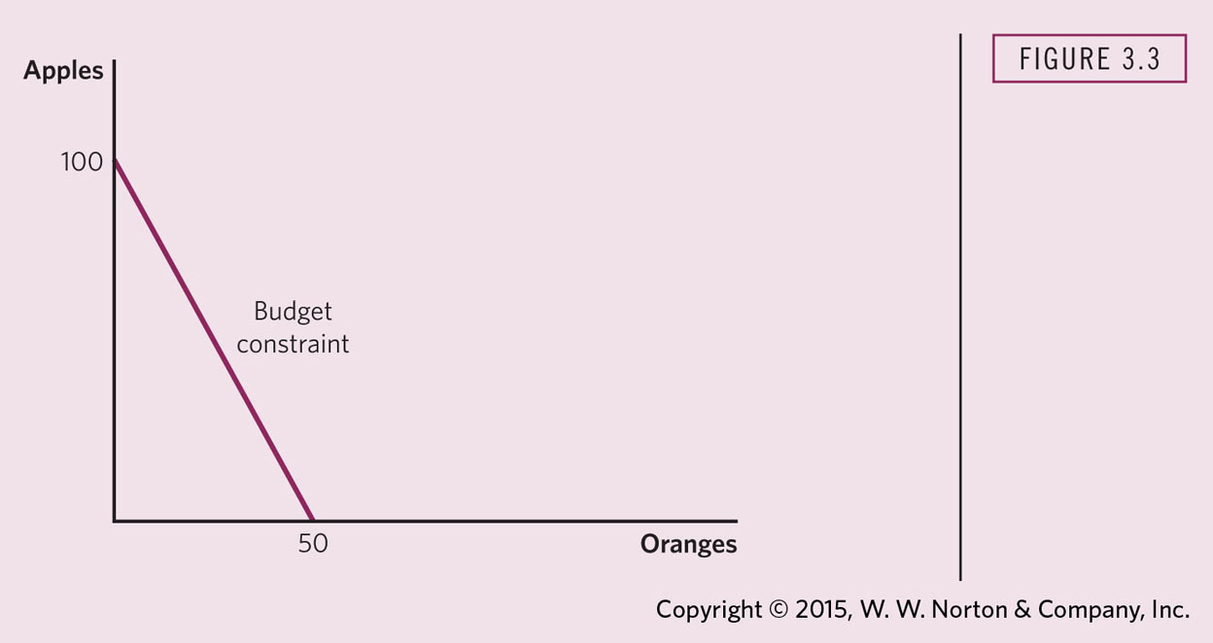
Notes:
CRUSOE’S BUDGET CONSTRAINT
Given income of $100, the price of oranges of $2, and the price of apples of $1, an individual can purchase any combination of apples and oranges along or to the left of the budget constraint. Any combination to the right of the budget constraint is unaffordable. The slope of the budget constraint is based on the relative price of oranges and apples.

Slide 26
Indifference Curves
Give the combinations of goods among which the consumer is indifferent or yield the same amount of utility.
Slope of indifference curve equals the MRS.
Combinations of goods along higher indifference curves give a higher level of utility.

Slide 27
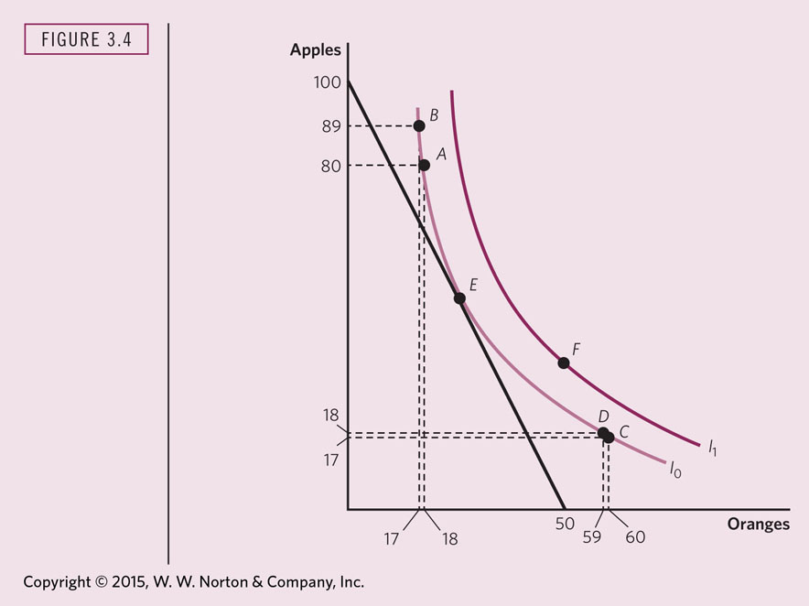
Notes:
THE CONSUMER’S CHOICE PROBLEM
The budget constraint gives the combinations of apples and oranges that Crusoe can buy, given his income and given the price of apples and oranges. The indifference curve gives the combinations of apples and oranges among which Crusoe is indifferent. A and B are on the same indifference curve; Crusoe is indifferent between them. Other individuals prefer combinations of apples and oranges that are on a higher indifference curve. Thus, point F is preferred to either A or B. Crusoe chooses the point along the budget constraint that he most prefers; that is, the point at which the indifference curve I₀ is tangent to the budget constraint (point E).

Slide 28
Exchange Efficiency
All possible allocations between Crusoe and Friday can be represented in a box (next slide).
At the point of tangency (E), the slopes of the indifference curves are the same.
Their MRS for oranges are the same.

Slide 29
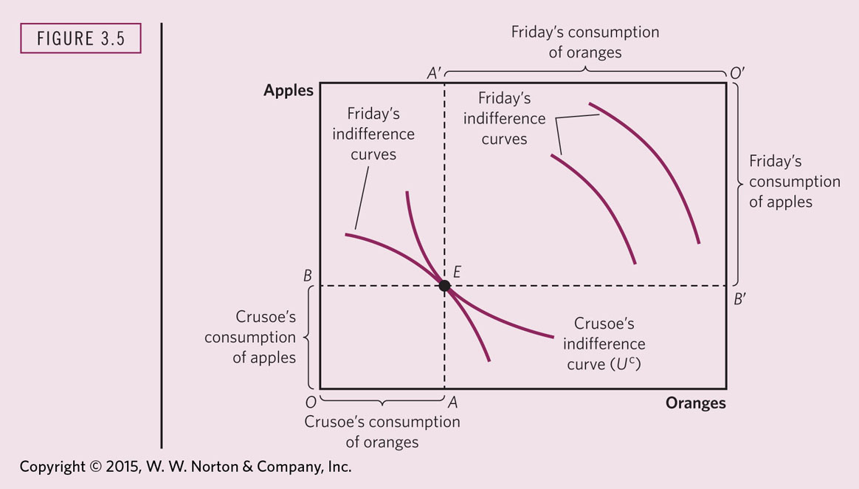
Notes:
EXCHANGE EFFICIENCY
The sides of this Edgeworth–Bowley box give the available supplies of apples and oranges. OA and OB give Crusoe’s consumption of the two commodities. Friday gets what Crusoe does not consume; that is, O’A’ and O’B’. Pareto efﬁciency requires the tangency of the two indifference curves (one such point is at E), where the marginal rates of substitution of apples for oranges are equal.

Slide 30
Production Efficiency
Along the Production Efficiency Frontier, the economy cannot produce more of one good without sacrificing some of another good, given a fixed set of inputs.
Isocost line is similar to budget constraint but for firms not individuals.
Notes:
Trade-off between goods.
Guns vs. Butter
Smartphones vs. Sneakers
Healthcare vs. Education
Another example of the Iron law of Scarcity.

