Slide 1




Intro to Public Finance
Week 4 Spring 2020

Slide 2
Overview
Librarian, Rebecca Hyde to talk about paper.
Review of where we left off last week.
How economists define efficiency.
Individual utility and consumer choice.
Budget constraint.
Exchange efficiency and Production efficiency.

Slide 3
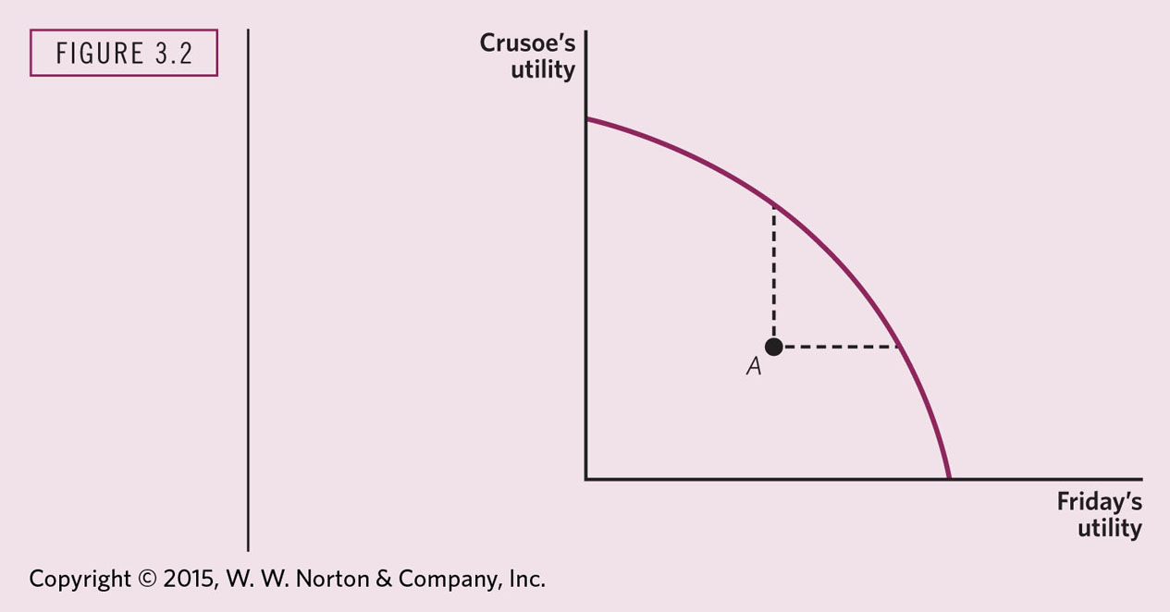
Notes:
THE UTILITY POSSIBILITIES CURVE
The utility possibilities curve gives the maximum level of utility that one individual (Friday) can achieve, given the level of utility of the other individual (Crusoe). Along the frontier, it is not possible for Crusoe to consume more unless Friday consumes less. Therefore, the utility possibilities curve is downward sloping: the higher Crusoe’s utility, the lower the maximum level of Friday’s utility.
Later on, comparing utility for 2 or more commodities.

Slide 4
Consumer’s Choice problem
Individuals’ decisions, such as what goods and services to buy, can be analyzed as choices made within certain budget constraints.
Generally, consumers are trying to get the most for their limited budget; in other words, they are trying to maximize total utility, or satisfaction, given their budget constraint.
Notes:
For example:
Tom has $1,000 to spend on movies or going to bars.
Linda has $500 to spend on eating in or eating out.
Each of these activities provides each individual with a certain number of utils, which represents the satisfaction the individual derives from the activity.

Slide 5
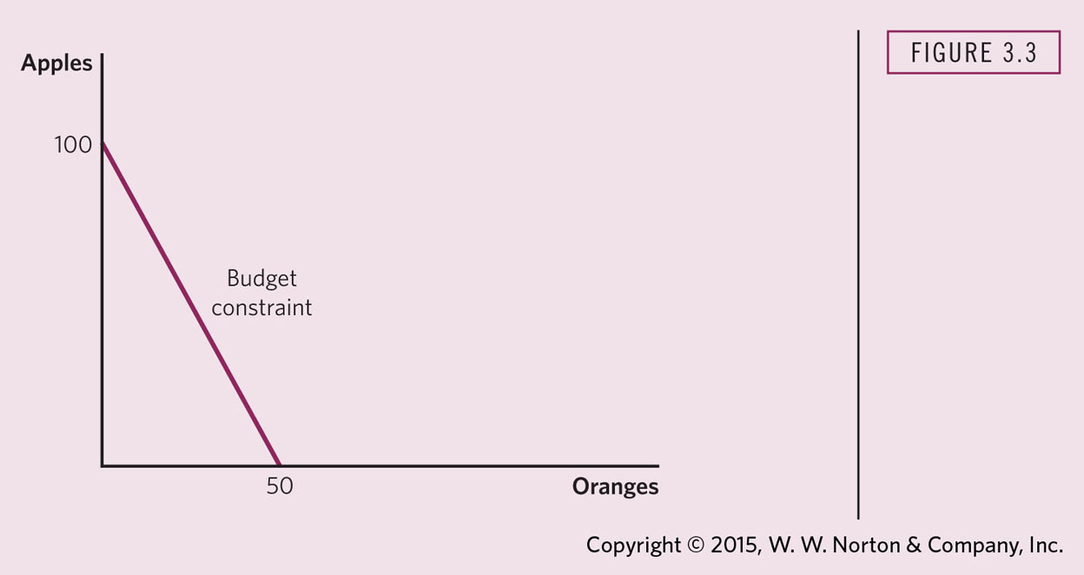
Notes:
CRUSOE’S BUDGET CONSTRAINT
In a budget constraint line, the quantity of one good is measured on the horizontal axis and the quantity of the other good is measured on the vertical axis. The budget constraint line shows the various combinations of two goods that are affordable given consumer income.
Given income of $100, the price of oranges of $2, and the price of apples of $1, an individual can purchase any combination of apples and oranges along or to the left of the budget constraint. Any combination to the right of the budget constraint is unaffordable. The slope of the budget constraint is based on the relative price of oranges and apples.
Examples:
If C. wants 100 apples how many oranges can he by? 0
If he wants 10 oranges, how many apples can he buy? 80
If he wants 20 apples, how many oranges can he get? 40

Slide 6
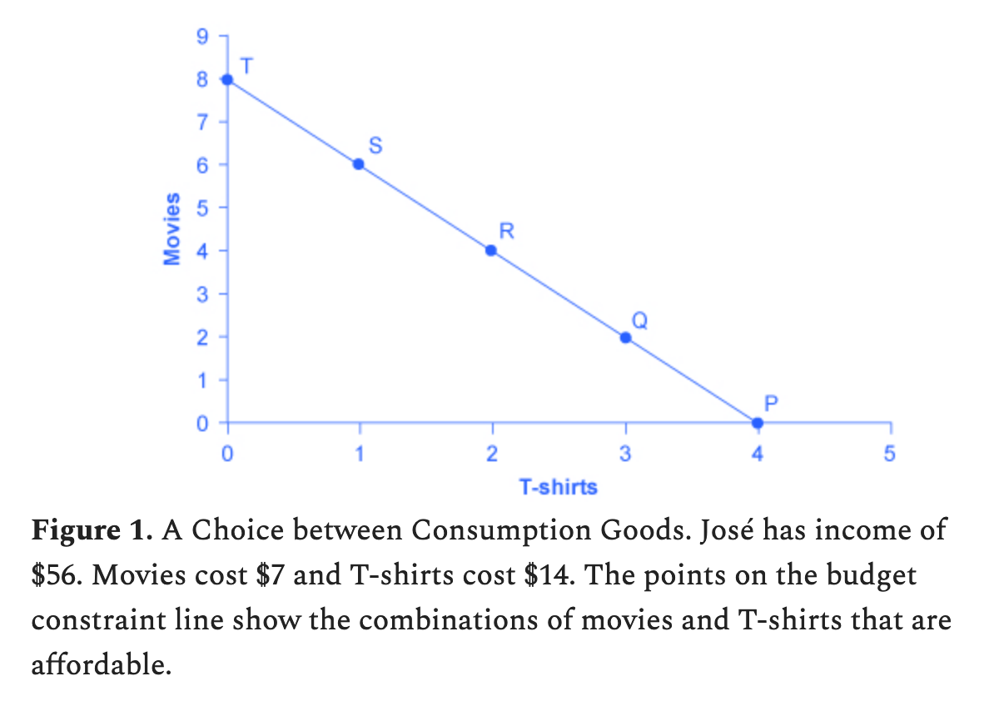
Notes:
José wishes to choose the combination that will provide him with the greatest utility, which is the term economists use to describe a person’s level of satisfaction or happiness with his or her choices.
Marginal utility diminishes as additional units are consumed, which means that each subsequent unit of a good consumed provides less additional utility. The marginal utility curve is downward sloping.
In simple terms, this means that a consumer’s satisfaction lessens with consumption of each additional unit of something. That decline becomes more marked at a certain point that is different for each person.
Rule for Maximizing Utility—how to get the most “bang for your buck” when choosing goods to consume. In other words, how do you maximize total utility with your budget constraint?
The general rule can also be expressed as the ratio of the prices of the two goods should be equal to the ratio of the marginal utilities.
This is known as consumer equilibrium, can be written in algebraic form:
P1/P2=MU1/MU2

Slide 7
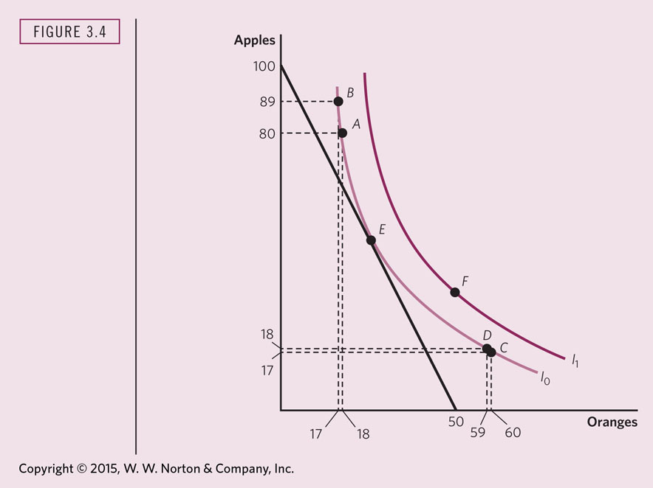
Notes:
THE CONSUMER’S CHOICE PROBLEM
The budget constraint gives the combinations of apples and oranges that Crusoe can buy, given his income and given the price of apples and oranges. The indifference curve gives the combinations of apples and oranges among which Crusoe is indifferent. A and B are on the same indifference curve; Crusoe is indifferent between them. Other individuals prefer combinations of apples and oranges that are on a higher indifference curve. Thus, point F is preferred to either A or B. Crusoe chooses the point along the budget constraint that he most prefers; that is, the point at which the indifference curve I₀ is tangent to the budget constraint (point E).

Slide 8
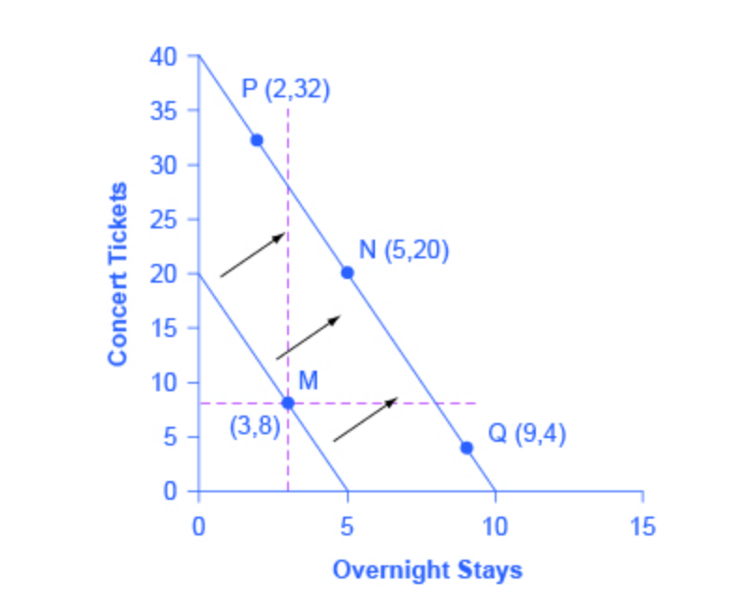
How a Change of Income Affects Consumption
Notes:
budget constraint that represents Kimberly’s choice between concert tickets at $50 each and getting away overnight to a bed-and-breakfast for $200 per night. Kimberly has $1,000 per year to spend between these two choices. After thinking about her total utility and marginal utility and applying the decision rule that the ratio of the marginal utilities to the prices should be equal between the two products, Kimberly chooses point M, with eight concerts and three overnight getaways as her utility-maximizing choice.
When income rises, the most common reaction is to purchase more of both goods, like choice N, which is to the upper right relative to Kimberly’s original choice M, although exactly how much more of each good will vary according to personal taste.

Slide 9
Exchange Efficiency
All possible allocations between Crusoe and Friday can be represented in a box (next slide).
At the point of tangency (E), the slopes of the indifference curves are the same.
Their MRS for oranges are the same.

Slide 10
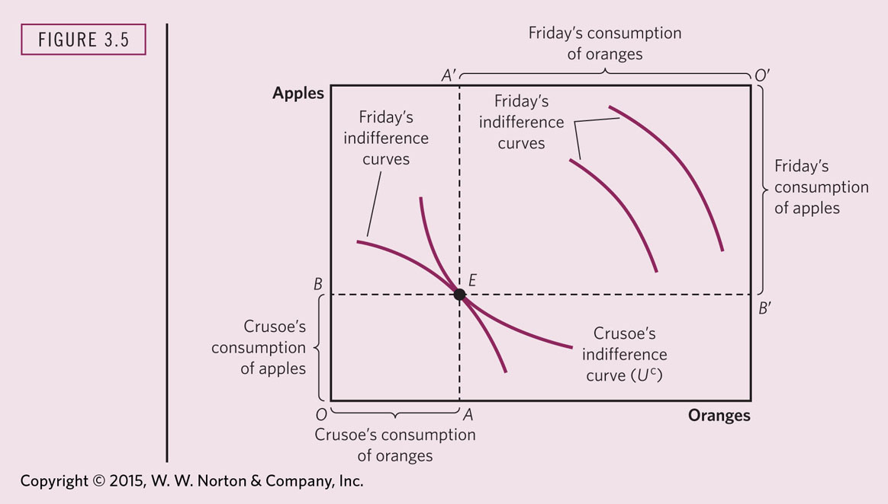
Notes:
EXCHANGE EFFICIENCY
The sides of this Edgeworth–Bowley box give the available supplies of apples and oranges. OA and OB give Crusoe’s consumption of the two commodities. Friday gets what Crusoe does not consume; that is, O’A’ and O’B’. Pareto efﬁciency requires the tangency of the two indifference curves (one such point is at E), where the marginal rates of substitution of apples for oranges are equal.

Slide 11
Production Efficiency
Along the Production Efficiency Frontier, the economy cannot produce more of one good without sacrificing some of another good, given a fixed set of inputs.
Theory of Marginal Rate of Technical Substitution (MRTS).
Isocost line is like the budget constraint but for firms not individuals.
Notes:
Hint about analzing economically.
When a question asks for something like production efficiency there is usually a theory that is at the heart of the solution. In this case it is MRTS. How do you know? Usually, Stiglitz & Rosengard will tell you.
Then finding a solution just involves applying the theory to the specifics of the question.

Slide 12
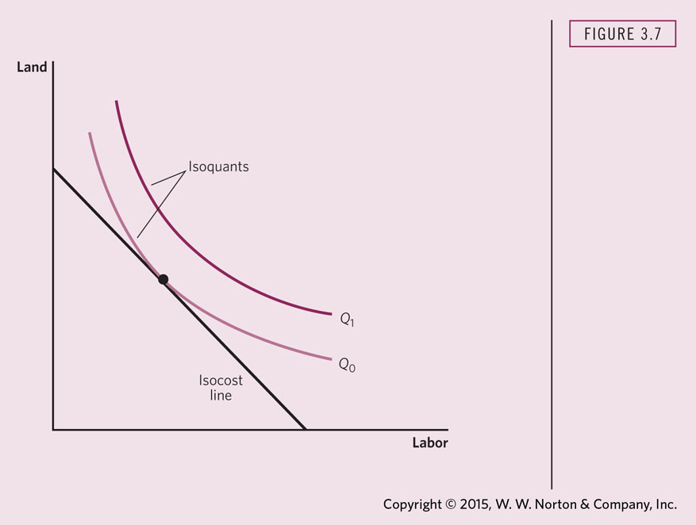
Notes:
ISOQUANTS AND ISOCOST LINES
An isoquant gives combinations of inputs (land and labor) that yield the same output. The isoquant labeled Q₁ represents a higher level of output than the isoquant labeled Q₀. The slope of the isoquant is the marginal rate of technical substitution.
Iso means same, quant means quantity. Represents the quantity of input (land & labor) that will yield the same output. As isoquant moves farther awat from the origin, the higher the level of output associated with that isoquant.
Isocost means same cost.
The isocost line gives the combinations of inputs that cost the same amount. The slope of the isocost line is given by the relative prices of the two inputs. The ﬁrm maximizes its output, given a particular level of expenditures on inputs, at the point where the isoquant is tangent to the isocost line. At that point, the marginal rate of technical substitution equals the relative price.
In the blog problem, the slope of the Isocost line is altered by the subsidy for the historic preservationists and not for the new home builders. Therefore, the subsidized firms can spend less on factors of production than the new home builders who do not receive a subsidy. The relative prices between the firms are no longer the same: one faces a lower a Isocost line. This produces a distortionary effect. All things being equal, this will result in more historical properties being preserved than new homes being built.

Slide 13
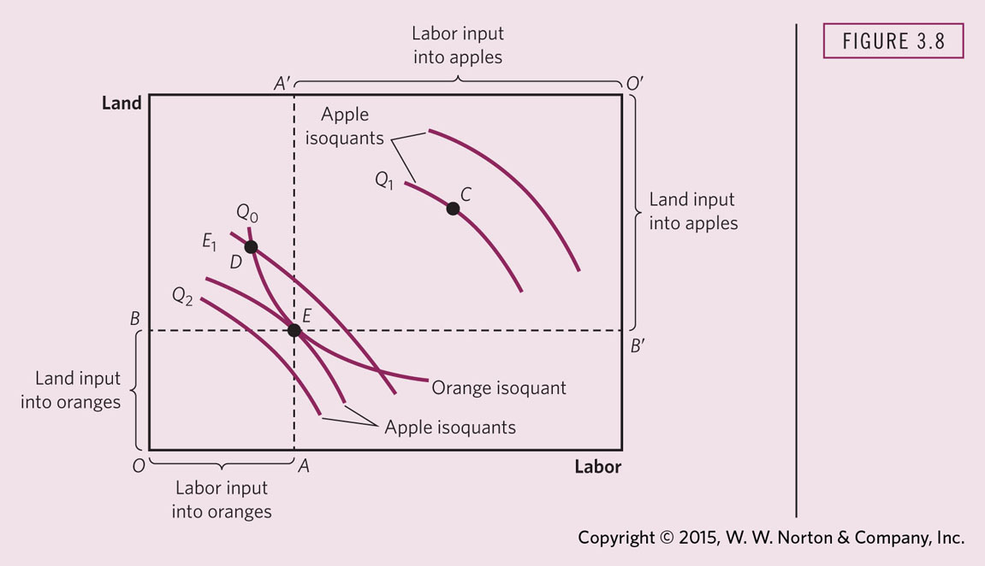
Notes:
PRODUCTION EFFICIENCY
The sides of this Edgeworth–Bowley box give the available supply of resources—land and labor. Resources used in the production of oranges are given by OA and OB; resources not used in the production of oranges are used in the production of apples, O’A’ and O’B’. Production efﬁciency requires the tangency of the isoquants. At tangency points, such as E, the marginal rate of substitution of land for labor is the same in the production of apples and oranges.
This is a bad example because some things are not correctly labeled.
In the blog example, the subsidy messes with the tangency point. The marginal rate of substitution of land for labor is affected by the subsidy by making land less expensive than labor for the historic presevationists. They will therefore make greater use of the properties (land & buildings) than new home builders.

Slide 14
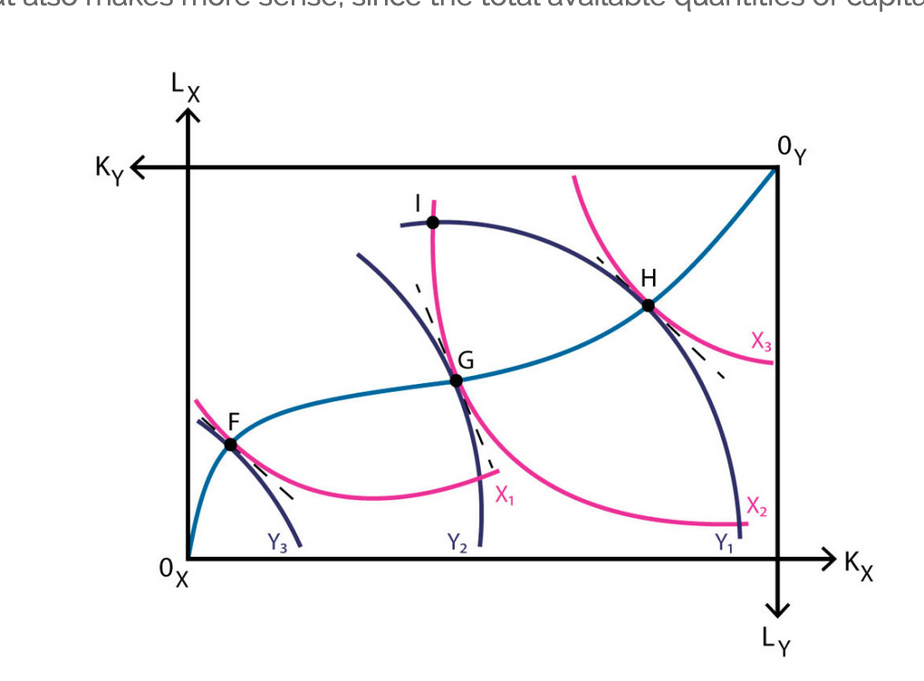
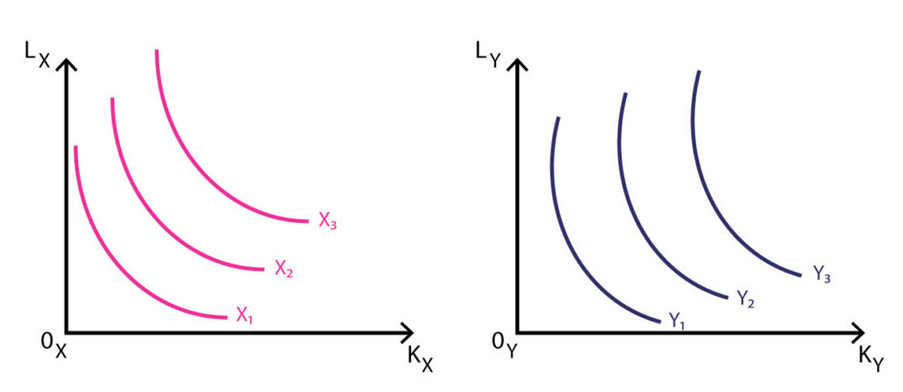
Edgeworth-Bowley Box
Notes:
The optimisation problem in production relies in the maximisation of total output production taking into consideration that it is subject to a limited amount of capital and labour.
We can start by looking at the production of goods X and Y as two different optimisation problems. The firm will have to decide what quantity of capital and labour allocate to the production of good X, as shown on the left side of the diagram below, but also what quantity of capital and labour assign to the production of good Y, as shown on the right. These curves are the isoquants corresponding to each production process.
These two diagrams can be plotted together using what is known as the Edgeworth box, which makes it easier to compare quantities of capital and labour used, while also comparing quantities of goods X and Y being produced. Indeed, it’s not only easier to analyse, but also makes more sense, since the total available quantities of capital and labour are given.

Slide 15
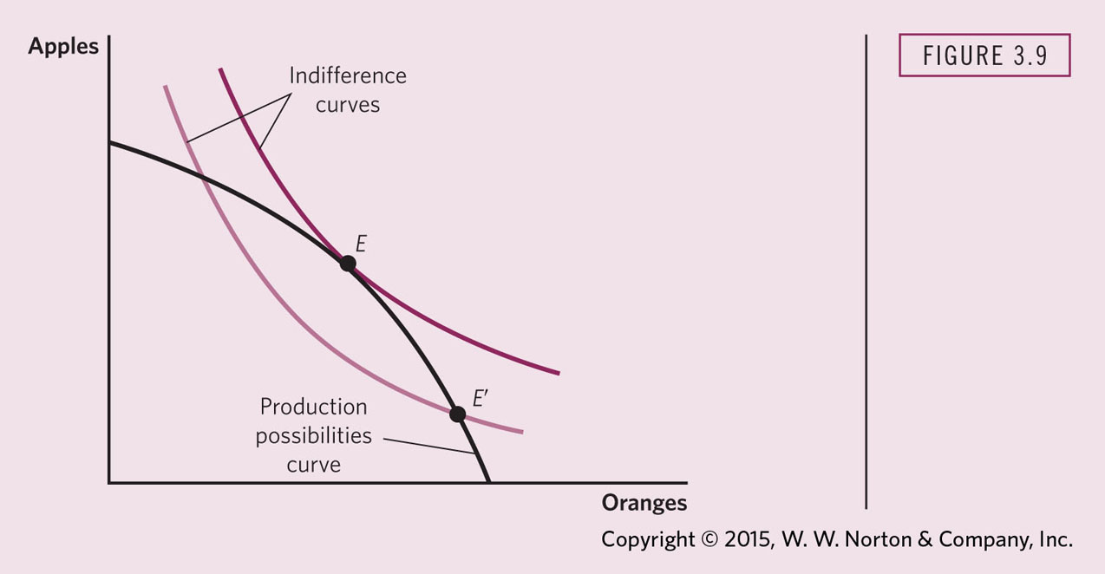
Notes:
PRODUCT MIX EFFICIENCY REQUIRES THAT THE MARGINAL RATE OF TRANSFORMATION EQUAL CONSUMERS’ MARGINAL RATE OF SUBSTITUTION
To reach the highest level of consumers’ utility, the indifference curve and the production possibilities schedule must be tangent (point E). At any other point, such as E’, consumer utility is lower than at E.
Hence, to be economically efficient, an economy must find that point on its production-possibilities frontier or that mix of products that has the highest value. This final condition of economically efficiency may be called product-mix efficiency.I f an economy is on the production-possibilities frontier, then more of one good, good A, can be produced only by shifting resources and thus producing less of something else, good B. The slope of the production-possibilities frontier, which economists call the marginal rate of transformation, shows how much of good B must be given up to produce more of good A.
The amount of good B that must be given to people so they willingly give up a unit of A must be the same for all people if the economy is exchange efficient. The ratio at which people will trade B for A is the marginal rate of substitution. Only when the marginal rate of transformation of each product is equal to the marginal rate of substitution will the economy be economically efficient.
The subsidy makes it more attractive for the consumers of historic housing vs. New home consumers.

Slide 16

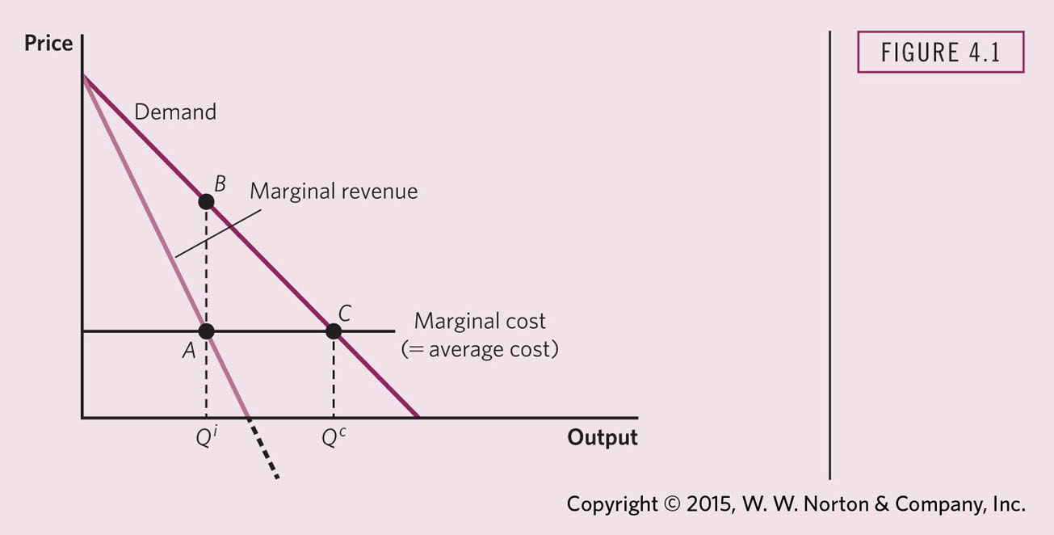
Notes:
MONOPOLY PRICING
Monopoly output is lower than competitive output, or the output at which proﬁts are zero. There is a resulting welfare loss.

