Slide 1
Theory of Public finance
Week 5

Slide 2
Overview
Finish production efficiency.
Review pure public goods vs. Private goods.
Pure Public Goods vs. Impure Public Goods.
Externalities
  Positive vs. Negative
Common resource problem.
Addressing negative externalities.
  Pigouvian taxes.
Subsidies.

Slide 3
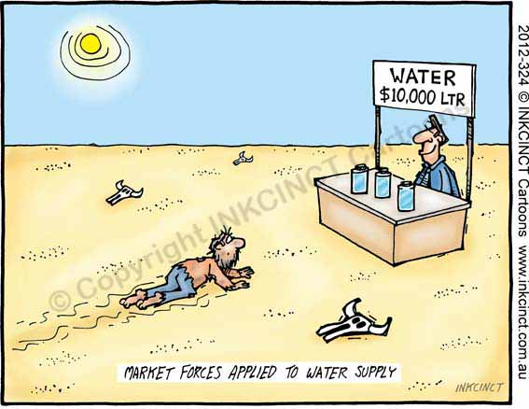
Market Failure
We’ve outlined why markets lead to Pareto efficient outcomes...but markets don’t always work the way they should.
  This week we will examine externalities, a large class of market failures.
When a market fails, it no longer produces an efficient outcome.
Pareto optimality isn't met so that it becomes possible to make one person better off without making someone else worse off.

Slide 4
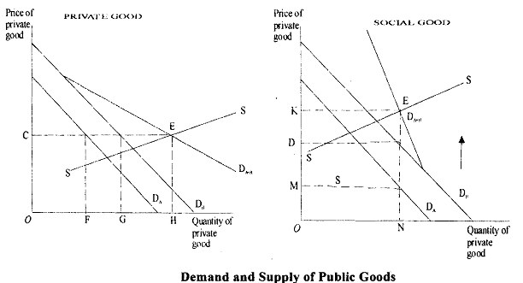
Public Good Market
Notes:
Private goods demand is summed horizontally, which means people pay the same amount but demand different quantities. Carton of milk costs $2.00 and I demand 2 cartons while you demand only one.
Public good demand is summed vertically: everyone pays a different price and demand the same quantity. Public park. National defense.

Slide 5
THE LOGIC OF PUBLIC ECONOMICS
A theoretical approach to any public policy problem.
Who receives the benefits and who bears the costs in society?
  Includes individual and social benefits, individual and social costs.
How might these be precisely assigned?
If the benefits and costs are misaligned or unequal, by what arrangement might this be altered?
This provides a valuable dimension to understanding any policy problem.
Notes:
Economic analysis can be used to reveal certain important aspects of any policy issue. This analysis can be performed in addition to other types of analysis as a supplement.
In general, knowledge of economics can help us think more logically and precisely about any public policy.

Slide 6
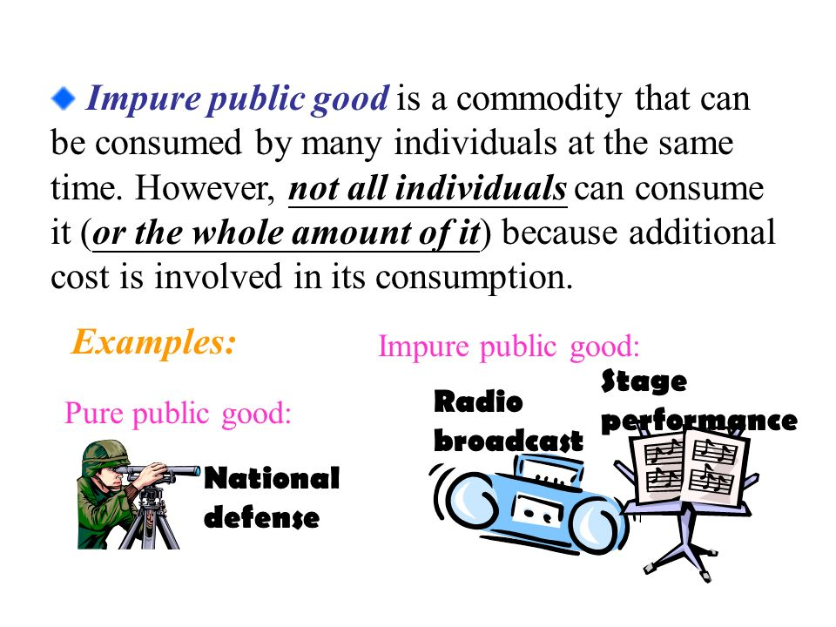
Notes:
Why are these examples of merit goods?
Useful to think of private goods and public goods as existing on a continuum. At one end, are the pure private goods and at the other are pure public goods. Stretched along the continuum is every good known to people. As we get closer to the pure public good end, these are the impure public goods. They have qualities of both private and public goods.

Slide 7
Merit Goods
One example of impure public good is a merit good.
Reflects a concern that some individuals might not act in their own best interests.
Even when fully informed some people might make poor decisions.
An individual’s perception of their own welfare may be an unreliable criterion for making welfare judgments.
In this case, government basically steps in and provides goods that are in the best interests of society.
Notes:
In economics, a person is supposed to make rational choices, I.e., he/she calculates the material benefits and costs of something and chooses the one with B>C.
The view that government should intervene because it knows what is in the best interest of individuals is called paternalism. Thus, a paternalistic approach would ban smoking as being bad for a person’s health and thus not permitted under any circumstance. This is the reason for rules prohibiting smoking on campus.
The opposite approach is known as libertarianism, which basically says that government should respect consumers’ preferences. Libertarians worry that once government assumes a paternalistic role, special interests will use the government to further their own views about how individuals should act or what they should consume.
Merit goods are ones with positive externalities.

Slide 8
Merit Goods
For example, smoking, not wearing seat belts, not wearing safety helmets, not purchasing health insurance, etc.
In these and other cases, individuals must be compelled to consume certain kinds of goods for their “own good”.
Libertarians, like Milton Friedman, oppose most forms of merit goods including Social Security.
Residents of Lake Charles, La, oppose environmental regulations even though they are the ones who are most affected by industry.
Notes:
An individual’s perception of their own welfare may be an unreliable criterion for making welfare judgments.
The view that government should intervene because it knows what is in the best interest of individuals is called paternalism. Thus, a paternalistic approach would ban smoking as being bad for a person’s health and thus not permitted under any circumstance. This is the reason for rules prohibiting smoking on campus.
The opposite approach is known as libertarianism, which basically says that government should respect consumers’ preferences. Libertarians worry that once government assumes a paternalistic role, special interests will use the government to further their own views about how individuals should act or what they should consume.

Slide 9
EXCESSIVE PRODUCTION OF GOODS YIELDING NEGATIVE EXTERNALITIES
The presence of negative externality means that marginal social costs (MSC) exceed marginal private costs (MC), and the market equilibrium will entail an excessive production of the commodity.
  Output exceeds what is socially efficient.
Q_{m} is market equilibrium, Q_{e} is the efﬁcient level of output (next slide).
Producing at Q_{m} means that the producer fails to take into account the social costs.
In practical terms, means too much pollution or whatever “bad” being produced.
Notes:
Also called spill over effects.
Externalities commonly occur in situations where property rights over assets or resources have not been allocated, or are uncertain. For example, no one owns the oceans and they are not the private property of anyone, so ships may pollute the sea without fear of being taken to court.
The importance of establishing property rights is central to the ideas of influential Peruvian economist, Hernando De Soto, who has widely argued that successful market economies need a widespread allocation of property rights to enable economies to fully develop.

Slide 10
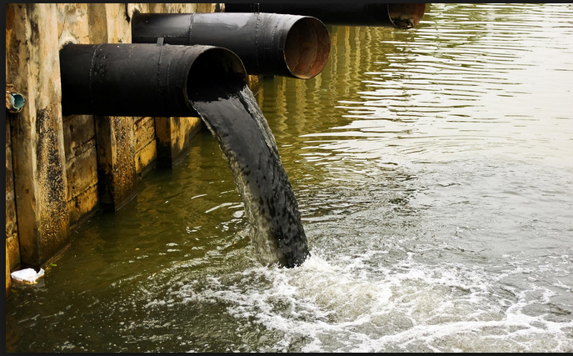
How Much is Too Much?
Notes:
Difficult, in practice, to draw a line in the sand between “right amount” and “too much” negative externalities. From industry’s persepctive, this might be the right amount. But not from the viewpoint of someone living a few hundred yards downriver.
Harmful effects vary by items. For some items, a little bit can be very harmful while in other cases, the harm threshold is higher.
Strontium 90
Cyanide
Tobacco
Salt
Sugar

Slide 11
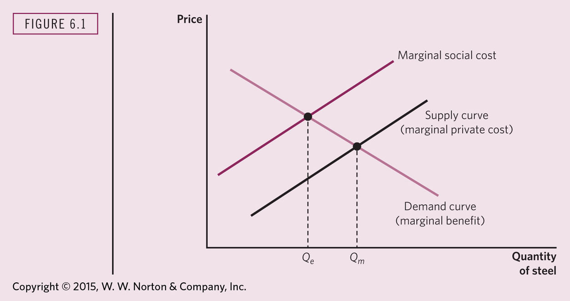
EXTERNALITIES AND OVER PRODUCTION
Notes:
Net welfare loss results from output at Q_{m}
Net welfare loss can exist in two situations. First, it exists when the marginal cost to society of a particular economic activity, such as manufacturing 200,000 computers, is greater than the marginal benefit to society. Secondly, it can exist when the marginal benefit of a given economic activity, such as producing 50,000m computers, is greater than the marginal cost.
The first situation can occur when the market produces 'too much', and the second when it produces 'too little'.

Slide 12
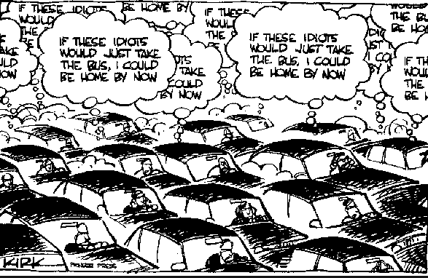
COMMON RESOURCE PROBLEM
What is the common resource here?
They refer to a pool of scarce resources to which access is unrestricted.
Can give rise to a common problem known as tragedy of the commons.
Imagine a lake stocked with fish in which the nearby town has universal access.
The extra output of an additional boat is less than the average output.
There will be an excessive number of boats.
Each additional boat reduces the catch of the other boats.
Notes:
A common resource is a resource, such as water or pasture, that provides users with tangible benefits. A major concern with common resources is overuse, especially when there are poor social-management systems in place to protect the core resource.
Common resources that are not owned by anyone are called open-access resources.
BREAKING DOWN 'Common Resource'
Overuse of common resources often leads to economic problems such as the tragedy of the commons, where user self-interest leads to the destruction of the resource in the long term, to the disadvantage of everyone.

Slide 13
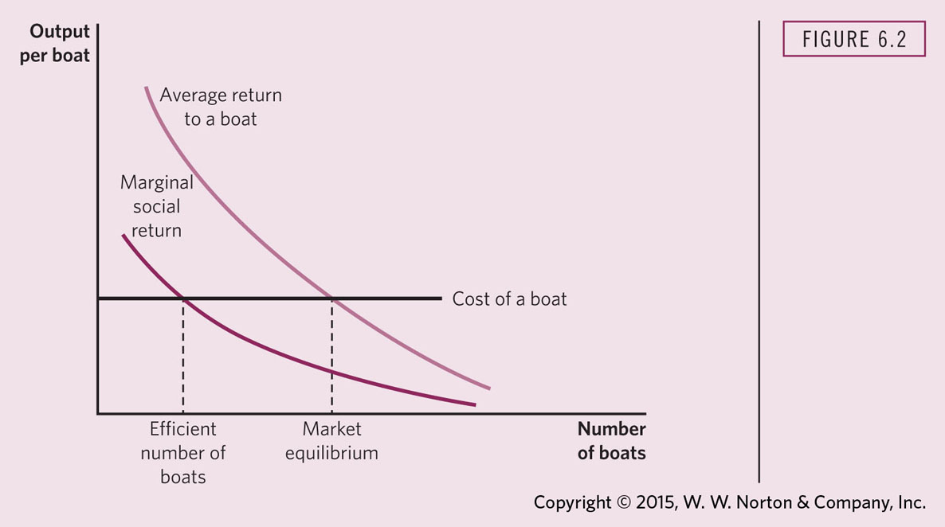
COMMON RESOURCE PROBLEM LEADS TO EXCESSIVE FISHING
Notes:
Unlike pure public goods, common pool resources face problems of congestion or overuse, because they are subtractable. A common-pool resource typically consists of a core resource (e.g. water or fish), which defines the stock variable, while providing a limited quantity of extractable fringe units, which defines the flow variable. While the core resource is to be protected or nurtured in order to allow for its continuous exploitation, the fringe units can be harvested or consumed.
This means that generally things are fine as long as the core is unaffected by fishing. Over-fishing that affects the core begins to deplete the supply of fish. Over time, the lake will stop providing fish.

Slide 14
MARKET-BASED SOLUTIONS TO COMMON RESOURCE
Levy a fine or tax in proportion to the amount of pollution.
Such a fine or tax would present the firm with the true social costs of its actions.
Pigouvian taxes—designed to make marginal private costs equal marginal social costs.
On the next slide, without a tax, the producers set price equal to MC thereby resulting in excessive production (and pollution).
Notes:
Pigouvian taxes are corrective taxes levied on each unit of output an externality-generator agent produces. It is named after economist Arthur C. Pigou, who developed the idea in his book “The Economics of Welfare”, 1920. Pigouvian taxes are used in order to diminish the ugly consequences of externalities, specially in highly polluting industries.

Slide 15
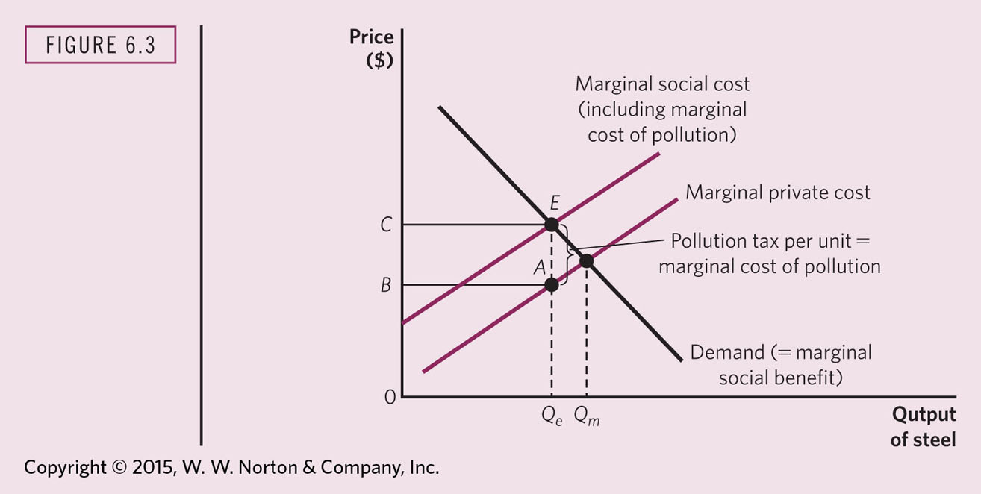
MARKET EQUILIBRIUM WITH AND WITHOUT FINES
Notes:
Consider the diagram below, which shows the graphical representation of a negative externality problem using a polluting factory as an example. The horizontal axis or x-axis measures the amount of output produced by the polluting factory and the vertical axis or the y-axis measures monetary units. The marginal benefit curve (MB) represents the marginal benefit of the factory for each level of production which declines as the amount of output increases. The marginal private cost curve (MPC) shows the marginal cost of the factory as output rises. The more the factory produces, the more it pollutes and hence the bigger the negative effects, which is represented by the marginal damage curve (MD). Lastly, the marginal social cost (MSC) represents the total marginal cost for the whole society, and is constructed by adding together the private costs (which directly translate to higher prices) and social costs.
In this scenario, we have a negative externality equal to E, and the equilibrium is set at an output level of Q_{A}at a price P_{A}. A Pigouvian tax could be imposed, in order to eliminate such negative externality. This tax would decrease the output produced to Q_{S}, and increase price to P_{S}, being this a socially efficient equilibrium.

Slide 16
EFFICIENT POLLUTION CONTROL
Firms can reduce pollution by producing less or changing production methods.
  Can also charge more for product, which should result in lower demand; but firm will not willingly charge more must have an incentive.
Fines related directly to the amount of pollution will ensure that firms will use the most efficient pollution abatement methods.
The efﬁcient level of pollution can be attained either by charging ﬁrms a ﬁne of f* per unit of pollution (say, measured by the number of particles added to the air) or by imposing a regulation that ﬁrms have a pollution abatement level P*.
Notes:
Pigouvian taxes alter firm’s decision to produce by increasing their costs and lowering profits. Tax can be levied on producers or consumers. Either way it reduces demand for the good. Example is tobacco tax. Tariffs can be viewed as a form of Pigouvian tax on imported goods. In this case, the tax is designed to make foreign goods more expensive in comparison with domestic goods. In an earlier era, this was more feasible and effective than today.
Alternatively, government can pay firms to produce less or install machinery that reduces the amount of pollution emitted.

Slide 17
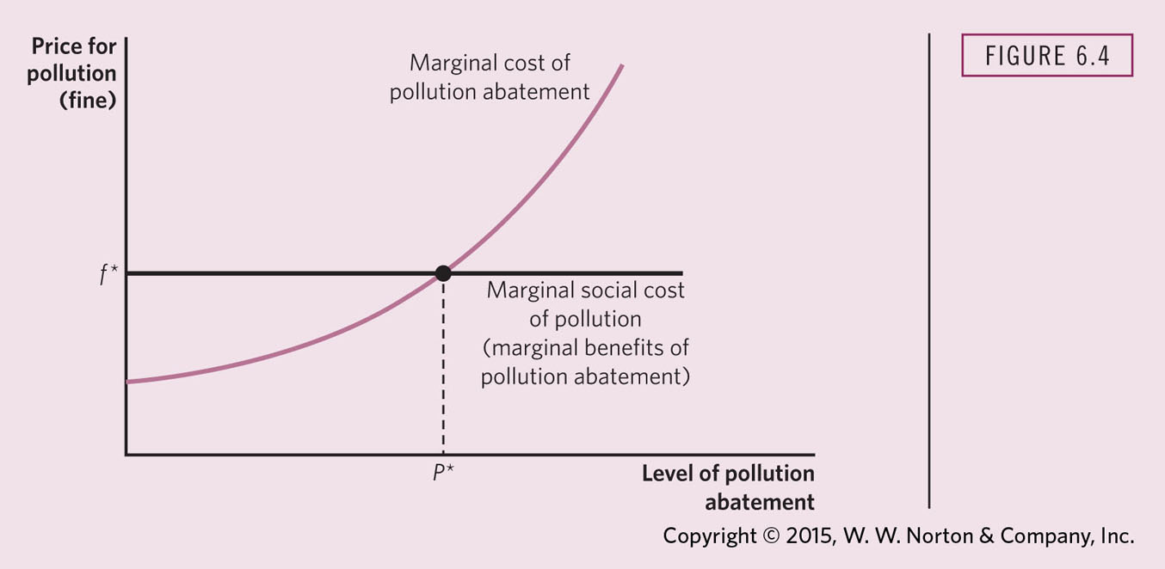
EFFICIENT CONTROL OF POLLUTION
Notes:
Assumes a fixed marginal social cost of pollution and rising costs of pollution abatement.

Slide 18
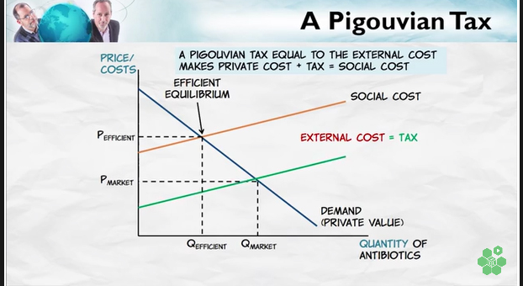
EFFECTS OF A PIGOUVIAN TAX
Notes:
At the market price, the quantity demanded does not take account of the social price. In order to bring the quantity into line with social costs, a tax equal to social cost must be imposed. This is represented by the Orange line. The Orange line intersects the demand at Q_{efficient} . This results in a socially efficient level of femand.

Slide 19
POLLUTION ABATEMENT SUBSIDIES
Firms have little incentive to make expenditures on pollution abatement.
Rather than taxing pollution, government could subsidize the firms’ pollution abatement expenditures.
By subsidizing the purchase of pollution abatement equipment (by the difference between marginal social beneﬁt of pollution abatement and marginal private beneﬁt), an efﬁcient level of expenditure on pollution abatement can be attained.
Notes:
Pigouvian subsidy. Whereas pigouvian taxes are meant to discourage causing negative externalities, a pigouvian subsidy would be a reward for creating positive externalities.
One way to do this is the government would create an incentive for creating positive externalities by offering monetary rewards. Though entrepreneurs cannot still charge their “consumer”, they get at least an opportunity to make money from their activities. Needless to say some checks should be implemented to prevent abuse of such subsidies.

Slide 20
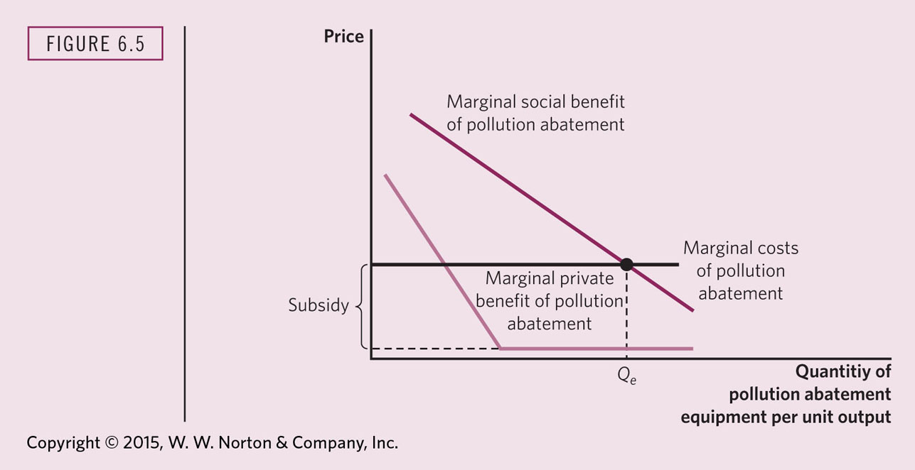
POLLUTION ABATEMENT SUBSIDIES
Notes:
As pollution decreases, the marginal social benefit from further pollution abatement decreases. In this graph, we assume that marginal costs are constant.
In this graph, the MC curve represents the private demand for pollution abatement, which is socially inefficient because it’s too low. MSB represents the social demand for pollution abatement. By lowering the price for the firm of purchasing pollution abatement equipment, it decreases the MC and increases consumption (the firm purchases more of it). Now the quantity demanded is more in line with the MSB. However, it is still not at Q_{E} But this unfortunately is not the end of the story!

Slide 21
POLLUTION ABATEMENT SUBSIDIES
The problem is that this remedy does not attain a socially efficient resource allocation.
Even after the pollution abatement subsidy, the equilibrium level of output of steel is still inefﬁcient; the ﬁrm fails to take into account the extra costs of public subsidies for pollution abatement associated with increased output of steel as well as the marginal social cost of any remaining pollution.
As before, the MSC of steel production exceeds the marginal private cost.
Notes:
Public subsidies require additional costs in the form of administration of the tax required to support the subsidy. As the subsidy increases with firm’s output so too do the deadweight loss associated with the subsidy. Therefore, a tax is more efficient that a Pigouvian subsidy.

Slide 22
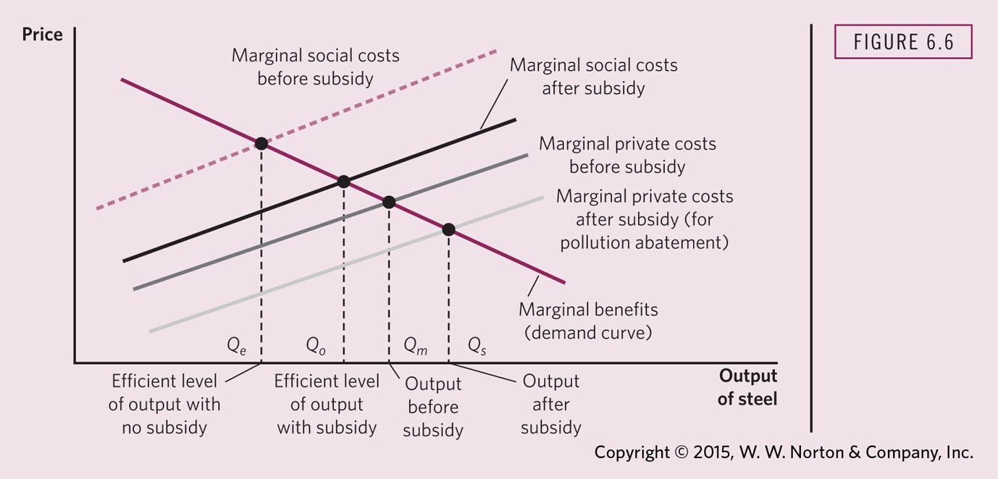
MARKET EQUILIBRIUM WITH POLLUTION ABATEMENT SUBSIDIES

Slide 23
PRIVATE SECTOR SOLUTIONS TO EXTERNALITIES
Are externalities really outside the market?
Key question raised by Ronald Coase.
Internalizing the externality: When either private negotiations or government action lead the price to the party to fully reflect the external costs or benefits of that party’s actions.
Coase Theorem (Part I): When there are well-defined property rights and costless bargaining, then negotiations between the party creating the externality and the party affected by the externality can bring about the socially optimal market quantity.
Notes:
Coase’s Theorem implies that government action is not always necessary, at least in theory.

Slide 24
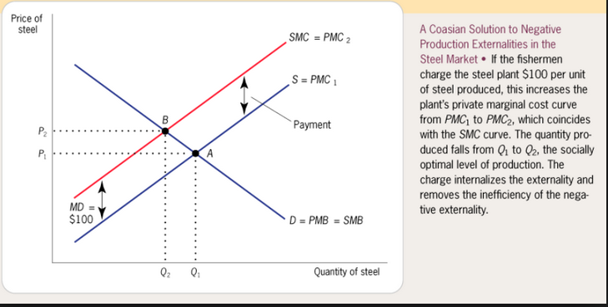
USING COASE TO CORRECT EXTERNALITIES
Notes:
In this example, the fishermen own the property rights to use of the stream and are able to charge the steel company for its use. Again, this is how externalities can be internalized, in theory.
In practice, the allocation of property rights in this way may be difficult to achieve. Property rights are not always allocated in the public interest.

Slide 25
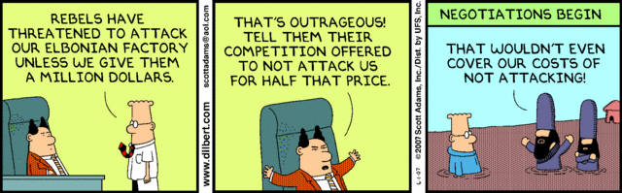
PRIVATE SECTOR SOLUTIONS TO EXTERNALITIES
Coase Theorem (Part II): The efficient solution to an externality does not depend on which party is assigned the property rights, as long as someone is assigned those rights.
Coase’s is appealing to economists because it represents a market-based solution to externalities.
The advantage of the market is that avoids government coercion by letting everyone act on their own self-interest (in theory).
Notes:
Why is coercion a bad thing from an economics perspective? Because it imposes costs on the coercee. It is inefficient.

