Slide 1
Interpretive Research?

Slide 2
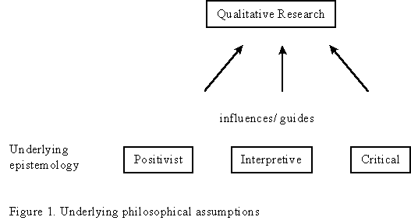
Underlying assumptions
(Myers, http://www.qual.auckland.ac.nz)

Slide 3

Questions?

Slide 4
1. Interpretive
The concept of interpretive research may also be known as
ethnographic
qualitative
participant observational
case study
symbolic interactionist
phenomenological
constructivist
Interpretive research studies the meaning of actions that occur, both in face-to-face interactions and in the wider society surrounding the immediate scene of action.
** To conduct interpretive research on a certain setting, intense and long-term participant observation is required, followed by deliberate and long-term reflection on what was observed.
??Questions regarding the observer's point of view, previously learned formal theories, cultural conditioning,
Interpretive researchers start out with the assumption that access to reality (given or socially constructed) is only through social constructions such as language, consciousness and shared meanings.
Interpretive studies generally attempt to understand phenomena through the meanings that people assign to them and
interpretive methods of research in IS are "aimed at producing an understanding of the context of the information system, and the process whereby the information system influences and is influenced by the context
Interpretive research does not predefine dependent and independent variables, but focuses on the full complexity of human sense making as the situation emerges

Slide 5
2. Positivist
Positivists generally assume that reality is objectively given and can be described by measurable properties which are independent of the observer (researcher) and his or her instruments. Positivist studies generally attempt to test theory, in an attempt to increase the predictive understanding of phenomena

Slide 6
Critical Research
Critical researchers assume that social reality is historically constituted and that it is produced and reproduced by people. Although people can consciously act to change their social and economic circumstances, critical researchers recognize that their ability to do so is constrained by various forms of social, cultural and political domination. The main task of critical research is seen as being one of social critique, whereby the restrictive and alienating conditions of the status quo are brought to light. Critical research focuses on the oppositions, conflicts and contradictions in contemporary society, and seeks to be emancipatory i.e. it should help to eliminate the causes of alienation and domination.

Slide 7
Interpretive research
Observational research method developed by social anthropologists in which customers are observed in their natural setting and their behavior is interpreted based on an understanding of social and cultural characteristics; also known as ethnography, or “going native.”

Slide 8
Interpretive Studies as Defined
(Orlikowski and Baroudi 1991)
‘Interpretive studies assume that people create and associate their own subjective and intersubjective meanings as they interact with the world around them.
Interpretive researchers thus attempt to understand phenomena through accessing the meanings participants assign to them

Slide 9
Interpretive Methods
(Walsham 1993)
‘Interpretive methods of research start from the position that our knowledge of reality, including the domain of human action, is a social construction by human actors and that this applies equally to researchers.
Thus there is no objective reality which can be discovered by researchers and replicated by others, in contrast to the assumptions of positivist science’

Slide 10
Interpretive View of Data
(Geertz 1973)
‘What we call our data are really our own constructions of other people’s constructions of what they and their compatriots are up to’

Slide 11
What is Interpretive Research?
Interpretive research focuses on identifying, documenting, and ‘knowing’ – through interpretation of :
  world views,
  values,
  meanings
  beliefs,
  thoughts and
  the general characteristics of life events, situations, ceremonies and specific phenomena under investigation,–

Slide 12
Goal :Interpretive Research?
with the goal being to document and interpret as fully as possible the totality of whatever is being studied in particular contexts from the people’s viewpoint or frame of reference’
Leininger, M. (1985) Qualitative Research Methods in Nursing. Orlando, Fla. : Grune & Stratton, p. 5.

Slide 13
Interpretive View of Knowledge
(Orlikowski and Baroudi 1991)
‘Social process is not captured in hypothetical deductions, covariances and degrees of freedom. Instead, understanding social process involves getting inside the world of those generating it’

Slide 14
Theory and Practice
(Orlikowski and Baroudi 1991)
‘The interpretive research approach towards the relationship between theory and practice is that the researcher can never assume a value-neutral stance, and is always implicated in the phenomena being studied’
‘There is no direct access to reality unmediated by language and preconception’

Slide 15
Current Status of Interpretive Research in IS Literature
Better represented now compared to Orlikowski and Baroudi’s (1991) data
Some interpretive articles in ‘top’ journals such as MIS Quarterly and Information Systems Research (although still a small minority)
Information and Organization contains many interpretive studies
Other IS journals publish interpretive studies: European Journal of IS; Scandinavian Journal of IS; Information Society; IT & People etc.

Slide 16

Notes:
Follow your instincts – You already are familiar with foods and drinks that go together – and more importantly those that don’t

Slide 17
Data Collection
Survey
Field observation
Witness accounts
Interviews
Focus group discussion
Empathic neutrality

Slide 18
Analysis Method
Content Analysis
  Identifying, Coding, Categorizing the primary patterns in the data
    Interaction styles in online discussion: analyzing chat transcripts
      Complexity of response
      Question type
      Levels of argumentation & negotiation
      Socializing
      Coding Scheme

Slide 19
Scientific Trustworthiness
Credibility (internal validity)
  prolonged engagement, persistent observation, triangulation of sources, peer debriefing.
Transferability (external validity)
  THICK description of context, process, findings.

Slide 20
Scientific Trustworthiness
Dependability (reliability)
  sampling rationale, data collection, analysis. An external auditor to audit methodological decisions.
Confirmability (objectivity)
  consistency between data and interpretation; between investigators' and respondents' views. Observer bias--the ideas we come in with
  Observer effect--the impact of having someone do a study.

Slide 21
1. Naturalistic Inquiry
Studying real life situations as they unfold
Non-manipulative, unobstrusive, and noncontrolling
Openness to whatever emerges – lack of predetermined constraints on outcomes.
themes

Slide 22
Theme 2. Emergent design flexibility
Openness to changing inquiry as understanding deepens or situations change; responsive
Researcher avoids getting locked into rigid designs
themes
themes

Slide 23
3. Purposeful ‘Sampling’
Cases for study (people, organisations, events, cultures) are selected because they are the focus of interest
‘sampling’ can be emergent too
themes

Slide 24
4. Qualitative Data
Observations that yield detailed, ‘thick’ description
Interviews that capture people’s personal perspectives and experiences
Careful and close document analysis
themes

Slide 25
5. Personal Engagement
The researcher gets close to the people, situation, or phenomenon under study
Researcher’s personal experiences and insights are important in understanding the phenomenon
themes

Slide 26
6. Empathic Neutrality
The researcher takes an empathic stance to seek understanding without judgment
Shows openness, sensitivity, respect, awareness, responsiveness
themes

Slide 27
7. Systems awareness
Researcher alert to dynamics of systems
Attends to contextual complexity
themes

Slide 28
8. Inductive analysis
Immersion in the details and specifics of the data to identify important categories, themes, dimensions and inter-relationships
Begins by exploring then confirming
themes

Slide 29
9. Holistic perspective
The whole phenomenon under study is understood as a complex system that is more than the sum of parts
Focus on complex interdependencies NOT on a few discrete variables
themes

Slide 30
10. Credibility
Conveys findings with authenticity and trustworthiness
Uses data
Conveys understanding of the phenomenon in all its complexity
themes

Slide 31
INTERPRETIVE RESEARCH in MARKETING
• Provides insight into consumer behavior and the ways consumers interact with brands.
• Researcher spends time studying the culture, called ethnographic research.
• Focus is on understanding the meaning of the product or consumption in the consumer’s life.
• Cost is higher than other forms of research.
• Captures what consumers actually do, not just what they say they do.

Slide 32
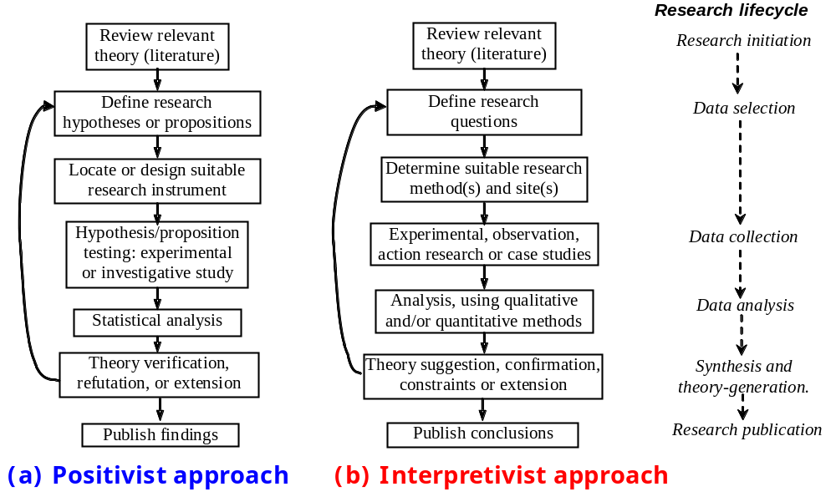
The Research Life-Cycle In Theory Generation
Tests/extends theory
Generates/explores theory

Slide 33
Qualitative Data Collection Vs. Qualitative Analysis
DATA
 | Qualitative | Quantitative
Qualitative | Interpretive content analysis studies. Hermeneutics, Phenomenology, Grounded Theory. | Search for and presentation of meaning in quantitative results. Explanations of findings Interpretation of statistical results Graphical displays of data Naming factors/clusters in factor analysis & cluster analysis
Quantitative | Post-positivist Content Analysis Turning words into numbers: Word Counts, Free Lists, Pile Sorts, etc. Statistical analysis of text frequencies; code co-occurrence | Positivist Research: Statistical & mathematical analysis of numeric data (e.g. regression). Multivariate analysis.
ANALYSIS
Source: Bernard, H.R. (1996) ‘Qualitative Data, Quantitative Analysis’, CAM, The Cultural Anthropology Methods Journal, Vol. 8 no. 1, available at http://www.analytictech.com/borgatti/qualqua.htm

Slide 34
Contributions of Qualitative Research
The contribution of qualitative research studies in IS can be:
The development of concepts
  e.g. “automate vs. informate" (Zuboff, 1988)
The generation of theory
  e.g. Orlikowski & Robey (1991): organizational consequences of IT.
The drawing of specific implications
  e.g. Walsham & Waema (1994): the relationship between design and development and business strategy.
The contribution of rich insight
  e.g. Suchman (1987): contrast of situated action with planned activity and its consequences for the design of organizational IT.
Walsham, G. (1995) ‘Interpretive Case Studies In IS Research: Nature and Method’, European Journal of Information Systems, No. 4, pp 74-81

Slide 35
Issues With Qualitative Research
How much data is enough?
How do you know that what you found is not what you were looking for?
Is it difficult to publish qualitative research studies?
Is qualitative research considered less acceptable than quantitative research?
Is this something that a PhD student should consider?

Slide 36

A Question
Q: If two researchers are presented with the same data, will they derive the same results if they use the same methods, applied rigorously?
Let’s find out!
Organize in groups of three(-ish) people.
Discuss themes arising from coded data (10 minutes)
Present findings: 5 minutes per group

