Slide 1
Considering Development Stage and Geography in Technology Transfer Public Policy
Malcolm S. Townes
Saint Louis University

Slide 2
Agenda
Significance and Importance
Research Questions and Hypotheses
Literature Review
Methodology and Data
Analysis
Limitations and Future Study
Open Discussion
Notes:
Intuitive concept.
No universal definition.

Slide 3
Defining Public Policy
“whatever governments choose to do or not do” (Dye, 1987).
“the sum total of government action, from signals of intent to the final outcomes”
(Cairney, 2016).
“the actions, objectives, and pronouncements of governments on particular matters, the steps they take (or fail to take) to implement them, and the explanations they give for what happens (or does not happen)” (Wilson, 2006).
Notes:
Intuitive concept.
No universal definition.

Slide 4
Significance and Importance

Slide 5
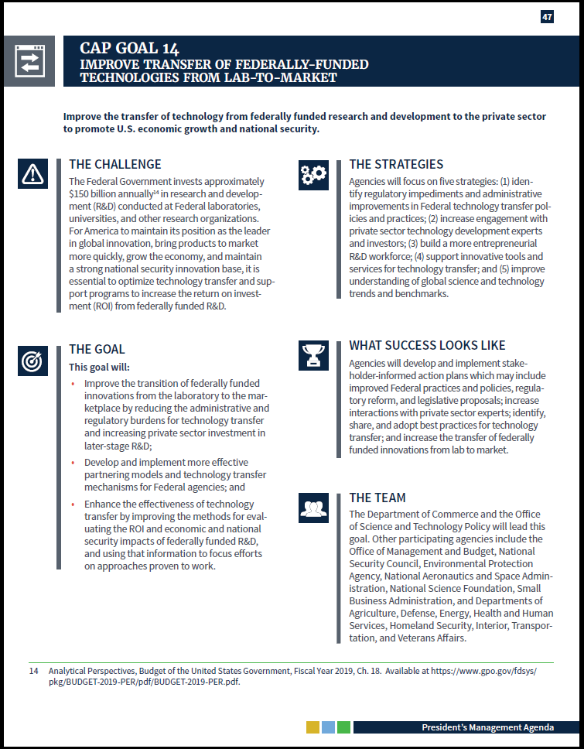

For America to maintain its position as the leader in global innovation, bring products to market more quickly, grow the economy, and maintain a strong national security innovation base, it is essential to optimize technology transfer and support programs to increase the return on investment (ROI) from federally funded R&D.
…increasing private sector investment in
later-stage R&D…
…more effective partnering models and technology transfer mechanisms…
…prior to 1980, only 5 percent of government-owned patents had ever been used by industry.
…improving the methods for evaluating
the ROI and economic and national
security impacts of federally funded R&D…
Source: OMB, 2018.
Schact (2012) as cited in Tseng & Raudensky, 2014
Notes:
Criteria: The government has decided that the issue is a societal problem that must be addressed.

Slide 6
Source: “CMS Medicare Budget Overview,” 2018. ; “US Spending”, nd.
Notes:
Criteria: The issue involves a significant amount of limited resources.
“CMS Medicare Budget Overview.” 2018. Centers for Medicare and Medicaid Services. U.S. Department of Health & Human Services. Retrieved from https://www.hhs.gov/about/budget/fy2018/budget-in-brief/cms/medicare/index.html.
US Spending. (n.d.) USGovernmentSpending.com. Retrieved from https://www.usgovernmentspending.com/year_spending_2018USbn_20bs2n_4041_605#usgs302

Slide 7
Notes:
Criteria: The issue has a significant impact on general societal welfare.

Slide 8
Literature Review

Slide 9
Literature Review
Construct
Technology
Literature
Limitations
Construct
Technology Transfer
Literature
The conveyance from one person or entity to another person or entity of a capability to perform a useful task or replicate a beneficial accomplishment.
Limitations

Slide 10
Literature Review
Construct
Technology Transfer Policy
Literature
[Text]
Limitations
Construct
Defining Success
Literature
[Text]
Limitations

Slide 11
Literature Review
Construct
Success Factors
Literature
[Text]
Limitations
Construct
Stage & Geography
Literature
[Text]
Limitations

Slide 12
Research Questions and Hypotheses

Slide 13
Research Questions
Q1 | What public policy alternatives are available for increasing the transfer of technologies derived from federally-funded research and development (R&D) to the private sector taking into consideration the potential role of development stage in technology transfer outcomes?
Q2 | Is there a statistically significant association between development stage of a federally-funded R&D project and the successful transfer to the private sector of technology derived from the R&D project?
Q3 | Is there a statistically significant association between how far a federally-funded R&D project progresses through the stages of the technology development process and the spatial distance between where the R&D project is conduct and the nearest city?
Q4 | Is there a statistically significant association between the successfully transfer to the private sector of technology derived from federally-funded R&D projects and the spatial distance between where the R&D project is conduct and the nearest city?
Policy Alternatives
Development Stage
Development Stage & Geography
Geography

Slide 14
Hypotheses
H1₀ | Technologies derived from federally-funded R&D projects that progress further along the development process are NOT transferred to the private sector at significantly greater rates than technologies derived from federally-funded R&D projects that don’t progress very far in the development process.
H1_{A} | Technologies derived from federally-funded R&D projects that progress further along the development process are transferred to the private sector at significantly greater rates than technologies derived from federally-funded R&D projects that don’t progress very far in the development process.
H2₀ | The spatial distance between where the R&D project is conducted and the nearest city is NOT negatively associated (i.e., either positively associated or not associated) with the final development stage attained by the R&D project.
H2_{A} | The spatial distance between where the R&D project is conducted and the nearest city is negatively associated with the final development stage attained by the R&D project.
H3₀ | Instances of technologies derived from federally-funded R&D projects that are successfully transferred to the private sector are NOT negatively associated (i.e., either positively associated or not associated) with the spatial distance between where the R&D project is conducted and the nearest city.
H3_{A} | Instances of technologies derived from federally-funded R&D projects that are successfully transferred to the private sector are negatively associated with the spatial distance between where the R&D project is conducted and the nearest city.

Slide 15
Methodology and Data

Slide 16
Methodology
Qualitative
Content Analysis
Quantitative
Logistic Regression
Kendall’s Tau
Qualitative
PPA
Delphi Technique
Logic Model
Research Question 1
Research Question 1
Research Question 2
Research Question 3
Research Question 4

Slide 17
Operationalization
Construct
Technology
Operationalization
Variables and Data
Construct
Technology Transfer
Operationalization
Variables and Data

Slide 18
Operationalization
Construct
Development Stage
Operationalization
Variables and Data
Construct
City
Operationalization
Variables and Data

Slide 19

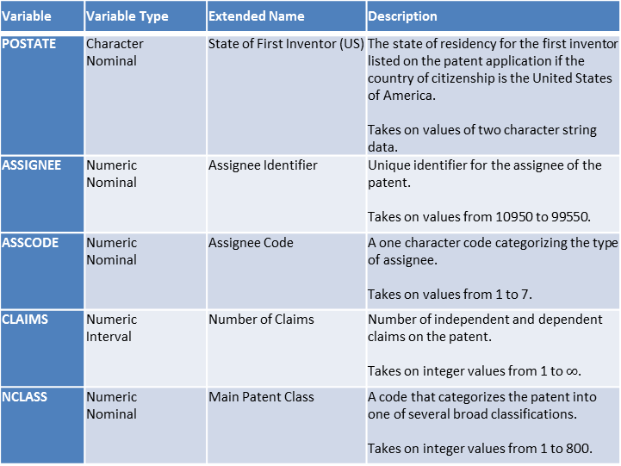
Original USPTO Variables from Source Data
Variable | Variable Type | Extended Name | Description
PATENT | Numeric Nominal | Patent Number | The number assigned to the allowed patent by the USPTO. Takes on values integer values between 3070801 and 6009554.
GYEAR | Numeric Interval | Grant Year | The year the USPTO allowed the patent. Takes on integer values between 1963 – 1999.
GDATE | Numeric Interval | Grant Date | The date the USPTO allowed the patent expressed in terms of the number of weeks elapsed since January 1, 1960. Takes on integer values between 156 and 2,028.
APPYEAR | Numeric Interval | Application Year | The year the patent application was submitted to the USPTO. Takes on integer values between 1963 – 1999.
COUNTRY | Character Nominal | Country of First Inventor | The country of citizenship for the first inventor listed on the patent application. Takes on values of two character string data.
Variable | Variable Type | Extended Name | Description
POSTATE | Character Nominal | State of First Inventor (US) | The state of residency for the first inventor listed on the patent application if the country of citizenship is the United States of America. Takes on values of two character string data.
ASSIGNEE | Numeric Nominal | Assignee Identifier | Unique identifier for the assignee of the patent. Takes on values from 10950 to 99550.
ASSCODE | Numeric Nominal | Assignee Code | A one character code categorizing the type of assignee. Takes on values from 1 to 7.
CLAIMS | Numeric Interval | Number of Claims | Number of independent and dependent claims on the patent. Takes on integer values from 1 to $∞$.
NCLASS | Numeric Nominal | Main Patent Class | A code that categorizes the patent into one of several broad classifications. Takes on integer values from 1 to 800.
National Bureau of Economic Research. (2018). Patent data, including constructed variables [data file]. Retrieved from http://www.nber.org/patents/
Hall, B. H., Jaffe, A. B. and Trajtenberg, M. (2001). "The NBER Patent Citation Data File: Lessons, Insights and Methodological Tools." NBER Working Paper 8498. Retrieved from http://www.nber.org/patents/

Slide 20
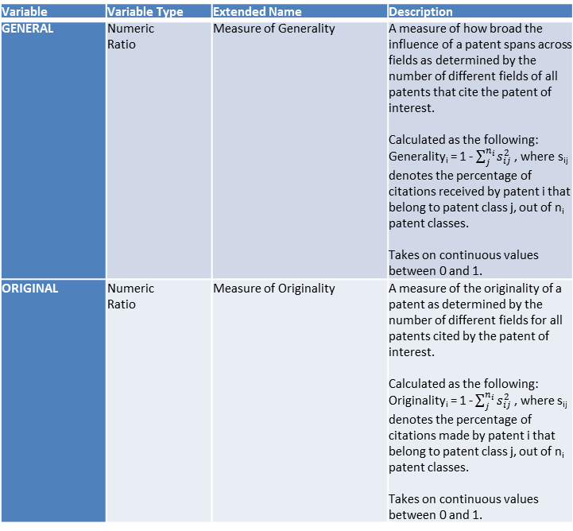
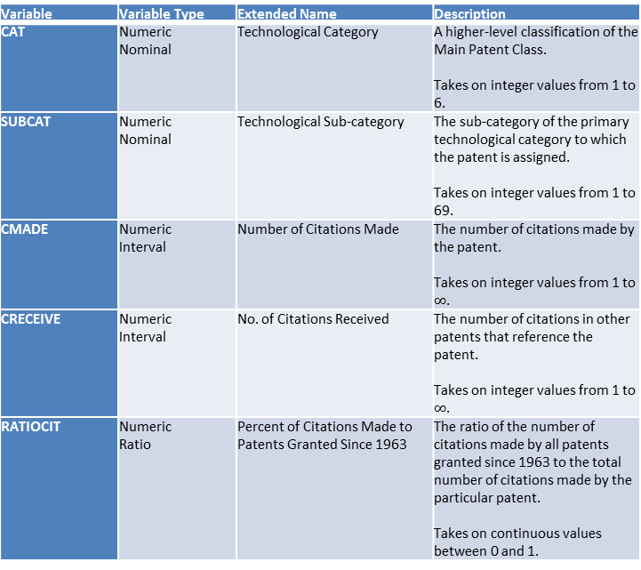
Original Constructed Variables from Source Data
Variable | Variable Type | Extended Name | Description
CAT | Numeric Nominal | Technological Category | A higher-level classification of the Main Patent Class. Takes on integer values from 1 to 6.
SUBCAT | Numeric Nominal | Technological Sub-category | The sub-category of the primary technological category to which the patent is assigned. Takes on integer values from 1 to 69.
CMADE | Numeric Interval | Number of Citations Made | The number of citations made by the patent. Takes on integer values from 1 to $∞$.
CRECEIVE | Numeric Interval | No. of Citations Received | The number of citations in other patents that reference the patent. Takes on integer values from 1 to $∞$.
RATIOCIT | Numeric Ratio | Percent of Citations Made to Patents Granted Since 1963 | The ratio of the number of citations made by all patents granted since 1963 to the total number of citations made by the particular patent. Takes on continuous values between 0 and 1.
Variable | Variable Type | Extended Name | Description
GENERAL | Numeric Ratio | Measure of Generality | A measure of how broad the influence of a patent spans across fields as determined by the number of different fields of all patents that cite the patent of interest. Calculated as the following: Generality_{i} = 1 - $\sum_{j}^{n_{i}}{s_{ij}^{2}}$ , where s_{ij} denotes the percentage of citations received by patent i that belong to patent class j, out of n_{i} patent classes. Takes on continuous values between 0 and 1.
ORIGINAL | Numeric Ratio | Measure of Originality | A measure of the originality of a patent as determined by the number of different fields for all patents cited by the patent of interest. Calculated as the following: Originality_{i} = 1 - $\sum_{j}^{n_{i}}{s_{ij}^{2}}$ , where s_{ij} denotes the percentage of citations made by patent i that belong to patent class j, out of n_{i} patent classes. Takes on continuous values between 0 and 1.
National Bureau of Economic Research. (2018). Patent data, including constructed variables [data file]. Retrieved from http://www.nber.org/patents/
Hall, B. H., Jaffe, A. B. and Trajtenberg, M. (2001). "The NBER Patent Citation Data File: Lessons, Insights and Methodological Tools." NBER Working Paper 8498. Retrieved from http://www.nber.org/patents/

Slide 21
Original Constructed Variables from Source Data (cont’d)
Variable | Variable Type | Extended Name | Description
FWDAPLAG | Numeric Ratio | Mean Forward Citation Lag | The mean time difference between the application or grant date of the patent and that of the other patents citing this patent. Takes on continuous values between 0 and 1.
BCKGTLAG | Numeric Ratio | Mean Backward Citation Lag | The mean time difference between the application or grant date of the patent and that of the patents it cites. Takes on continuous values between 0 and 1.
SELFCTUB | Numeric Ratio | Share of Self-Citations Made – Upper Bound | The number of citations made by the patent to other patents with the same assignee divided by the total number of citations made by all patents with assignee codes. Takes on continuous values between 0 and 1.
SELFCTLB | Numeric Ratio | Share of Self-Citations Made – Lower Bound | The number of citations made by the patent to other patents with the same assignee divided by the total number of citations made by all patents. Takes on continuous values between 0 and 1.
Variable | Variable Type | Extended Name | Description
SECUPBD | Numeric Ratio | Share of Self-Citations Received – Upper Bound | The number of citations received by the patent from other patents with the same assignee divided by the total number of citations received by all patents with assignee codes. Takes on continuous values between 0 and 1.
SECDLWBD | Numeric Ratio | Share of Self-Citations Received – Lower Bound | The number of citations received by the patent from other patents with the same assignee divided by the total number of citations received by all patents. Takes on continuous values between 0 and 1.
National Bureau of Economic Research. (2018). Patent data, including constructed variables [data file]. Retrieved from http://www.nber.org/patents/
Hall, B. H., Jaffe, A. B. and Trajtenberg, M. (2001). "The NBER Patent Citation Data File: Lessons, Insights and Methodological Tools." NBER Working Paper 8498. Retrieved from http://www.nber.org/patents/

Slide 22
Data Analysis

Slide 23
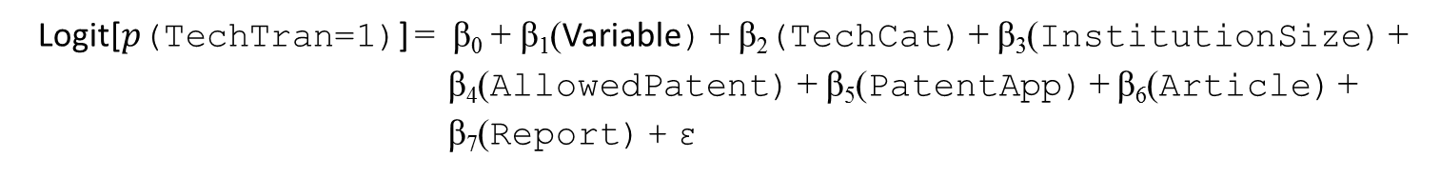




Logistic Regression Analyses
Logit[$p$(TechTran=1)] = β₀ + β₁(Variable) + β₂(TechCat) + β₃(InstitutionSize) + β₄(AllowedPatent) + β₅(PatentApp) + β₆(Article) + β₇(Report) + ε
H1: Variable = TRL
H₀: β₁ $=$ 0
Coding for TechTran:
1 = Technology was transferred
0 = Technology was NOT transferred
H3: Variable = Distance
H_{A}: β₁ $≠$ 0
TRL = β₀ + β₁(Distance) + β₂(TechCat) + β₃(InsistutionSize) +
β₄(AllowedPatent) + β₅(PatentApp) + β₆(Article) + β₇(Report) + ε
H2₀: β₁ $=$ 0
H2_{A}: β₁ $≠$ 0
Notes:
Excluded CMADE and RATIOCIT because of logical reasoning.
Excluded other predictor variables that were not continuous interval.

Slide 24
Kendall’s Tau

Slide 25
Limitations and Future Study
Obtain more current data.
Buffer the sample data on the front and back time period to minimize truncation.
Repeat multiple regression and hierarchical regression analyses using the
natural logarithm of the number of citations received as dependent variable.
Repeat binary logistic regression using a mean split instead of median split.
Modify path model using the measure of generality as the primary endogenous independent variable instead of the number of claims.
Separate independent claims and dependent claims as distinct variables.
Include patent classifications and sub-classifications as an indicator of generality.
Control for the patent categories.
Consider the effects of technology readiness level (TRL).

Slide 26
Policy Implications
Provides information to help both industry professionals and policymakers better understand the drivers of the technology transfer outcomes.
Identifies possible factors that should be considered when forming public policy regarding technology transfer.
Suggests that considering non-transactional measures of technology transfer may be feasible.
Affect the objectives of policymakers with regard to technology transfer.
Influence how policymakers think about technology transfer and how they formulate public policy to increase the transfer of federally-funded research to the private sector.

Slide 27
Acknowledgements
Enter text.

Slide 28
Questions and Suggestions
Open Discussion

Slide 29
References
Cairney, P. (2016). What is Policy? Retrieved April 11, 2019, from https://paulcairney.wordpress.com/2016/03/04/what-is-policy-3/
“CMS Medicare Budget Overview.” 2018. Centers for Medicare and Medicaid Services. U.S. Department of Health & Human Services. Retrieved from https://www.hhs.gov/about/budget/fy2018/budget-in-brief/cms/medicare/index.html.
Dye, T. R. (1976). Understanding Public Policy. Upper Saddle River, NJ: Prentice-Hall.
Office of Management and Budget [OMB]. (2018). The President's Management Agenda. Retrieved from https://www.whitehouse.gov/wp-content/uploads/2018/03/Presidents-Management-Agenda.pdf
“US Spending”. nd. USGovernmentSpending.com. Retrieved from https://www.usgovernmentspending.com/year_spending_2018USbn_20bs2n_4041_605#usgs302

