Slide 1
A Spatial Analysis of Race and Poverty in the Springfield, Missouri Metropolitan Statistical Area
Malcolm Townes
SOC 5670 Spatial Demography
Saint Louis University
Preliminary Results
April 30, 2020

Slide 2
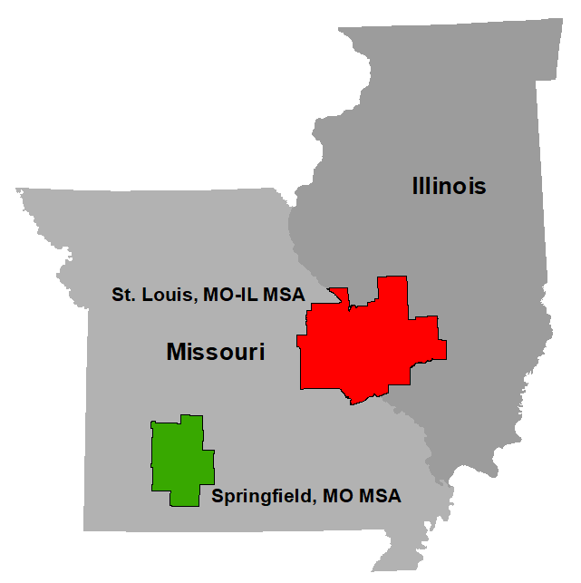
Why Springfield, Missouri?
Seat of government for Greene County
Largest school district in the state of Missouri
Unique historical context
Within a slave state that remained in the Union
Strategically important during the Civil War
Slavery was less economically-driven
Lynching used to expel rather than control
Instances of racially integrated neighborhoods as far back as the early 1900s

Slide 3
Research Question
Is there a statistically significant association between poverty and race when controlling for certain factors including potential spatial processes?
Hypothesis
H₁
There a positive association between poverty and the Black population ratio when controlling for certain factors including potential spatial processes.
H₂
The association between poverty and the Black population ratio is greater than the association between poverty and the White population ratio when controlling for certain factors including potential spatial processes.

Slide 4
Dependent Variable
Data
Poverty ratio
American Community Survey (ACS)
2014-2018 5-year estimates
SocialExplorer.com
U.S. Census Bureau
TIGER/line shapefile database of the
metropolitan and micropolitan statistical areas (MSAs) for the United States
Independent Variables
Black population ratio
White population ratio
Education attainment
Median household income
Population density

Slide 5
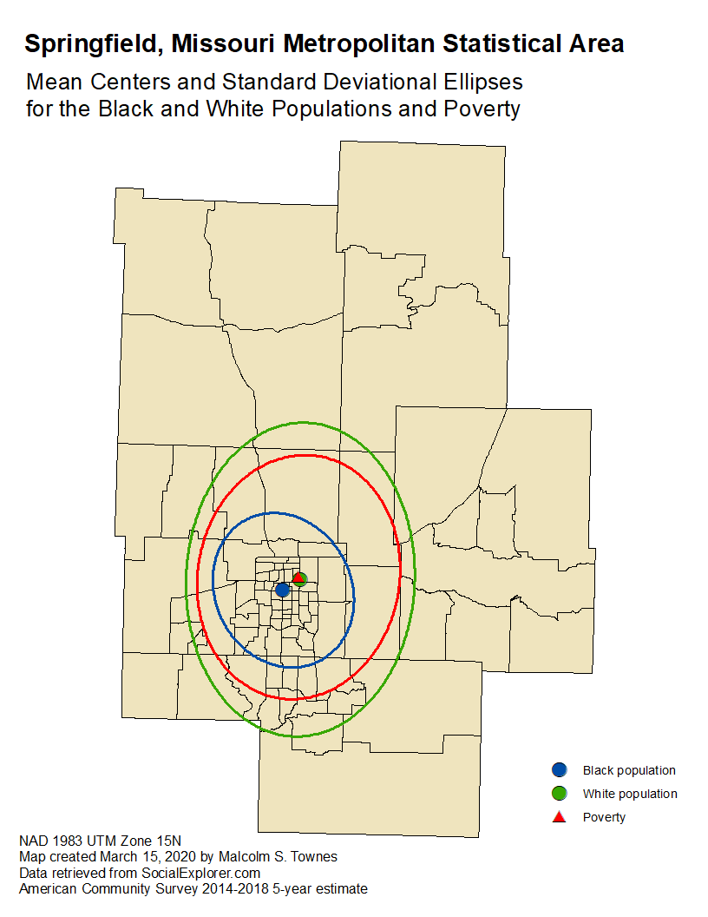

Slide 6
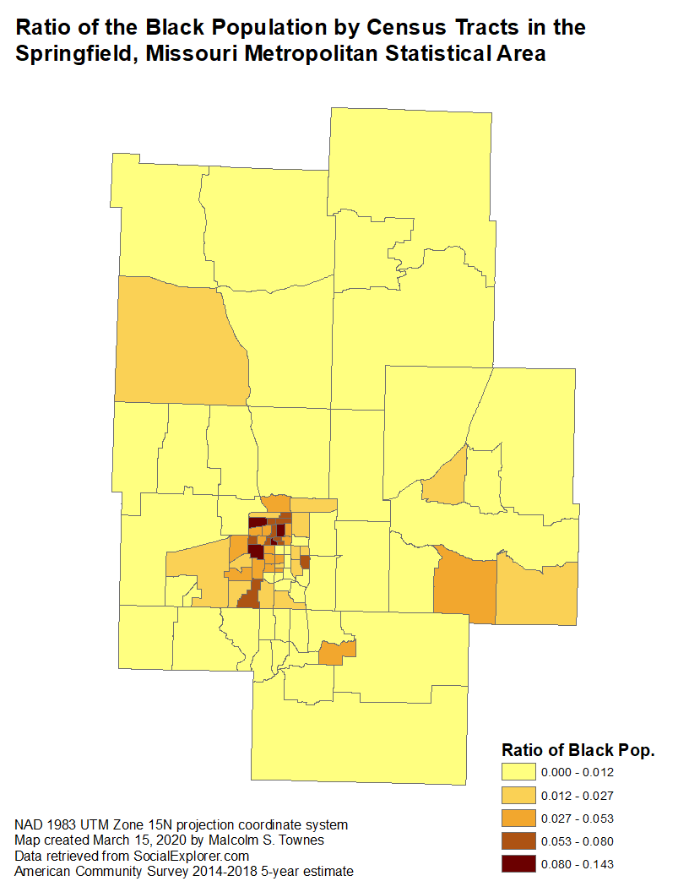
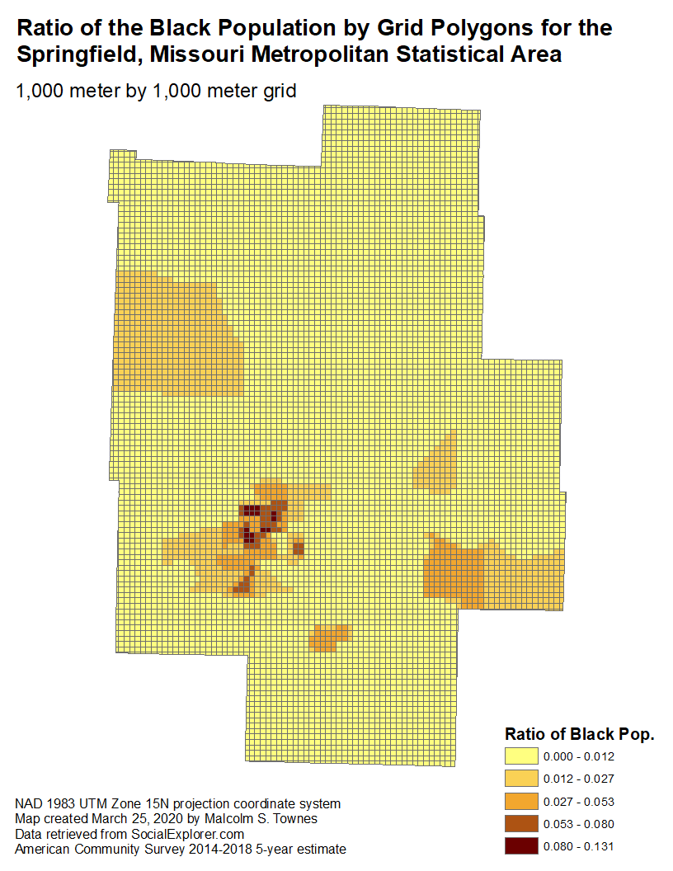

Slide 7
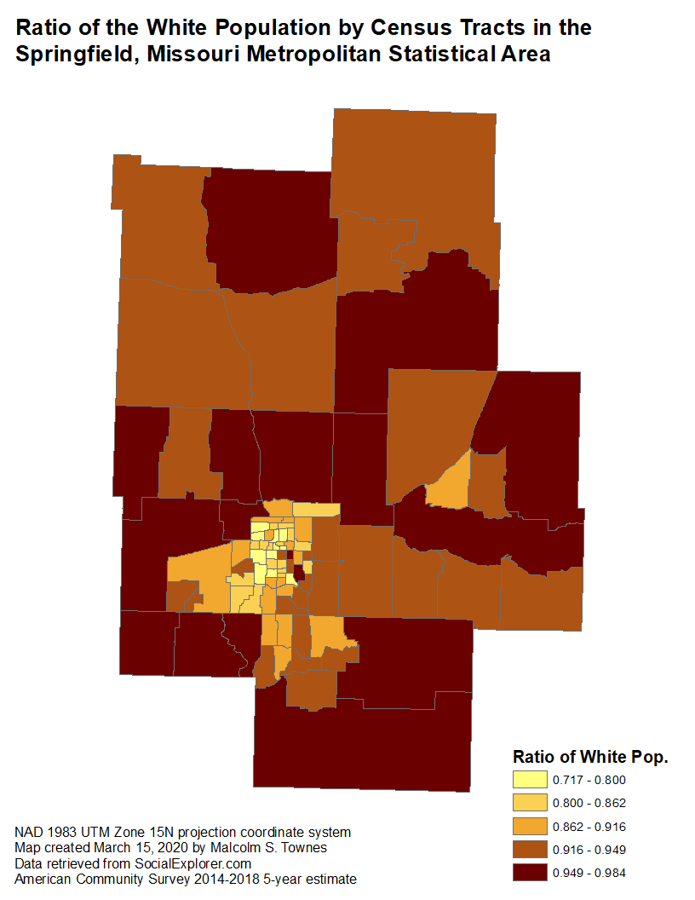
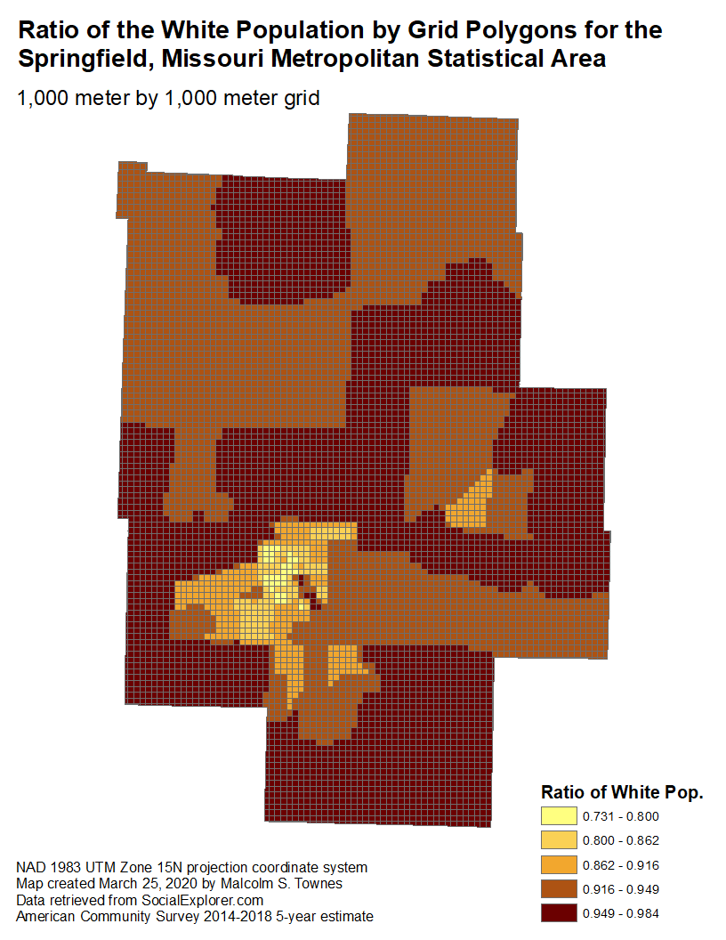

Slide 8
Table created by Dr. J. S. Onésimo Sandoval, Saint Louis University

Slide 9
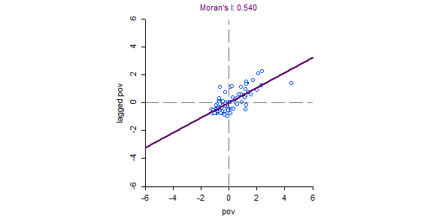
Global spatial autocorrelation for poverty ratio

Slide 10
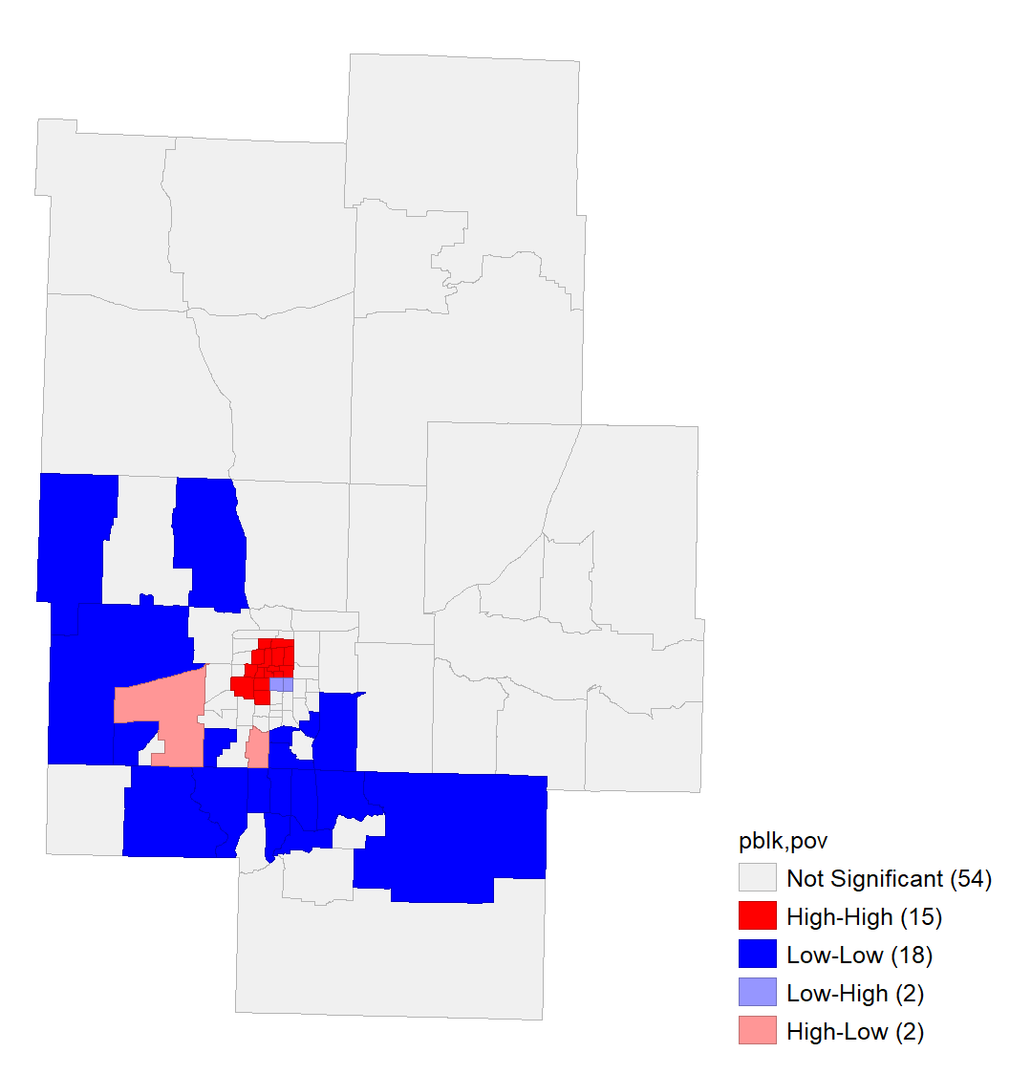
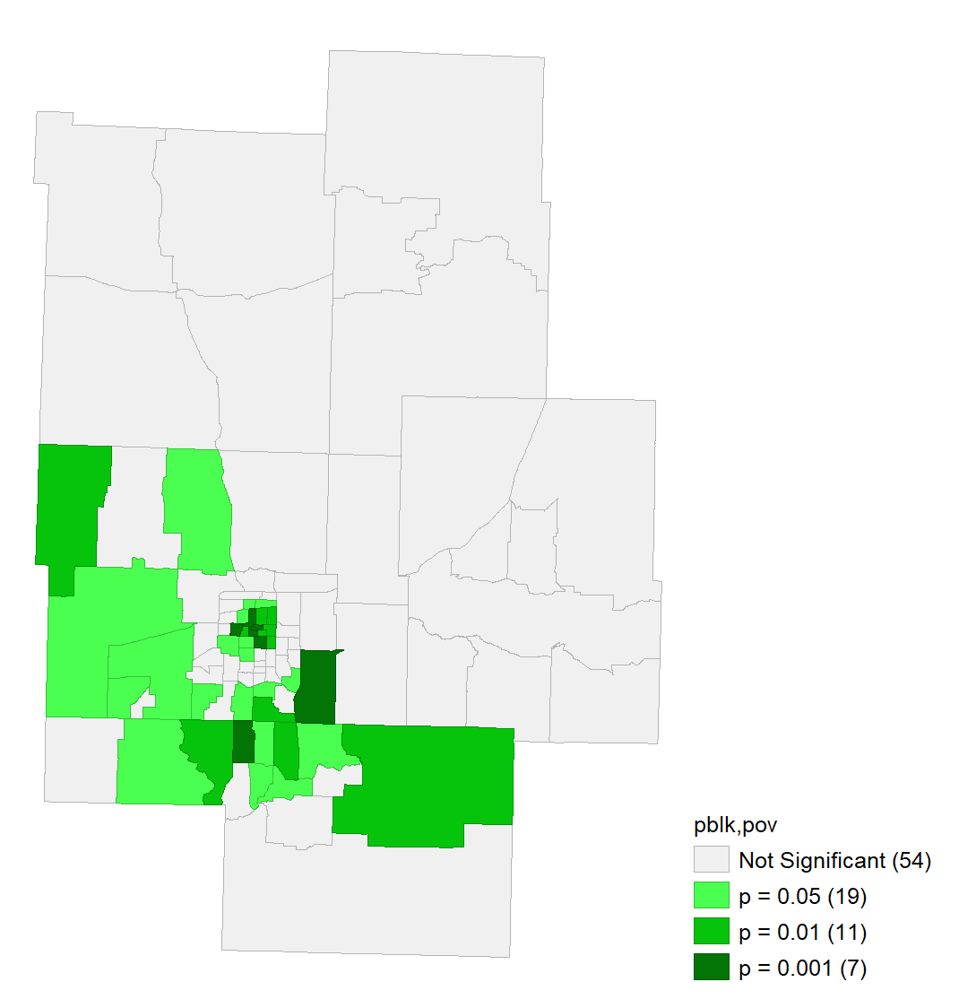
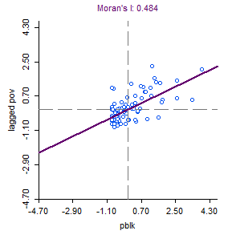
Bivariate LISA indicates mostly positive spatial autocorrelation between Black population ratio and poverty.

Slide 11
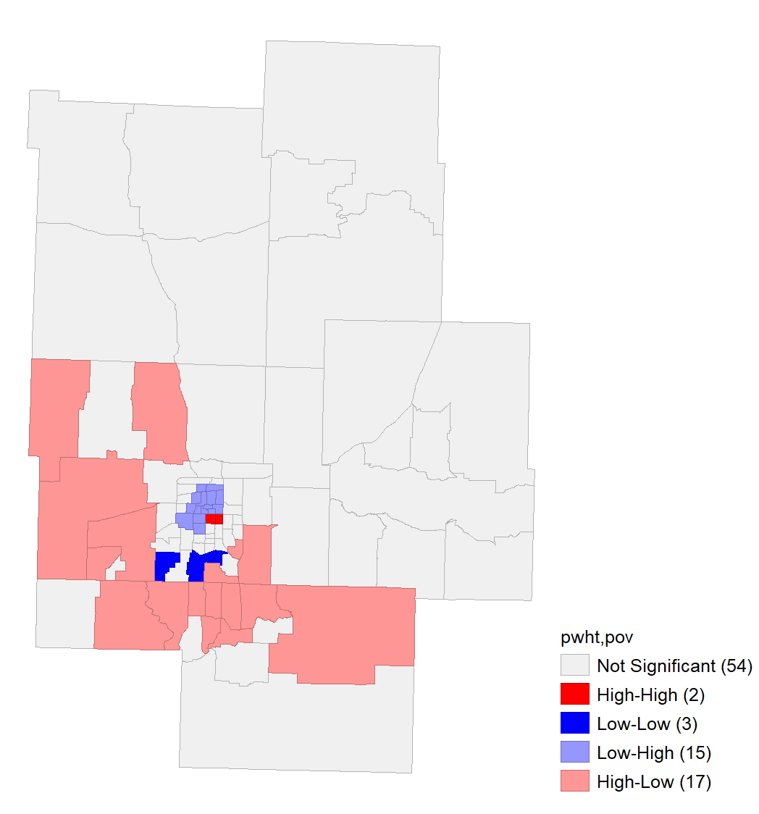
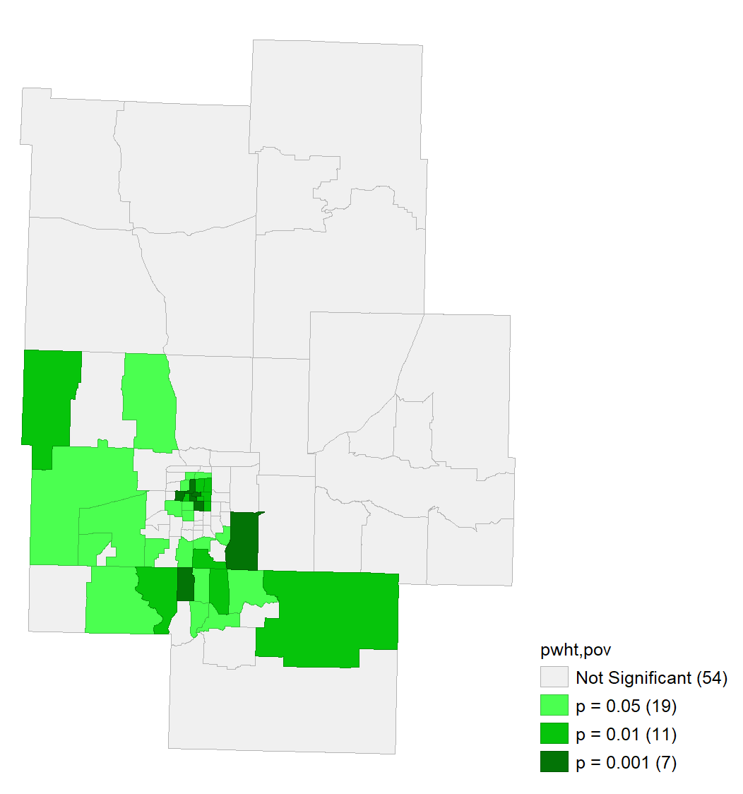
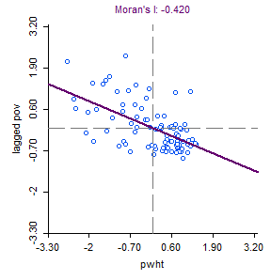
Bivariate LISA indicates mostly negative spatial autocorrelation between White population ratio and poverty.

Slide 18
Questions and Discussion

Slide 19
Appendix
Supplementary Information

Slide 20
ρ_{pov|mhi}
1
as
σ_{hhsize}
0
Where
pov = poverty ratio
hhsize = household size

