Slide 1
A Spatial Analysis of Race and Poverty in the Springfield, Missouri Metropolitan Statistical Area
Malcolm Townes
SOC 5670 Spatial Demography
Saint Louis University
April 30, 2020

Slide 2
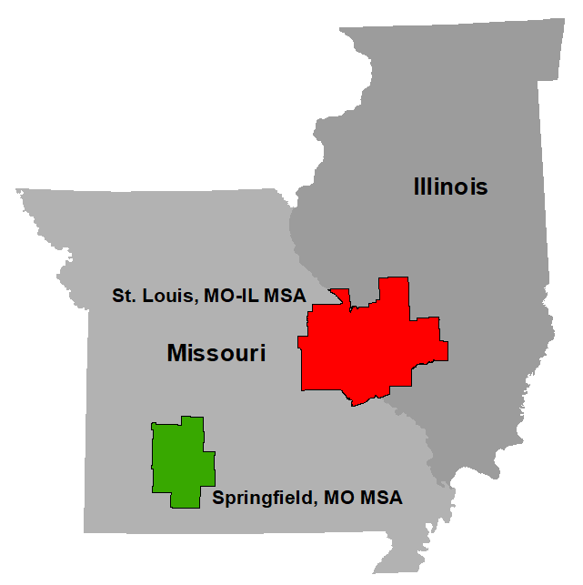
Why Springfield, Missouri?
Seat of government for Greene County
Largest school district in the state of Missouri
Unique historical context
Slave state that remained in the Union
Strategically important during the Civil War
Slavery was less economically-driven
Lynching used to expel rather than control
Instances of racially integrated neighborhoods as far back as the early 1900s

Slide 3
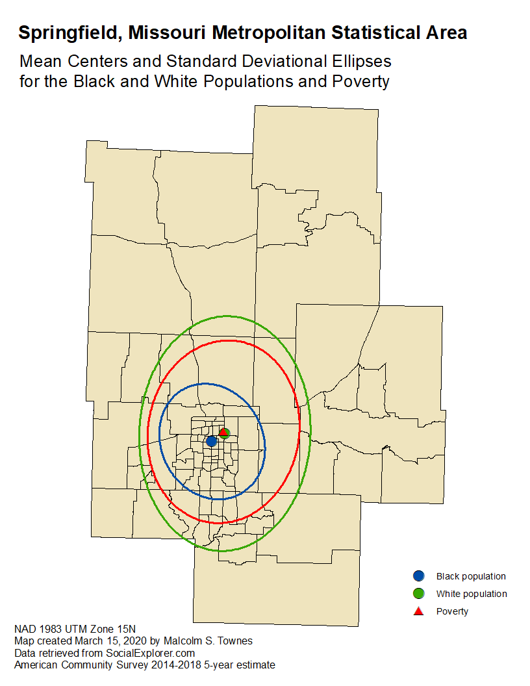

Slide 4
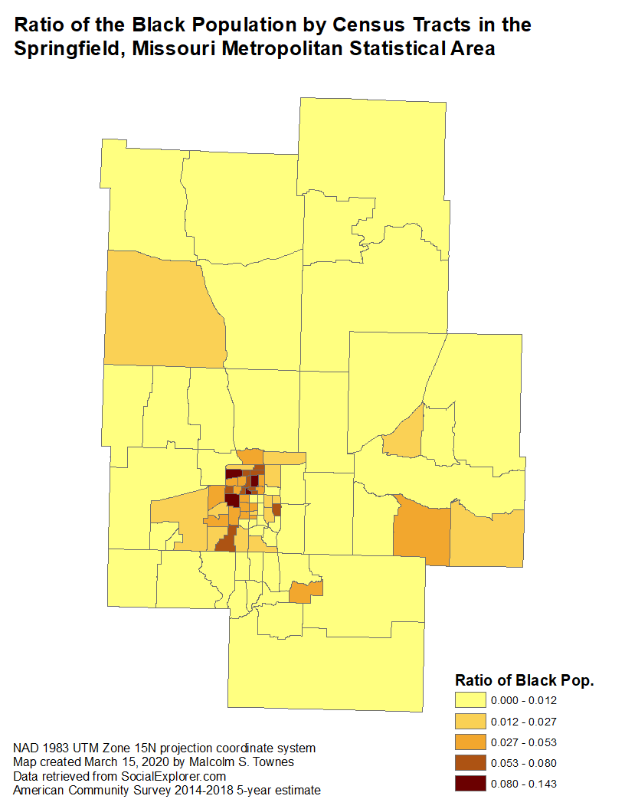
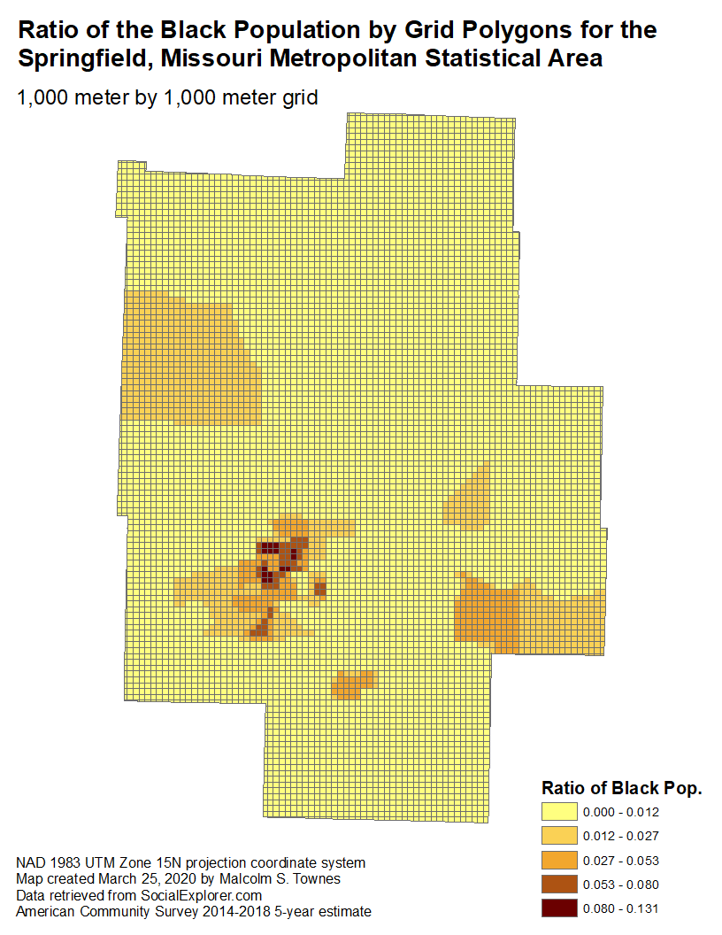

Slide 5
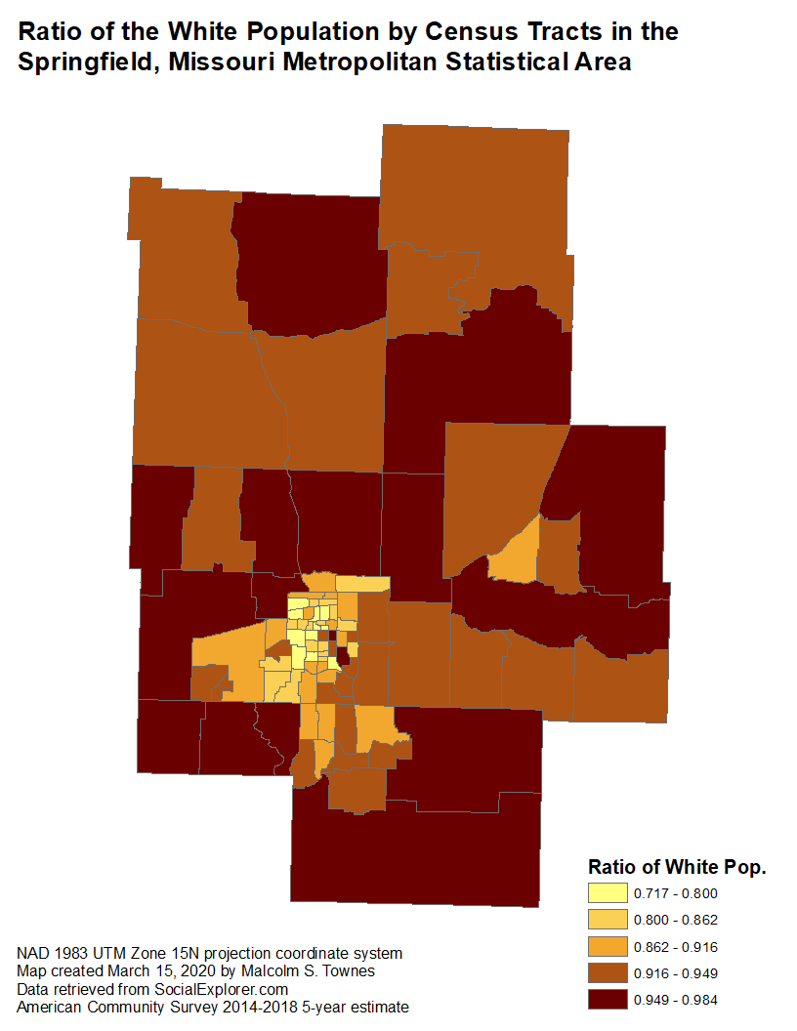
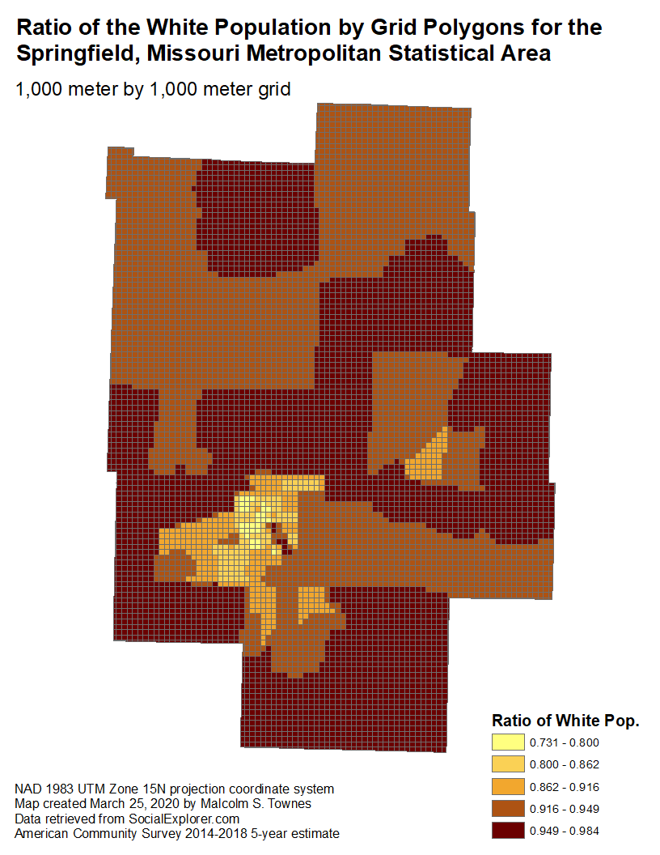

Slide 7
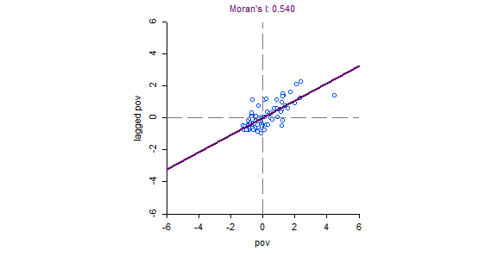
Global spatial autocorrelation for poverty ratio

Slide 8
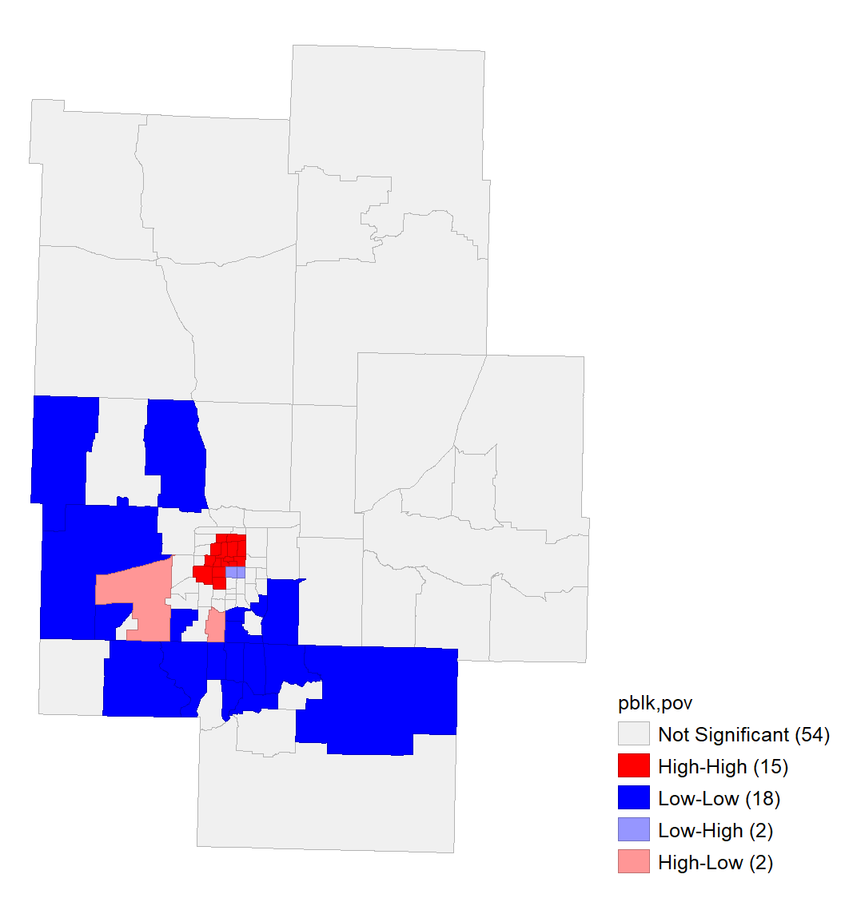
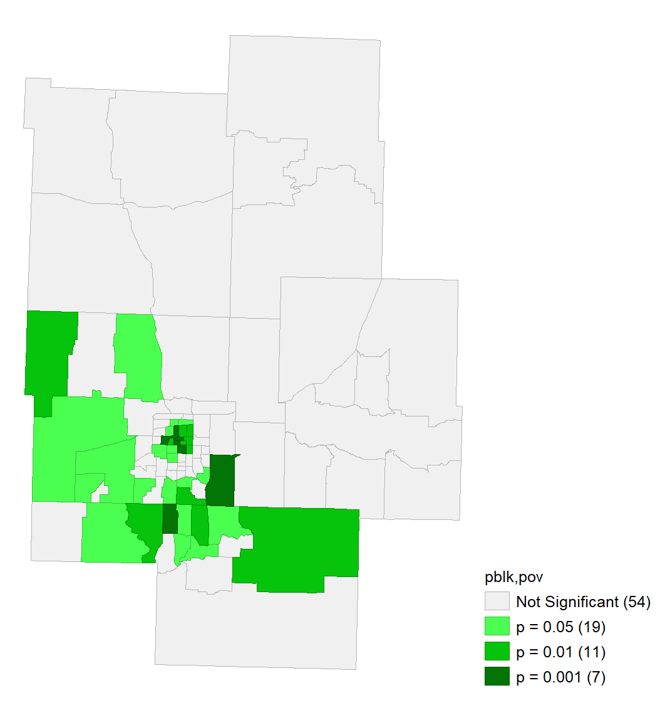
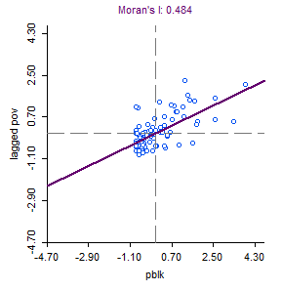
Bivariate LISA indicates mostly positive spatial autocorrelation between Black population ratio and poverty.

Slide 9
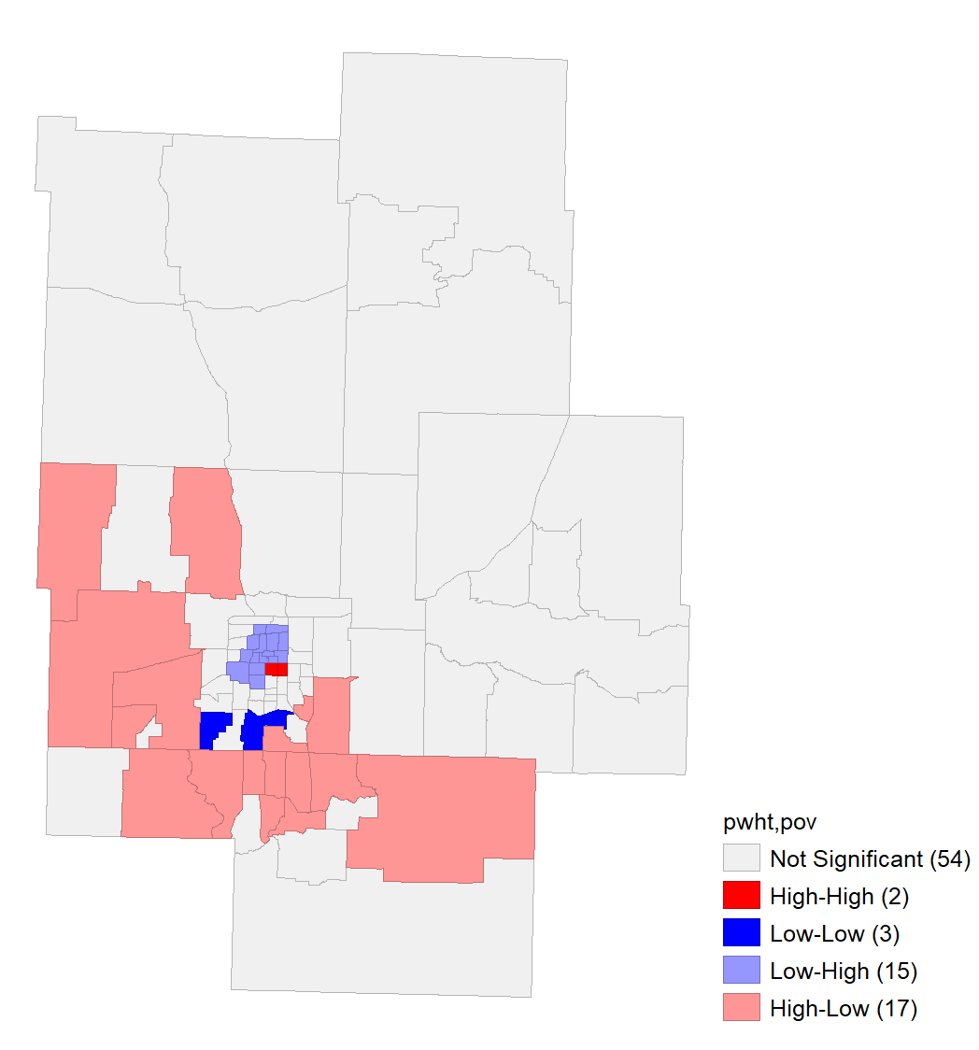
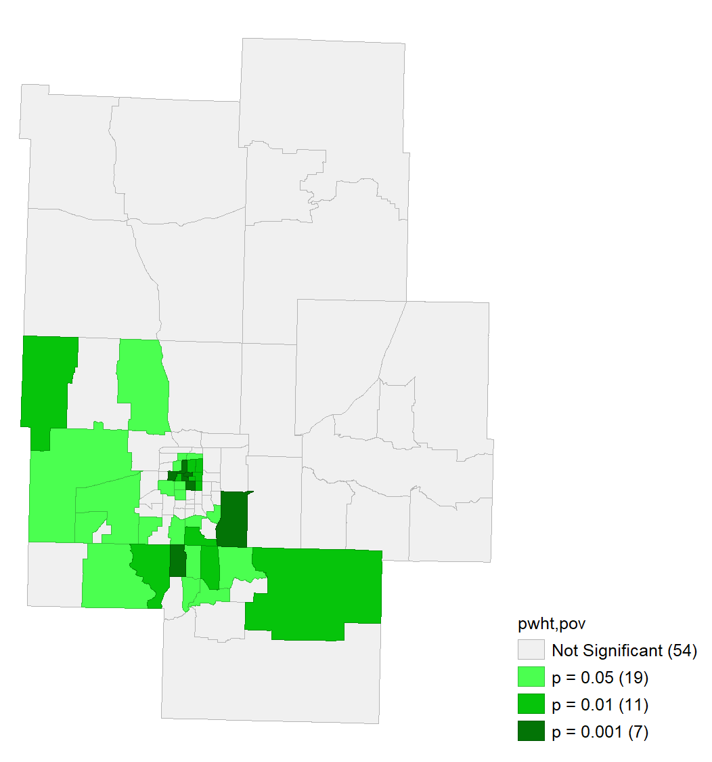
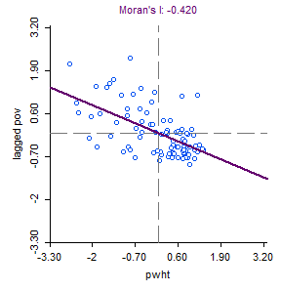
Bivariate LISA indicates mostly negative spatial autocorrelation between White population ratio and poverty.

Slide 11
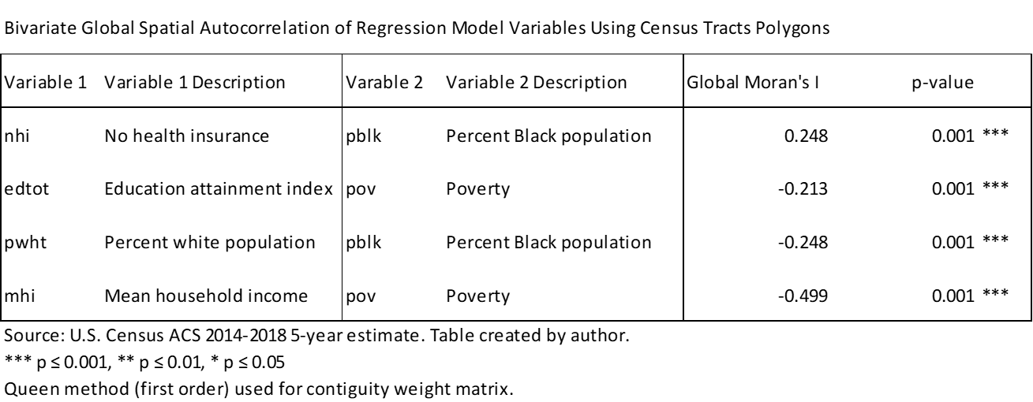

Slide 16
ρ_{pov|mhi}
1
as
σ_{mhi}
0
Where
pov = poverty ratio
mhi = median household income

