Slide 1
A Spatial Analysis of Race and Poverty in the Springfield, Missouri Metropolitan Statistical Area
Malcolm Townes
SOC 5670 Spatial Demography
Saint Louis University
April 30, 2020

Slide 2
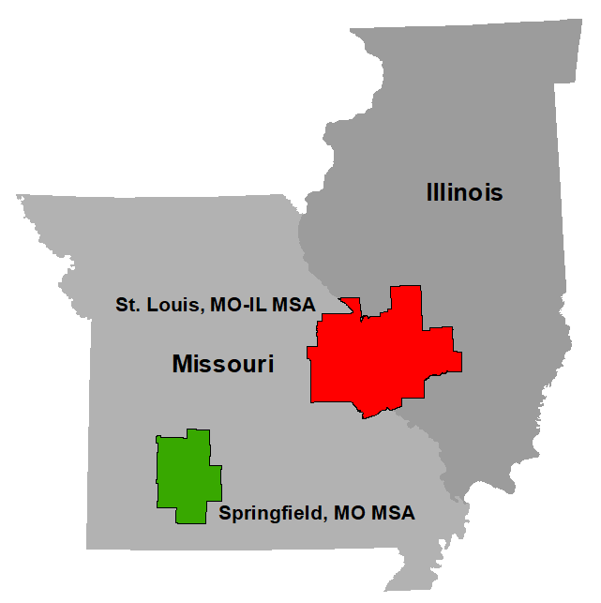
Why Springfield, Missouri?
Seat of government for Greene County
Largest school district in the state of Missouri
Unique historical context
Within a slave state that remained in the Union
Strategically important during the Civil War
Slavery was less economically-driven
Lynching used to expel rather than control
Instances of racially integrated neighborhoods as far back as the early 1900s

Slide 3
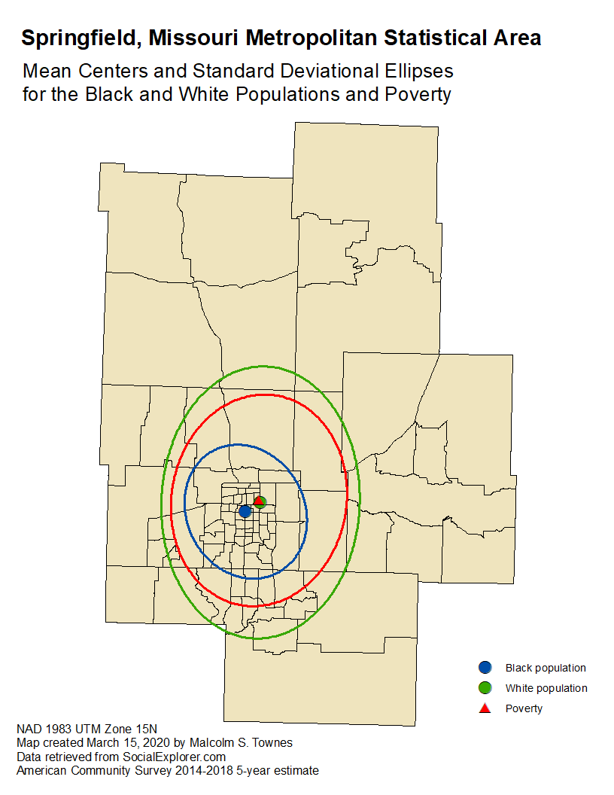

Slide 4
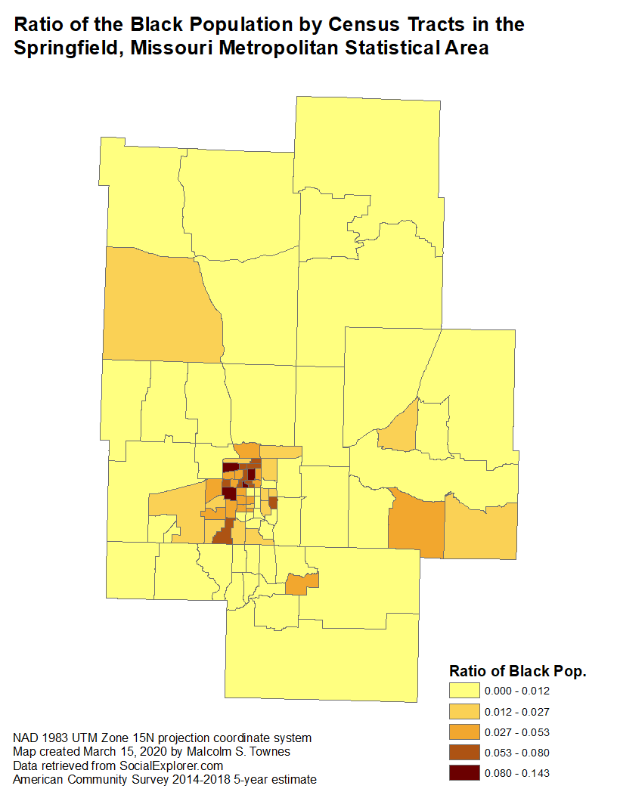
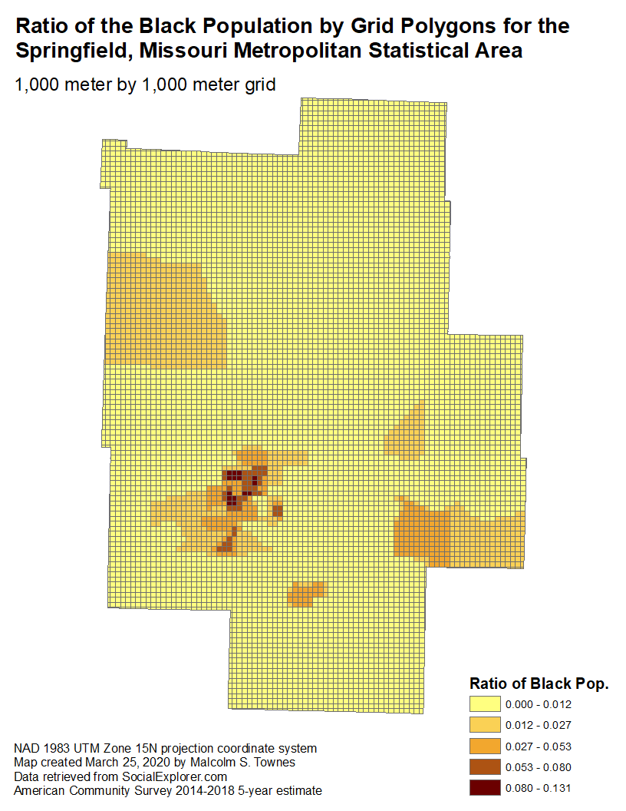

Slide 5
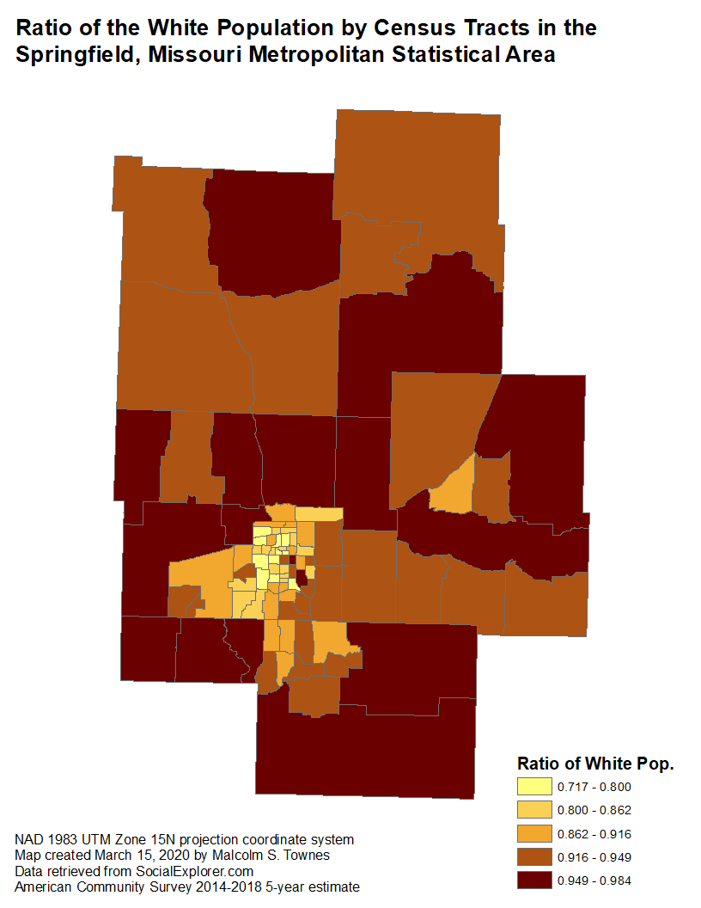
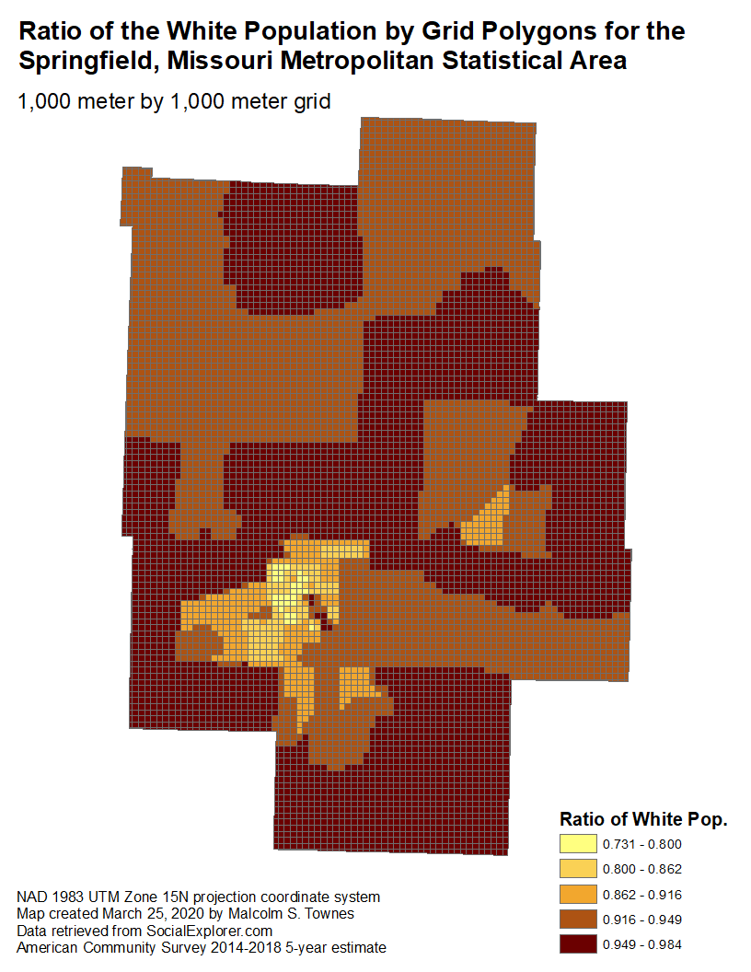

Slide 7
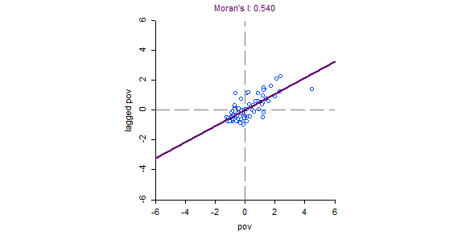
Global spatial autocorrelation for poverty ratio

Slide 8
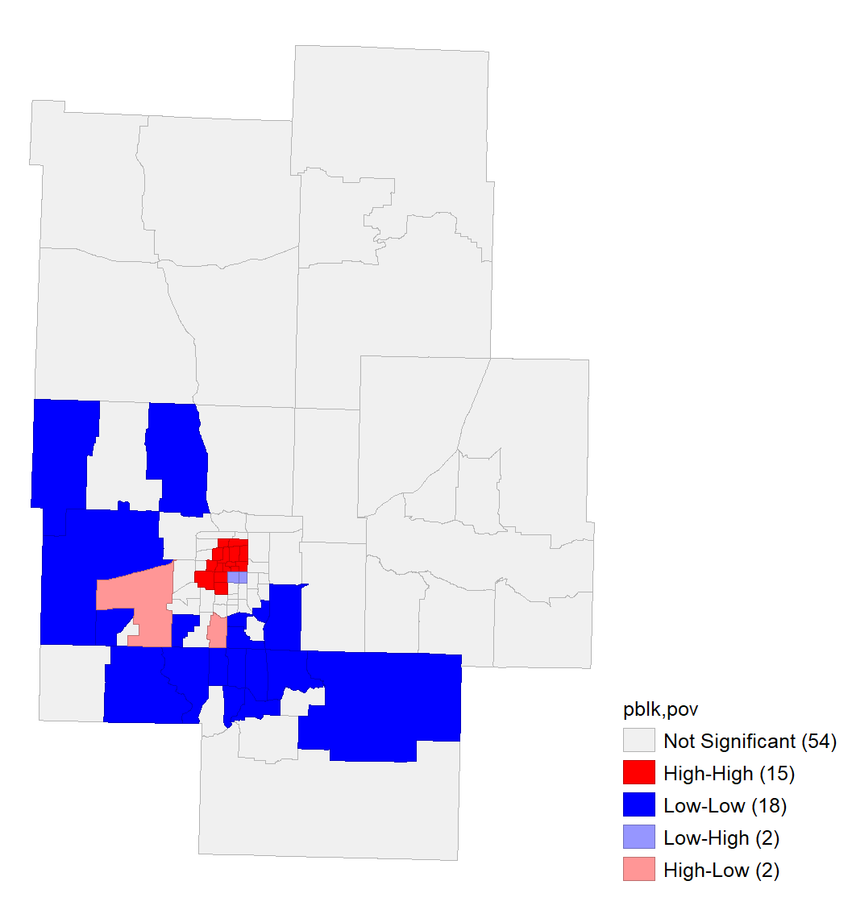
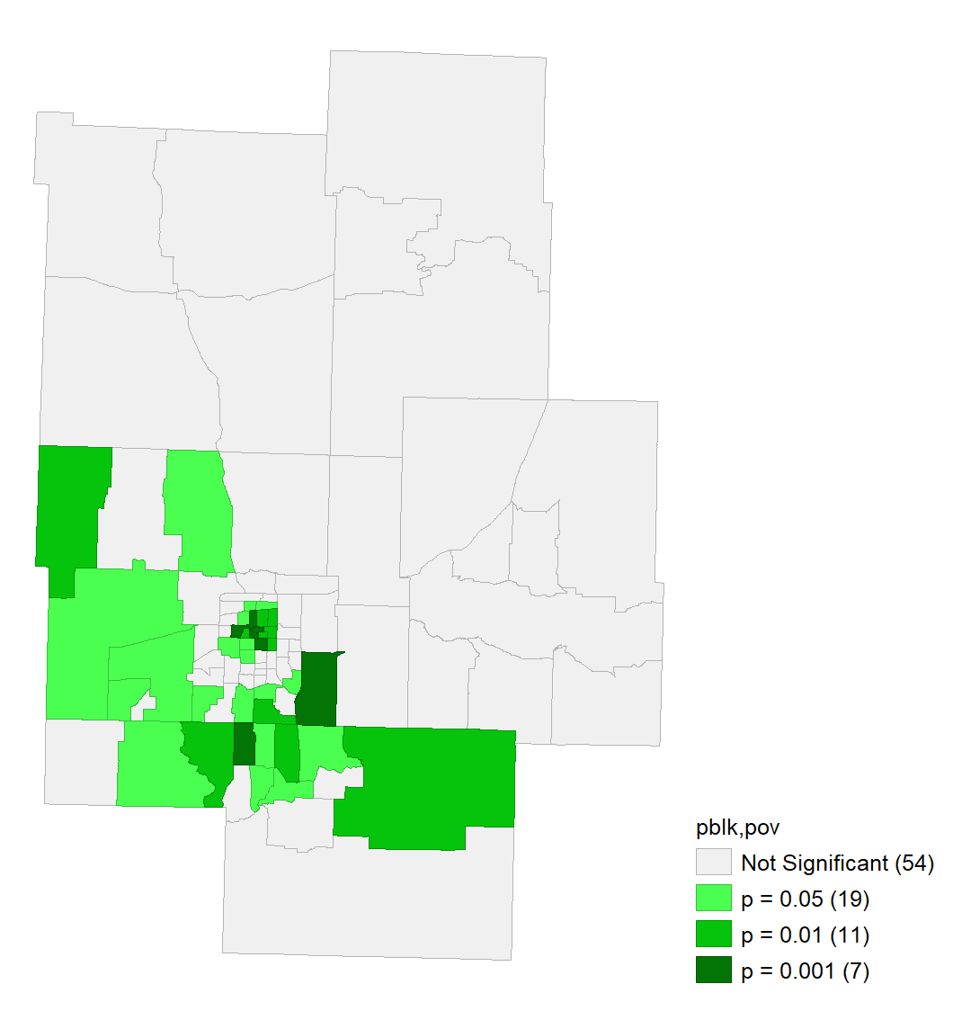
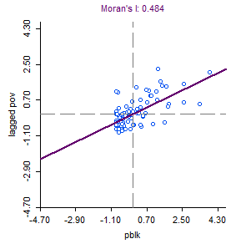
Bivariate LISA indicates mostly positive spatial autocorrelation between Black population ratio and poverty.

Slide 9
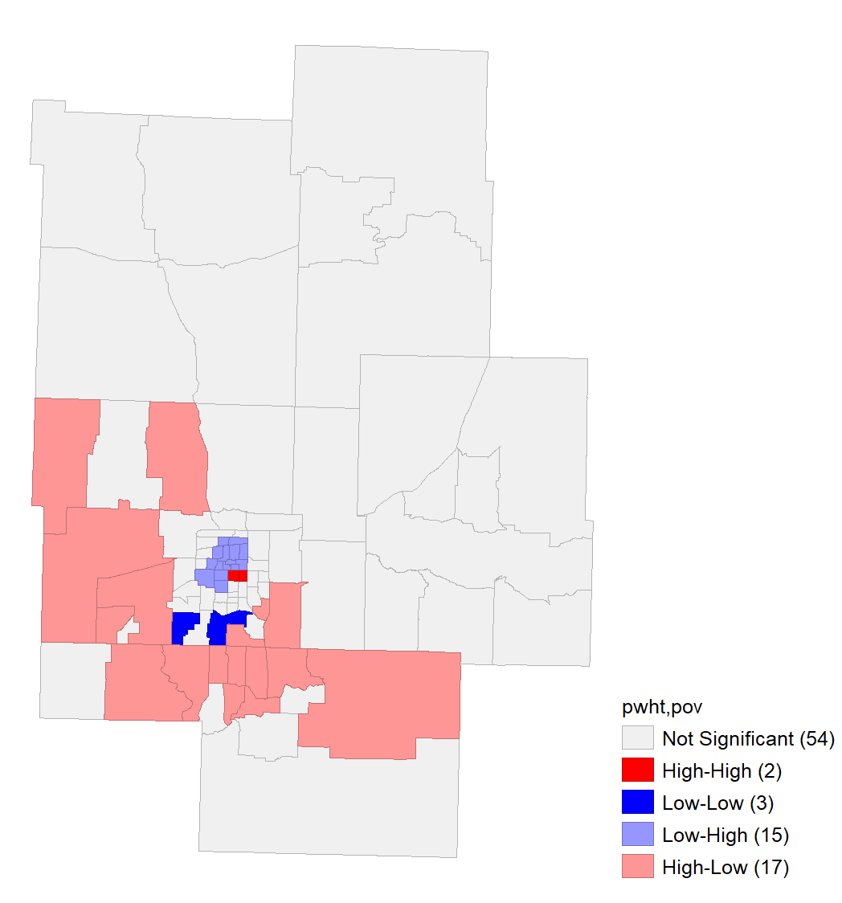
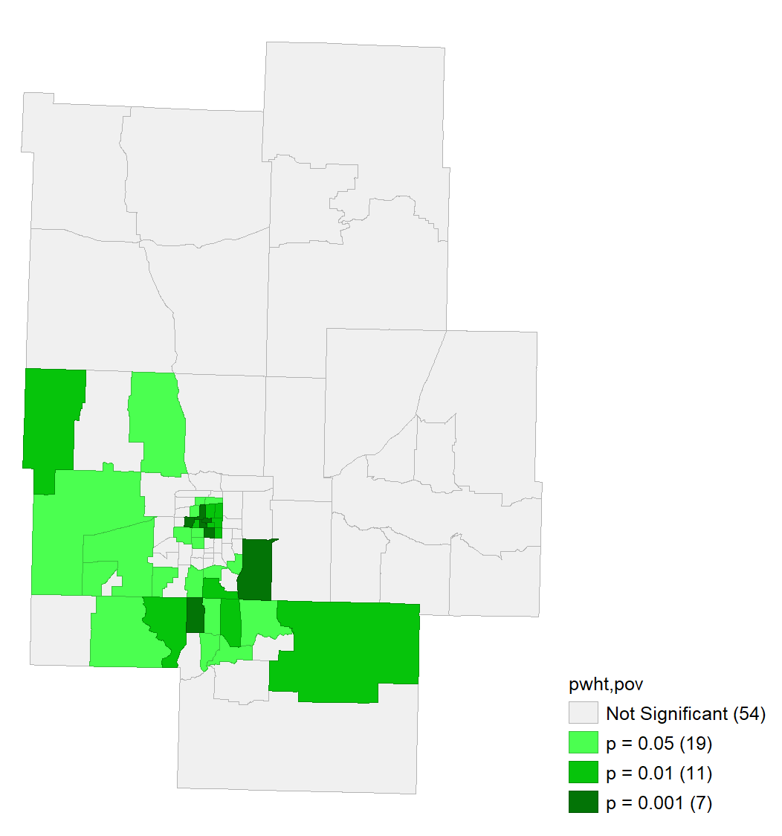
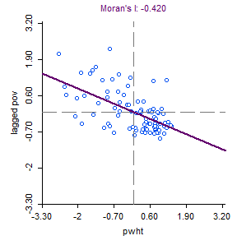
Bivariate LISA indicates mostly negative spatial autocorrelation between White population ratio and poverty.

Slide 15
Questions and Discussion

Slide 16
ρ_{pov|mhi}
1
as
σ_{hhsize}
0
Where
pov = poverty ratio
hhsize = household size

Slide 17
