Slide 1

Answers to open-ended questions
Hand written answers: type in a word document
Online survey: download into statistical package, then copy/paste onto a word document

Slide 2


Some Examples
Campus Climate Survey

Slide 3
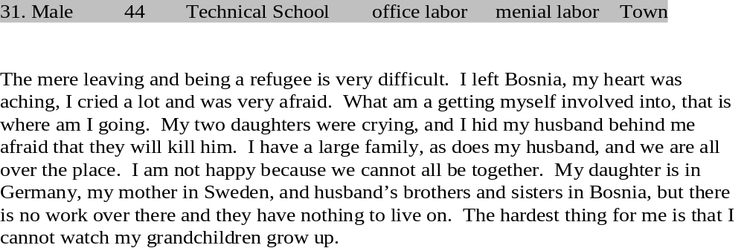
Bosnian Survey (In the space below, please describe your thoughts and emotions about fleeing Bosnia, being a refugee, and living in the United States.)

Slide 4
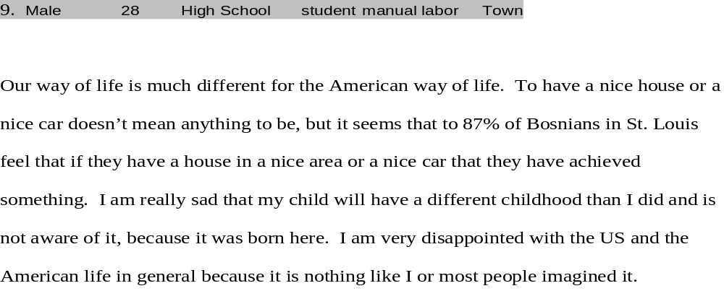

Slide 5
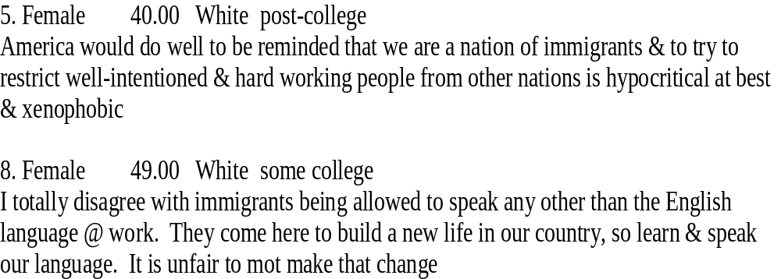
Attitudes toward Immigrants (Thank you very much for your time. In the space below, please write any additional thoughts that you may have regarding immigrants in the St. Louis area or in the United States. Also, you may use this space to describe any experiences you have had with immigrants while living in St. Louis.

Slide 6
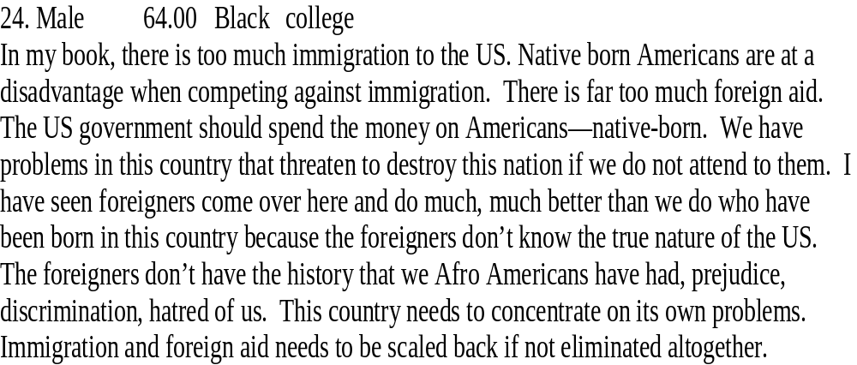

Slide 7
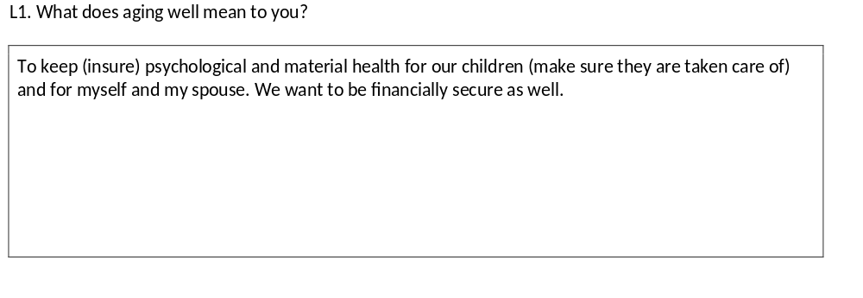
Successful Aging among Immigrants after Midlife (SAIM)

Slide 8
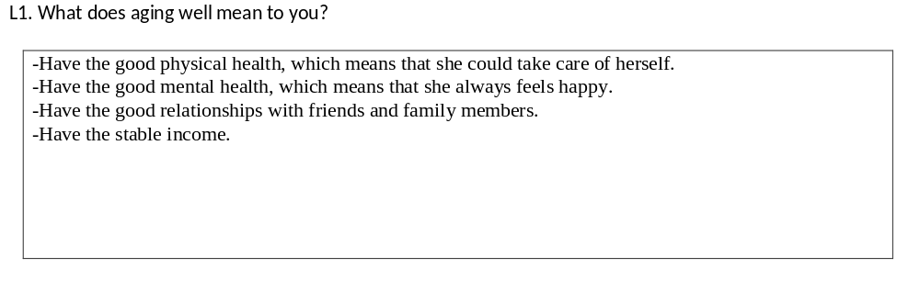

Slide 9

1. Qualitative to Quantitative
a. Read through all the comments
b. Specify several themes
e.g. Racial discrimination (Campus Climate Survey)
Threat (Attitudes toward immigrants)
Isolation (SAIM study)

Slide 10
c. Create coding/categories for each theme
e.g. Theme: negative experience based on sexual orientation
1= derogatory comments by a professor
2= derogatory comments by peer students
3= observed derogatory behaviors

Slide 11
d. Computerize with a statistical packet (SPSS or other statistical software)
e. Use these variables for statistical data analysis (demographic variables)

Slide 12
2. Qualitative to Qualitative
a. Open-coding
Read through all the written comments, taking notes (memo writing)

Slide 13
b. Specify themes and categories
e.g. One theme might be discrimination
Under Discrimination, there are some categories (Personal, environmental)

Slide 14
c. Use some quotes as supplemental and/or complementary data in compiling a report
OR
d. Conduct an extensive content analysis

Slide 15

a. Create Dimensions/Themes (e.g. Presidential
debate)
b. Under each theme, create categories with some examples.
c. Conduct frequency counts (MaxQDA, ATLASti, Nvivo)
www.tagcrowd.com
d. Inter-rater reliability (e.g. Cohen’s Kappa)
Ratio of agreements between raters

Slide 16
Kappa Calculation
k=p_{o} – p_{e}/1 – p_{e}
p_{o} :Observed agreement
p_{e} : Expected agreement

Slide 17

