Slide 1


Slide 2

1. Cross-sectional study: takes a cross section
of some phenomena at one time (snap-shot)
Cannot study a process
(Identity development, organizational
aturation, change in delinquent behaviors)

Slide 3

2. Longitudinal study: observation over an extended period (video tapes)
a) Cohort Study: generation, age,
Baby boomers
Those born before and after
the Vietnam War

Slide 4
b) Trend Study: Study on change within general population over time
Change in educational achievement
Change in gender ideology
Change in political involvement

Slide 5
c) Panel Study: Study the same set of subjects over extended period
e.g. Marital adjustment of couples
Behavioral change during probationary
period
Need to consider attrition rates

Slide 6

Unit of the objects under study
e.g. Patients, clients, students, organizations, schools, universities, households, families, couples, cities, counties, states, countries
What is your unit of analysis?

Slide 7
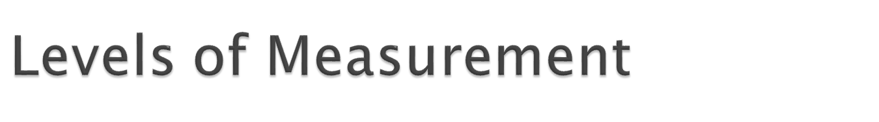
Nominal: no logical order (sex, race, political affiliation, religion)
Ordinal: logical order, but the distances between categories/ranks are not equal
(social class, letter grade, Likert scale)

Slide 8
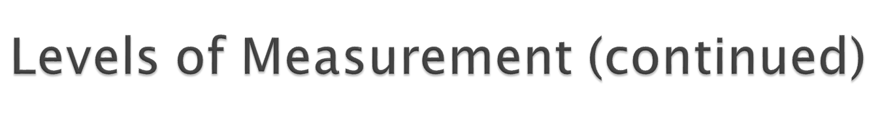
Interval: meaningful and equal distances between categories, but no true zero
Temperature
Ratio: logical and equal distances between categories and true zero
Income, number of children

Slide 9
Using simpler statistics for ratio variables is a waste of information. (Using only t-test for ratio variables)
Using advanced statistics for nominal and/or ordinal variables is a violation of assumptions (Using regression analysis for ordinal variables)
Match between levels of measurement and statistical techniques

Slide 10
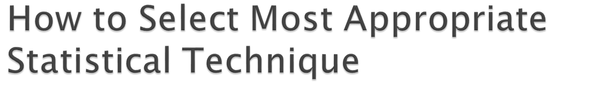
1. Clear research questions or hypothesis
e.g. There is a difference in % of obesity among different zip codes in St. Louis metropolitan area.
2. Levels of measurement
e.g. % of obesity: ratio variable
Zip codes: categorical/ nominal variable
(caution)

Slide 11

1. Central Tendency (mean, median, and mode for ratio variables)
2. Variations (Standard deviation, Skewness, Distribution)
3. Graphs and Tables (Histograms for ratio variables, Pie Charts for nominal and ordinal variables, Frequency tables for nominal and ordinal Vs)
4. Confidence Interval (95% CI for ratio variables)

Slide 12

1. Comparison of Means
a) One population mean test (Test of sample
mean against baseline data)
T-test with one sample mean (one ratio variable)
e.g. SLU freshmen’s IQ score is higher than national average of 100?

Slide 13

b) Two population means test
Independent T-test (one ratio V and dichotomous V)
e.g. Is the mean of male employees’ salaries higher than that of females?
e.g. Is the mean of male employees’ salaries the same as that of females?

Slide 14
c) Analysis of Variance (ANOVA)
Compare three or more population means (one ratio V and one nominal/ordinal V)
e.g. Is there any difference in hours studied among students with different letter grades?

Slide 15
2. Test of Association
a) Chi-square test (two nominal/ordinal Vs)
e.g. Is there any association between social class and political affiliation?
e.g. Is there any association between religious affiliation and attitude toward death penalty?

Slide 16
b) Log-linear model (three or more nominal/ordinal Vs)
e.g. What are associations among political affiliation, social class, racial background, sex, and attitude toward gun control?

Slide 17
3. Test of Correlation
a) Pearson Correlation (two ratio Vs)
e.g. Is there any correlation between educational achievement and income?
b) Spearman’s Rho (two ordinal Vs)
e.g. Is there any correlation between degree and liberalism?

Slide 18
4. Test of Causal Relationships
Correlation does not explain causality
Bivariate analysis does not explain the entire picture
e.g. Bell-curve (Chapter 13)
Race ----- Intelligence (IQ) ------ Economic
Success

Slide 19
Need for the use of control variable to obtain more accurate picture
a) Regression Analysis (one ratio DV and one or more ratio IVs, ratio covariate and/or dichotomous Vs)
Y = a + b1x1 + b2x2 + b3x3
Income = a + b1Education + b2Age + b3Sex

Slide 20
b) Use of Interaction Terms in Regression Model (dichotomous V interacted with ratio V)
Income= a+Education+Age+Sex+Sex*Educ
c) Logistic Regression (Dichotomous DV)

Slide 21
d) Test of Path Model (Examine all the possible relationships among DV and IVs in the model)
e) Linear Structural Equation Model (LISREL)
Examines possible relationships among latent factors (concepts) and empirical variables
f) Hierarchical Linear Model (HLM)
Examines nested data (e.g. students’ test score and different school districts)

Slide 22



