Slide 1

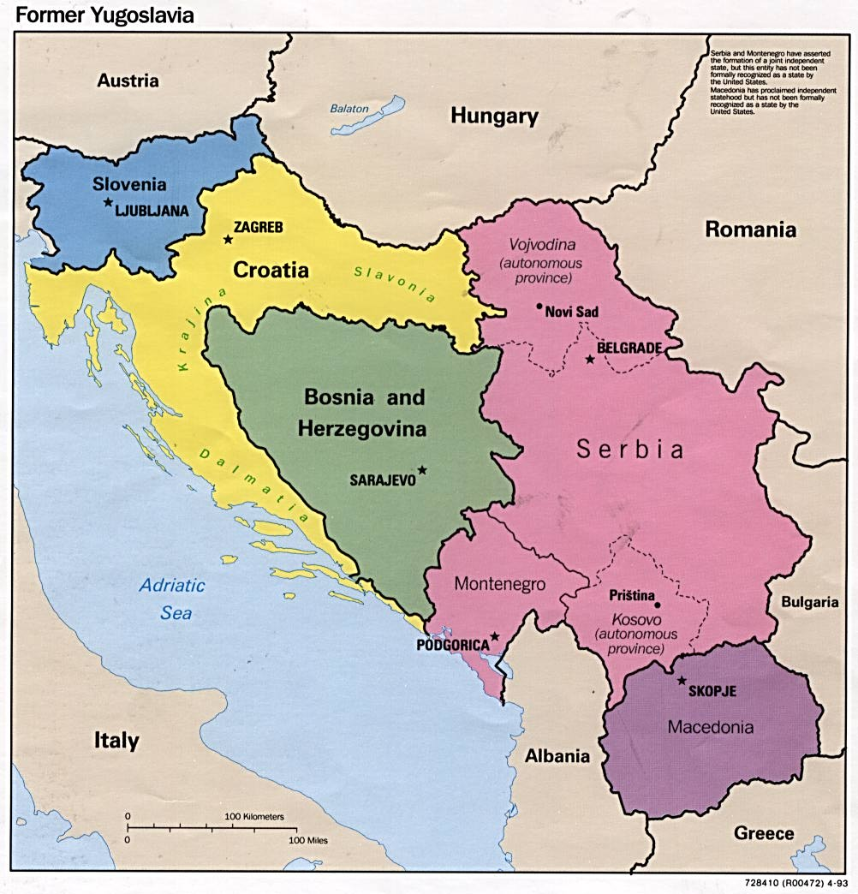
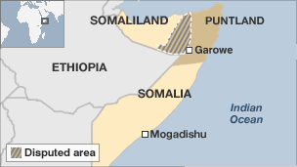
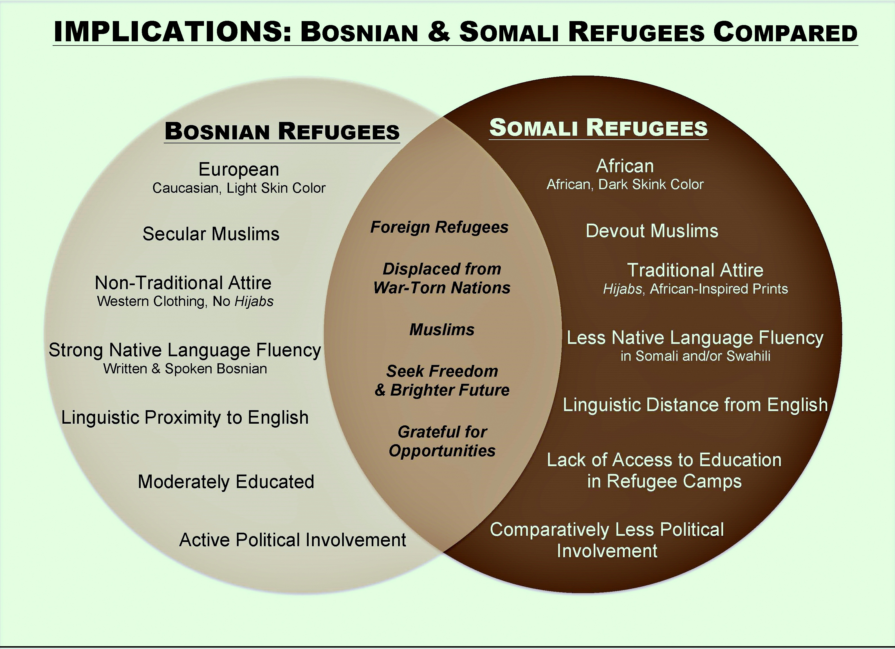
REFUGEE RESTLEMENT IN ST.LOUIS, MISSOURI: RACE, RELIGIN, AND IDENTITY
W. Almostadiª, C. Wessel^{b}, C. Ruoccoª, T. Do^{b}, S. Groverª, D. Githinjiª, A. Giovanoni^{c}, E. Uwalaka^{d}, K. Kuhn^{c}, and H, Matsuo^{c}
Department of Public Policy Analysis, College of Arts and Sciences
Department of Educational Studies, College of Education and Public Service
Department of Sociology and Anthropology, College of Arts and Sciences
Department of Political Science, College of Arts and Sciences
Abstract
The incident on September 11, 2001 has changed Americans’ perceptions toward people with Islamic background. While many Americans often associate Muslims with middle Easterners, the United States has received Muslims with various racial backgrounds. Since the end of the Bosnian war 1992-1995, the number of immigrants from Bosnia-Herzegovina) admitted as refugees and as a part of family reunification process has increased. The United States has also received refugees from Somalia who were displaced because of domestic violence and famine in their home country. While these two groups are primarily Muslim, they have distinctive differences in terms of population size, community solidarity, racial background, religious practices, and other resources. Data were collected through 23 face-to-face interviews with male and female refugees from Bosnia and Somalia of various age, educational level, and length of stay in the United States. Grounded theory method was used for data analyses, developing categories and some emerging themes relevant to these two groups. Despite similar U.S. entry and length of stay, these two groups have had different experiences in the process of adaptation to American society. While a majority of Bosnians are cultural Muslims, Somali Muslims are often orthodox. Some Somali Muslims perceive spiritual aspects that are important in their religious beliefs, which might reflect the differences between Bosnian and Somali community solidarity. The results indicate insightful patterns about refugees’ experiences regarding religion, race, socioeconomic status, and ambiguity between self-identification as refugees or Americans.
Study Design
This study used a semi-structured face-to-face interview to collect information about participants’ perceptions and experiences regarding race, religion, socioeconomic status, and self-identification among Bosnian and Somali refugees. The major constructs in the final interview schedule were 1) pre-immigration history, 2) problems with resettlement, 3) employment and educational aspirations, 4) religious and cultural identity, 5) gender roles, 6) impressions about the city of St. Louis, and 7) general impressions about their migration to the United States. We used face-to-face interviews with a total of 23 participants who were refugees from Somalia or Bosnia, replying on a purposive sampling method. The criteria for inclusion were: Participants had to be 18 years old or older, migrated to the United States as refugees, and resided in the St. Louis area at the time of interviews. Interviewers distributed invitation letters to potential participants, which indicated the goals of study and guaranteed the minimum risks for participating and protection of confidentiality. Face-to-face interviews lasted from 60 to 90 minutes, and participants received a $30 gift certificate to a local grocery store at the end the interview.
Results Continue
Loss & Distress: Fear drove refugees to flee their home country and some of them have lingering memories of rough conditions in refugee camps Many also experience long-term effects of losing friends & family (as war casualties).
Identify & Place: Most refugees had Temporary living arrangements in initial host countries Eventually they applied to relocate to U.S. (one of the several nations which provide status adjustment) and acquired permanent residency However, transitioning from a mere residence site, St. Louis became a preferred place (home) to establish roots.
Freedom and Opportunities: Many refugees received assistance by resettlement agencies (e.g. International Institute, Catholic Charities) in the areas of learning English, finding places to live, cultural educations, and job search. Common perception of U.S. by refugees is a land-of-opportunity, where permanent living status grants refugees equal rights.
Discrimination: Most refugees experienced some form of discrimination, especially after 9/11. While religion was a basis for discrimination for both refugee groups, Bosnians experienced less discrimination than Somalis
Family Future: The one common goal for both groups was for their children to have better lives than the parents. They perceived education as a vehicle for social mobility. Both groups expressed optimism about the future
Research Question
How do immigrations status, religion, and race intersect each other?
Exodus
Country of origin
Duration in refugee camps
Longer stay on refugee campus deprived Somalis from educational opportunities
Results
Five Themes from Interviews
1) Loss & Distress ,2) Identity & Place, 3) Freedom & Opportunity , 4)Discrimination, 5)Family Future
Race/Skin Color
as Social Capital
European vs. African origin
Different perceptions by Americans
Racial hierarchy among refugees
Social Integration
Job opportunities
Generational upward mobility
Political involvement
Marital assimilation over generations
Primordial vs. Circumstantial
Religious Identity
Bosnians religious identity is situational and contextual
Somalis hold stable religious identity
Community Resources
Support Network
Population Size
A lack of critical mass for Somalis
Social Integration Model
Conclusion and Limitations
Conclusion: There are many similarities and dissimilarities between groups. However, even with the similarities both groups have different experience in resettlement and social adaptations. This difference is influenced by their culture, education, and skin color/race.
Limitations: The focus of the research on 23 Bosnian and Somali refugees was a limitation. The sample size reflected a small portion of the population. Uneven proportion of gender in both groups is another limitation, although recruiting Somali women was a challenge which is one of the cultural differences.
Background
St. Louis was designated as a preferred resettlement community in the early 1990s
International Institute and Catholic Charities assisted thousand of refugees from many countries
In early 2000s, there were 35,000 Bosnians and 300 Somalis.
Currently, about over 50,000 Bosnians and 5,000 Somalis reside in the St. Louis area.
Acknowledgements
Research Support by the Center for Intercultural Studies
Beaumont Faculty Development

