Slide 1

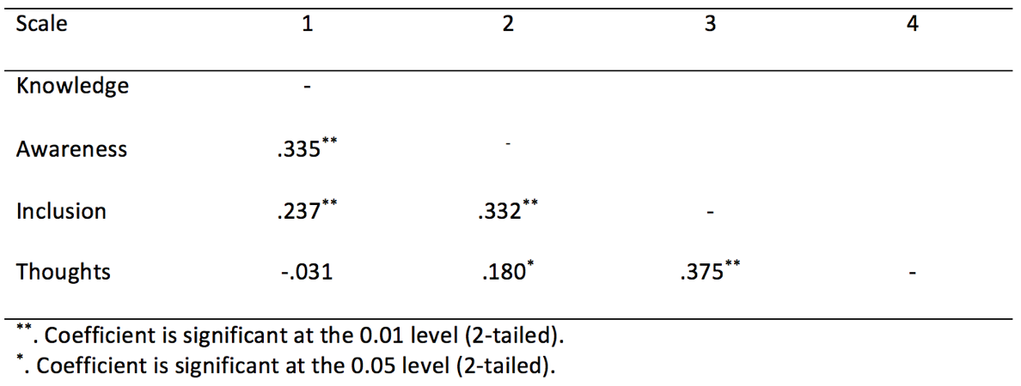
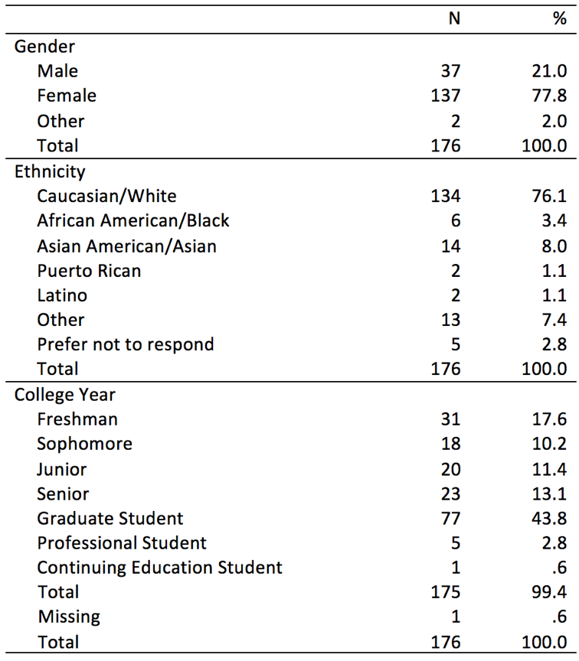
College Students’ Attitudes
towards Inclusion of People with Disability
Tanyathorn Hauwadhanasuk
hauwadhanasukt@slu.edu
Rasheed Algethami
rasheed.algethami@slu.edu
Turki Alqarni
turki.alqarni@slu.edu
Husain Alruwaili
husain.alruwaili@slu.edu
Rafif Alsedrani
rafif.alsedrani@slu.edu
Saint Louis University
School of Education
3500 Lindell Blvd.
Fitzgerald Hall, Room101
St. Louis, MO 63103
Karen Myers, Ph.D.
karen.myers@slu.edu
Mark Pousson, Ph.D.
mark.pousson@slu.edu
Purpose of Study
Results
Discussion
This study aims to investigate the attitudes of college students toward people with disabilities. With sets of questionnaires regarding background information (demographic information), knowledge of disability, disability awareness, inclusion of people with disabilities, and thoughts about disability, the study attempts to raise awareness among the stakeholders at the university in order for them to advocate for the inclusion and social justice for people with disabilities on campus that would improve the inclusion in the society.
As is evidenced in Table 1, the majority of the students who participated in the survey were graduate students (43.8%), female (77.8%), and white (76.1%). There is no sampling frame for this study; therefore, the response rate was not calculated.
A multiple linear regression was conducted to predict people’s thoughts, using students’ knowledge, awareness, and inclusion related people with disabilities as independent variables. There was statistically significant in the inclusion of people with disabilities variable.
Table 2 show the intercorrelation matrix of relevant variables. The relationship between thoughts of people with disabilities and inclusion of people with disability was investigate using Pearson Product-moment correlation coefficient. There was moderate positive correlation between the two variables, r = .375, n = 176, p< .01. There was small correlation between the two variables, r -.031, n = 176, p = < .01, with thoughts of people with disabilities and disability knowledge that did not reach significance. A negative correlation between knowledge and thoughts indicated the more negative thoughts about people with disabilities, the less knowledge about disability they have.
Reliability: In the current study, reliability analysis (internal consistency) revealed a Cronbach’s alpha coefficient was 0.659.
There was weak correlation between thoughts of people with disabilities and disability knowledge that do not reach significance. Limitation: The correlation between thoughts of people with disabilities and disability knowledge showed weak and do not reach significance. The correlation among variables showed weak to moderate that indicated student’s attitudes towards inclusion of people with disabilities.
Research Questions
Table 2: Correlation of Scales
Q1: Is there a relationship between knowledge about, awareness and inclusion of people with disabilities and the respondents' thoughts toward disabilities issues on a college campus?
Q2: Is there a difference in the respondents' thoughts toward disability issues on a college campus when comparing their knowledge about, awareness and inclusion of people with disabilities?
Background
Social justice and access or widening participation in higher education become the important issues (Wilson-Strydom, 2015).
The enrollment of students with disabilities is increasing in colleges and universities; nevertheless, many institutions are unprepared in supporting students with disabilities in regard to equal access and appropriate accommodations mandated by the federal government (Hong, 2015).
According to Tinklin, Riddell, and Wilson (2004), the increased numbers of students have affected funding and accessibility for students with disabilities in colleges. Pressure has been applied to institutions to improve accessibility for people with disabilities (Tinklin et al., 2004).
Sachs and Schreuer (2011) reported that students with disabilities invest more time on their studies than their peers without disabilities in order to meet course requirements; spend less time in social participation and extra-curricular activities; and do not use computers and technology.
Students with disabilities encountered the barriers on a daily basis that include faculty perception; fit of advisors; college stressors, and quality of support services (Hong, 2015). The importance of understanding students’ everyday lives and experiences as well as their conditions (personal, social, economic and environment) that enable and constrain students' well-being and performance must be recognized (Wilson-Strydom, 2015).
Methods
The participants in this study included both undergraduate and graduate students at the university in the Midwest. This study conducted an online quantitative survey (many items were 5 points Likert scale) to collect data. Data were collected using a self-report questionnaires. There are sections: (1) Demographics and (2) A set of questions related to Knowledge about Disability (10 items), Disability Awareness (10 items), Inclusion of People with Disabilities (10 items), and Thoughts about Disability (10 items).
According to the profile of the university in 2017, there are currently 13000 students who are enrolling in undergraduate and graduate studies. Researchers used an online Raosoft program (Raosolf, 2017) to calculate the sample size of the study. Approximately 266 participants are needed to achieve the confidence interval 85-95%. Ninety participants who replied to the online survey skipped some questions. The participants of this study included a total of 176 in undergraduate and graduate studies. 33.9% responses were incomplete. There is no sampling frame for this study; therefore, the response rate was not calculated
Table 1: Demographic Information
Implications
The higher education institutions could promote inclusion of people with disabilities by raising disability awareness and educate knowledge of disability among the stakeholders on campus. The university stakeholders can help advocate for the inclusion and social justice for people with disabilities that would improve the inclusion in the society. Limitation model moves toward humanizing disabilities (Myers, 2009). Implementation of Universal Design concept into teaching and supporting diverse learners, students can be familiar with and understand people with disabilities and disability in society (Myers, 2009).
Selected References
Hong, B. S. (2015). Qualitative Analysis of the Barriers College Students With
Disabilities Experience in Higher Education. Journal Of College Student Development, (3), 209.
Myers, K. (2009). A new vision for disability education: Moving on
from the add-on. About Campus, 14(5), 15–21.
Raosoft. (2017). Sample size calculator. Retrieved from
http://www.raosoft.com/samplesize.html
Tinklin, T., Riddell*, S., & Wilson, A. (2004). Policy and provision for disabled students in higher
education in Scotland and England: the current state of play. Studies in Higher Education, 29(5), 637-657.

