Slide 1








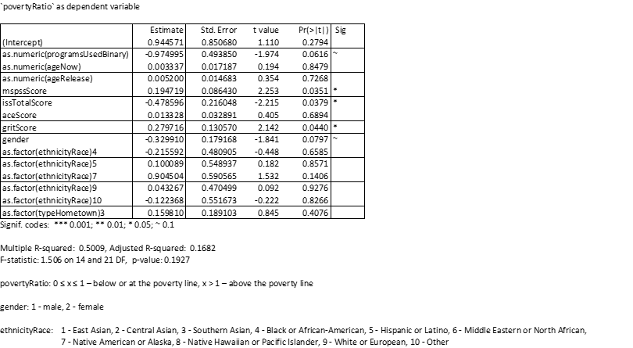
How Formerly Incarcerated Individuals Who Successfully Reintegrated
Cope with Barriers to Re-Entry
Jacob Eikenberry¹, Daniel Ferris², Malcolm Townes², Nick Sokolis³ 1. College of Public Health and Social Justice 2. Ph.D Program in Public and Social Policy 3. College of Engineering, Aviation, and Technology
Background
Incarceration in the United States of America
Each year in the United States, an estimated 600,000 individuals are released from state and federal prisons and there are more than 5,000,000 former offenders under community supervision. ^{i}
An alarming 68% of individuals are re-arrested within three years of their release. ^{ii}
Almost half of released prisoners serve another sentence in prison. ^{iii}
Literature Review
There is a significant amount of scholarly research on formerly incarcerated individuals, particularly related to recidivism.
Research has demonstrated an association between rehabilitative programs and decreases in recidivism. ^{iv}
Research has also identified risk and protective factors for returning individuals such as having or not having positive social networks, employment, housing, education, health care access, rehabilitative opportunities and supervised probation or parole upon release. ^{v}
Few studies focus on individuals who successfully reenter the community (i.e. do not recidivate).
Research Question 1:
What are the characteristics and assets of a group of largely successful reintegrated individuals?
Demographic Characteristics:
Research Question 3: Is there an association between successful community re-entry and use of various types of assistance programs?
We asked participants "What kind of help did you receive after your last incarceration ended?" We identified three major themes. What was also notable was the lack of reference to employment assistance.
Variable​
Age (years, mean±SD)​ | 43.6±9.1​
Race (n [%])​
White​ | 34 (59.7)​
Black​ | 13 (22.8)​
Other​ | 10 (17.5)​
Gender (n [%])​
Female​ | 26 (45.6)​
Male​ | 31 (54.4)​
Highest Ed. (n [%]) ​ | ​​
Associates or less​ | 18 (31.6)​
Bachelors​ | 13 (22.8)​
Masters​ | 16 (28.1)​
Doctorate​ | 10 (17.6)​
Income in 2018 (n [%])​ | ​
Less than 12,490​ | 13 (23.6)​
Between 12,490 and 16,910​ | 1 (1.82)​
Between 16,911 and 21,330​ | 3 (5.5)​
Between 21,331 and 25,750​ | 7 (12.7)​
Between 25,751 and 30,170​ | 3 (5.5)​
Between 30,171 and 34,590​ | 4 (7.3)​
Between 34,591 and 50,000​ | 8 (14.6)​
Between 50,001 and 75,000​ | 7 (12.7)​
Between 75,000 and 100,000​ | 3 (5.5)​
Between 100,000 and 150,000​ | 4 (7.3)​
Greater than 150,000​ | 2 (3.6)​
When using `povertyRatio` as a measure of success in a multiple regression analysis, there was not a significant association with whether respondents used social programs, but there was a statistically significant association with the two measures of social support (p < 0.05).
Years out (years, mean±SD)​ | 7.1±5.9​
Total time incarcerated (years, mean±SD)​ | 7.3±7.7​
Household size (people, mean±SD)​ | 2.8±1.5​
Pop. of release area (n [%])​ | ​ ​
Rural​ | 1 (1.8)​
Suburban​ | 21 (37.5)​
Urban​ | 34 (60.7)​
Religion (n [%])​ | ​ ​
Not Religious or Spiritual​ | 9 (15.8)​
Religious or Spiritual​ | 42 (73.7)​
Prefer not to answer​ | 6 (10.5)​
Relationship at release (n [%]) ​ | ​ ​
Not married, no relationship​ | 50 (87.7)​
In a relationship​ | 4 (7.0)​
Married​ | 3 (5.3)​
MSPSS Composite (Score, mean±SD)​ | 4.5±1.5​
ISS Composite (Score, mean±SD)​ | 2.5±0.7​
Number of Services (Number, mean±SD)​ | 3.7±2.1​
ACES (Number, mean±SD)​ | 4.4±2.3​
Grit Composite (Score, mean±SD)​ | 3.7±0.7​
Poverty 2018 (n [%])​ | ​
No​ | 34 (69.4)​
Yes​ | 15 (30.6)​
Methods
Sample Frame
The target population was all formerly incarcerated individuals in the U.S.
Excluded anyone currently incarcerated
Survey respondents were recruited from the Formerly Incarcerated College Graduates Network (FICGN)
Survey Tool
82 questions including screening, consent, demographics, multiple scales, grit, and open-ended qualitative questions.
Received approval from SLU IRB with minor revisions including allowing respondents to skip questions.
Key variables collected included demographics, public service utilization, educational attainment, income, social support, and grit.
Survey Dissemination
The Qualtrics survey link was posted to the FICGN Facebook page and supplemented by emails from the group administrator requesting members to complete the survey questionnaire.
Survey responses received after each outreach with diminishing returns.
Over 50% of responses received within 24 hours after the group administrator sent the first email message.
Validated Scales
Social support from family, friends, and a significant other (Multidimensional Scale of Perceived Social Support) – 12 Items ^{vi}
Instrumental Social Support from family and friends – 10 Items ^{vii}
Adverse Childhood Experiences (ACES) – 10 Items ^{viii}
Short Grit Scale – 8 Items ^{ix}
Food insecurity measured by Hunger Vital Signs – 2 Items ^{x}
Research Question 2:
How do formerly incarcerated individuals who have successfully reintegrated into the community cope with barriers to re-entry that transitioning individuals typically encounter?
Research Question 4:
Is there an association between successful community re-entry and prior inmate traits?
Respondents were asked what contributed the most to helping them re-enter the community after their last incarceration. Themes from responses included:
employment
housing
social and/or family support
recovery programs
education
How interactions with the criminal justice system affected respondent reintegration:
Positive = 8 (13%)
Negative = 16 (27%) responded with negative interactions
Neutral or no impact = 15 (25%)
Unclear or no response = 21 (35%)
Using savings to cover at least three (3) months of expenses as success, there was a statistically significant difference between the grit level of those who did have savings compared to those that didn't (F = 12.37, p < 0.001).
`savings` | Count | Mean | SD
1 - yes | 15 | 4.18 | 0.551
0 - no | 39 | 3.52 | 0.625
`savings` | DF | Sum Sq | Mean Sq | F-value | P-value | sig
`savings` | 1 | 4.528 | 4.528 | 12.37 | 0.000938 | ***
residuals | 50 | 18.301 | 0.366
Significance codes *** 0.001 ** 0.01 * 0.05 ~ 0.10
6 observations deleted due to missingness
^{i} James (2015) ^{ii} Beck (2006) ^{iii} Durose et al. (2014) ^{iv} Ore & Birdgen (2003) ^{v} Pettus-Davis & Epperson (2015) ^{vi} Zimet, Dahlem, Zimet, & Farley, 1988 ^{vii} Fahmy, 2018 ^{viii} Felitti & Anda (1998) ^{ix} Duckworth & Quinn (2009) ^{x} Hager et al. (2010)

