Slide 1
How Formerly Incarcerated Individuals Who Successfully Reintegrated Cope with Barriers to Re-entry
Jacob Eikenberry (PI)
Social Work
Daniel Ferris
Public and Social Policy
Nicholas Sokolis
Civil Engineering
Malcolm Townes
Public and Social Policy

Slide 2
Presentation Overview
Topic Importance and Background
Research Questions and Survey Design
Data Collection and Survey Instrument
Descriptive Statistics
Quantitative Analysis
Qualitative Analysis
Limitations

Slide 3

Each year in the United States, an estimated 600,000 individuals are released from state and federal prisons and more than 5,000,000 former offenders are under some form of community supervision

Slide 4
Research Questions
What are the characteristics and assets of a group of largely successfully reintegrated formerly incarcerated individuals?
How do formerly incarcerated individuals who have successfully reintegrated into the community cope with the barriers to re-entry that transitioning individuals typically encounter?
Is there an association between successful community re-entry and use of various types of assistance programs?
Is there an association between successful community re-entry and prior inmate traits and ideological indicators?

Slide 5



Slide 6
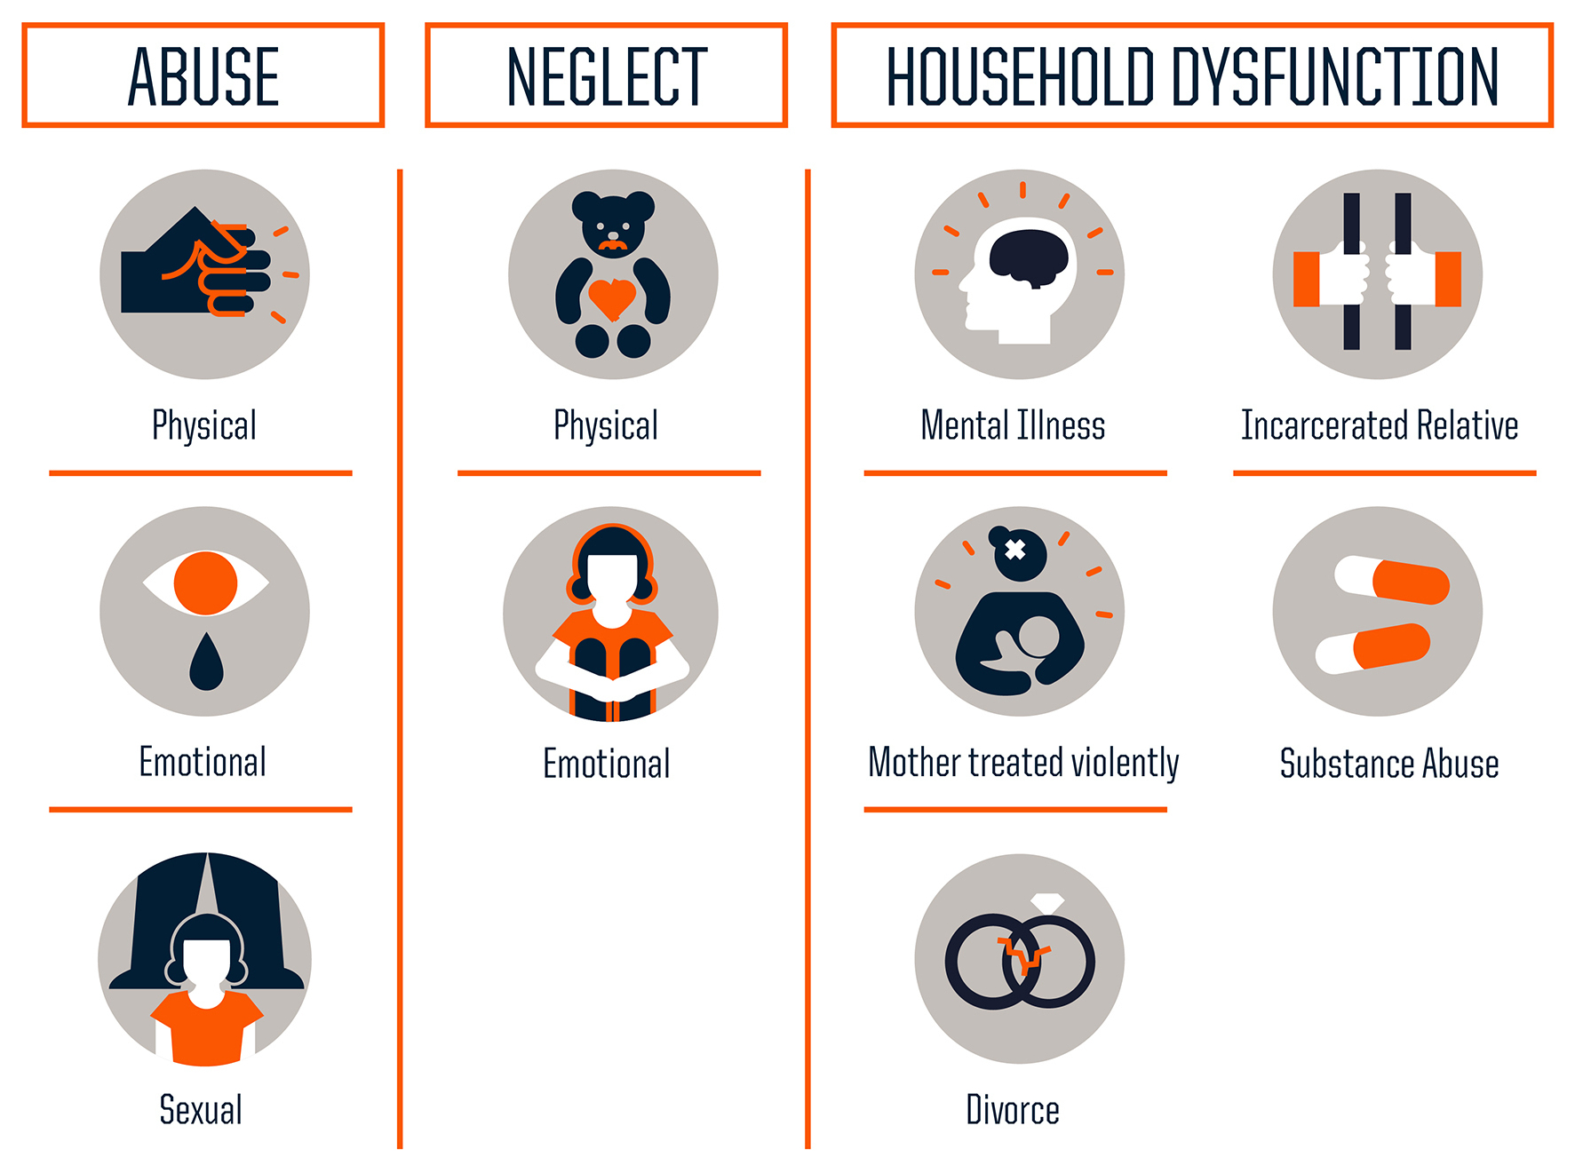
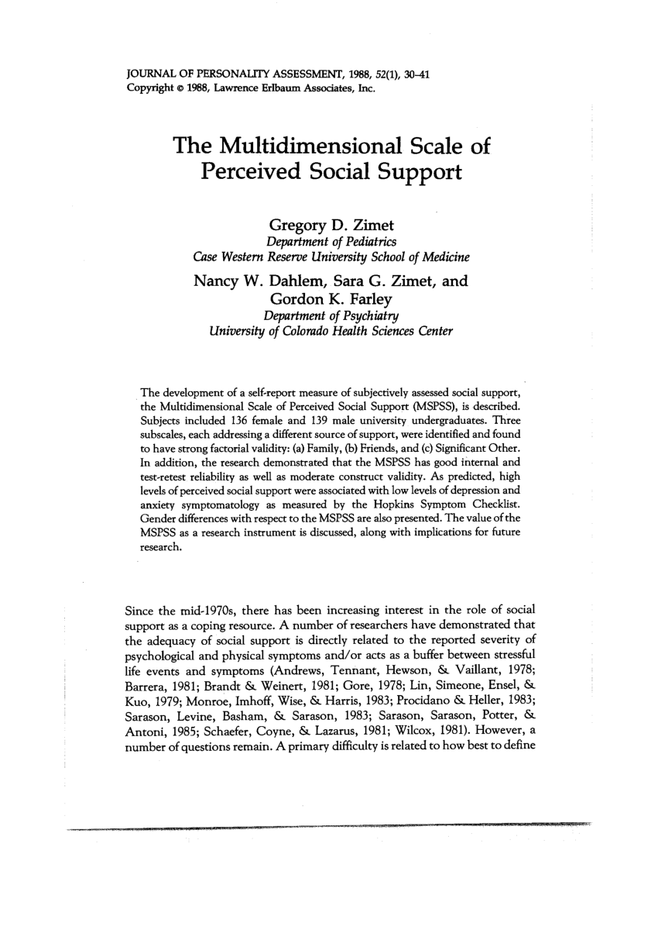
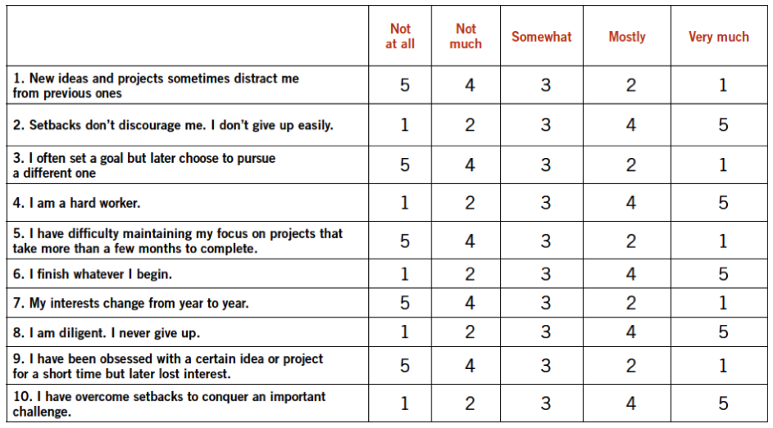





Slide 7


Slide 8
Table 1: Selected demographic variables. (N = 57)
Age (years, mean±SD) | 43.6±9.1
Race (n [%])
White | 34 (59.7)
Black | 13 (22.8)
Other | 10 (17.5)
Gender (n [%])
Female | 26 (45.6)
Male | 31 (54.4)
Highest Education (n [%])
Associates or less | 18 (31.6)
Bachelors | 13 (22.8)
Masters | 16 (28.1)
Doctorate | 10 (17.6)
Income in 2018 (n [%])
Less than 12,490 | 13 (23.6)
Between 12,490 and 16,910 | 1 (1.82)
Between 16,911 and 21,330 | 3 (5.5)
Between 21,331 and 25,750 | 7 (12.7)
Between 25,751 and 30,170 | 3 (5.5)
Between 30,171 and 34,590 | 4 (7.3)
Between 34,591 and 50,000 | 8 (14.6)
Between 50,001 and 75,000 | 7 (12.7)
Between 75,000 and 100,000 | 3 (5.5)
Between 100,000 and 150,000 | 4 (7.3)
Greater than 150,000 | 2 (3.6)

Slide 9
Table 2. Correlations
 | 1 | 2 | 3 | 4 | 5
1. incomeLastYr | 1.00000000 | 0.90578130 | 0.40586231 | -0.17256374 | -0.226783228
2. povertyRatio | 0.90578130 | 1.00000000 | 0.24798815 | -0.10726547 | -0.121653817
3. financialStatus | 0.40586231 | 0.24798815 | 1.00000000 | -0.46516980 | 0.168101584
4. savings | -0.17256374 | -0.10726547 | -0.46516980 | 1.00000000 | -0.118957738
5.programsUsedBinary | -0.22678323 | -0.12165382 | 0.16810158 | -0.11895774 | 1.000000000
6. ageNow | -0.11081109 | 0.03311116 | -0.24607676 | 0.07952369 | 0.065615387
7. ageRelease | -0.24684348 | -0.08304453 | -0.28127030 | 0.05394767 | -0.005941853
8. mspssScore | 0.08568878 | 0.06090829 | -0.05715269 | -0.07887455 | 0.099528730
9. aceScore | 0.12372821 | 0.18268279 | 0.05294731 | -0.11583557 | 0.048407327
10. gritScore | 0.00860284 | 0.01599544 | 0.23272742 | -0.41539499 | 0.331767042
 | 6 | 7 | 8 | 9 | 10
1. incomeLastYr | -0.11081109 | -0.246843481 | 0.08568878 | 0.12372821 | 0.00860284
2. povertyRatio | 0.03311116 | -0.083044529 | 0.06090829 | 0.18268279 | 0.01599544
3. financialStatus | -0.24607676 | -0.281270301 | -0.05715269 | 0.05294731 | 0.23272742
4. savings | 0.07952369 | 0.053947668 | -0.07887455 | -0.11583557 | -0.41539499
5.programsUsedBinary | 0.06561539 | -0.005941853 | 0.09952873 | 0.04840733 | 0.33176704
6. ageNow | 1.00000000 | 0.820731148 | 0.11755203 | 0.21280707 | 0.09270469
7. ageRelease | 0.82073115 | 1.000000000 | 0.25976062 | 0.27653637 | -0.02083793
8. mspssScore | 0.11755203 | 0.259760622 | 1.00000000 | 0.14027692 | 0.07119170
9. aceScore | 0.21280707 | 0.276536370 | 0.14027692 | 1.00000000 | 0.11068394
10. gritScore | 0.09270469 | -0.020837932 | 0.07119170 | 0.11068394 | 1.00000000

Slide 10
Table 3. Analysis of Variance of `gritScore` by `savings` groups

Slide 11
Qualitative Analysis
What contributed the most to helping you re-enter the community after your last incarceration ended?
What were the greatest obstacles to your community re-entry after your last incarceration ended?
What kind of help did you receive after your last incarceration ended?
Since your last release, how have interactions with the criminal justice system affected your reintegration (Probation, parole, etc.)?

Slide 12
Limitations
Coverage
Survey nonresponse
Operationalizing “successful re-entry”

Slide 13
Questions and Discussion

