Slide 1
Program/Policy Evaluation and Assessment Research Design for Program Evaluation: Quasi-Experimental Design
Nhial T. Tutlam, PhD, MPH
September 20, 2018

Slide 2
Categories of Evaluation Design
There are three main categories of design:
Experimental:
Includes random assignment to an experimental E and control C group.
Quasi-Experimental:
Includes an experimental E group and a comparison (C) group created by methods other than random assignment
Non-Experimental/Observational/Pre-Experimental:
Includes one group of participants with baseline and follow up observations

Slide 3
What is Quasi-Experimental Design
Comparing two groups: intervention and comparison groups
People/units of analysis are not selected randomly
Are comparisons robust?
Threats to internal validity?
Not all quasi-experimental designs have comparison groups
Notes:
In this design, we typically have two group, both intervention and comparison groups. As you recall from our lecture last week, we said for experimental design, we have an intervention group and a control group.
In quasi-experimental design, we have an experimental group and comparison group (C), which denotes that is created by a method that is NOT random. This is the key difference between an experimental design and a quasi-experimental design.
Once we have two groups that are not assigned randomly, an important question that arises is whether the comparisons are robust or not.
Quasi-experimental designs are typically able to address one or more categories of possible internal validity threats but not all of them. For example, quasi-experimental design addresses the threat to………..

Slide 4
Types of Quasi-Experimental Designs
Before-after comparison group design
Single time-series design/Interrupted time-series design
Before-after design
Notes:
There are several types of quasi-experimental designs.
The most common quasi-experimental design is the Comparison Group Pre-test/Post-test Design.
This design is the same as the classic controlled experimental design except that the subjects cannot be randomly assigned to either the experimental or the control group, or the researcher cannot control which group will get the treatment.
Another type is the single time-series design/Interrupted time-series design.
Yet another one is the before-after design.

Slide 5
Quasi-Experimental Design Biases
Selection
Historical
Notes:
An important thing to point out when talking about quasi-experimental design is that it exerts non-uniform control over the major threats to internal validity.
Selection and historical bias are always the initial major biases to examine when a quasi experimental design is used.
The initial differences from known, and especially unknown, selection biases make all E and (C) group adjusted post-test comparisons challenging.
Statistical adjustment methods cannot fully adjust for known, and cannot adjust for multiple unknown selection characteristics of participants or matched groups/sites.

Slide 6
Advantage
Practicality and convenience
Cost
Reduce the threat of ecological validity
Are your results generalizable
Notes:
Some of the advantages of the quasi-experimental design include the fact that it is practical and convenient. In other words, there are situations where we cannot randomize for example, and quasi-experimental designs allow us to get as close as possible to the gold standard of experimental design without necessarily crossing that threshold.
It is also convenient, because in some cases, you can use data that already exists.
Obviously, one of the reasons that we are unable to do experimental design sometime is due to cost and lack of resources. Quasi experimental design is a little less expensive, especially when you can use existing data sources such as administrative data for the evaluation.
One problem with experimental designs sometime is the fact that they occur in very controlled environment to the point that the question of generalizability is often raised. Now, with quasi-experimental design, sometimes they occur in an environment that is as close as possible to the real world, and therefore it may be easier to generalize results, finding. This, therefore, reduces the threat of ecological validity.

Slide 7
Techniques for Ensuring Equivalence between groups
Constructing comparison groups by matching
Intervention group typically specified first, then a comparison group is constructed
Comparison group matched on selected characteristics
Example: Matching of Landfill group and comparison group in St. Louis County
Notes:
Constructing control groups by matching
One procedure for constructing comparison groups in quasi-experimental design is by using matching. Here, we typically specify the intervention group first and then we select the comparison group based on specified characteristics. This may be done through either individual or aggregate matching. Individual matching is usually preferable to aggregate matching.
One major problem with matching is the fact that after matching on one or two baseline variables, it is usually very difficult to match on a third major characteristic.
For example, two years ago, we conducted an assessment of respiratory conditions of people living in St. Louis County. We matched based on level of education in the census blocks and proportion of white population in those census tracts.

Slide 8
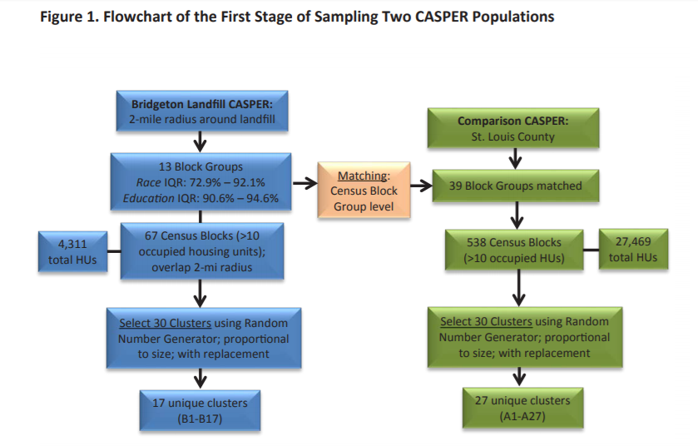
Source: St. Louis County Department of Public Health

Slide 9
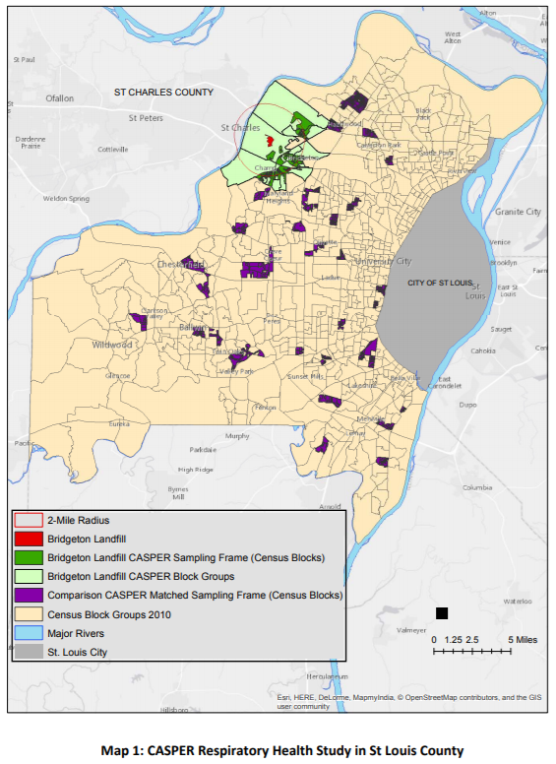

Slide 10
Techniques for Ensuring Equivalence between groups
Equating groups by statistical procedures
Multivariate statistical techniques
Modeling the determinant of outcomes
Modeling the determinants of selection
Regression-discontinuity design
Also referred to as cutting-point design
Reflexive controls
Simple pre-post studies
Time—Series design
Notes:
Equating groups by statistical procedures
Here, outcomes for an intervention group are compared with those of a comparison group. We do this a number of ways:
Multivariate statistical techniques
Modeling the determinant of outcomes
Modeling the determinants of selection
Regression-discontinuity design
Regression-discontinuity design is a quasi-experimental design in which selection into intervention or comparison group is based on the observed value on appropriate quantitative scale, with targets scoring above a designated cutting point on that scale assigned to one group and those scoring below assigned to the other. Also called a cutting-point design.
Reflexive controls
Here the estimates of program effects come entirely from information on the targets at two or more points in time, at least one of which is before the exposure to the program.
The strongest reflexive control design is a time-series design consisting of a number of observations over a time period spanning the intervention.

Slide 11
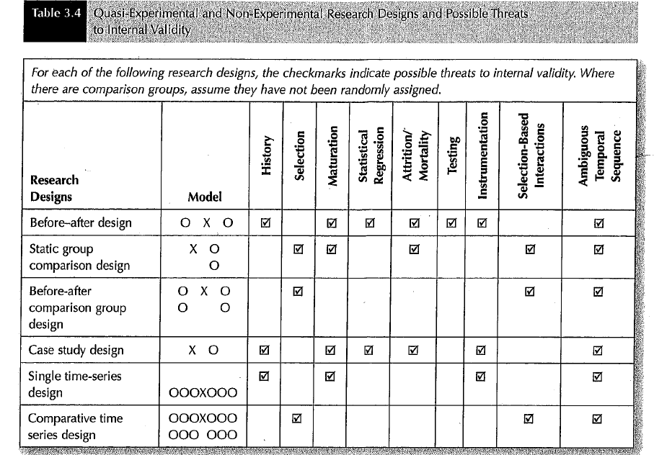
Notes:
This table here is in page 120 of our text. The table presents the various types of quasi-experimental designs and possible threats to internal validity.
We talked last week about 8/9 possible threats to validity. They are all listed here.
One that we touched on last week is called the interactive effect threat to validity; here it is the selection-based interactions. And this is the idea that there is a compounding effect brought on by interaction of the different threats to internal validity.
I want to draw your attention to the last column of the table. As you can see, all the designs are affected by this last one. In fact, this threat to internal validity cannot be ruled out even for experimental designs.
It is resolved by making sure that the program implementation is consistent with program theory.
You have to be able to have a plausible explanation as to how cause-and-effect variables are linked time wise.
Before-after comparison group design and comparative time-series design have the fewest possible threats to internal validity.
These two designs are usually great substitutes for randomized experimental designs.
The reason why these don’t have too many threats to internal validity is that they can be combined with statistical analysis that compensate for selection threats to internal validity.
The single time series design, also called interrupted time-series design, is next with fewer threats to internal validity.
The single time series designs are great because they lend themselves to statistical analysis to determine impact of program or policy intervention; can also be displayed graphically. We will see this shortly.
The static group comparison design is vulnerable to five different threats of internal validity. Of note, this design does not have baseline measurement.

Slide 12
Testing Causal Linkages in Program Logic Models
Research designs used to examine causal relationships
Program evaluation about examining linkages in logic model
Cause-and-effect variables have to be measured using the same unit of analysis
Notes:
Last week we talked about research design. As we discussed, research designs are used to examine causal relationships.
In research design there has been a general tendency to focus the research design on the main linkages between the program as a whole and the observed outcomes.
When we evaluate programs, we are generally examining the linkages in the logic models so that we can see whether there is a correlation between outputs and short term outcomes.
When looking at the linkages, we are essentially asking a question as to whether the independent variable in the linkage correlated with the dependent variable, and whether there are any other factors that could potentially affect this correlation or explain it.
A important thing that we have to point out when we are talking about examining linkages between two constructs in a logic model is that both the intended cause-and-effect variables must be measured using the same unit of analysis. We will discuss unit of analysis in chapter 4 next week.

Slide 13
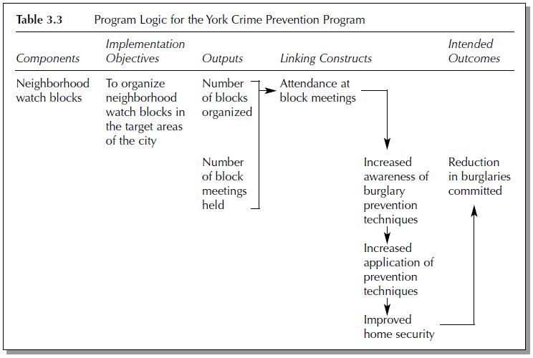
Notes:
This is a logic model of the York Crime Prevention Program.
Looking at this logic model, the intended outcome, as you can see here, is the reduction in burglaries committed.
If the program works as intended, the program theory will have been sort of confirmed.
As you can see, as you move through the logic model, various constructs within the model are measured in different ways. This implies each kind of has its own design.
When you are looking at any logic model, ask yourself how the key constructs are going to be measured and what research design is implied by the measure.

Slide 14
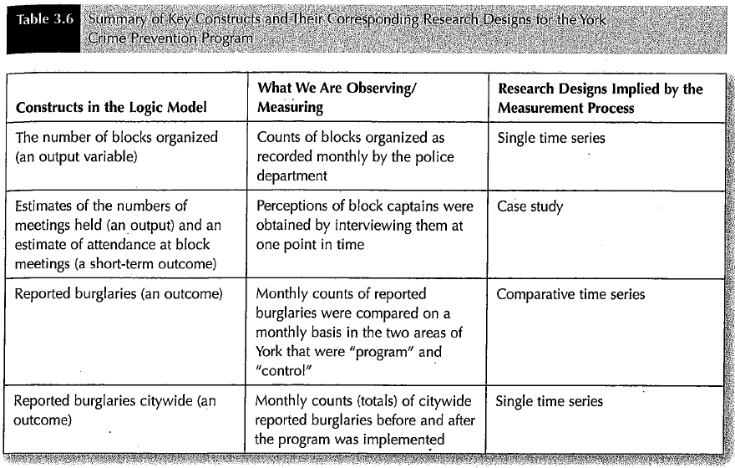
Notes:
This table here summarizes the key constructs and corresponding research designs for the York Crime Prevention Program.
As indicated in the table here, there were three different research designs for the program, that is, single time series, case study and comparative time series.
As you can see, no single one of the single designs would have allowed examination of the whole logic model. In other words, we had to have a patched-up research designs.
Each of this research designs focused on a specific construct of the logic model.
As y can see here, not every aspect that could have been affected or that could have been an outcome of the study was measured by this evaluation. As we discussed previously, sometimes, lack of resources can limit your ability to gather all the necessary data for evaluation. For example, in the case of this particular evaluation, the evaluators were not able to collect data on:
1) Increased awareness of prevention strategies
2) Increased application of techniques and
3) Improved home security
All these are important indicators, but because it would have required surveying all residents of the neighborhood, and tracking any changes in the neighborhoods, the evaluators opted not to evaluate this aspect.

Slide 15
Testing Causal Linkages in Program Logic Models
Why not test whole logic models?
Lack of adequate resources
Lack of control over programs
Notes:
In light of the discussion we just had, a good question that may be asked is why evaluators do not design program evaluation in which whole logic models are tested.
The simple answer is that in many cases, the resources are not there to be able to design evaluation in which you are testing for everything. As we just saw in the previous discussion, the evaluators had to make a decision not to evaluate every possible linkage.
Another big reason is that as we have said previously, evaluators often come after a program has been implemented; therefore, they often do not have control over program constructs to be able to come up with a designs that collect every aspect of program effects.

Slide 16
Research Design and Performance Measurement
Research design important for credible evaluation
Certain designs allow use of existing data that is used for performance measurement
Outcomes focused on performance measurement require more resources
Notes:
For an evaluator to conduct a credible evaluation, we often have to keep in mind the research design. Are we going to be able to get the data for the design we are proposing, do we have sufficient funds to be able to carry out the evaluation necessary using this design.
So as we think of evaluation design, it is important to understand that certain designs can allow us to use existing resources so that we do not have to spend additional resources to obtain the data we would need for evaluation.
For example, the data that we need for a single time-series design is often available in organizational records and overlaps with important sources of information in performance measurement. So, this kind of design is very appealing since it saves us resources and time.
But as is often the case with any endeavor where you are using something that is already in place such as using existing data, for example, if you are using administrative data, be aware that this can raise questions about reliability and validity.
Data on output are usually more accessible and are often included in performance measurement. However, data focused on outcomes, which we see as more desirable, are often not readily available and often require additional resources to collect. So this may in some cases be a limitation.

Slide 17
Propensity Score Analysis
The propensity score is the probability of treatment assignment conditional on observed baseline characteristics
Allows us to compare different groups as though they were similar (apples-to-apples)
Done using logistic regression
Notes:
By treatment assignment, we mean whether you are assigned to intervention or compassion group
In other words, it predicts likelihood/probability of being in treatment or comparison group based on baseline sociodemographic characteristics
We can use this for matching individuals. For example, we can match individuals in intervention group to an individual with similar propensity score in the comparison group.

Slide 18
Non-Experimental Designs
Have no explicit comparison group in design
No program vs non-program group
No before-after comparison
Construct internal comparisons
Dosage comparisons
Divide people into subgroups
Referred to as implicit or case study designs
Notes:
Non experimental designs are the ones that have no explicit comparison group built into the design. In other words, we do not have a program and non-program groups.
They are actually very common and typically, are used when evaluators have been brought into the picture late, long after the program has been implemented. Most of the time, at this stage of the game, the prospect for a comparison group or even before and after comparison is almost impossible.
That said, in these types of situations, evaluators come up with some strategies to try to address the problem of internal validity. One strategy that is commonly used is to construct internal comparison. This simply means you create some kind of mechanism to divide the same group so that you can compare them against each other based on characteristic that is unique to the subgroup. For example, you can categorized based on dosage, where you can, for example, divide by level of dose: low, medium and high, with the assumption that you will have different outcomes at different dosage levels.
Another strategy that is often used is to divide people into different subgroups. For example, you can divide by gender, age, level of education, employment status, geographic location and others.
The type of designs where you have internal comparisons are commonly referred to as Implicit design or case study designs.

Slide 19
Time Series Design
Single time series design
000000X000000
Comparative time series design
000000X000000
000000 000000
Requires availability and accessibility of existing data
Ideal design for dissemination-effectiveness evaluation
Notes:
Time series designs are fairly underutilized for some reason.
Some people advocate for greater use of interrupted time series design for community intervention research.
There are two main types:
The single time-series design, which as we saw earlier is also called interrupted time-series design.
The second one is the comparative time series design. This is typically stronger than a case study or single time series because it includes a comparison group.
They enable production of knowledge about effects of state and country-wide intervention policies in circumstances in which randomization is too expensive or simply not practical.
Time series design is the most likely type of design that is used for evaluating dissemination and effectiveness. It is especially appropriate for evaluating the effects of new policies that are intended to be disseminated or adopted systemwide.

Slide 20
Time Series Design
Design can be considered if a program:
Routine data monitoring exists
Establish validity and reliability of measurements
Periodicity-pattern of the impact or outcomes being measured
Measured at multiple time points
Implemented at specific time and end at specific time
Notes:
Establish that routinely reported data monitoring system exists for the impact rate, and this data is accessible and current.
Establish validity and reliability, completeness, and even stability of the impact measurement and rates. We will talk about reliability and validity next week.
Establish that the data is reported periodically and there is a pattern of reporting, collection.
Document the measures at multiple monthly, quarterly, or annual data points at least two to three years before and two to three years after a program implementation.
Introduce program/intervention system-wide at specific time and, if justified, to withdraw the intervention at specified time period in the future.

Slide 21
The York Watch Neighborhood Watch Program:
Program intended to reduce reported burglaries
Burglaries tracked over time at neighborhood and city wide levels
Block captains surveyed
Environmental factors were measured
Notes:
This was a neighborhood watch program in the town of York, Pennsylvania intended to reduce reported burglaries in the city and neighborhoods. This was at the beginning implemented in one area of the city.
The reported burglaries were tracked over time at both the neighborhood and city levels.
Interviews were conducted with neighborhood block captains to get their perception of the program, including estimates of resident attendance of the neighborhood watch meetings.
In addition, key environmental factors such as un employment rate in the whole community, were measured throughout the intervention period.

Slide 22
The York Watch Neighborhood Watch Program:
Program implemented at the level of neighborhood block watch
Case-study design
Captains interviewed
Reported burglaries compared between neighborhoods
Comparative time-series design
000000X000000
000000 000000
Reported burglaries were compared before and after city-wide program implementation
Single time-series design
000000X000000
Notes:
As we have already pointed out, the program was implemented at the neighborhood block levels. As we have already discussed, when doing an evaluation, you sometimes have to rely on multiple study designs. In this case, a number of designs were employed.
The first one is case-study design, where the neighborhood watch captains were interviewed.
In the second phase, reported burglaries were compared between the neighborhoods that received the program and those that did not. This was a comparative time-series design. This is typically stronger than a case study design.
In addition, reported burglaries were compared before and after city-wide program implementation. In this case, a single time-series design was employed to compare before and after program implementation citywide.
Remember this program was initially started in one section of the city, but then it was expanded city wide, so they had to evaluate the effect of the citywide implementation as well.

Slide 23
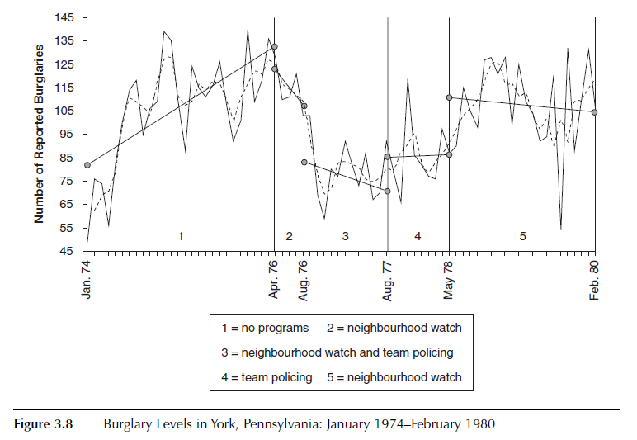
Notes:
This graph shows you the trend of burglaries in the entire city from 1974 through 1980.
The first part shows when there was no program and it shows a steady increase in the number of burglaries in the city.
One thing you can take a way from this first part of the graph is the classic example of what usually prompts an action/policy implementation. The politicians were no doubt under pressure to do something about this menace.
For a period of 4 months between April and August of 1976, the police implemented neighborhood watch program then shortly after that they added team policing to the intervention. There after they cancelled the neighborhood watch program but maintained the team policing program. Then they finally cancelled the team policing program and re-introduced the neighborhood watch program.
You can only imagine the heated internal discussion and debate in the police department. This is a classic example of what happens in many agencies, where you have different people with competing interests arguing about the direction of an agency. You end up sometimes pulling otherwise effective programs prematurely.
As you can see here, the burglaries declined when the neighborhood watch program was introduced, and then they went down further when community policing was introduced.
A good question is which particular program was responsible for the decline in burglaries.
The problem in this case is that this is a difficult question to answer in this scenario.
When two programs are implemented so closely together in time, it is almost impossible to sort out their contribution to the outcomes. Which one had the most effect?
In essence, one program introduces historical bias toward the other, it becomes an intervening external event that can affect the outcome, so you are not sure whether the outcome is as a direct result of the main program implemented. You can have a rival hypothesis as to what caused an outcome.

Slide 24
Case Study

Slide 25
Time Series Design for a National Occupational Health Policy-Program
C. Montfort and R. Windsor, “An Impact evaluation of Federal Mine Safety Training Regulation and Policies on Fatality and Injury Rates Among US Stone, Sand and Gravel Workers: An Interrupted Time-Series Analysis,: American Journal of Public Health (August 2010)

Slide 26
Introduction
The Mine Safety Administration instituted new mandatory 24 hours of training for new employees in 1979
Experienced employees were to receive 8 hours training annually
No well-designed evaluations of the effectiveness of the taring

Slide 27
Methods
This evaluation designed to assess the impact of the policy on injury and fatality rates in the US
Congress mandated new rules be issued by 9/20/1999, and take effect by 10/1/2000
Time period of interest Jan 1995 – Dec 2006
Pre-intervention evaluation-analysis period:
Jauary1995 to October 2000
Post-intervention analysis intervention period:
October 2000 to December 2006

Slide 28
Evaluation Design
An Interrupted time series (TSD)
Based on models for sequential observation over time to evaluate the impact of the policy
With time-series data, analyses account for the correlation between proximal observations

Slide 29
Results
Quarterly fatality rates
January 1, 1995 to Dec 31, 2006: 259 fatalities
Pre-intervention period (25 quarters): 160 fatalities
Fatality rate = 0.025 per 200,000 employee hours
Post-intervention period (23 quarters): 99 fatalities
Fatality rate = =.017 per 200,000 employee hours
Represented a decline of 33%
But NOT statistically significant
Notes:
Although there was a 33% decline in the fatality rate between the pre-intervention period and the post-intervention period, this decline was not statistically significant.
Therefore, the decline in fatality rate could not be attributed to the implementation of the training program.

Slide 30
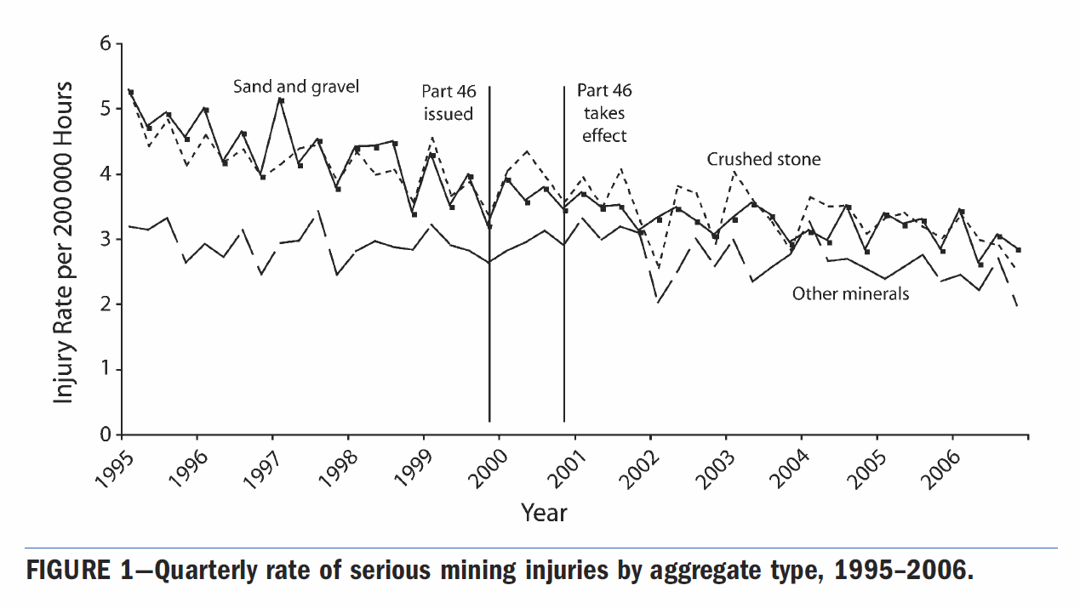

Slide 31
Discussion
The time-series and regression analysis provided mixed results
No statistically significant results in less severe injuries
Identified statistically significant results in rate of permanently disabling injuries
There is need to consider alternative plausible explanations
Historical bias
Selection bias
Explore other reasons why there was no effect from the training
Notes:
No other mining related policies, so and no changes in composition of the study population, so these are not plausible alternative explanation for no positive findings.
We may have to examine, the quality, time, frequency and intensity of the training sessions.
Probably consider process evaluation to document these characteristics and confirm the degree of fidelity of program implementation. Fidelity of program implementation is an important aspect of program/policy evaluation.
An important point to take away from the findings of this study is that policy makers need to consider the opportunities (or obstacles) to evaluating a regulation’s impact prior to its creation and once it is in place.

Slide 32
Discussion Question
Discuss question 6 in the text book

