Slide 1
Review of Univariate and Bivariate Analysis
Regression Analysis and Non-Linear Models: Sociology 6100
Dr. Matsuo
Spring 2017 - Saint Louis University

Slide 2
Levels of Measurement
Nominal: no logical order
Sex, race, political affiliation, religion
Ordinal: indicates logical order, but cannot indicate the distance of ranks
Social class
Likert-scale (people’s opinion)
Interval: meaningful standard distance between attributes
No true zero
Temperature, height, weight, IQ
Ratio: measures based upon true zero and logical standard distance between attributes
Income, age, population, number of church attendance
Terms, interval and ratio, are used interchangeably
Match between levels of measurements and statistical techniques

Slide 3
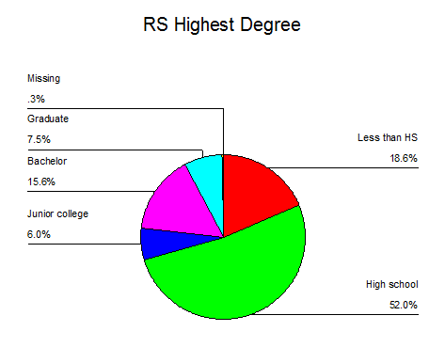
Descriptive Statistics
Nominal and Ordinal Variables
Frequency Table
Pie Chart

Slide 4
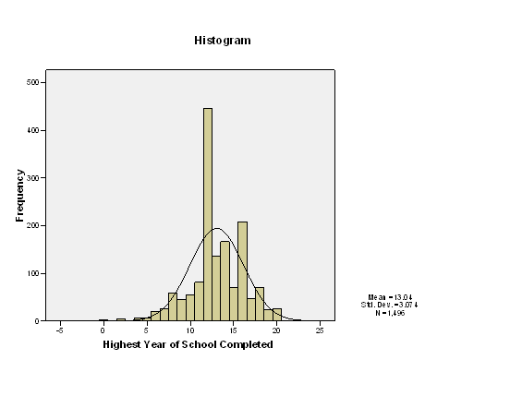
Descriptive Statistics (cont.)
Continuous Variables
Central tendency (Mean, Median, Mode)
Variation (Standard deviation, Skewness, Histogram)

Slide 5
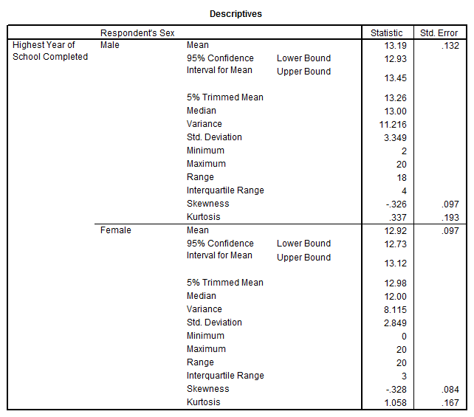
Descriptive Statistics (cont.)
Confidence interval
Based upon point estimate (sample mean), we construct interval of values in which the population mean will fall.
95% confidence interval
99% confidence interval

Slide 6
Inferential Statistics
1) Null hypothesis and alternative hypothesis
Alternative hypothesis: hypothesis that we want to test
Null hypothesis: hypothesis which will be tested
2) Type I and Type II errors
Type I Error: Rejecting a null hypothesis when it is true
Type II Error: Not rejecting a null hypothesis when it is false
3) Test of significance
Significance level (critical region)
Higher value of test statistics (t-value, F-value, χ² -value, etc) corresponds to a lower p-value (more significant, p< .05, p<0.01, p < .001)
H₀ : There is not difference between males and females in income
H_{a}: There is a difference between males and females in income
Significance level was p=0.012
Reject the null hypotheses. But, there is 0.012 (1.2%) chance to make Type I error

Slide 7
Inferential Statistics (cont.)
4) Correlation and causal model
Pearson correlation ( r )
Eg. Academic performance and IQ
Educational attainment and income
Correlation does not explain causality
Causal Model
a) spurious relationships (no x – y relationships)

Slide 8
Inferential Statistics (cont.)
Causal Model (cont.)
b) Indirect relationship intervened by z
c) Multiple causes

Slide 9
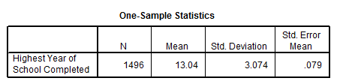
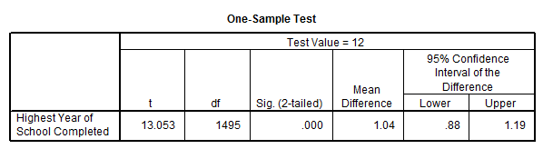
Application of Statistics
1) T-Test: One-sample mean (H0: The sample mean is 12.0.)
H0: µ1=12.0

Slide 10
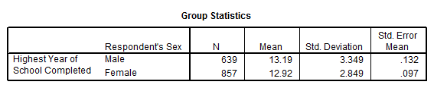
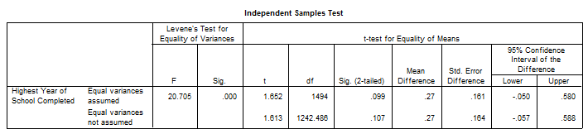
Application of Statistics (cont.)
2) T-Test: Comparison of two samples means (H0: There is no gender difference in education)
H0: µ1= µ2

Slide 11
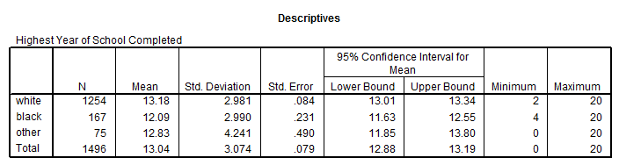
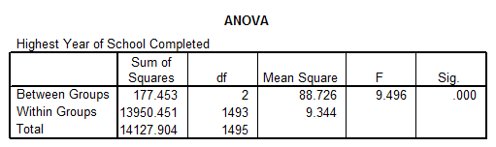
Application of Statistics (cont.)
3) One-way ANOVA: Comparison of means among three or more groups (H0: There is no difference in education among racial groups)
H0: µ1= µ2 = µ3

Slide 12
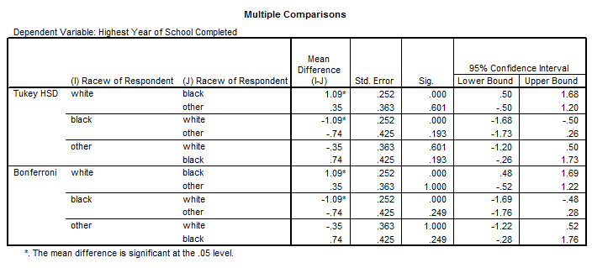
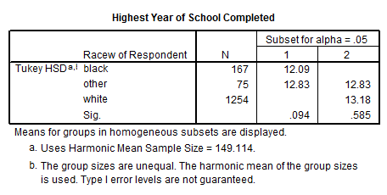
Application of Statistics (cont.)
Post Hoc Tests
Homogeneous Subsets

Slide 13
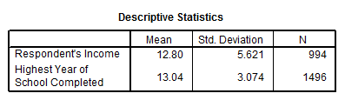
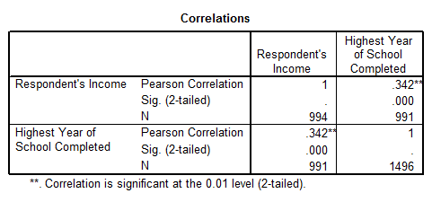
Application of Statistics (cont.)
4) Correlations: Pearson correlation between education and income (H0: There is no correlation between education and income)
H0: ρ = 0

Slide 14
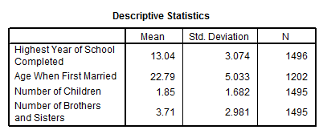
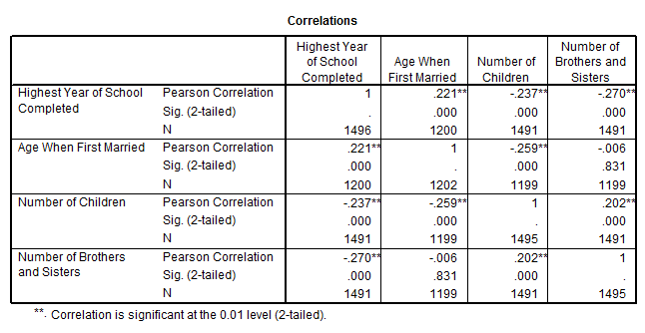
Application of Statistics (cont.)
Correlations: Pearson correlations with multiple variables

Slide 15
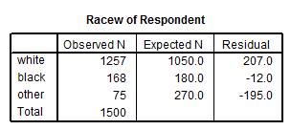
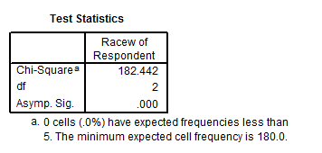
Application of Statistics (cont.)
5) Chi-Square Test: Sample representativeness (white 70%, black 12%, other 28%)
H0: Sample frequencies are the same as the population
Frequencies

Slide 16
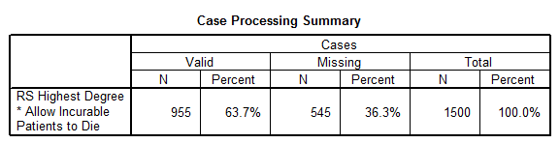
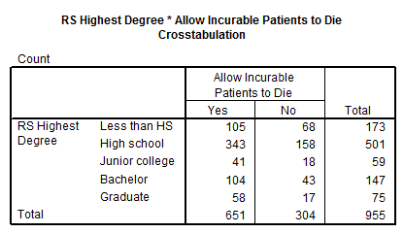
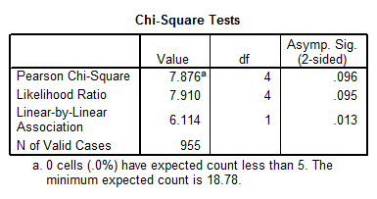
Application of Statistics (cont.)
Crosstabs: Chi-square test (Association between education and allow incurable patient to die)
H0: There is no association between two variables
Ha: There is an association between two variables

Slide 17
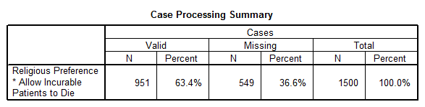
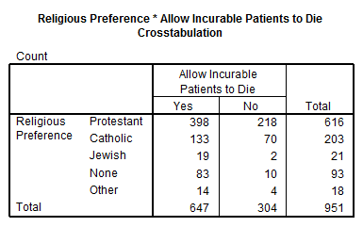
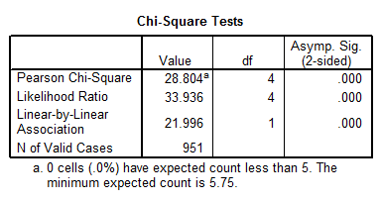
Application of Statistics (cont.)
Crosstabs: Chi-square test (association between religion and incurable patient to die)

Slide 18
Application of Statistics (cont.)
6) Simple Regression Analysis: Income as DV, and Education as IV

Slide 19
Application of Statistics (cont.)
Simple Regression Analysis (cont.)

Slide 20
Statistical Application (cont.)
7) Regression: Impact of Age, Sex, and Education on Income
About 24% of variation of DV is explained by IVs.

Slide 21
Statistical Application (cont.)
Regression (cont.)
Large F-statistics with small p-value shows good model fit.
H0: β1=β2=β3=0 is rejected.
Sex: Male=1, Female=0

