Slide 1
Investigating the Feasibility of Using Patent Citations to
Assess Technology Transfer Outcomes
Malcolm S. Townes
Saint Louis University

Slide 2
Technology Transfer: The conveyance of a capability or ability to perform a technical task or replicate a technical accomplishment from one person or entity to another person or entity.
Improving the transfer of technology derived from federally-funded research and development (R&D) to the private sector is a priority for the public policy of the United States of America (OMB, 2018).
Notes:
“CMS Medicare Budget Overview.” 2018. Centers for Medicare and Medicaid Services. U.S. Department of Health & Human Services. Retrieved from https://www.hhs.gov/about/budget/fy2018/budget-in-brief/cms/medicare/index.html.
US Spending. nd. USGovernmentSpending.com. Retrieved from https://www.usgovernmentspending.com/year_spending_2018USbn_20bs2n_4041_605#usgs302

Slide 3
Asset-based
Patent rights
Trade secrets
Copyright
License
Acquisition
New venture
Information-based
Patent documents
Patent applications
Journal articles
Presentations
Citations
Downloads
Readings
Event attendance
Service-based
Consulting services
Sponsored research
COI Disclosure
Contracts
Research Questions
1. Can patent citations data serve as a useful measure of technology transfer outcomes?
2. Is technology transfer as measured by patent citations received significantly related to other variables captured in the patent citation data?

Slide 4
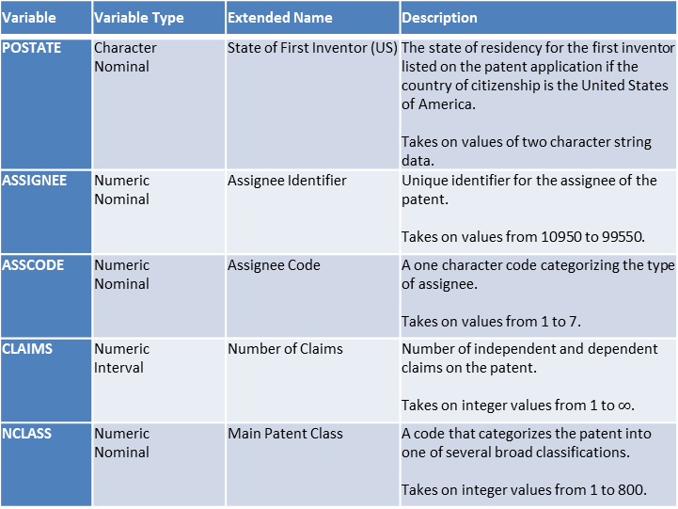
Original USPTO Variables from Source Data
Variable | Variable Type | Extended Name | Description
PATENT | Numeric Nominal | Patent Number | The number assigned to the allowed patent by the USPTO. Takes on values integer values between 3070801 and 6009554.
GYEAR | Numeric Interval | Grant Year | The year the USPTO allowed the patent. Takes on integer values between 1963 – 1999.
GDATE | Numeric Interval | Grant Date | The date the USPTO allowed the patent expressed in terms of the number of weeks elapsed since January 1, 1960. Takes on integer values between 156 and 2,028.
APPYEAR | Numeric Interval | Application Year | The year the patent application was submitted to the USPTO. Takes on integer values between 1963 – 1999.
COUNTRY | Character Nominal | Country of First Inventor | The country of citizenship for the first inventor listed on the patent application. Takes on values of two character string data.
Variable | Variable Type | Extended Name | Description
POSTATE | Character Nominal | State of First Inventor (US) | The state of residency for the first inventor listed on the patent application if the country of citizenship is the United States of America. Takes on values of two character string data.
ASSIGNEE | Numeric Nominal | Assignee Identifier | Unique identifier for the assignee of the patent. Takes on values from 10950 to 99550.
ASSCODE | Numeric Nominal | Assignee Code | A one character code categorizing the type of assignee. Takes on values from 1 to 7.
CLAIMS | Numeric Interval | Number of Claims | Number of independent and dependent claims on the patent. Takes on integer values from 1 to $∞$.
NCLASS | Numeric Nominal | Main Patent Class | A code that categorizes the patent into one of several broad classifications. Takes on integer values from 1 to 800.

Slide 5
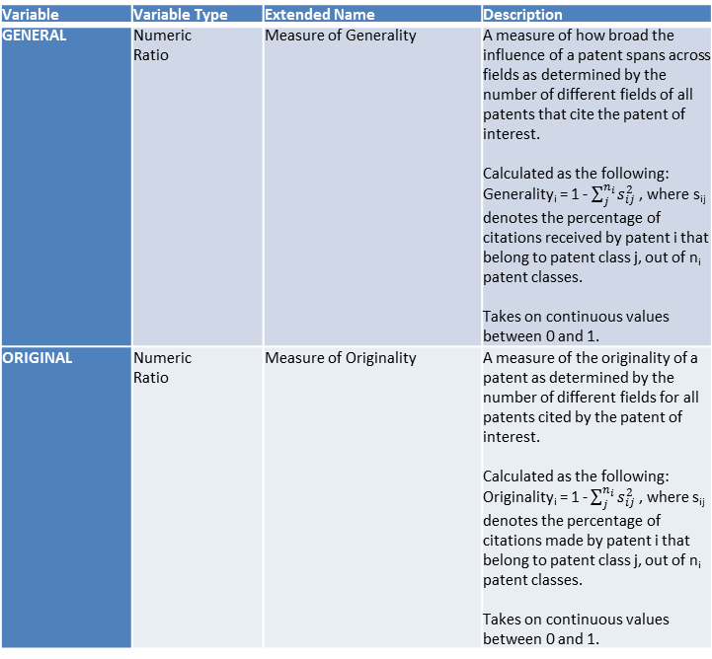
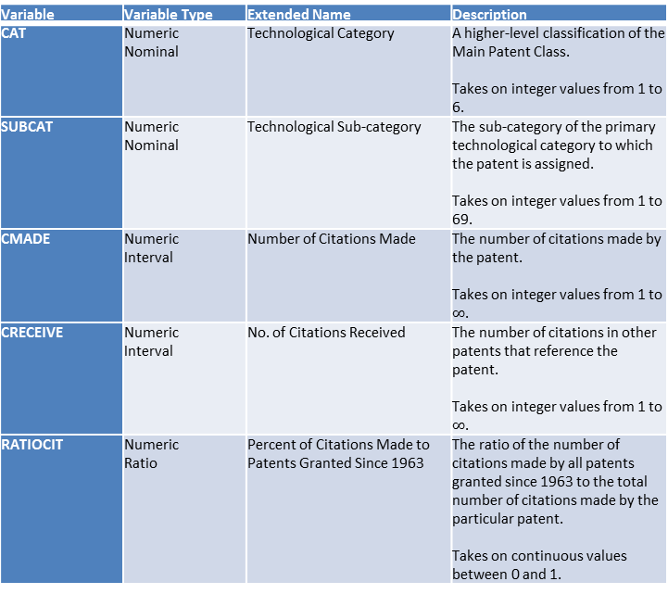
Original Constructed Variables from Source Data
Variable | Variable Type | Extended Name | Description
CAT | Numeric Nominal | Technological Category | A higher-level classification of the Main Patent Class. Takes on integer values from 1 to 6.
SUBCAT | Numeric Nominal | Technological Sub-category | The sub-category of the primary technological category to which the patent is assigned. Takes on integer values from 1 to 69.
CMADE | Numeric Interval | Number of Citations Made | The number of citations made by the patent. Takes on integer values from 1 to $∞$.
CRECEIVE | Numeric Interval | No. of Citations Received | The number of citations in other patents that reference the patent. Takes on integer values from 1 to $∞$.
RATIOCIT | Numeric Ratio | Percent of Citations Made to Patents Granted Since 1963 | The ratio of the number of citations made by all patents granted since 1963 to the total number of citations made by the particular patent. Takes on continuous values between 0 and 1.
Variable | Variable Type | Extended Name | Description
GENERAL | Numeric Ratio | Measure of Generality | A measure of how broad the influence of a patent spans across fields as determined by the number of different fields of all patents that cite the patent of interest. Calculated as the following: Generality_{i} = 1 - $\sum_{j}^{n_{i}}{s_{ij}^{2}}$ , where s_{ij} denotes the percentage of citations received by patent i that belong to patent class j, out of n_{i} patent classes. Takes on continuous values between 0 and 1.
ORIGINAL | Numeric Ratio | Measure of Originality | A measure of the originality of a patent as determined by the number of different fields for all patents cited by the patent of interest. Calculated as the following: Originality_{i} = 1 - $\sum_{j}^{n_{i}}{s_{ij}^{2}}$ , where s_{ij} denotes the percentage of citations made by patent i that belong to patent class j, out of n_{i} patent classes. Takes on continuous values between 0 and 1.

Slide 6
Original Constructed Variables from Source Data (cont’d)
Variable | Variable Type | Extended Name | Description
FWDAPLAG | Numeric Ratio | Mean Forward Citation Lag | The mean time difference between the application or grant date of the patent and that of the other patents citing this patent. Takes on continuous values between 0 and 1.
BCKGTLAG | Numeric Ratio | Mean Backward Citation Lag | The mean time difference between the application or grant date of the patent and that of the patents it cites. Takes on continuous values between 0 and 1.
SELFCTUB | Numeric Ratio | Share of Self-Citations Made – Upper Bound | The number of citations made by the patent to other patents with the same assignee divided by the total number of citations made by all patents with assignee codes. Takes on continuous values between 0 and 1.
SELFCTLB | Numeric Ratio | Share of Self-Citations Made – Lower Bound | The number of citations made by the patent to other patents with the same assignee divided by the total number of citations made by all patents. Takes on continuous values between 0 and 1.
Variable | Variable Type | Extended Name | Description
SECUPBD | Numeric Ratio | Share of Self-Citations Received – Upper Bound | The number of citations received by the patent from other patents with the same assignee divided by the total number of citations received by all patents with assignee codes. Takes on continuous values between 0 and 1.
SECDLWBD | Numeric Ratio | Share of Self-Citations Received – Lower Bound | The number of citations received by the patent from other patents with the same assignee divided by the total number of citations received by all patents. Takes on continuous values between 0 and 1.

Slide 7
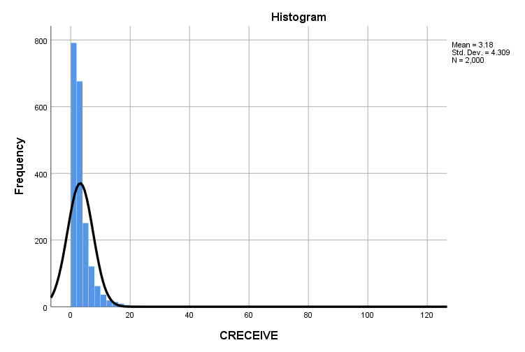
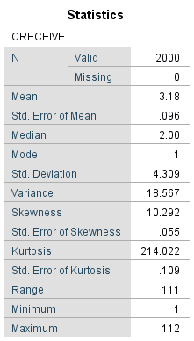
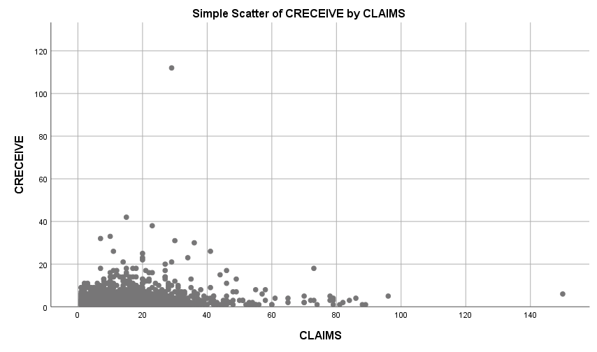

Slide 8
Multiple Regression Analysis

Slide 9
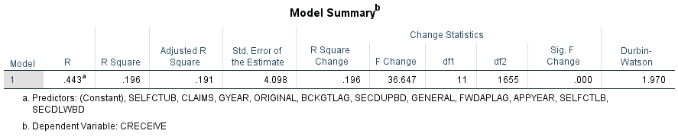
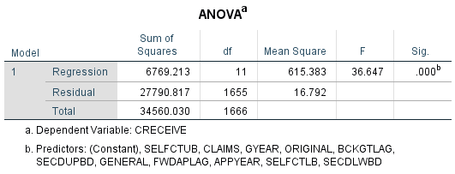
CRECEIVE = β₀ + β₁(GRYEAR) + β₂(APPYEAR) + β₃(CLAIMS) + β₄(GENERAL) + β₅(ORIGINAL) + β₆(CMADE) + β₇(RATIOCIT) + β₈(BCKGTLAG) + β₉(FWDAPLAG) + β₁₀(SELFCTUB) + β₁₁(SELFCTLB) + β₁₂ (SECDLWBD) + β₁₃(SECDUPBD)+ ε
H₀: β₁ = β₂ … = β₁₃ = 0
H_{A}: β ≠ 0 for at least one independent variable

Slide 11
Hierarchical Regression Analysis

Slide 12
 | Unstandardized |  |  |  | Standardized
Variable | Model 1 |  | Model 2 |  | Model 1 |  | Model 2
Constant | 330.669 | *** | 331.411 | *** | 0.000 | *** | 0.000 | ***
CLAIMS | 0.005 | *** | 0.008 | *** | 0.077 | *** | 0.127 | ***
CMADE | 0.001 |  | 0.001 |  | 0.021 |  | 0.022
GENERAL | 1.744 | *** | 1.752 | *** | 0.569 | *** | 0.572 | ***
GYEAR | -0.166 | *** | -0.166 | *** | -0.221 | *** | -0.222 | ***
ORIGINAL | -0.301 | *** | -0.195 | * | -0.104 | *** | -0.067 | *
RATIOCIT | 0.555 | *** | 0.557 | *** | 0.081 | *** | 0.082 | ***
SECDUPBD |  |  | 0.053 |  |  |  | 0.023
SELFCTUB |  |  | -0.033 |  |  |  | -0.010
CLAIMSORIGINAL |  |  | -0.007 |  |  |  | -0.073
Adj. R² | 0.436 |  | 0.437 |  | 0.436 |  | 0.437
Adj. R² change | 0.436 |  | 0.001 |  | 0.436 |  | 0.001
F | 215.741 | * | 144.442 | * | 215.741 | * | 144.442 | *
F change | 215.741 | * | 1.474 |  | 215.741 | * | 1.474
Δ F | 215.741 |  | 71.299 |  | 215.741 |  | 71.299
Dependent variable: logCRECEIVE
* p < 0.05; ** p < 0.01; *** p < 0.001

Slide 13
Path Model

Slide 14
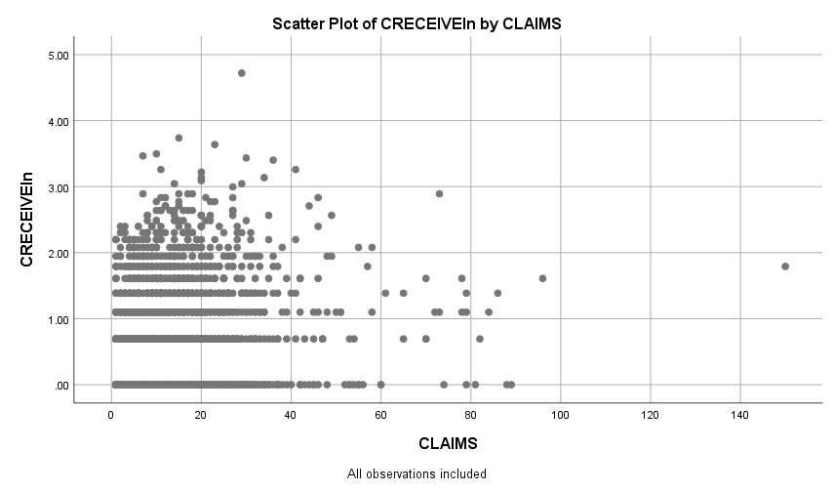

Slide 15
Theoretical Model

Slide 16
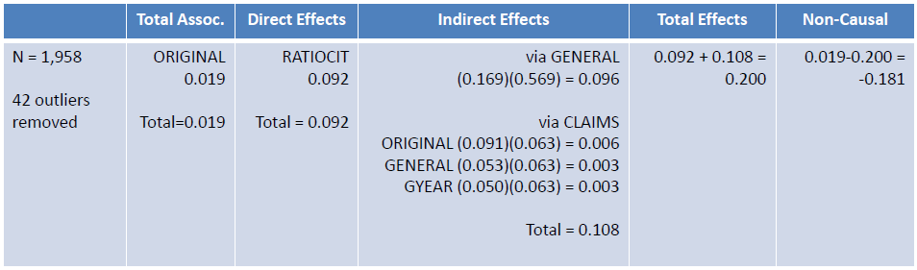
Original Model
Revised Model

Slide 17
Binary Logistic Regression

Slide 18
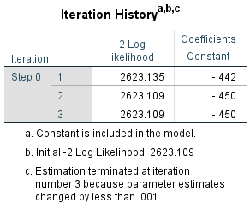
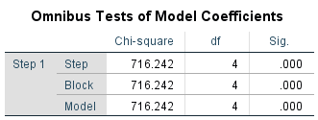
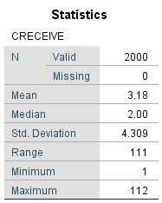

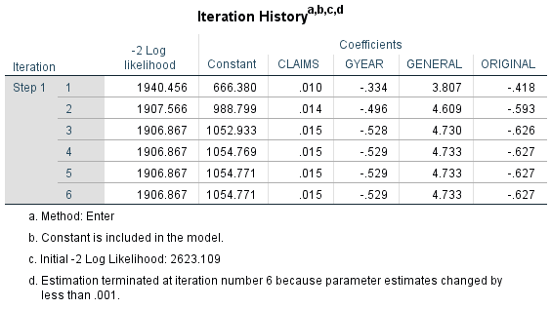
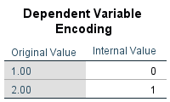

Slide 19
