Slide 1

SOC 6100 Fall 2018 Journal Article Critique
Saeed Asiri
Nathaniel House
Malcolm Townes
Notes:
Malcolm

Slide 2
Presentation Outline
Theoretical and Conceptual Framework
Malcolm Townes
Data and Methods
Saeed Asiri
Critique
Open Discussion
Results
Nathaniel House
Notes:
Malcolm

Slide 3
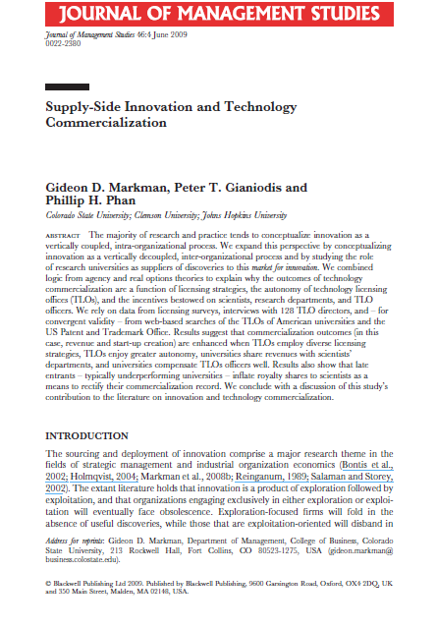
Markman, G. D., Gianiodis, P. T., & Phan, P. H. (2009). Supply-Side Innovation and Technology Commercialization. Journal of Management Studies, 46(4), 625-649. doi:10.1111/j.1467-6486.2009.00835.x
Study Objectives
Study the role of research universities as suppliers of innovations.
Explain why technology commercialization outcomes are a function of licensing strategies, technology licensing office (TLO) autonomy, researcher incentives, department incentives, and TLO staff incentives.
Notes:
Malcolm

Slide 4


Development
Innovation Exploitation
Intra-Firm View
Innovation Exploration
Research
Company A
Companies C, D, …
Development
Innovation Market
Development
Innovation Exploitation
Innovation Exploitation
Ecosystem View
Innovation Exploration
Innovation Exploration
Research
Research
Company A
Company B
Universities
Notes:
Malcolm

Slide 5
Hypothesis 1: Sponsored research is negatively related to commercialization outcomes.
Hypothesis 2: A disproportional or ongoing use of licensing-for-cash strategies is negatively
related to commercialization outcomes.
Hypothesis 3: An autonomous or decentralized organizational structure is positively related to commercialization outcomes.
Hypothesis 4: The greater the royalty share universities allocate to inventors, the greater the commercialization outcomes.
Hypothesis 5: Generous royalty sharing between universities and departments is associated
with greater commercialization outcomes.
Hypothesis 6: Higher pay for TLO officers is positively related to greater commercialization
outcomes.
Notes:
Malcolm

Slide 6
Dependent Variables
licRev ≡ average annual revenues from commercializing intellectual property (1999-2000)
firmCreation ≡ avg. no. of yearly spinouts from technology transfer activities (1998–2001)
Study Variables
facQual ≡ 1995 National Survey of Graduate Faculty score for the institution (1=poor; 5 = dist)
sponsRes ≡ percent of commercialization via sponsored research agreements
licAgmnt ≡ percent of commercialization via licensing agreements
autoLow ≡ technology licensing office has low degree of autonomy (1 = yes; 0 = no)
autoHigh ≡ technology licensing office has high degree of autonomy (1 = yes; 0 = no)
payInventors ≡ percentage of licensing revenue distributed to inventors
payDept ≡ percentage of licensing revenue distributed to inventors’ departments
payTLO ≡ average salary of technology licensing office staff in thousands of USD
Control Variables
TLOage ≡ age of the technology licensing office in years
TLOsize ≡ number of licensing staff in the technology licensing office
pubPriv ≡ whether the institution is a public or private university (public = 1; private = 0)
incub ≡ whether the institution has a business incubator (yes = 1; no = 0)
Notes:
Malcolm

Slide 7
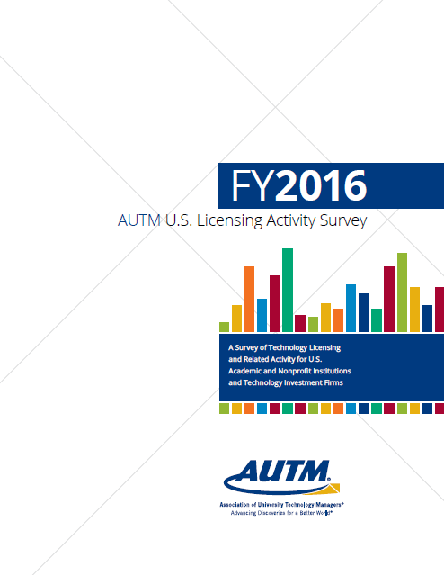
FY1999
Notes:
Saeed

Slide 8
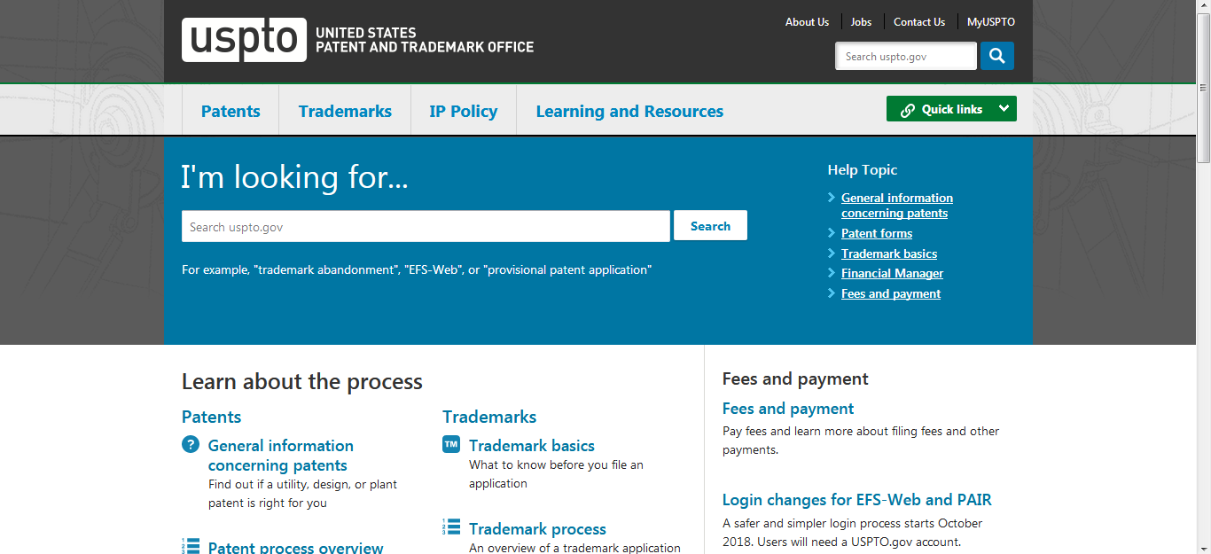
Notes:
Saeed

Slide 9

Structured Phone Interviews
TLO directors from 128 of 139 AUTM member institutions
60% of federal and industry research support
70% of licenses executed
85% of patents issued to universities
Notes:
Saeed

Slide 10
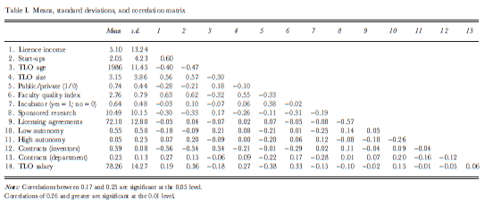
Table 1 on p. 638
Notes:
Saeed

Slide 11
Model 1
log (licRev) = β₀ + β₁(TLOage) + β₂(TLOsize) + β₃(pubPriv) + β₄(facQual) + β₅(incub) + E
Model 2
log (licRev) = β₀ + β₁(TLOage) + β₂(TLOsize) + β₃(pubPriv) + β₄(facQual) + β₅(incub) +
β₆(sponsRes) + β₇(licAgmnt) + β₈(autoLow) + β₉(autoHigh) +
β₁₀(payInventors) + β₁₁(payDept) + β₁₂(payTLO) + E
Model 3
log (firmCreation) = β₀ + β₁(TLOage) + β₂(TLOsize) + β₃(pubPriv) + β₄(facQual) + β₅(incub) + E
Model 4
log (firmCreation) = β₀ + β₁(TLOage) + β₂(TLOsize) + β₃(pubPriv) + β₄(facQual) + β₅(incub) +
β₆(sponsRes) + β₇(licAgmnt) + β₈(autoLow) + β₉(autoHigh) +
β₁₀(payInventors) + β₁₁(payDept) + β₁₂(payTLO) + E
Notes:
Nathan

Slide 12
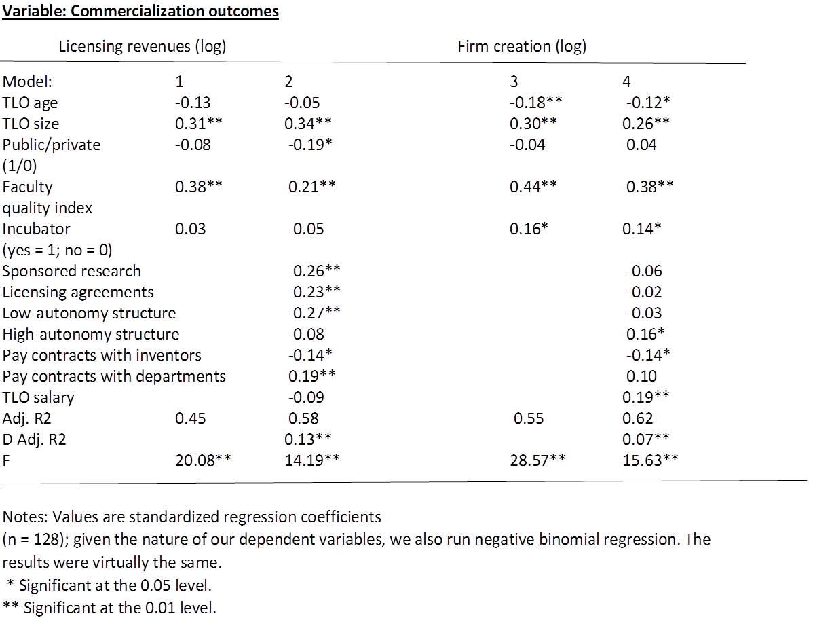
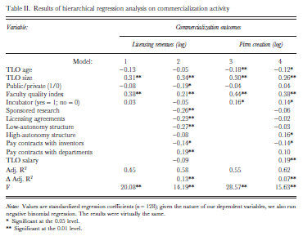
Table 2 on p. 639
Notes:
Nathan

Slide 13
Hypothesis 1: Sponsored research is negatively related to commercialization outcomes.
Confirmed in Model 2
Sponsored research inversely associated with licensing revenue.
Unconfirmed in Model 4
No association between sponsored research and firm creation.
Hypothesis 2: A disproportional or ongoing use of licensing-for-cash strategies is negatively
related to commercialization outcomes.
Confirmed in Model 2
Licensing-for-cash inversely associated with licensing revenue.
Unconfirmed in Model 4
No association between licensing-for-cash and firm creation.

Slide 14
Hypothesis 3: An autonomous or decentralized organizational structure is positively related to commercialization outcomes.
Partially confirmed in Model 2
Low autonomy inversely associated with licensing revenue.
No association between high autonomy and licensing revenue.
Partially confirmed in Model 4
No association between low autonomy and firm creation.
High autonomy positively associated with firm creation.
Hypothesis 4: The greater the royalty share universities allocate to inventors, the greater the commercialization outcomes.
Contradicted in Model 2
Compensation to inventors inversely associated with licensing revenue.
Contradicted in Model 4
Compensation to inventors inversely associated with firm creation.

Slide 15
Hypothesis 5: Generous royalty sharing between universities and departments is associated
with greater commercialization outcomes.
Confirmed in Model 2
Compensation to inventors’ departments positively associated with licensing revenue.
Unconfirmed in Model 4
No association between compensation to inventors’ departments and firm creation.
Hypothesis 6: Higher pay for TLO officers is positively related to greater commercialization
outcomes.
Unconfirmed in Model 2
No association between compensation to TLO licensing staff and licensing revenue.
Confirmed in Model 4
Compensation to TLO licensing staff positively associated with firm creation.

Slide 16
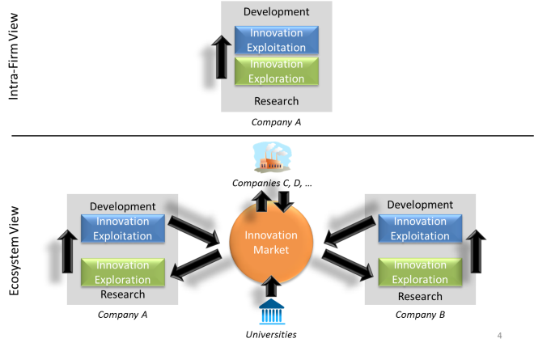

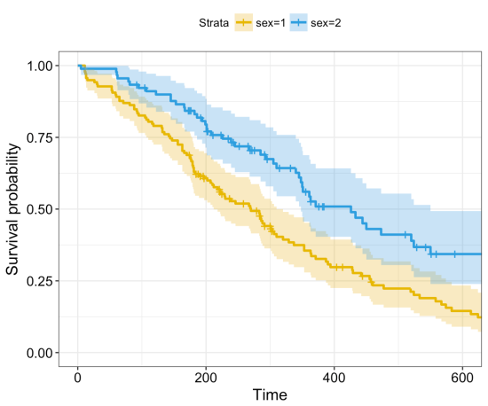
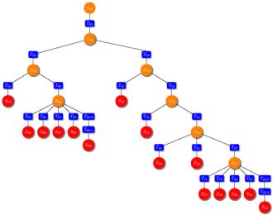
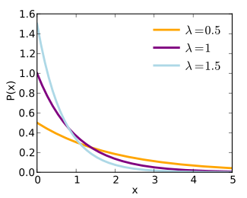
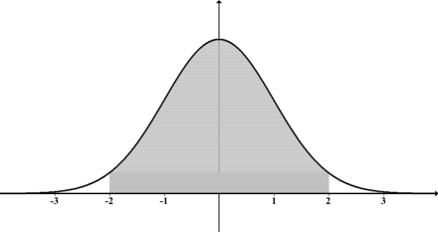
Improve Study
Data Issues
Type of Analysis
Study Variables
Regression model fit with conceptual framework
Interpretation of Results
Notes:
Data might be more suited to a different type of analysis:
Survival analysis is generally defined as a set of methods for analyzing data where the outcome variable is the time until the occurrence of an event of interest.
Machine learning is a method of data analysis that automates analytical model building. It is a branch of artificial intelligence based on the idea that systems can learn from data, identify patterns and make decisions with minimal human intervention. This could be used to show better the nodes where significant differences are in groups of data.
Latent Class Analysis (LCA) is a statistical method for identifying unmeasured class membership among subjects using categorical and/or continuous observed variables. For example, you may wish to categorize people based on their drinking behaviors (observations) into different types of drinkers (latent classes).

