Slide 1
Investigating the Feasibility of Using
Patent Citations as a Measure of Technology Transfer
Malcolm S. Townes
Saint Louis University

Slide 2
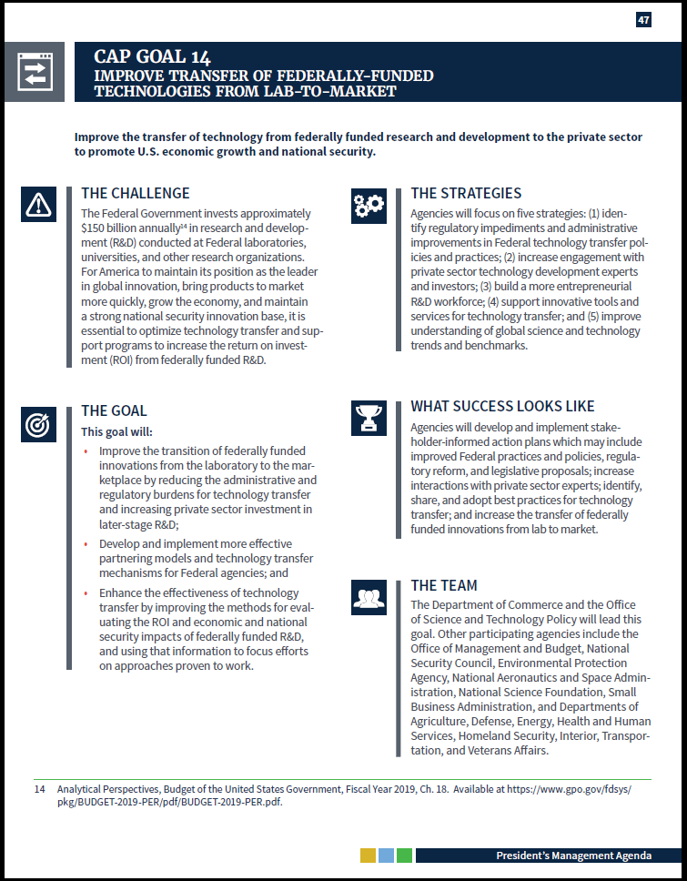

Technology Transfer: The conveyance from one person or entity to another person or entity of a capability to perform a useful task or replicate a beneficial accomplishment.
…prior to 1980, only 5 percent of government-owned patents had ever been used by industry.
Schact (2012) as cited in Tseng & Raudensky, 2014

Slide 3
“CMS Medicare Budget Overview.” 2018. Centers for Medicare and Medicaid Services. U.S. Department of Health & Human Services. Retrieved from https://www.hhs.gov/about/budget/fy2018/budget-in-brief/cms/medicare/index.html.
“US Spending”. nd. USGovernmentSpending.com. Retrieved from https://www.usgovernmentspending.com/year_spending_2018USbn_20bs2n_4041_605#usgs302
Notes:
“CMS Medicare Budget Overview.” 2018. Centers for Medicare and Medicaid Services. U.S. Department of Health & Human Services. Retrieved from https://www.hhs.gov/about/budget/fy2018/budget-in-brief/cms/medicare/index.html.
US Spending. nd. USGovernmentSpending.com. Retrieved from https://www.usgovernmentspending.com/year_spending_2018USbn_20bs2n_4041_605#usgs302

Slide 4
Literature Review
Anderson, Daim & Lavoie (2007) Used an approach based on data envelopment analysis (DEA) to evaluate University Technology Transfer (UTT) productivity. Their study included patent applications and patents allowed as outputs.
Choi, Jang, Jun & Park (2015) Developed a predictive model based on patent analysis for evaluating the transfer potential of a technology and determining the relationship between technology transfer and a range of patent data variables. Their study included a multiple regression analysis. Three of the four models they developed included patent citation variables as statistically significant contributors.
Ho, Liu, Lu & Huang (2014) Investigated the efficiency of UTT in different stages of the technology transfer process. Their approach included patent applications and patents allowed among the intermediate input factors in a two-stage, networked-based DEA model.

Slide 5
Literature Review
Ji, Lim, & Park (2016) Used patent citation data to identify potential cases of technology transfer.
Markman, Gioniodis & Phan (2009) Used hierarchical regression analysis to isolate various drivers of technology transfer. They found that several factors were associated with patent license income and university spin-out company formation. However, their analysis indicated that patent data variables were either not significant or did not improve their existing model.
Sharma (2017) Conducted a survey of patent citation analysis and presented a methodology for generating patent citation networks.

Slide 6


Category
Embodiment
Measureable Indicators
Asset-based
Patent rights
Trade secrets
Copyright
License agreements
License income
New ventures
Acquisitions
Information-based
Patent documents
Patent applications
Journal articles
Presentations
Citations
Downloads
Readings
Event attendance
Service-based
Consulting services
Contract services
Sponsored research
Outside interest disclosures
Contracts
Service invoices
SR agreements
Research Questions
1. Can patent citations serve as a useful measure of technology transfer?
2. Is technology transfer as measured by patent citations received significantly related to other variables captured in the patent citation data?
Notes:
Previous analyses focus on asset-based measures of technology transfer, which are typically transactional.
I theorize that a significant amount of technology transfer is non-transactional, information-based.
Focus on asset-based measures of technology transfer suggests that construct validity (i.e., content validity) may be lacking.

Slide 7

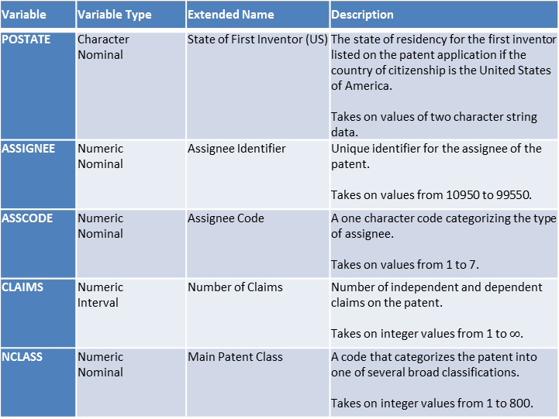
Original USPTO Variables from Source Data
Variable | Variable Type | Extended Name | Description
PATENT | Numeric Nominal | Patent Number | The number assigned to the allowed patent by the USPTO. Takes on values integer values between 3070801 and 6009554.
GYEAR | Numeric Interval | Grant Year | The year the USPTO allowed the patent. Takes on integer values between 1963 – 1999.
GDATE | Numeric Interval | Grant Date | The date the USPTO allowed the patent expressed in terms of the number of weeks elapsed since January 1, 1960. Takes on integer values between 156 and 2,028.
APPYEAR | Numeric Interval | Application Year | The year the patent application was submitted to the USPTO. Takes on integer values between 1963 – 1999.
COUNTRY | Character Nominal | Country of First Inventor | The country of citizenship for the first inventor listed on the patent application. Takes on values of two character string data.
Variable | Variable Type | Extended Name | Description
POSTATE | Character Nominal | State of First Inventor (US) | The state of residency for the first inventor listed on the patent application if the country of citizenship is the United States of America. Takes on values of two character string data.
ASSIGNEE | Numeric Nominal | Assignee Identifier | Unique identifier for the assignee of the patent. Takes on values from 10950 to 99550.
ASSCODE | Numeric Nominal | Assignee Code | A one character code categorizing the type of assignee. Takes on values from 1 to 7.
CLAIMS | Numeric Interval | Number of Claims | Number of independent and dependent claims on the patent. Takes on integer values from 1 to $∞$.
NCLASS | Numeric Nominal | Main Patent Class | A code that categorizes the patent into one of several broad classifications. Takes on integer values from 1 to 800.
National Bureau of Economic Research. (2018). Patent data, including constructed variables [data file]. Retrieved from http://www.nber.org/patents/
Hall, B. H., Jaffe, A. B. and Trajtenberg, M. (2001). "The NBER Patent Citation Data File: Lessons, Insights and Methodological Tools." NBER Working Paper 8498. Retrieved from http://www.nber.org/patents/

Slide 8
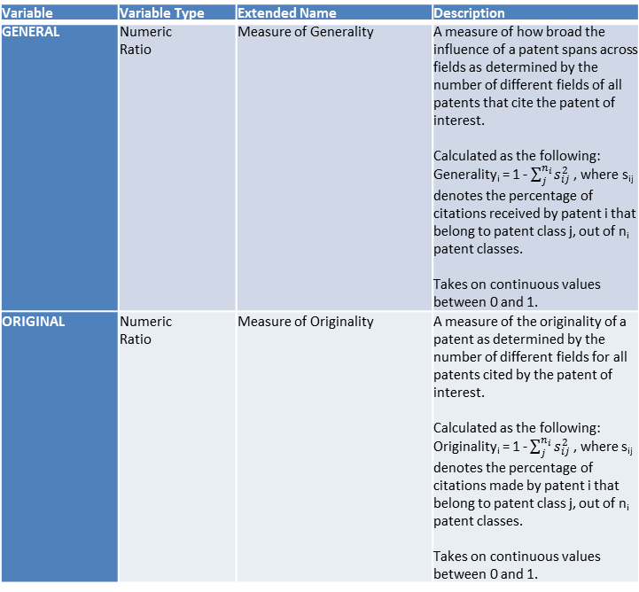
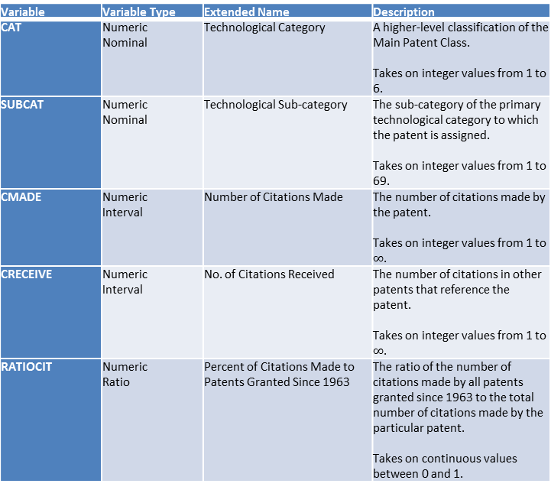
Original Constructed Variables from Source Data
Variable | Variable Type | Extended Name | Description
CAT | Numeric Nominal | Technological Category | A higher-level classification of the Main Patent Class. Takes on integer values from 1 to 6.
SUBCAT | Numeric Nominal | Technological Sub-category | The sub-category of the primary technological category to which the patent is assigned. Takes on integer values from 1 to 69.
CMADE | Numeric Interval | Number of Citations Made | The number of citations made by the patent. Takes on integer values from 1 to $∞$.
CRECEIVE | Numeric Interval | No. of Citations Received | The number of citations in other patents that reference the patent. Takes on integer values from 1 to $∞$.
RATIOCIT | Numeric Ratio | Percent of Citations Made to Patents Granted Since 1963 | The ratio of the number of citations made by all patents granted since 1963 to the total number of citations made by the particular patent. Takes on continuous values between 0 and 1.
Variable | Variable Type | Extended Name | Description
GENERAL | Numeric Ratio | Measure of Generality | A measure of how broad the influence of a patent spans across fields as determined by the number of different fields of all patents that cite the patent of interest. Calculated as the following: Generality_{i} = 1 - $\sum_{j}^{n_{i}}{s_{ij}^{2}}$ , where s_{ij} denotes the percentage of citations received by patent i that belong to patent class j, out of n_{i} patent classes. Takes on continuous values between 0 and 1.
ORIGINAL | Numeric Ratio | Measure of Originality | A measure of the originality of a patent as determined by the number of different fields for all patents cited by the patent of interest. Calculated as the following: Originality_{i} = 1 - $\sum_{j}^{n_{i}}{s_{ij}^{2}}$ , where s_{ij} denotes the percentage of citations made by patent i that belong to patent class j, out of n_{i} patent classes. Takes on continuous values between 0 and 1.
National Bureau of Economic Research. (2018). Patent data, including constructed variables [data file]. Retrieved from http://www.nber.org/patents/
Hall, B. H., Jaffe, A. B. and Trajtenberg, M. (2001). "The NBER Patent Citation Data File: Lessons, Insights and Methodological Tools." NBER Working Paper 8498. Retrieved from http://www.nber.org/patents/

Slide 9
Original Constructed Variables from Source Data (cont’d)
Variable | Variable Type | Extended Name | Description
FWDAPLAG | Numeric Ratio | Mean Forward Citation Lag | The mean time difference between the application or grant date of the patent and that of the other patents citing this patent. Takes on continuous values between 0 and 1.
BCKGTLAG | Numeric Ratio | Mean Backward Citation Lag | The mean time difference between the application or grant date of the patent and that of the patents it cites. Takes on continuous values between 0 and 1.
SELFCTUB | Numeric Ratio | Share of Self-Citations Made – Upper Bound | The number of citations made by the patent to other patents with the same assignee divided by the total number of citations made by all patents with assignee codes. Takes on continuous values between 0 and 1.
SELFCTLB | Numeric Ratio | Share of Self-Citations Made – Lower Bound | The number of citations made by the patent to other patents with the same assignee divided by the total number of citations made by all patents. Takes on continuous values between 0 and 1.
Variable | Variable Type | Extended Name | Description
SECUPBD | Numeric Ratio | Share of Self-Citations Received – Upper Bound | The number of citations received by the patent from other patents with the same assignee divided by the total number of citations received by all patents with assignee codes. Takes on continuous values between 0 and 1.
SECDLWBD | Numeric Ratio | Share of Self-Citations Received – Lower Bound | The number of citations received by the patent from other patents with the same assignee divided by the total number of citations received by all patents. Takes on continuous values between 0 and 1.
National Bureau of Economic Research. (2018). Patent data, including constructed variables [data file]. Retrieved from http://www.nber.org/patents/
Hall, B. H., Jaffe, A. B. and Trajtenberg, M. (2001). "The NBER Patent Citation Data File: Lessons, Insights and Methodological Tools." NBER Working Paper 8498. Retrieved from http://www.nber.org/patents/

Slide 10
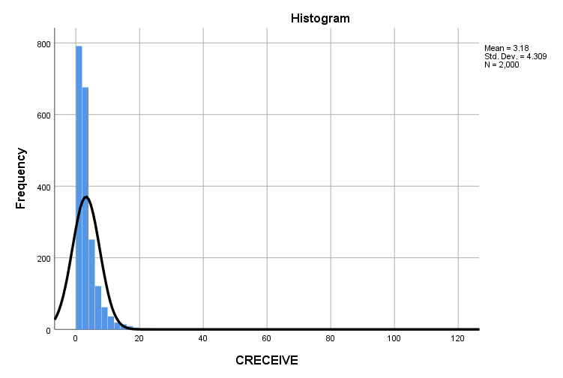
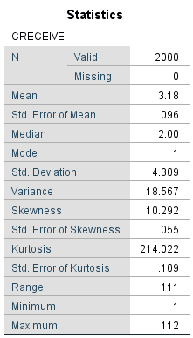
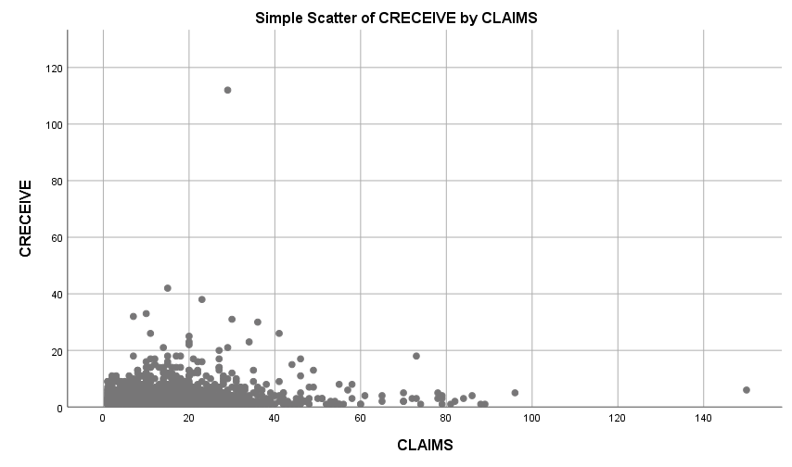
Notes:
All utility patents granted in the U.S. from January 1, 1963 to December 30, 1999.
Listed in the Technology Assessment and Forecast (TAF) database of the United States Patent and Trademark Office (USPTO).
The file contained data on 2,923,922 patents across 23 variables.
Random sample of 2,000 patents from a subset of 253,328 patents for the period January 1, 1995 to December 31, 1999.

Slide 11
Multiple Regression Analysis

Slide 12
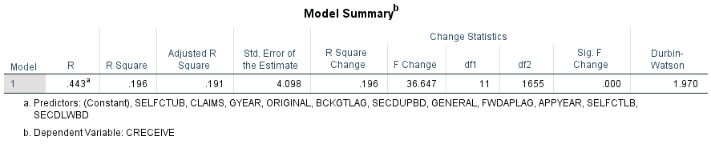
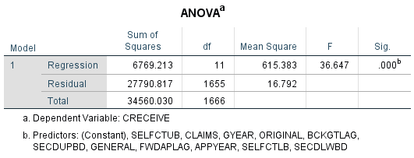
CRECEIVE = β₀ + β₁(GYEAR) + β₂(APPYEAR) + β₃(CLAIMS) + β₄(GENERAL) + β₅(ORIGINAL) + β₆(BCKGTLAG) + β₇(FWDAPLAG) + β₈(SELFCTUB) + β₉(SELFCTLB) + β₁₀ (SECDLWBD) + β₁₁(SECDUPBD)+ ε
H₀: β₁ = β₂ … = β₁₁ = 0
H_{A}: β ≠ 0 for at least one independent variable
Notes:
Excluded CMADE and RATIOCIT because of logical reasoning.
Excluded other predictor variables that were not continuous interval.

Slide 13

Notes:
GENERAL variable had the greatest influence.
GYEAR and ORIGINAL were negatively associated with the number of citations received.
Most constructed variables were not significant with the exception of BCKGTLAG.
APPYEAR was not significant but GYEAR was significant.
Constructed variables had high degrees of multicollinearity.

Slide 14
Hierarchical Regression Analysis

Slide 15
 | Unstandardized |  |  |  | Standardized
Variable | Model 1 |  | Model 2 |  | Model 1 |  | Model 2
Constant | 330.669 | *** | 331.411 | *** | 0.000 | *** | 0.000 | ***
CLAIMS | 0.005 | *** | 0.008 | *** | 0.077 | *** | 0.127 | ***
CMADE | 0.001 |  | 0.001 |  | 0.021 |  | 0.022
GENERAL | 1.744 | *** | 1.752 | *** | 0.569 | *** | 0.572 | ***
GYEAR | -0.166 | *** | -0.166 | *** | -0.221 | *** | -0.222 | ***
ORIGINAL | -0.301 | *** | -0.195 | * | -0.104 | *** | -0.067 | *
RATIOCIT | 0.555 | *** | 0.557 | *** | 0.081 | *** | 0.082 | ***
SECDUPBD |  |  | 0.053 |  |  |  | 0.023
SELFCTUB |  |  | -0.033 |  |  |  | -0.010
CLAIMSORIGINAL |  |  | -0.007 |  |  |  | -0.073
Adj. R² | 0.436 |  | 0.437 |  | 0.436 |  | 0.437
Adj. R² change | 0.436 |  | 0.001 |  | 0.436 |  | 0.001
F | 215.741 | * | 144.442 | * | 215.741 | * | 144.442 | *
F change | 215.741 | * | 1.474 |  | 215.741 | * | 1.474
Δ F | 215.741 |  | 71.299 |  | 215.741 |  | 71.299
Dependent variable: logCRECEIVE
* p < 0.05; ** p < 0.01; *** p < 0.001
Notes:
I used logCRECEIVE as the dependent variable.
I created a product term called CLAIMSORIGINAL using the CLAIMS variable and ORIGINAL variable to test for possible interaction.
I suspected that the relationship between the DV and the CLAIMS variable varies as a function of the ORIGINAL variable.
I surmised that the higher the originality of a technology as represented by a patent, the more interest that it may receive from other innovators and thus the more likely that the patent will be cited in the patents of other innovators.

Slide 16
Path Model

Slide 17
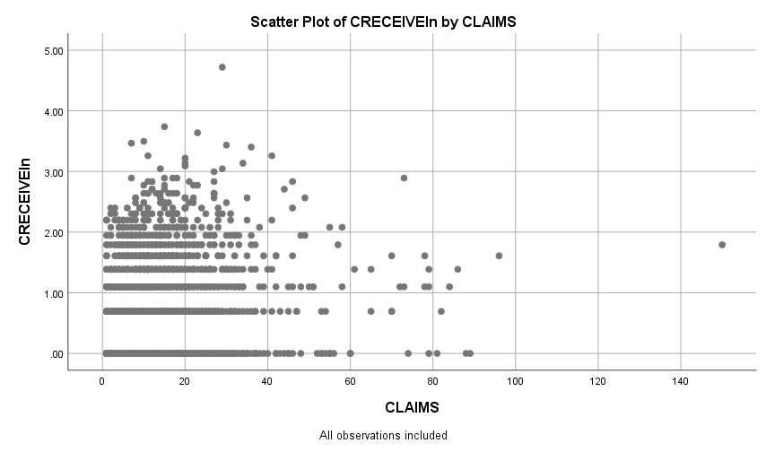
Notes:
Based on a scatter plot of the CRECEIVE variable against the CLAIMS variable, I removed observations with CLAIMS greater than 90 claims and CRECEIVE greater than 40 citations received as outliers.
Constructed the CRECEIVEln variable as the natural logarithm transformation of the CRECEIVE variable to bring out potential linear relationships between the CRECEIVE and the CLAIMS variable.

Slide 18
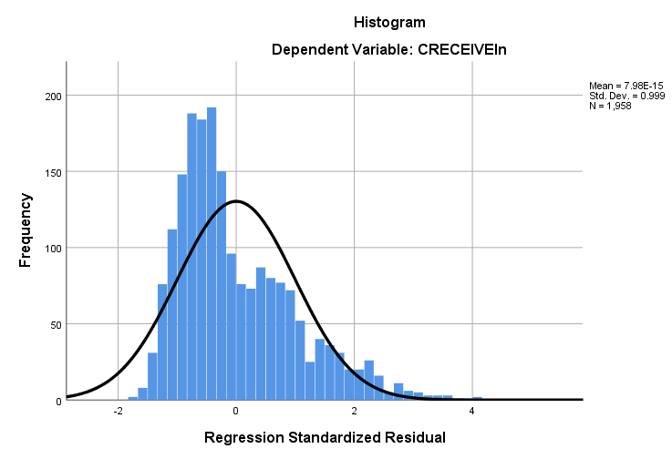
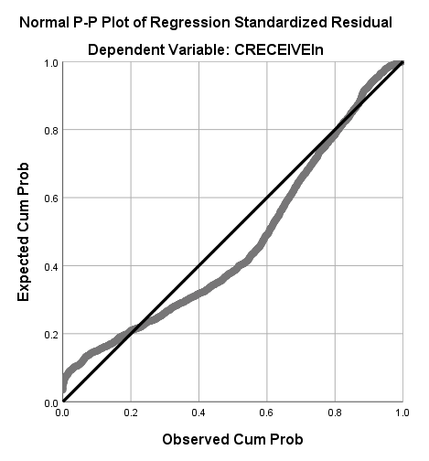
Notes:
References
https://www.youtube.com/watch?v=Vi34XayXk_Y
https://www.google.com/url?sa=t&rct=j&q=&esrc=s&source=web&cd=3&ved=2ahUKEwi0y9_6rvfeAhUQ0lMKHebFDzwQFjACegQICxAC&url=http%3A%2F%2Fcore.ecu.edu%2Fpsyc%2Fwuenschk%2FSPSS%2FResidual-Plots-SPSS.doc&usg=AOvVaw0ZKB4phPkzUUcCpSOxJrIq
https://en.wikipedia.org/wiki/P%E2%80%93P_plot
https://www.itl.nist.gov/div898/handbook/eda/section3/eda33l.htm

Slide 19
Theoretical Model
Notes:
Sub-model 1 uses GENERAL as the DV and ORIGINAL as the IV.
It is likely that the originality of a patent will influence whether or not it will have broad applicability.
The more original the patent, the more likely that other innovators in various fields will identify applications of the technology over time.
Patents that rank low in originality are likely to be specific or specialized to a narrower range of applications within closely related fields.
Sub-model 2 uses CLAIMS as the DV and ORIGINAL, GENERAL, GYEAR, and RATIOCIT as the IVs.
The claims of a patent define the scope of the subject that it asserts to be novel, nonobvious, and useful.
Patents that rank higher in originality are likely to generate more claims because they stake out new innovation territory.
Patents the rank higher in generality are likely to generate more claims because the scope of their applicability.
In general, patents are likely to have more claims as the grant year increases because of the temporal nature of advances in sciences and the cumulative effects of scientific knowledge.
I suspect that as the ratio of the number of citations made by all patents granted since 1960 to the total number of citations made by a particular patent increases the number of claims for a patent because of the general increase in scientific knowledge due to network effects.
Sub-model 3 uses CRECEIVEln as the DV and ORIGINAL, GENERAL, CLAIMS, GYEAR, and RATIOCIT as the IVs.
Previous analysis indicated an inverse relationship between the originality of a patent and the number of citations it received. This may be because the full capabilities of highly original patents are less readily apparent than patents that rank lower on originality.
Patents that rank high in generality probably receive higher numbers of citations because the broader scope of their applicability creates more opportunities to be cited.
Likewise, patents that have more claims probably have more opportunities to be cited than patents with fewer claims.
In general, patents are likely to receive more citations over time because scientific knowledge accumulates and spreads over time.
I suspect that as the ratio of the number of citations made by all patents granted since 1960 to the total number of citations made by a particular patent increases the number of citations a patent receives because of network effects.

Slide 20
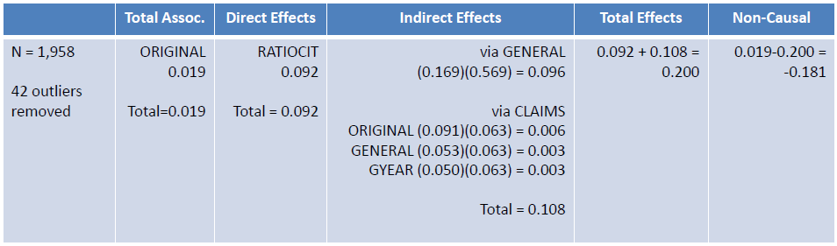
Original Model
Revised Model
Notes:
Removed path between RATIOCIT and CLAIMS because doing so simplified the model without significantly reducing the R² value the CLAIMS variable.

Slide 21
Binary Logistic Regression

Slide 22
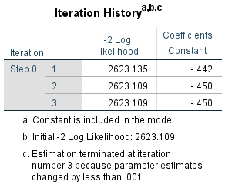
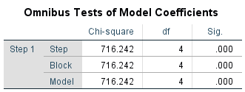
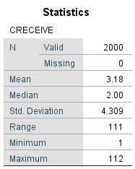

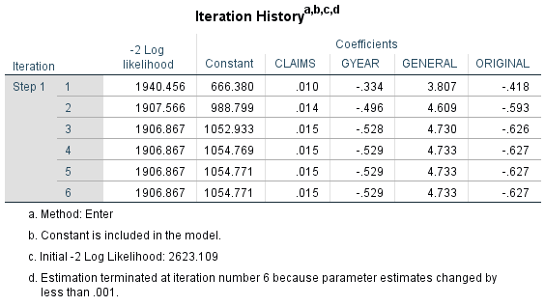
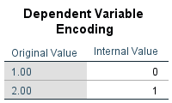
Dependent variable: CRECBINARY
1 = 2 or fewer citations
2 = 3 or more citations
Notes:
The result of the Omnibus test indicates that including the CLAIMS, GYEAR, GENERAL, and ORIGINAL variables improved the model fit.
One or more of these IVs predict the dependent variable.
The p-value was less than 0.001, which was significant.
The -2 Log likelihood was reduced from 2,623.109 to 1,906.867, which was a decrease of 716.242.
The Nagelkerke R² was 0.415, which indicates that 41.5 percent of the probability that a patent received more than 2 citations was explained by the IVs included in the model.
Hosmer-Lemeshow Test results suggest a lack of fit for the model.
The chi-square value was 23.671, which does not seem very small.
The p-value was 0.003 which is not much above the 0.001 significance level.
Predictive ability vs. goodness-of-fit
Hosmer-Lemeshow Test results affected by the number of groups and sample size (larger n exacerbates the inherant discrepency between the logistic form and real-world process)
-2 log likelihood statistic is a measure of how “poorly” the model predicts the data; the smaller the statistic the better the model.
The deviance, or -2 log-likelihood (-2LL) statistic, is basically a measure of how much unexplained variation there is in our logistic regression model – the higher the value the less accurate the model.
References
https://stats.stackexchange.com/questions/273966/logistic-regression-with-poor-goodness-of-fit-hosmer-lemeshow
https://stats.stackexchange.com/questions/169000/goodness-of-fit-test-in-logistic-regression-which-fit-do-we-want-to-test
https://statisticalhorizons.com/hosmer-lemeshow
https://www.revolvy.com/page/Omnibus-test
http://www.restore.ac.uk/srme/www/fac/soc/wie/research-new/srme/modules/mod4/6/index.html
http://www.restore.ac.uk/srme/www/fac/soc/wie/research-new/srme/glossary/index1695.html?selectedLetter=D#deviance-2ll

Slide 23
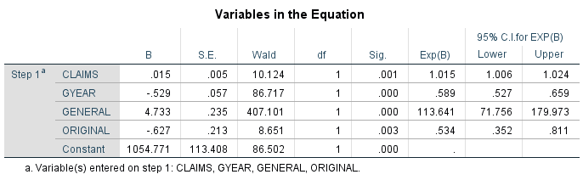
Dependent variable: CRECBINARY (1 = 2 or fewer citations; 2 = 3 or more citations)
Probability that a patent receives more than 2 citations by other patents:
$\hat{p}$ = Logit⁻¹($p$) = $\frac{e^{1054.771 + 0.015\left(CLAIMS\right) – 0.529\left(GYEAR\right) + 4.733(GENERAL) – 0.627(ORIGINAL)}}{{1+ e}^{1054.771 + 0.015\left(CLAIMS\right) – 0.529\left(GYEAR\right) + 4.733(GENERAL) – 0.627(ORIGINAL)}}$
Notes:
The GENERAL variable had the strongest association with the DV.
For a one unit increase in the GENERAL variable, the patent was 113.6 times more likely to have been cited by 3 or more times by other patents.
Influence of the GENERAL variable was much higher than expected.

Slide 24
Limitations and Future Study
Obtain more current data.
Buffer the sample data on the front and back time period to minimize truncation.
Repeat multiple regression and hierarchical regression analyses using the natural logarithm of the number of citations received as dependent variable.
Repeat binary logistic regression using a mean split instead of median split.
Modify path model using the measure of generality as the primary endogenous independent variable instead of the number of claims.
Separate independent claims and dependent claims as distinct variables.
Include patent classifications and sub-classifications as an indicator of generality.
Control for the patent categories.
Consider the effects of technology readiness level (TRL).

Slide 25
Policy Implications
Provides information to help both industry professionals and policymakers better understand the drivers of the technology transfer outcomes.
Identifies possible factors that should be considered when forming public policy regarding technology transfer.
Suggests that considering non-transactional measures of technology transfer may be feasible.
Affect the objectives of policymakers with regard to technology transfer.
Influence how policymakers think about technology transfer and how they formulate public policy to increase the transfer of federally-funded research to the private sector.

Slide 26
Questions and Answers
Open Discussion

Slide 27
References
Aldieri, L. ( 1 ), & Vinci, C. P. ( 2 ). (n.d.). Technological Spillovers through a Patent Citation Analysis. International Journal of Innovation Management, 20(2). https://doi.org/10.1142/S1363919616500286
American Association for the Advancement of Science [AAAS]. (2018a). Defense, Nondefense, and Total R&D, 1976-2018 [Data file]. Retrieved from https://www.aaas.org/page/historical-trends-federal-rd
American Association for the Advancement of Science [AAAS]. (2018b). Federal Support for Universities by Agency, 1990-2016 (Obligations) [Data file]. Retrieved from https://www.aaas.org/page/rd-colleges-and-universities
Anderson, T. R., Daim, T. U., & Lavoie, F. F. (2007). Measuring the efficiency of university technology transfer. Technovation, 27(5), 306-318. doi:10.1016/j.technovation.2006.10.003
Appio, F. P., Martini, A., & Fantoni, G. (2017). The light and shade of knowledge recombination: Insights from a general-purpose technology. Technological Forecasting & Social Change, 125, 154–165. https://doi.org/10.1016/j.techfore.2017.07.018
Bush, V. (1945). Science, the endless frontier. A report to the President: Washington, U.S. Government printing office, 1945.

Slide 28
References
Chávez, G. A. G., & Víquez, H. G. (2015). Patterns of knowledge flow from industrialized to Latin American and Asian countries in the pharmaceutical industry: a patent citation analysis. Contaduría y Administración, 60 (Supplement 1), 31–56. https://doi.org/10.1016/j.cya.2015.08.008
Choi, J., Jang, D., Jun, S., & Park, S. (2015). A Predictive Model of Technology Transfer Using Patent Analysis. Sustainability (2071-1050), 7(12), 16175
Congressional Budget Office [CBO]. (2018). Historical Budget Data [Data file]. The Budget and Economic Outlook: 2018 to 2028 Retrieved from https://www.cbo.gov/about/products/budget-economic-data#2
Hall, B. H., Jaffe, A. B. and Trajtenberg, M. (2001). "The NBER Patent Citation Data File: Lessons, Insights and Methodological Tools." NBER Working Paper 8498. Retrieved from http://www.nber.org/patents/
Ho, M. H. C., Liu, J. S., Huang, C. C., & Lu, W. M. (2014). A new perspective to explore the technology transfer efficiencies in US universities. Journal of Technology Transfer, 39(2), 247-275. doi:10.1007/s10961-013-9298-7
Ji, I., Lim, H., & Park, T.-Y. (2016). Exploring Potential Users of Patents for Technology Transfer: Utilizing Patent Citation Data. Procedia Computer Science, 91, 211–220. https://doi.org/10.1016/j.procs.2016.07.059

Slide 29
References
Kirkman, D. M. (2013). Selecting University Technology Transfer Modes: An Examination of Biotechnology Firms’ Entrepreneurial Orientation. Journal of Technology Management & Innovation, Vol 8, Iss 2, Pp 189-208 (2013), (2), 189. https://doi.org/10.4067/S0718-27242013000200016
Markman, G. D., Gianiodis, P. T., & Phan, P. H. (2009). Supply-Side Innovation and Technology Commercialization. Journal of Management Studies, 46(4), 625-649. doi:10.1111/j.1467-6486.2009.00835.x
National Bureau of Economic Research. (2018). Patent data, including constructed variables [data file]. Retrieved from http://www.nber.org/patents/
Office of Management and Budget [OMB]. (2002). The President's Management Agenda. Retrieved from http://www.dtic.mil/dtic/tr/fulltext/u2/a394421.pdf
Office of Management and Budget [OMB]. (2018). The President's Management Agenda. Retrieved from https://www.whitehouse.gov/wp-content/uploads/2018/03/Presidents-Management-Agenda.pdf
Park, T.-Y., Lim, H., & Ji, I. (n.d.). Identifying potential users of technology for technology transfer using patent citation analysis: a case analysis of a Korean research institute. SCIENTOMETRICS, 116(3), 1541–1558. https://doi.org/10.1007/s11192-018-2792-9

Slide 30
References
Raut, R. D., Priyadarshinee, P., Gardas, B. B., & Jha, M. K. (2018). Analyzing the factors influencing cloud computing adoption using three stage hybrid SEM-ANN-ISM (SEANIS) approach. Technological Forecasting & Social Change, 134, 98–123. https://doi.org/10.1016/j.techfore.2018.05.020
Sharma, P., & Tripathi, R. C. (2017). Patent citation: A technique for measuring the knowledge flow of information and innovation. World Patent Information, 51, 31–42. https://doi.org/10.1016/j.wpi.2017.11.002
Tseng, A. & Raudensky, M. (2014). Assessments of technology transfer activities of U.S. universities and associated impact of Bayh-Dole Act. Scientometrics, 101(3), 1851-1869.
United Nations. (2017). GDP and its breakdown at current prices in U.S. dollars [Data file]. Retrieved from http://unstats.un.org/unsd/snaama/dnltransfer.asp?fID=2
Vagnani, G., & Volpe, L. (2017). Innovation attributes and managers’ decisions about the adoption of innovations in organizations: A meta-analytical review. International Journal of Innovation Studies, 1, 107–133. https://doi.org/10.1016/j.ijis.2017.10.001

Slide 31
References
Yan, E., & Yu, Q. (2016). Using path-based approaches to examine the dynamic structure of discipline-level citation networks: 1997-2011. Journal of the Association for Information Science & Technology, 67(8), 1943–1955. https://doi.org/10.1002/asi.23516
Yoshikane, F. (2013). Multiple regression analysis of a patent’s citation frequency and quantitative characteristics: the case of Japanese patents. Scientometrics, 96(1), 365–379. https://doi.org/10.1007/s11192-013-0953-4

