Slide 1

SOC 6100 Fall 2018 Journal Article Critique
Saeed Asiri
Nathaniel House
Malcolm Townes
Notes:
Malcolm

Slide 2
Presentation Outline
Theoretical and Conceptual Framework
Malcolm Townes
Data and Methods
Saeed Asiri
Critique
Theme 1 – Nathan House
Theme 2 – Saeed Asiri
Theme 3 – Malcolm Townes
Results
Nathan House
Notes:
Malcolm

Slide 3
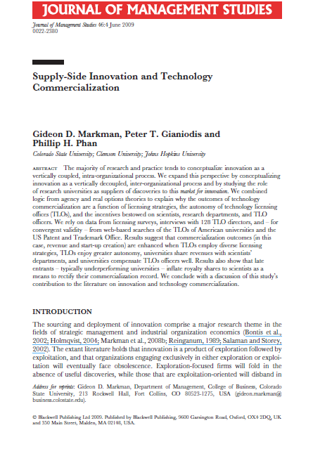
Markman, G. D., Gianiodis, P. T., & Phan, P. H. (2009). Supply-Side Innovation and Technology Commercialization. Journal of Management Studies, 46(4), 625-649. doi:10.1111/j.1467-6486.2009.00835.x
Study Objectives
Study the role of research universities as suppliers of innovations.
Explain why technology commercialization outcomes are a function of licensing strategies, technology licensing office (TLO) autonomy, researcher incentives, department incentives, and TLO staff incentives.
Notes:
Malcolm

Slide 4

Development
Innovation Exploitation
Intra-Firm View
Innovation Exploration
Research
Company A
Development
Development
Innovation Exploitation
Innovation Market
Innovation Exploitation
Ecosystem View
Innovation Exploration
Innovation Exploration
Research
Research
Company A
Company B
Universities
Notes:
Malcolm

Slide 5
Hypothesis 1: Sponsored research is negatively related to commercialization outcomes.
Hypothesis 2: A disproportional or ongoing use of licensing-for-cash strategies is negatively
related to commercialization outcomes.
Hypothesis 3: An autonomous or decentralized organizational structure is positively
related to commercialization outcomes.
Hypothesis 4: The greater the royalty share universities allocate to inventors, the
greater the commercialization outcomes.
Hypothesis 5: Generous royalty sharing between universities and departments is associated
with greater commercialization outcomes.
Hypothesis 6: Higher pay for TLO officers is positively related to greater commercialization
outcomes.
Notes:
Malcolm

Slide 6
Dependent Variables
licRev ≡ average annual revenues from commercializing intellectual property (1999-2000)
firmCreation ≡ avg. no. of yearly spinouts from technology transfer activities (1998–2001)
Study Variables
facQual ≡ 1995 National Survey of Graduate Faculty score for the institution (1=poor; 5 = dist)
sponsRes ≡ percent of commercialization via sponsored research agreements
licAgmnt ≡ percent of commercialization via licensing agreements
autoLow ≡ technology licensing office has low degree of autonomy (1 = yes; 0 = no)
autoHigh ≡ technology licensing office has high degree of autonomy (1 = yes; 0 = no)
payInventors ≡ percentage of licensing revenue distributed to inventors
payDept ≡ percentage of licensing revenue distributed to inventors’ departments
payTLO ≡ average salary of technology licensing office staff in thousands of USD
Control Variables
TLOage ≡ age of the technology licensing office in years
TLOsize ≡ number of licensing staff in the technology licensing office
pubPriv ≡ whether the institution is a public or private university (public = 1; private = 0)
incub ≡ whether the institution has a business incubator (yes = 1; no = 0)
Notes:
Malcolm

Slide 7

FY1999 Survey was used
Notes:
Saeed

Slide 8
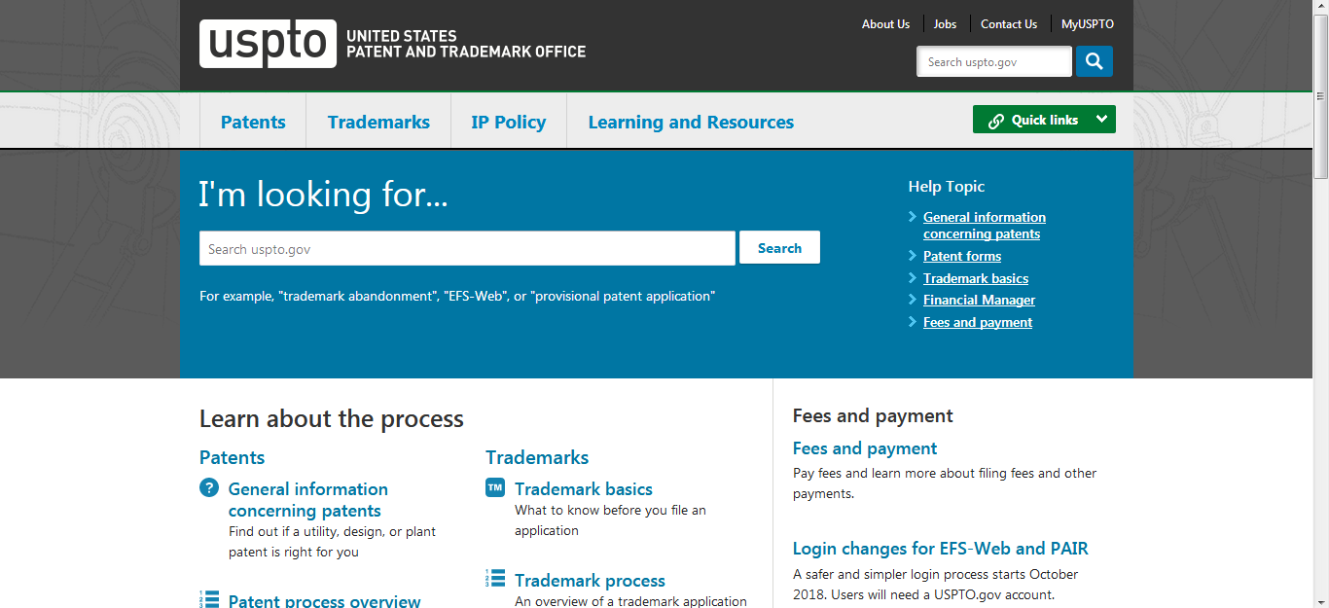
Notes:
Saeed

Slide 9
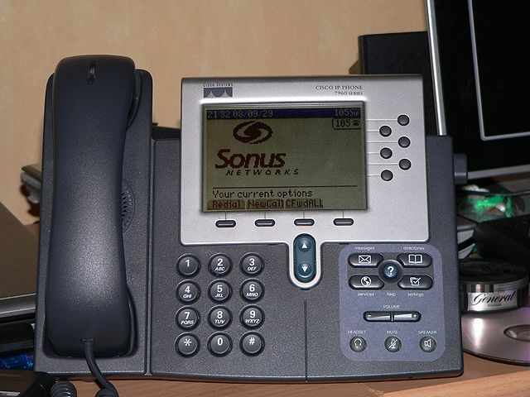
Structured Phone Interviews
TLO directors from 128 of 139 AUTM member institutions
60% of federal and industry research support
70% of licenses executed
85% of patents issued to universities
Notes:
Saeed

Slide 10
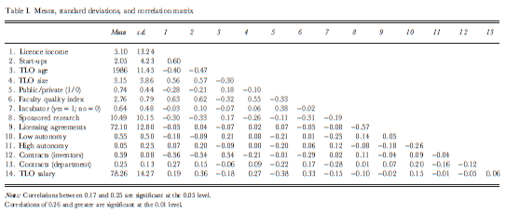
Notes:
Saeed

Slide 11
Model 1A
log (licRev) = β₀ + β₁(TLOage) + β₂(TLOsize) + β₃(pubPriv) + β₄(facQual) + β₅(incub) + E
Model 1B
log (licRev) = β₀ + β₁(TLOage) + β₂(TLOsize) + β₃(pubPriv) + β₄(facQual) + β₅(incub) +
β₆(sponsRes) + β₇(licAgmnt) + β₈(autoLow) + β₉(autoHigh) +
β₁₀(payInventors) + β₁₁(payDept) + β₁₂(payTLO) + E
Model 2A
log (firmCreation) = β₀ + β₁(TLOage) + β₂(TLOsize) + β₃(pubPriv) + β₄(facQual) + β₅(incub) + E
Model 2B
log (firmCreation) = β₀ + β₁(TLOage) + β₂(TLOsize) + β₃(pubPriv) + β₄(facQual) + β₅(incub) +
β₆(sponsRes) + β₇(licAgmnt) + β₈(autoLow) + β₉(autoHigh) +
β₁₀(payInventors) + β₁₁(payDept) + β₁₂(payTLO) + E
Notes:
Nathan

Slide 12
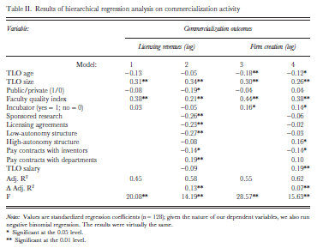
Notes:
Nathan

