Slide 1
SOC 6100 Fall 2018 Journal Article Critique
Saeed Asiri
Nathan House
Malcolm Townes

Slide 2
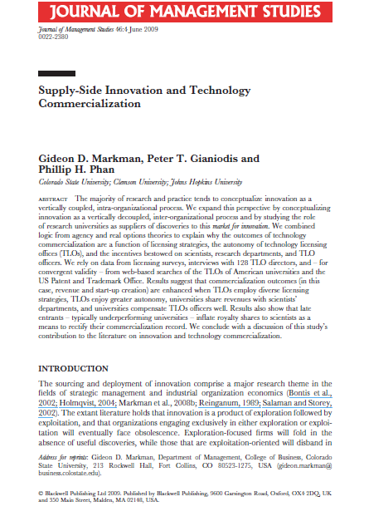
Markman, G. D., Gianiodis, P. T., & Phan, P. H. (2009). Supply-Side Innovation and Technology Commercialization. Journal of Management Studies, 46(4), 625-649. doi:10.1111/j.1467-6486.2009.00835.x
Study Objectives
Study the role of research universities as suppliers of discoveries.
Explain why technology commercialization outcomes are a function of licensing strategies, technology licensing office (TLO) autonomy, researcher incentives, department incentives, and TLO staff incentives.

Slide 3
Development
Innovation Exploitation
Intra-Firm View
Innovation Exploration
Research
Company A
Development
Development
Innovation Exploitation
Innovation Exploitation
Ecosystem View
Innovation Exploration
Innovation Exploration
Research
Research
Company A
Company B

Slide 4
Presentation Outline
Conceptual Framework and Literature Review
Malcolm Townes
Data and Methods
Saeed Asiri
Critiques
Theme 1 – Nathan House
Theme 2 – Saeed Asiri
Theme 3 – Malcolm Townes
Results
Nathan House

