Slide 1
SOC 6100
Article Critique
Diana Nevarez Ramirez & Laura Brugger-Gardner
SOC 6100
Notes:
Laura: 1-3; 9-12; 14; 16; 17
Diana: 4-8, 13; 15; 17

Slide 2
Well-Being in Mexican and Mexican American Women: The Role of Acculturation, Ethnic Identity, Gender Roles, and Perceived Social Support
Tanya Diaz & Ngoc H. Bui
Journal of Happiness Studies (2017) 18: 607-624

Slide 3
Agenda
Relevant Literature
Theory
Gaps in Literature
Hypotheses
Data
Methods
Results
Limitations
Critique

Slide 4
Relevant Literature
Subjective Well-Being (SWB)
Components of SWB are life satisfaction and affect (Diener 1994)
SWB and Latinos
Another component of SWB are cultural differences
Individualism vs. collectivism (Triandis 2000)
Familismo - “Latino’s strong loyalty, reciprocity, solidarity, and attachment to the nuclear and extended family” (Marin and Marin 1991).
Acculturation
Cultural changes that happen when two distinct cultures come in contact with one another (Redfield et al. 1936)
Four modes: assimilation, integration, separation, and marginalization (Berry 1980)
Notes:
SWB
SWB is the evaluation/measure of how one’s life is going
Positive affect includes emotional states such as joy, interest, alertness. Negative affect includes emotional states such as sadness, fear, anger (Watson 2002).
Happiness is the balance between these two. Positive affect more closely related to well-being.
Life satisfaction is related to but distinguishable from positive and negative affect. Furthermore, positive is distinguishable from negative affect.
SWB and Latinos
Life satisfaction changes depending on the culture you are from (Suh et al. 1998).
Individualism: ‘‘the self is regarded as autonomous, personal goals have priority over in-group goals… and social exchanges characterize interpersonal relationships’’ (Triandis 2000, p. 13–14).
Collectivism: ‘‘the self is regarded as an aspect of groups, interdependent with members of those groups, in-group norms have priority over personal needs… and relationships are communal’’ (Triandis 2000, p. 14).
Literature that proves the importance of familismo and well-being among Latinos.
Acculturation
Assimilation: when minority group members get behaviors and values of dominant culture and abandon their traditional culture (p. 610)
Integration: minority members combine traits from traditional culture with dominant culture.
Separation: individual keeps traditional culture and is reluctant to adapt to dominant culture.
Marginalization: completely reject dominant and traditional culture.
Acculturation and its effect on SWB had mixed results so it's inconclusive.

Slide 5
Relevant Literature (cont’d)
Ethnic identity
Ethnic minority groups held in low regard (Molix and Bettencourt 2010).
Group identification seen as coping mechanism for negative effects of belonging to ethnic minority group (Branscombe et al. 1999)
Gender roles
Machismo - characterizes male beliefs, attitudes, and behaviors (Galanti 2003).
Marianismo - describes Latina female beliefs, attitudes, and behaviors (Stevens 1973).
Being androgynous (both feminine and masculine) has been left out as a choice (Bem 1975).
Mixed findings on the relationship between being androgynous and life satisfaction.
Notes:
Ethnic Identity
Being held in low regard leads to a lack of power, stigmatization, which in turn affects well-being.
For example, one study showed that Ethnic identity moderated perceived discrimination and life satisfaction but Ethnic identity did not moderate perceived discrimination and positive affect (Vera et al. 2011)
Gender Roles
Traditional gender roles play a critical role in understanding Latino well-being.
Machismo
Men are also expected to be hyper-masculine, aggressive, and sexist (Galanti 2003).
Marianismo
females are expected to be nurturing, self-sacriﬁcing, and emulate the Virgin Mary (Stevens 1973).
Fixed socio-cultural norms produce conﬂict and frustration. Behaviors pertaining to such gender roles appear to interfere with mental health (Diaz-Guerrero 1975).
Being androgynous… or really this idea that we don’t have to identify with only one category and that a combination of that two could be a good thing. For example, Napholz (1994) study found that Latinas who scored higher on masculine scale had higher life satisfaction scores.

Slide 6
Relevant Literature (cont’d)
Perceived Social Support
Most significant component of familism for Latinos (Sabogal 1987).
Strong support helps survive poverty, discrimination, and negative impact of stressful events (House et al. 1988; Cohen and Willis 1985).
Positively impacts positive affect and well-being (Meehan et al. 1993; Rodrigues et al. 2007)
Notes:
Might strengthen adjustment by promoting positive affect , self-confidence or a sense of personal satisfaction (Meehan et al. 1993)
Placing high importance on family and perceiving high family support were positively associated with well-being (Rodriguez et al. 2007).
High perceived family support meant lower distress among Mexican American college women (Castillo et al. 2004)
Perceived social support helped minimize negative effects of stress (Solberg and Villareal 1997).

Slide 7
Theory
Multiracial Feminism
Originates from feminist theory (Brown 2010) but includes social factors such as race, class, ethnicity, and gender identity (Arellano and Ayala-Alcantar 2004; Baca Zinn and Dill 1996).
Also recognizes that above factors connect with different settings in people’s lives which result in different experiences of power (Arellano and Ayala-Alcantar 2004; Baca Zinn and Dill 1996).
Used to explain the relationship between variables of acculturation, ethnic identity, gender roles, and perceived social support from family on Mexican American women’s well-being.
Notes:
Multiracial feminism and SWB can both be understood as positive psychology, they focus on the strengths of individuals.
Also value diverse meanings of what embodies health and a good life.
“Examine diverse construction of life meaning”

Slide 8
Gaps in the Literature
Life satisfaction, positive affect, and negative affect have not been studied separately.
Cultural differences in SWB.
Multiracial feminism and SWB not found together in literature.
Few studies have focused on gender roles and SWB among the U.S. population, and even fewer studies have explored these variables among Latina women.
Notes:
Life satisfaction…in this study, life satisfaction and positive affect are tested separately.
Cultural… so this study examines SWB among Latinas extensively.
Multiracial… so this study uses this as their theoretical framework to study SWB

Slide 9
Hypotheses
H₁: Identifying with both Mexican culture and the dominant culture (bicultural), greater ethnic identity, stronger androgynous gender role identity, and greater perceived social support from family will predict greater life satisfaction among Mexican and Mexican American women with low socioeconomic status.
H₂:Among the predictors, social support from family will be the most signiﬁcant predictor of life satisfaction.
H₃: Identifying with both Mexican culture and the dominant culture (bicultural), greater ethnic identity, stronger androgynous gender roles, and greater perceived social support from family will predict more positive affect among Mexican and Mexican American women with low socioeconomic status.
H₄: Among the predictors, social support from family will be the most signiﬁcant predictor of positive affect.
Notes:
Research Questions
What are the predictors of life satisfaction among low socioeconomic status Mexican and Mexican American women?
What are the predictors of positive affect among low socioeconomic status Mexican and Mexican American women?

Slide 10
Data
194 females living in CA
Inclusion criteria
Self-identify as Mexican or Mexican American
Considered low SES according to California definition
Convenience & snowball sampling
Email and social media = 80 participants
Flyers at 3 community college campuses
Research panel from Qualtrics = 114 participants
Notes:
-other characteristics, 18 years +, proficient in English, id as low socioeconomic status
-age between 18-74 (mean= 30, SD= 10.5)
-48% completed a high school education; only 1 completed a college
-28 were born in Mexico, 166 (86%) born in the U.S.
-SES determined by California state income limits for Section 8 Housing Voucher Program
-drawing to win one of three $50 VISA gift cards (for participants in initial phase). Qualtrics participants compensated w/ credits to Qualtrics account

Slide 11
Methods: Instruments
Series of questionnaires
Short Acculturation Scale for Hispanics (SASH; Marin et al. 1987)
Multi-Group Ethnic Identity Measure: Revised (MEIM; Phinney and Ong, 2007)
Bem Sex Role Inventory (Bem, 1975)
Multidimensional Scale of Perceived Social Support (MSPSS; Zimet et al. 1988)
Satisfaction with Life Scale (SWLS; Diener et al. 1999)
Scale of Positive and Negative Experience (SPANE-P; Diener et al. 2009)
Notes:
SASH:In what language do you read and speak? Think?
mean scores, validated with Mexican Americans and Central Americans and showed similar results for both groups; alpha coefficient was .92 = adequate reliability; strong internal consistency- Cronbach’s alpha= .86
Originally 12-questions, limited to 4 for this study
MEIM
I.e. “I have a strong sense of belonging to my own ethnic group”
Cronbach’s alpha of .88 in current study
BSRI-short
Short form consists of 30 items with 10 on each of 3 scales (feminine, masculine, and neutral)
R rates each adjective on how it describes them using a 7-point Likert scale
Masculine and feminine categories result from scoring above median; undifferentiated below median in both; androgynous as above median in both
Good internal consistency (.84 and .85)
Majority undifferentiated (n=62); androgynous (n=56); masculine and feminine (n=38)
Satisfaction with Life

Slide 12
Methods: Analysis
Preliminary analysis to compare groups (independent t-tests and Chi-square)
Reveal differences
Assumption and normality testing
Standard multiple regression analysis to test all 4 hypotheses
Univariate analysis of variance to explore influence of gender role identity on positive affect
Variables
Dependent: Life Satisfaction and Positive Affect
Independent: acculturation, ethnic identity, gender roles, perceived social support
Notes:
Independent samples t-tests to compare two random sample groups and found statistically significant differences between groups for
Ethnic identity
Perceived social support
Life satisfaction
Positive affect
Masculinity and femininity scores
Variables normally distributed, multicollinearity within acceptable limits & VIF values under 5.0
Scatter plots for life satisfaction and positive affect showed homoscedasticity
Standard multiple regression analysis =

Slide 13
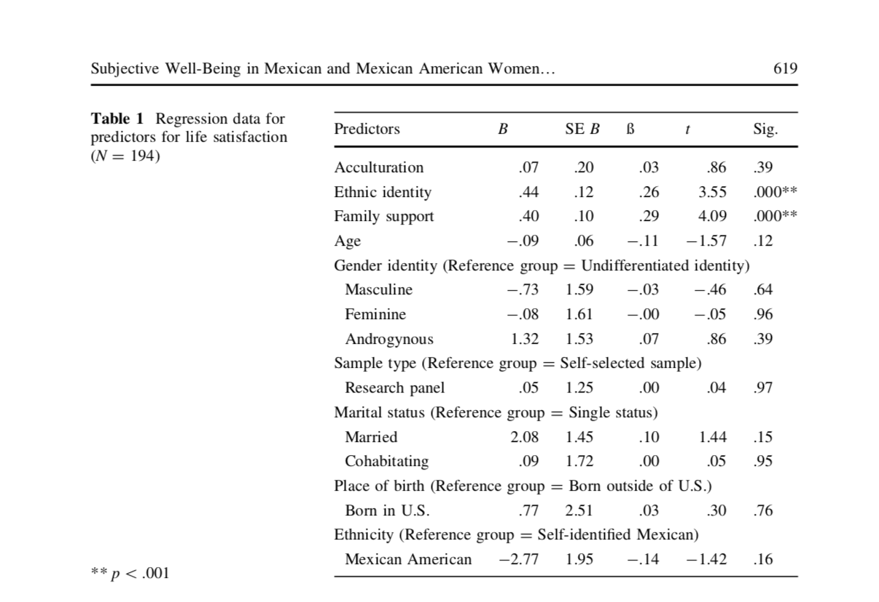
Table 1
R2- 0.25
Adjusted R2- .20
F- 5.01
p<.001
Notes:
No demographic variables were significant predictors
Stronger ethnic identity (beta= .26, p<.001) and greater family ss (beta=.29, p<.001) were significant predictors of life satisfaction
Partial support for h1 (R2 = .25, Adjusted R2 = .20, F (12, 181) = 5.01, p \ .001, Cohen’s f2 = .33) with the model accounting for 25 % of the variance in life satisfaction.
Support for h2 where perceived social support from family was the most significant predictor in the model of life satisfaction, t (181) = 5.45, p \ .001.

Slide 14
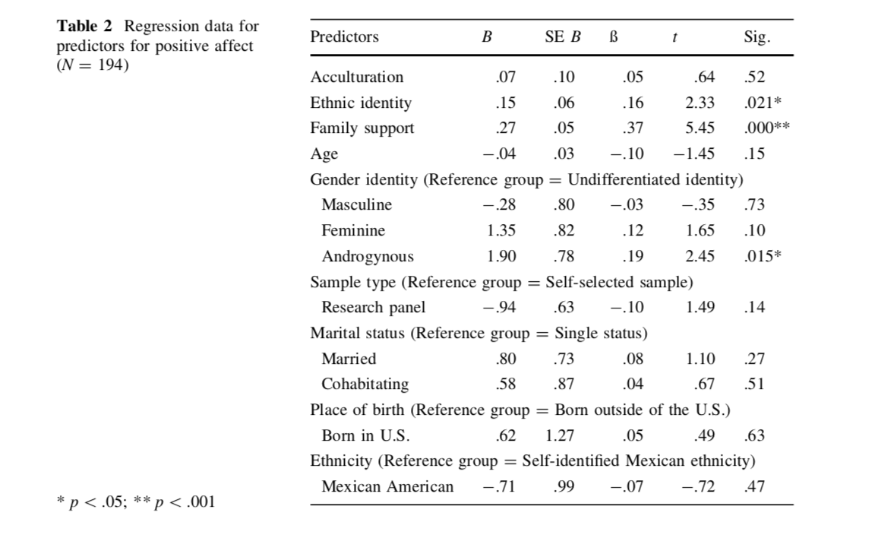
Table 2
R2- 0.33
Adjusted R2- .29
F- 7.53
p<.001
Notes:
No demographic variables were significant predictors
Stronger ethnic identity (beta= .16, p<.001) and greater family ss (beta=.37, p<.001), and androgynous gender roles (beta = .19, p = .01) were significant predictors of positive affect.
Partial support for h3 (R2 = .33, Adjusted R2 = .29, F (12, 181) =7.53, p < .001, Cohen’s f2 = .49) with the model accounting for 33 % of the variance in positive affect.

Slide 15
Results (cont’d)
Univariate Analysis of Variance
Undifferentiated (n=62); Masculine (n=38) ; Feminine (n=38); Androgynous (n=56)
Androgynous and feminine gender roles
Feminine (M=23.32, SD= 5.04) & Undifferentiated (M=20.82, SD= 3.69)
Mean difference (2.39, p=.01)
Feminine & Masculine (M=20.76, SD=4.44)
Mean difference (2.45, p = .01)
Androgynous (24.23, SD=4.37) & Undifferentiated
Mean difference (3.41, p<.001)
Androgynous & Masculine
Mean difference (3.47, p<.001)
Notes:
Univariate analysis purpose is to describe one variable and its data and patterns.
No table
univariate analysis used to explore gender role identity on positive affect
Results from this analysis revealed significant differences among groups for positive affect (F (3, 190) = 8.30, p\.001, g2 = .12).
Support for h4 where perceived social support from family was most significant predictor of positive affect.
Feminine gender roles had significantly higher positive affect scores (M = 23.21, SD = 5.04) than undifferentiated and masculine gender roles
Androgynous gender role had significantly higher positive affect scores (M = 24.23, SD = 4.37) than undifferentiated and masculine gender roles.
**Additional Notes**
Life Satisfaction
Of the four predictors of life satisfaction, only ethnic identity and social support from family were significant
Perceived social support from family was most significant
Consistent with previous research
High importance on family and perceived high family support are positively associated with well-being
Positive Affect
Of four predictors, ethnic identity, gender roles, and perceived social support explained a significant amount of variance
Somewhat supports previous findings
Androgynous and greater pos= supported by lit
But: also found feminine had greater pos affect which does not support previous findings;
Perceived social support from family most significant predictor of pos affect supported predictions and lit
Gender
ID w/ androgynous gender roles had greater positive affect scores than those id w/ undifferentiated and masculine gender
Means: id w/ some type of gender role vs. undifferentiated is important to subjective well-being
Life Satisfaction
High importance on family and perceived high family support are positively associated with well-being (supports previous findings)
Positive Affect
Androgynous identification result in greater positive affect (supports previous findings)
Feminine identification had greater positive affect (not supported by previous findings)
Perceived social support from family most significant predictor of positive (supports previous findings)

Slide 16
Limitations
Criteria limit generalizability to larger Mexican and Mexican American population
86% of sample self-id as Mexican American, 14% self-id as Mexican
Different experiences of acculturation and ethnic identity
Significant differences in sample (self or researcher recruited)
Difference in means across 5 out of 6 variables
Possible demographic variation (religious affiliation, self-esteem, personality variables)
Notes:
These are their identified limitations

Slide 17
Critique
SASH was limited to 4 language items (original 12)
Original 12 item also used “Media” and “Ethnic Social Relations” items
BSRI
Change in gender role perceptions (sample items)
Recent reexamination of validity
Table presentation improvements
Additional variables to increase explanatory power
Notes:
SASH-
Shortened only focused on language however when talking about acculturation we’re talking about cultural changes and culture includes more than just language
Original scale created by providing 16-page questionnaire that measured behavioral acculturation (acculturative contact and participation, measured proficiency and preference for speaking a language in particular setting) **I think preferences in particular would change over time. It’d be different in the late 1980’s than in 2018**, demographic questions, and cultural values.
BSRI
Traditional masculine and feminine gender role perceptions are weakening
Sample items on the BSRI include “independent,” “forceful,” and “leadership ability” (M); and “loves children”, “gentle”, and “eager to soothe hurt feelings” (F)
Whether items were feminine or masculine were determined by opinion of only 43 participants (23 males and 19 females undergraduates at Stanford)
Although cronbach’s alpha and reliability scores were numerically acceptable, the content of the scale were definitely outdated
Table improvements
Include table for univariate analysis of variance (would be nice to see in table format since tables were provided for standard mra but not this)
Include more variables
Diana: include marital status as predictor variable and tested “significant other” items in social support scale as well since they talk about how traditional gender roles are critical in understanding latino well-being so I think gender roles can really play out in relationships and so I think marital status could've been a predictor of life satisfaction and positive affect
Laura:
Nice conclusion
Family support and gender roles had the most impact on life satisfaction and positive affect. This information can help mental health professionals in understanding the subjective well-being of Latinas they treat. Future studies could benefit more by broadening the SASH items beyond language and use a different survey to replace BSRI….etc.

Slide 18
Questions?

