Slide 1
bw2widgets Turn your parametrized LCA models into interactive HTML/JS figures https://github.com/SLU-biochar/bw2-widgets
2022-12-30
Notes:
Thank you for intro..
Warm welcome to everyone in the room & online
To online participants, see slides & hear me well, in case please write chat, tech assist in the room
To you here in the room, glad to see so many here – x online – came to hear about Biochar systems across scales in Sweden
*title*

Slide 2
The end product…
Output:
Standalone HTML/JS files in a folder, displaying your LCA charts with sliders for parameters. Can easily be shared via email, or incorporated to static websites, e.g. hugo websites
Input:
Brightway2 LCA model
Excel file defining parameters ranges, units, and pretty names

Slide 3
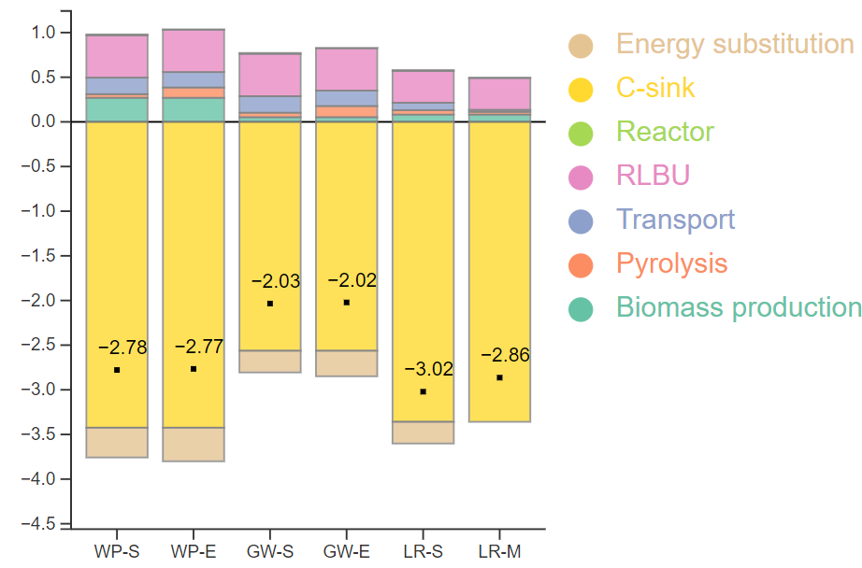
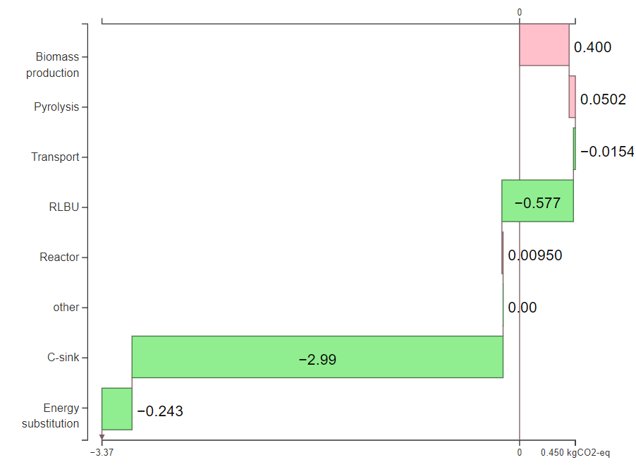
Built by bringing together various components…
To build your LCA model:
brightway2, activity-browser
To convert your LCA model into a javascript algebraic expression:
lca_algebraic
LCA contribution analysis functions (grouping by tags as implemented in e.g. SimaPro, in contributionAnalysis.py)
To HTML/JS charts:
d3.js
Currently implemented charts:
stacked bar chart, upgraded from online (i.e. stackoverflow) examples
waterfall inspired from lcopt from pjjoyce
stacked bars
waterfall

Slide 4
How it works in practice…
Step 1. Build your LCA model with project-level parameters, as you would normally do
Step 2. In the notebook CreateWidgets.ipynb, use the provided functions to “tag” activities in your LCA model for the contribution analysis.
Step 3. In the notebook CreateWidgets.ipynb, use the provided functions to convert the LCA model into a set of algebraic equations & an set-up an Excel file for parameter ranges.
Step 4. In the notebook CreateWidgets.ipynb, use the provided functions to generates the HTML and JS files.
Step 5. Integrate to your website or share with colleagues the widgets.
See standalone example in the notebook demo4contest.ipynb

Slide 5
Further development & contributions
option for multiple impact categories, in the plots, via a dropdown menu
add option to specify parameter order (custom or by Sobol importance)
add option to use Sobol-simplified models as output (reduced number of parameters)
shift from .js file to a .json file export
new plot types in d3.js
Inclusion in activity-browser

