Slide 1
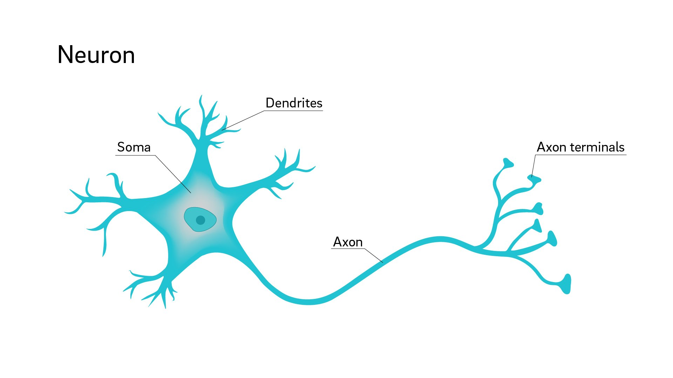

Slide 3
neuron
output

Slide 4
Input 1
weight 1
neuron
weight 2
Input 2
weight 3
Input 3

Slide 5
Input 1
weight 1
∑
weight 2
Input 2
weight 3
Input 3

Slide 6
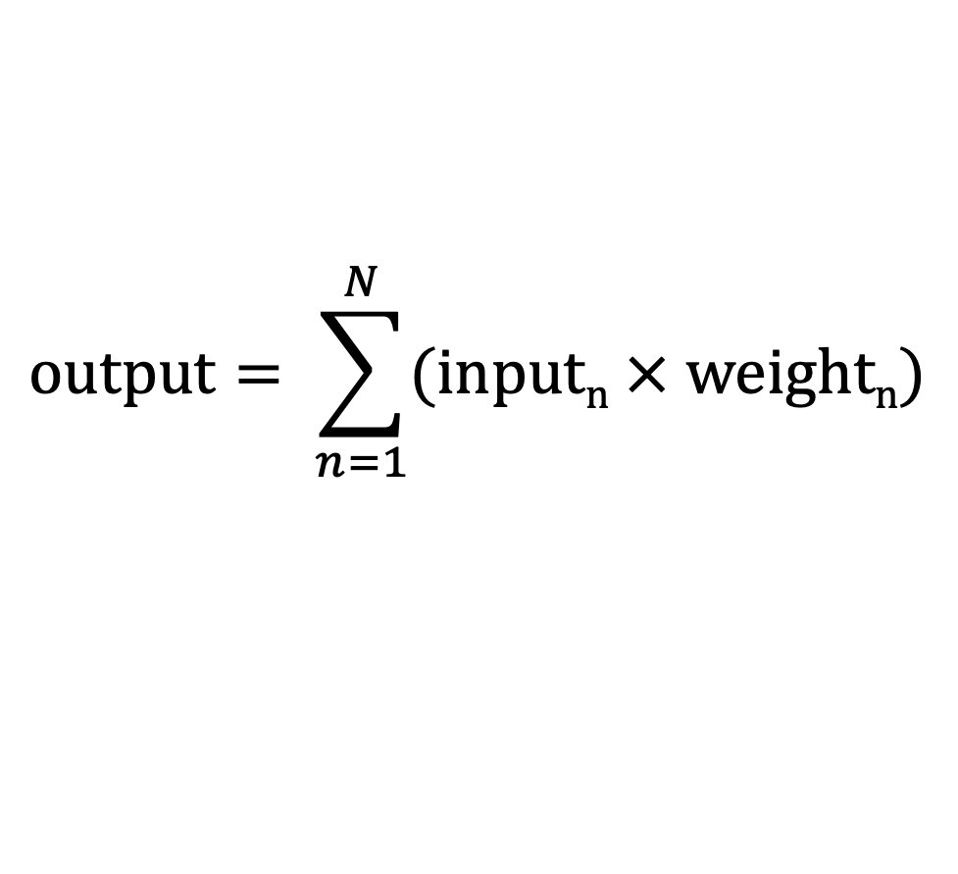
$$output= \sum_{n=1}^{N}{(inputn × weightn)}$$
Input 1
weight 1
∑
weight 2
Input 2
weight 3
Input 3

Slide 7
$$output= \sum_{n=1}^{N}{(inputn × weightn)}$$
Input 1
weight 1
∑
weight 2
Input 2
weight 3
Input 3

Slide 8
Input 1
weight 1
∑
weight 2
𝑓
Input 2
weight 3
Input 3

Slide 9
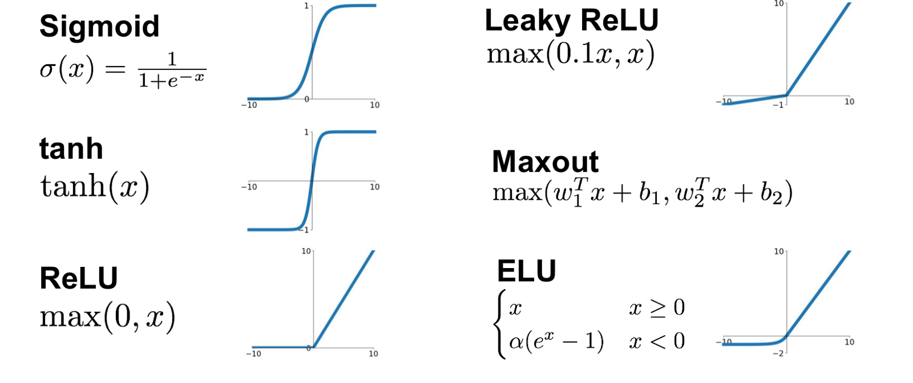
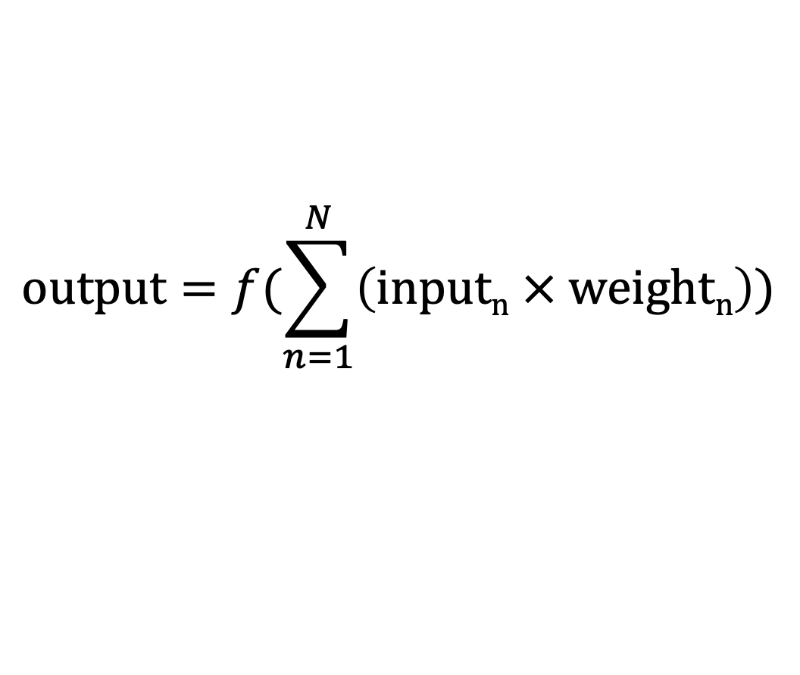
$$output=\text{f}(\sum_{n=1}^{N}{\left(inputn × weightn\right)})$$
Input 1
weight 1
∑
weight 2
𝑓
Input 2
weight 3
Input 3

Slide 10
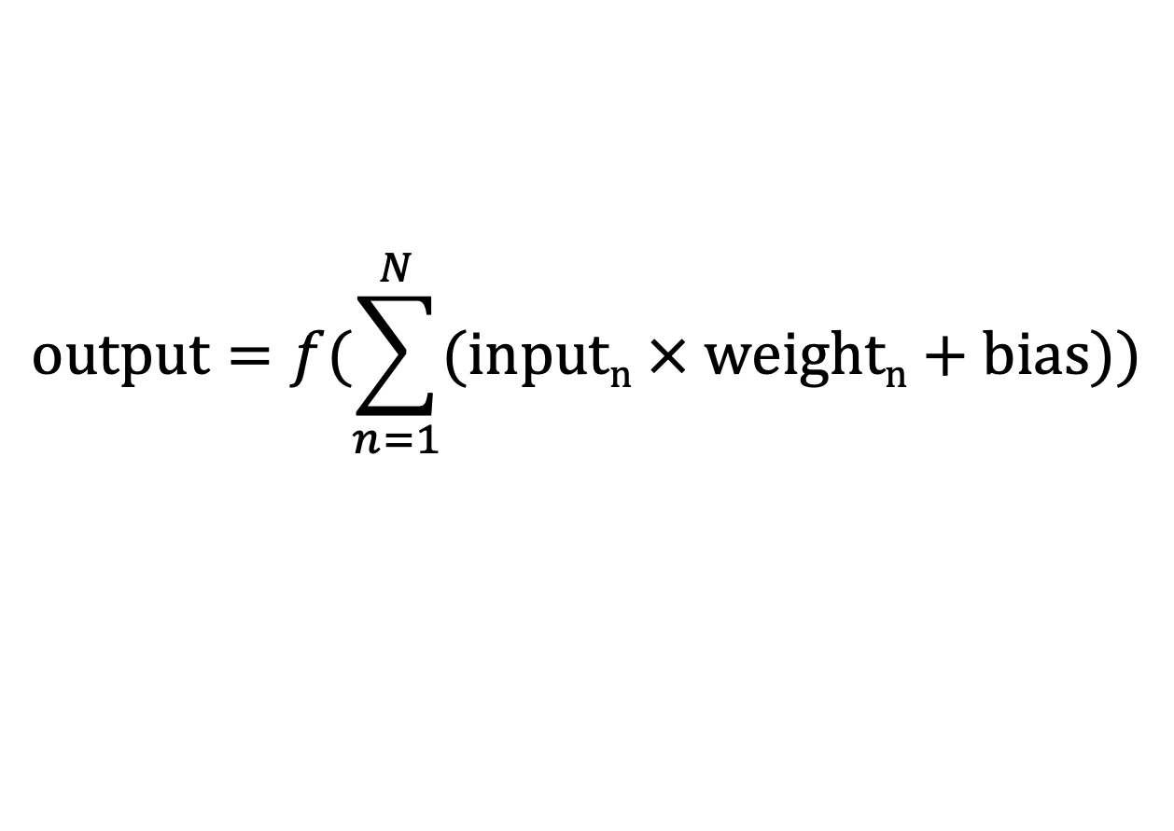
$$output=f(\sum_{n=1}^{N}{(inputn × weightn+bias))}$$
Input 1
weight 1
∑
weight 2
𝑓
Input 2
weight 3
Input 3
bias

Slide 13
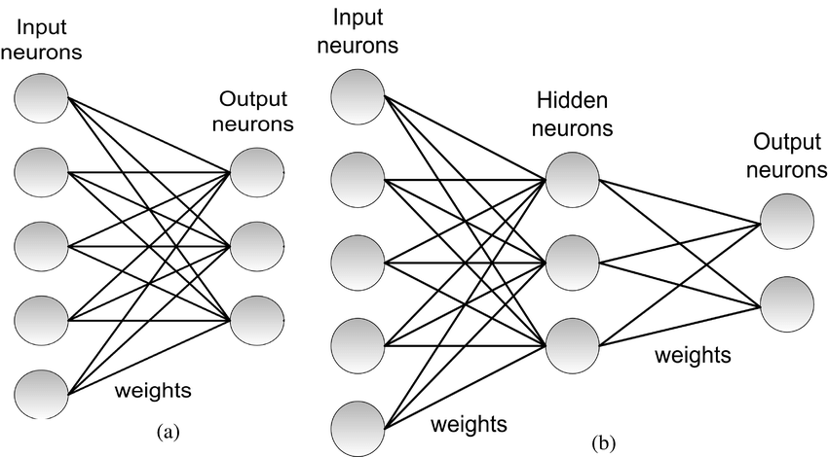
Single Layer Perceptron

Slide 15
Multi-Layer
Perceptron

Slide 16
Multi-Layer
Perceptron

Slide 17
Multi-Layer
Perceptron
How wrong were we?

Slide 18
Multi-Layer
Perceptron
How wrong were we?

Slide 19
Multi-Layer
Perceptron

Slide 20
Multi-Layer
Perceptron
How wrong were we?

Slide 21
Multi-Layer
Perceptron
How wrong were we?

Slide 22
Multi-Layer
Perceptron

Slide 23
Multi-Layer
Perceptron
How wrong were we?

Slide 24
Multi-Layer
Perceptron
How wrong were we?

Slide 25
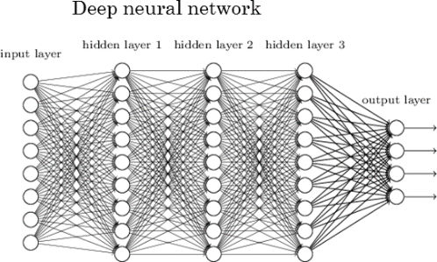

Slide 26
