Slide 1
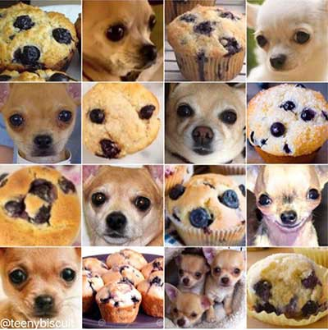
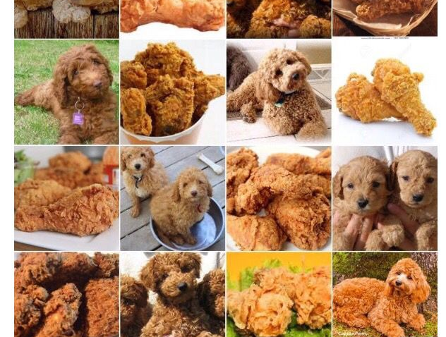
Image Classification

Slide 2
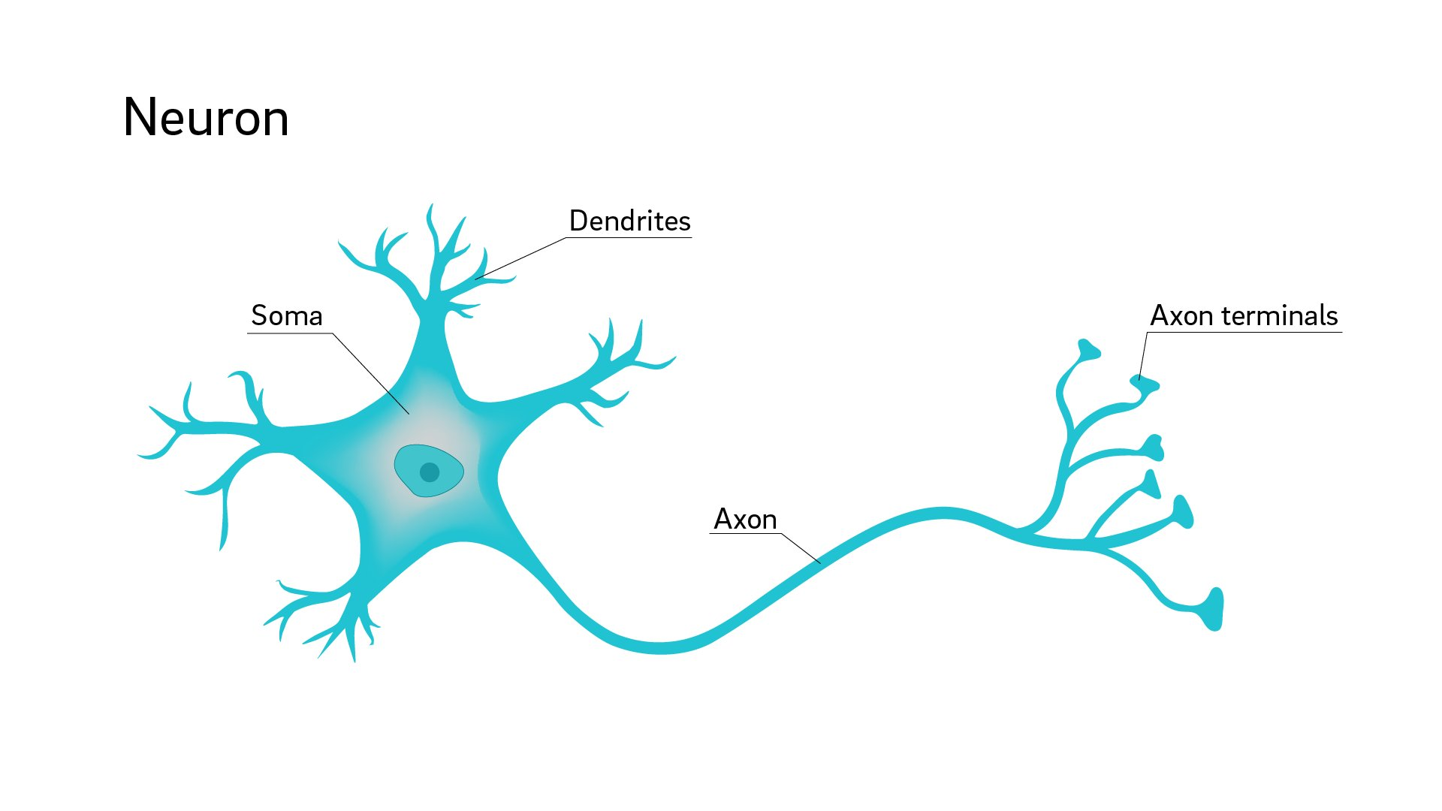

Slide 3
An Artificial Neuron, or Perceptron

Slide 4
An Artificial Neuron, or Perceptron
neuron
output

Slide 5
An Artificial Neuron, or Perceptron
Input 1
weight 1
neuron
weight 2
Input 2
weight 3
Input 3

Slide 6
An Artificial Neuron, or Perceptron
Input 1
weight 1
∑
weight 2
Input 2
weight 3
Input 3

Slide 7
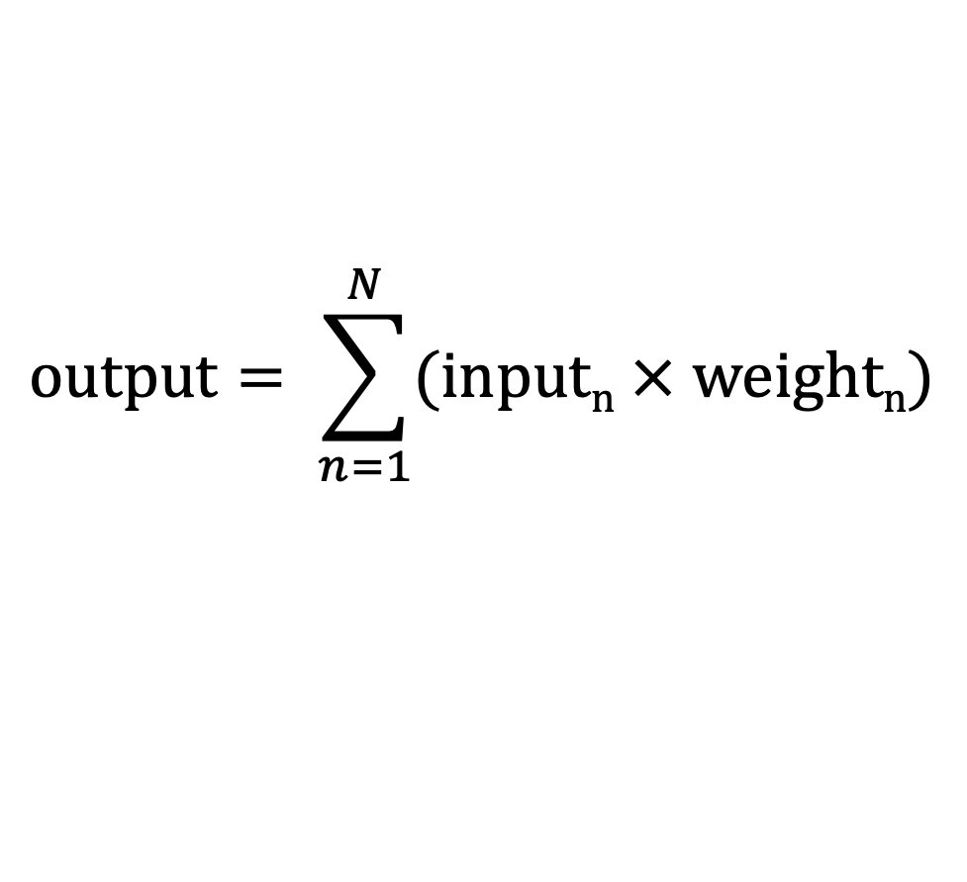
$$output= \sum_{n=1}^{N}{(inputn × weightn)}$$
Input 1
weight 1
∑
weight 2
Input 2
weight 3
Input 3

Slide 8
An Artificial Neuron, or Perceptron
Input 1
weight 1
∑
weight 2
𝑓
Input 2
weight 3
Input 3

Slide 9
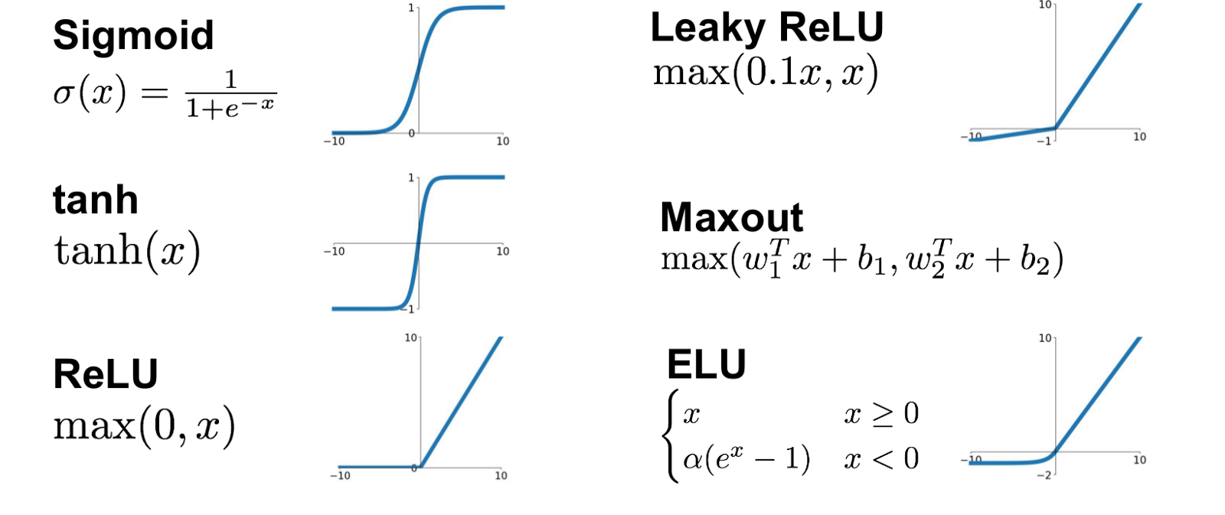
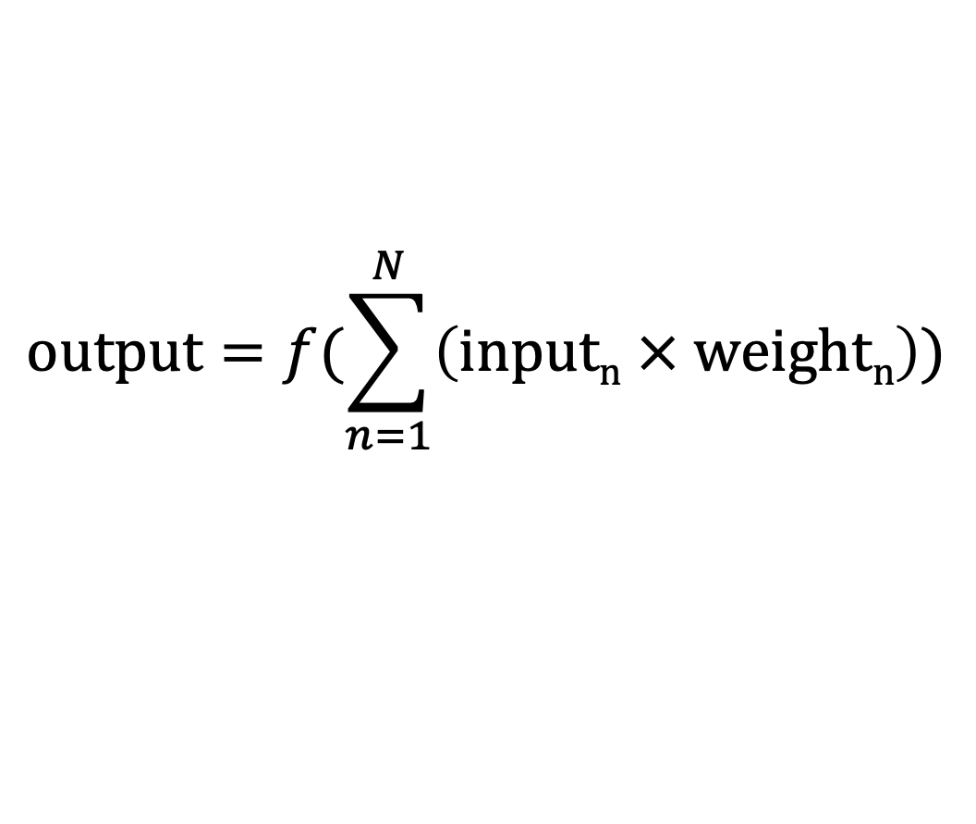
$$output=\text{f}(\sum_{n=1}^{N}{\left(inputn × weightn\right)})$$
Input 1
weight 1
∑
weight 2
𝑓
Input 2
weight 3
Input 3

Slide 10
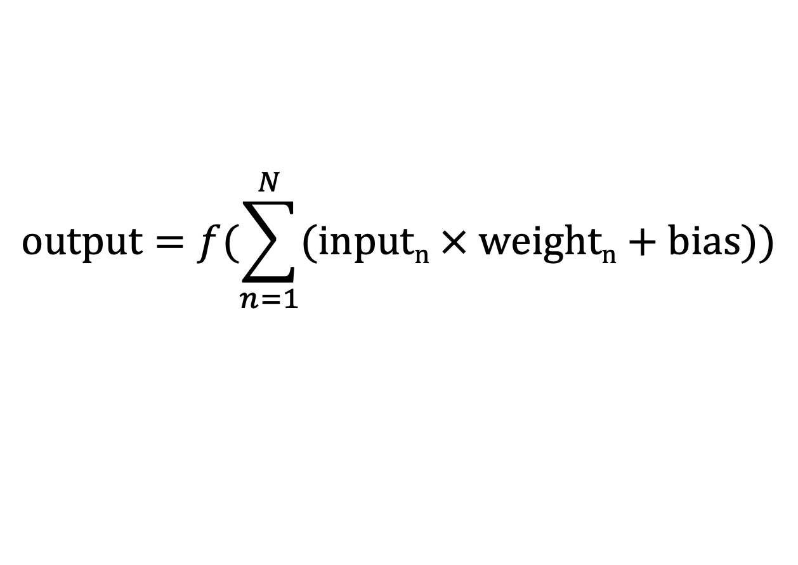
$$output=f(\sum_{n=1}^{N}{(inputn × weightn+bias))}$$
Input 1
weight 1
∑
weight 2
𝑓
Input 2
weight 3
Input 3
bias

Slide 13
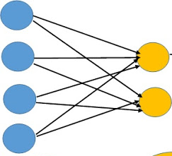
Single Layer Perceptron
inputs
outputs
chihuahua
muffin
weights

Slide 15
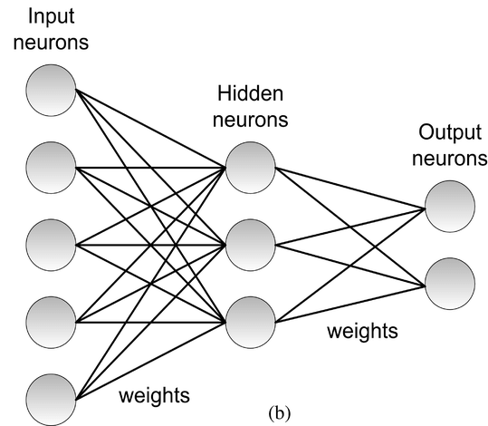
Multi-Layer
Perceptron

Slide 16
chihuahua
muffin

Slide 17
.7
chihuahua
.3
muffin

Slide 18
.7
How wrong were we?
.3

Slide 19
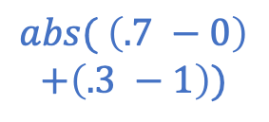
.7
How wrong were we?
.3
$$abs( \left(.7 −0\right)$$
$$+\left(.3 −1\right))$$

Slide 20
.7
How wrong were we?
.3
$$abs( \left(.7 −0\right)$$
$$+\left(.3 −1\right))$$

Slide 21
.3
chihuahua
.7
muffin

Slide 22
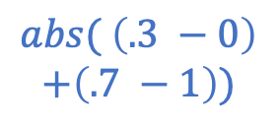
.3
How wrong were we?
.7
$$abs( \left(.3 −0\right)$$
$$+\left(.7 −1\right))$$

Slide 23
.3
How wrong were we?
.7
$$abs( \left(.3 −0\right)$$
$$+\left(.7 −1\right))$$

Slide 24
.1
chihuahua
.9
muffin

Slide 25
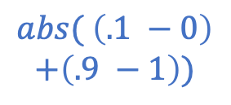
.1
How wrong were we?
.9
$$abs( \left(.1 −0\right)$$
$$+\left(.9 −1\right))$$

Slide 26
Multi-Layer
Perceptron

Slide 27
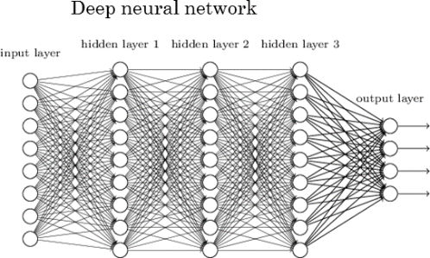

Slide 28
