Slide 1
Shapes Comparisons and Modelling
Assignment 1
CPRG304 – Object-Oriented Programming III

Slide 2
Shape Comparisons in Assignment
Your project should be able to compare using one of 3 criteria:
By height – this is just an attribute of the object (using comparable)
By base area – calculated from one or more attributes of the object (using comparator)
By volume – calculated from one or more attributes of the object (using comparator)
Formulas for these calculations are given in the bottom of the assignment document

Slide 3
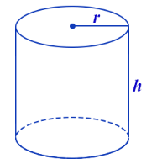
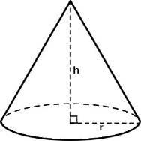
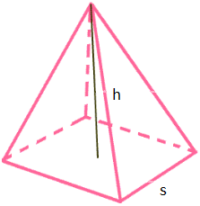
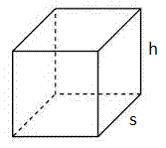
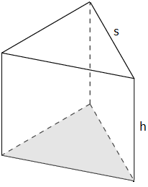
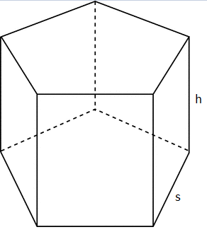
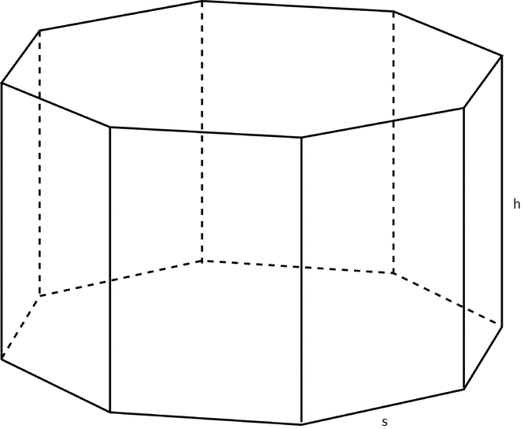
Shapes
Array[Shape] to store all the objects
4 types of shapes:
4 different prisms:
Notes:
Make sure your assignment can support all 7 shapes with proper OOP modelling! Why not make them now :D

Slide 4
Shape Classes
Cylinder
double height;
double radius;
double calcVolume();
double calcBaseArea();
Cone
double height;
double radius;
double calcVolume();
double calcBaseArea();
Pyramid
double height;
double side;
double calcVolume();
double calcBaseArea();
SquarePrism
double height;
double side;
double calcVolume();
double calcBaseArea();
TriangularPrism
double height;
double side;
double calcVolume();
double calcBaseArea();
PentagonalPrism
double height;
double side;
double calcVolume();
double calcBaseArea();
OctagonalPrism
double height;
double side;
double calcVolume();
double calcBaseArea();
Notes:
Must be able to compare all 7 types of shapes, so we need a base abstract class – Shape.

Slide 5
Data Modelling in OOP
Make our code reusable, maintainable and scalable!
Now we have a base class to compare the height!
Shape implements the Comparable interface
public int compareTo(Shape s){
if ( this.getHeight() > s.getHeight() ) return 1;
else if ( this.getHeight() < s.getHeight() ) return -1;
else return 0;
}
Prism <<abstract>>
double height;
double side;
double calcVolume();
double calcBaseArea();
Shape <<abstract>>
double height;
double calcVolume();
double calcBaseArea();
Notes:
Check out the Driver and KittySort classes in comparableVsComparator package!
Note: lambda expressions in Java are new as of Java 8 – it’s Java’s foray into functional programming. A java lambda expression is a function (method) that can be defined without a class and can be “passed” around like an object to be ran whenever and wherever!
An interface with only one (unimplemented) method is also referred to as a functional interface in functional programming

