Slide 1

LIBRARY MANAGEMENT SYSTEM

Slide 2

Group Members:
NATASHA SEN, CALCUTTA INSTITUTE OF ENGINEERING AND MANAGEMENT, 131650110028
SAMBUDDHA GHOSH, JIS COLLEGE OF ENGINEERING, 131230110091
SOUBARNO BANERJEE, SWAMI VIVEKANANDA INSTITUTE OF SCIENCE AND TECHNOLGY, 142410110047
SUKHBINDER SINGH, B.I.E.T, 141180110020
HARPRIT KAUR, JIS COLLEGE OF ENGINEERING, 131230110041

Slide 3
Project Objective
The objective of the project is to develop and implement a Web based Library Management System (LMS) to help users to search books, issue books and return them and help admin to add books, categories, new users or new admin.

Slide 4
Entities in Project
Admin
User

Slide 5
Functional Requirements
Book entry – In this module we can store the details of the books.
Register student-- In this module we can store the details of the new students or candidate.
Book issue-- This module used to keep the track of book issue details.
Book return-- This module enables to keep the track of return the books.

Slide 6

Screen Shot of Home Page

Slide 7
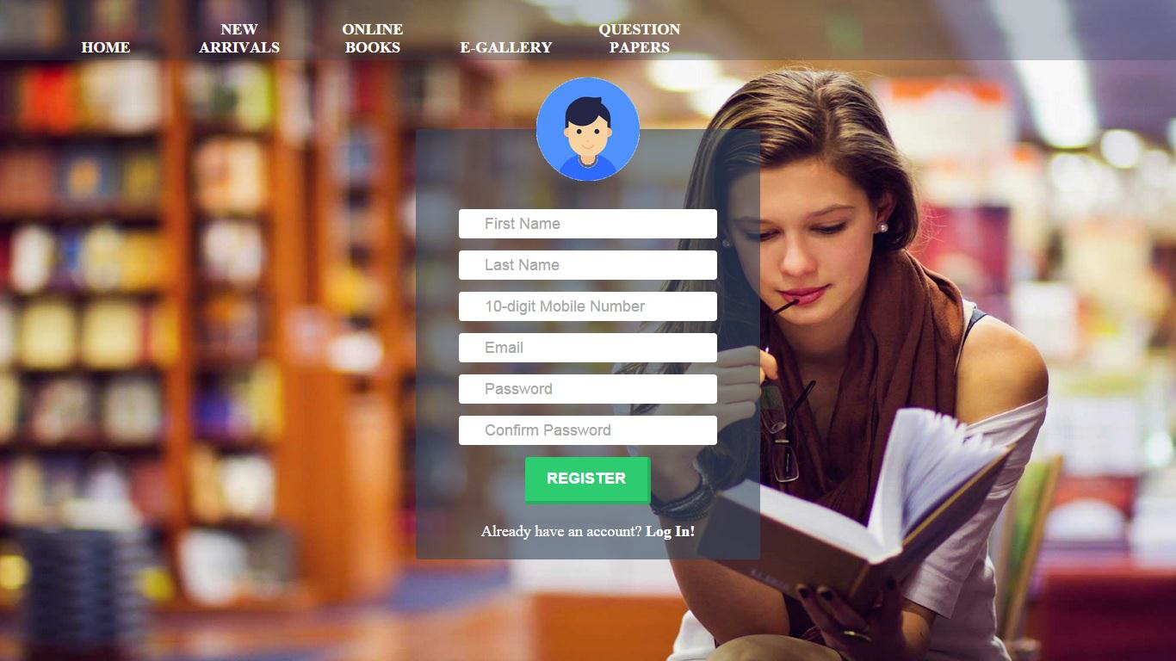
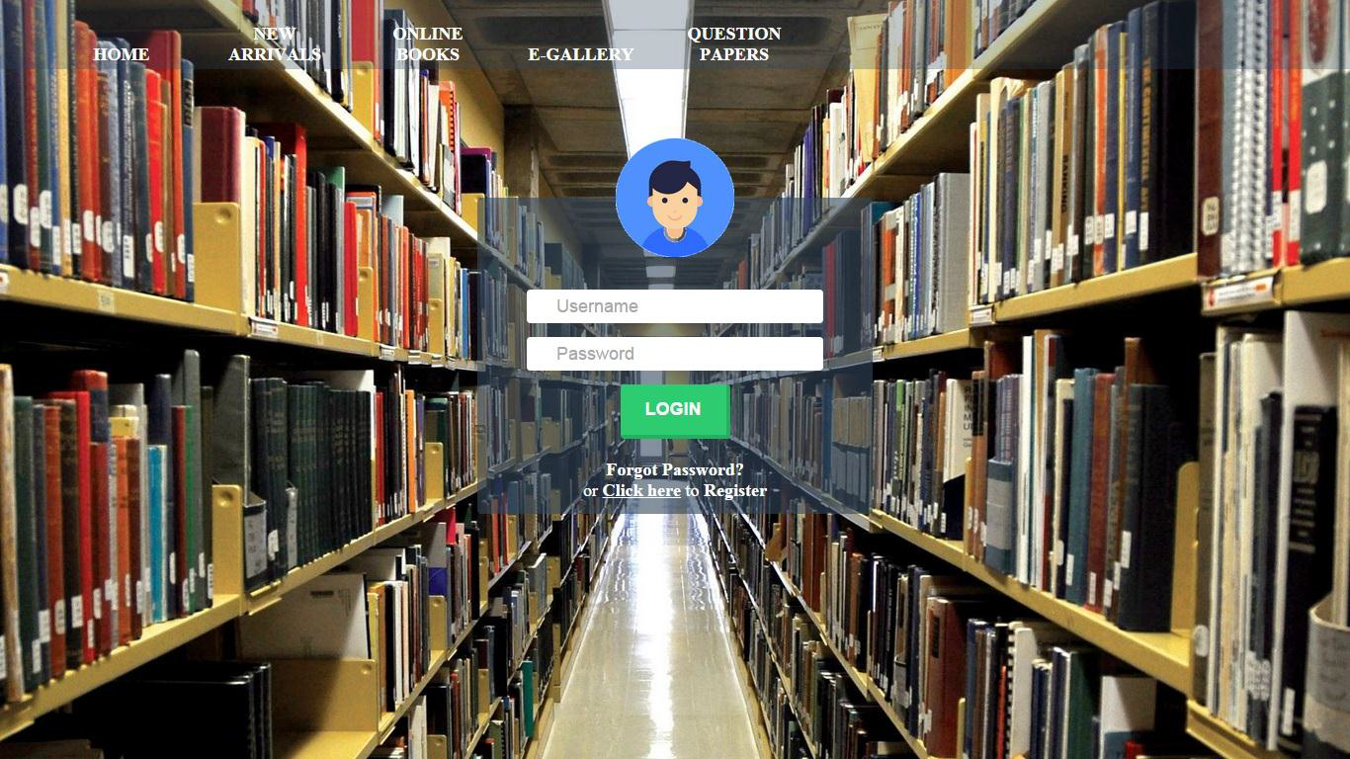
Registration and Login Page

Slide 8
THANK
YOU

